Slide 1
Educator Equity Data Collection (EEDC) Kickoff Webinar January 11, 2022
Louann Stalder, Associate Director, Title IIA
Elizabeth Rush, Program Supervisor, Title IIA
Pat Smithson, Program Supervisor, Title IIA
Coleen Putaansuu, Program Supervisor, Title IIA
Kaori Strunk, Assistant Director of Educator Data, Title IIA
Notes:
We are not recording this presentation, but we will have the slides—including the notes—posted to the Title IIA website later this week. It will be posted to the Communications section.
We will be answering questions in the chat as time allows. We will capture these questions into a document and make sure that all questions received a response. This Q&A document will be posted to the website along with the ppt slides.
You may have noticed that the EE Tool is still in test mode while we wait for our contractor to fix some remaining bugs. We will send an email notice to those who have signed up for Title IIA notifications once the EE Tool has launched for 2021-22.

Slide 2
Tribal Land Acknowledgement
We would like to acknowledge the Indigenous people who have stewarded this land since time immemorial and who still inhabit the area today, the Steh-Chass Band of Indigenous people of the Squaxin Island Tribe.
Notes:
We encourage you to think about who's traditional lands you are joining us from today. Here at the base of Budd Inlet in Olympia we sit in the lands of the Steh-Chass Band of Indigenous people of the Squaxin Island Tribe and the tribes and bands who signed the Treaty of Medicine Creek 1854.
If you don't already have a Tribal Land Acknowledgement that you use, I suggest you go to https://land.codeforanchorage.org/ and enter your address. Also visit the tribal government websites of the indigenous people who have stewarded this land since time immemorial and understand their treaties, history, and modern life.

Slide 3
OSPI Vison, Mission and Values Statement
Notes:
This presentation, like everything we do, is shaped by our vision, mission, and values. We strive to prepare all students for post secondary pathways, careers and civic engagement, to close the opportunity gaps, ensure equity, and focus on the whole child.

Slide 4
Welcome!
Enter your questions into the chat at any time during the presentation.
Please note that presentation slides are posted on the Title IIA Educator Equity Plan and Tool webpage.
Please use the reaction icons.

Slide 5
Agenda
Purpose of Educator Data Reporting
Resources and Supports
Why Data Matters – Data Use to Work Towards Equity
Using Educator Data – Next Steps
Q & A
Tips for Accurate Reporting
Teachers Flagging as OTF? Here's What to Do!
Upcoming EEDC Changes
EEDC Tool Functionality
EEDC Tool Overview
Notes:
Vocab primer
The Educator Equity Data Collection Tool (EEDC) is often referred to as the EE Tool.
Teachers who are out-of-endorsement are referred to as OTF (out-of-field) in the EEDC Tool.

Slide 6
Purpose of Educator Data Reporting
We are nice people; we wouldn’t make you do this much work without a compelling reason, a.k.a federal requirement.

Slide 7
Why We Monitor
ESEA, as amended by ESSA, requires:
The Local Education Agency (LEA) must ensure that all teachers . . . meet applicable state requirements and licensure requirements.
Sec. 1112(c)(6)

Slide 8
ESSA: Teacher Professional Qualifications
OSPI will monitor for teacher qualifications including certification, endorsements, teaching assignments, and years of experience reported in the Educator Equity Data Collection Tool (EDS Application).
SEA: ESEA, as amended by ESSA, Sec. 1111(g)(2)(J)
Notes:
The ultimate goal is for students to have the teacher best suited to lead the content of the course they're being taught.
ESSA allows for greater flexibility and options at the local level – not punitive.
Educator data is combined with course information in the Educator Equity Data Collection Tool, which examines professional qualifications in conjunction with each teaching assignment.
NCLB: Highly Qualified Teachers (HQT)
LEAs are no longer required to identify and document “Highly Qualified Teacher” (HQT) status for teachers hired after December 10, 2015.
The EE Tool reflects our state certification rules, and those rules are complex, we are here to help!

Slide 9
Resources and Supports
We’re happy to help!

Slide 10
Resources Please add additional resource requests into the chat.
Educator Equity Tool Issues and Solutions
Not sure why a teacher is flagging as OTF? This document shows which actions to take for a specific OTF issue.
Common Elementary Course Codes
These course codes are not new but have been narrowed down to the most common K-8 course codes. Please share with your K-8 registrars.
Plan of Support Template for Out-of-Endorsement Educators
Thanks Auburn SD! We appreciate using your template as a model for this optional template.
Parents Right-to-Know Requirement
Includes link to templates in ten languages.
Office Hours
30- and 60-minute appts. are available.
If a teacher taught at any time during the school year without the proper certification, please contact us for a template to send to the Office of Professional Practices (OPP).
Notes:
These resources are on the OSPI website through the first link on the Title IIA pg. Labeled "Educator Equity Plan & Tool“.
When scheduling office hours, please include a comment as to whether you have specific questions, or whether you want us to walk you through the actions needed for the OTF teachers.

Slide 11
Recommended Timeline
Prior to Start of School
School Board Approval
Develop Plans
Semester 1
Review EE Tool for OTF teachers, take action as needed
Semester 2
Upload any remaining documents
Lock buildings
Mid-June
Submit Report
Upload school board approval into EE Tool
Review EE Tool for OTF teachers, take action as needed
Upload school board approval into EE Tool
Run Expired Cert Report in E-Cert
Notes:
We suggest that LEAs begin the EE Tool process in the summer.
Be sure to login to your EDS account, then open E-Cert to run a report showing any teachers with an expired cert as this is an Office of Professional Practices issue, not an OTF issue.
You’ll want to review the EE Tool at the beginning of each semester/quarter.
That way, in mid to late June, you will be ready to submit the report.

Slide 12
Running an Expired Cert Report in E-Cert
Select the “Reports” tab in the tool bar
Select the “Certificate Expiration” report
Use the dropdown options to select your LEA and expiration date range
4. Select the search option to populate expired certificate information
Important: Run the expired cert report prior to taking a teacher to the school board for OTF approval. The issue might not be that the teacher is OTF, it might be that the cert is expired.
Notes:
Certification provided this information on how to run an expired cert report. If you need assistance, you can reach them at cert@k12.wa.us.
If a teacher has an expired certificate he/she may not remain in the assignment until this is corrected, unless you assign another certificated teacher to the classroom and enter that person as teacher of record for the course.
* The district supt is required to report educators with expired certificates to OPP. This is a procedural practice and is only reported to OPP.

Slide 13
Educator Equity Data Collection Tool Functionality

Slide 14
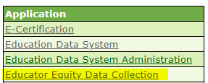
How to Access the EE Tool
If you need access, ask your District Data Security Manager for access to the Educator Equity Data Collection.
Once you have access, login to EDS.
Choose “View my applications”.
Choose Educator Equity Data Collection.
Notes:
Be sure to let your district data security manager know that the Educator Equity Data Collection Tool is found under the Teacher Quality section.

Slide 15
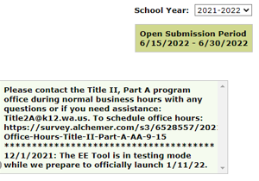
LEA Tab
Notes:
Here's a screenshot of the information on the landing tab. This is the LEA tab. The right side of the landing page shows:
1. The current school year (2021-22 is the default, but the LEA may choose to look at an earlier year to see previous actions). The timeline to lock the buildings and submit the report is also included.
2. The text box will provide key updates. Please check the updates periodically to find new information we may have added, or if there is a known bug in the system that we are working to correct.
Chart:
* First column opens the school page
* Columns 2-3 = school name and grade span
* Column 4 = Title IA status of the school (this is important because school board OTF approval is required prior to using Title IA funds for salaries in Title IA schools). For those of you who have worked in the EE Tool before, you'll notice that we're using a purple outline throughout this presentation to draw your attention to changes to the EE Tool.
* Column 5 = number of teachers assigned to the building based on S-275 data
* Column 6 = number of OTF teachers (this number does not change after checkboxes are marked and/or school board minutes are uploaded as the teacher is still OTF).
* Final column = shows whether the building is locked. The district takes this step in mid-June after the final CEDARS report is loaded.

Slide 16
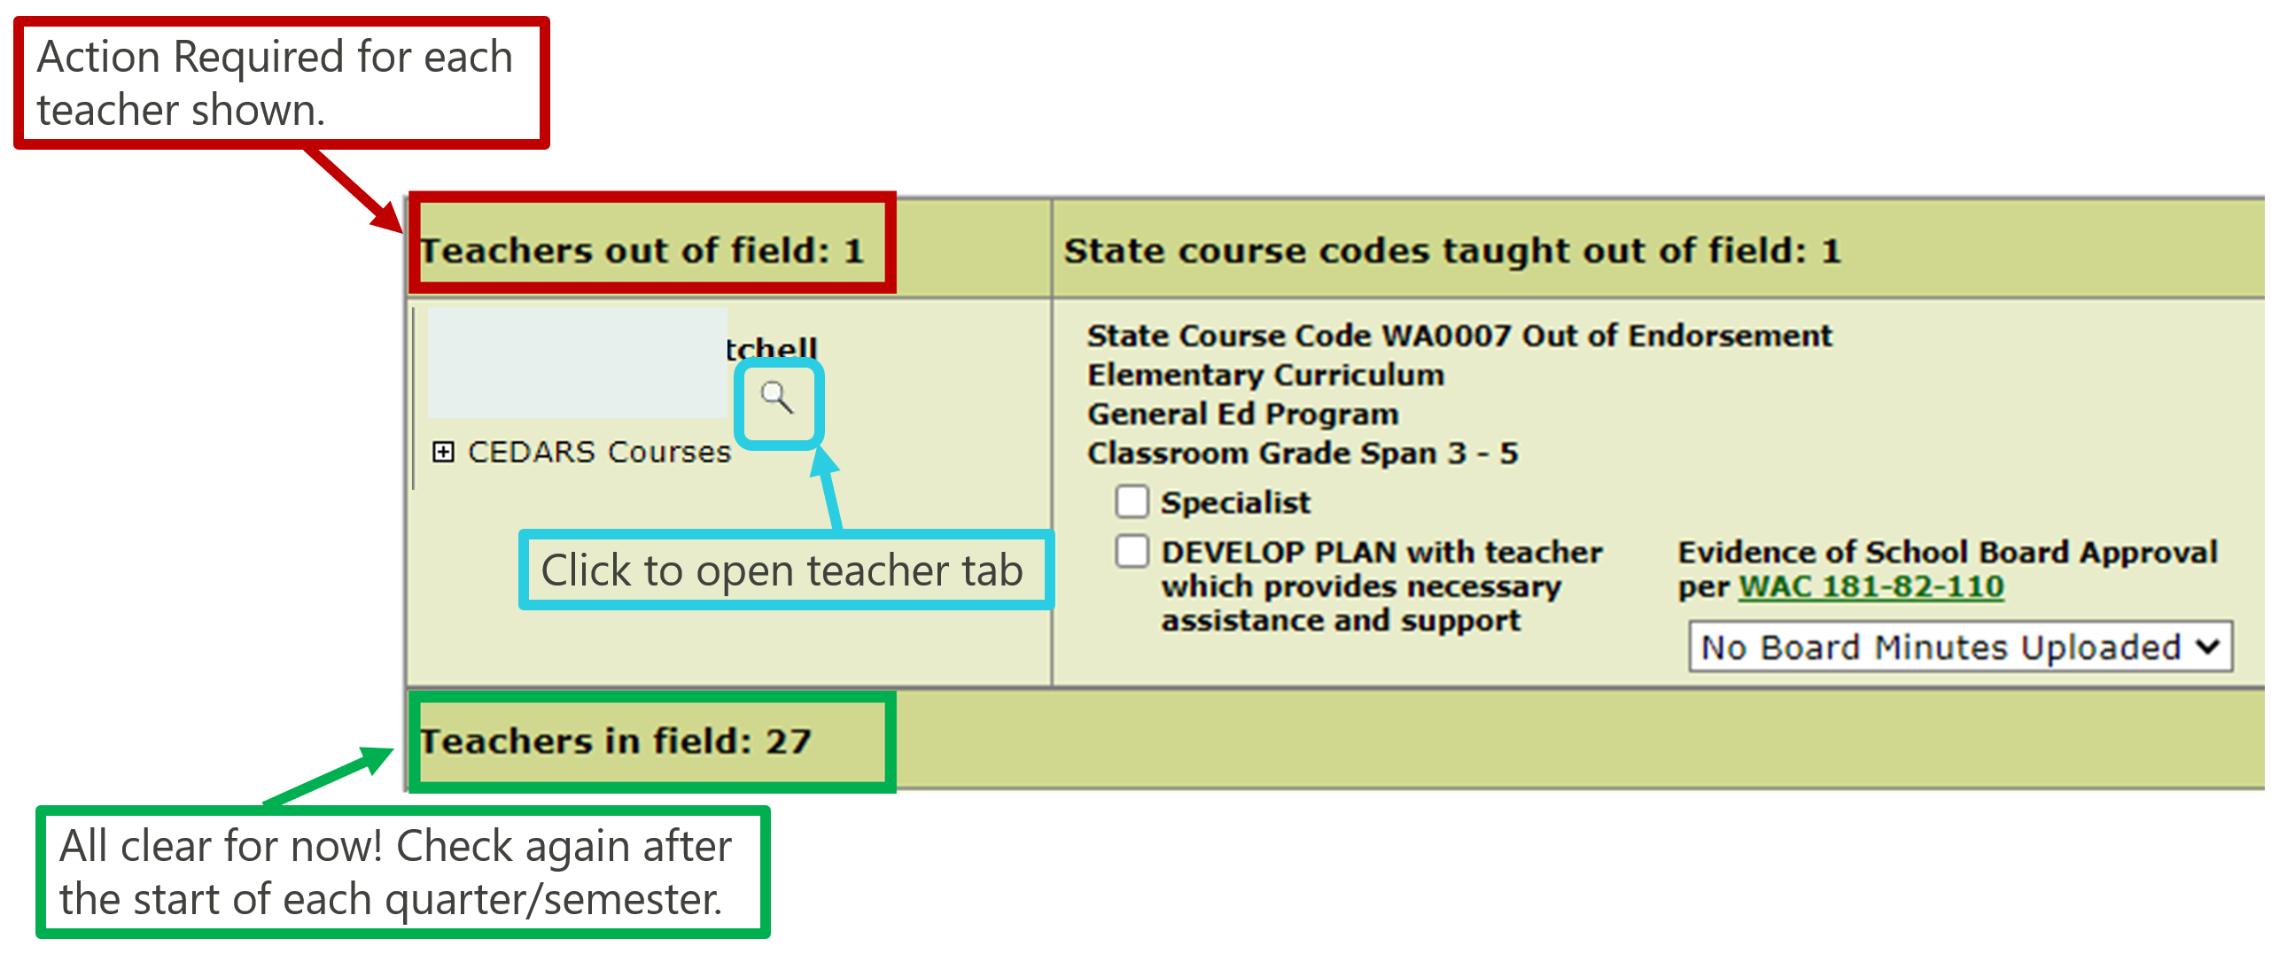
Building Tab
Notes:
Here's a screenshot of the building tab.
The OTF teachers will be at the top of the list to draw your attention to where you will need to take action.
Here’s how to read this section:
* The arrow pointing to the first line is showing course code that is OTF.
* The second line shows the course name that is OTF.
* The third line shows which student group is causing the teacher to flag as OTF. In this case, it’s general education students but you might see special education or bilingual education in this row.
* The fourth line shows the grade span that is flagging as OTF.
* To see the certification and endorsement details for a teacher, click the magnifying glass.

Slide 17
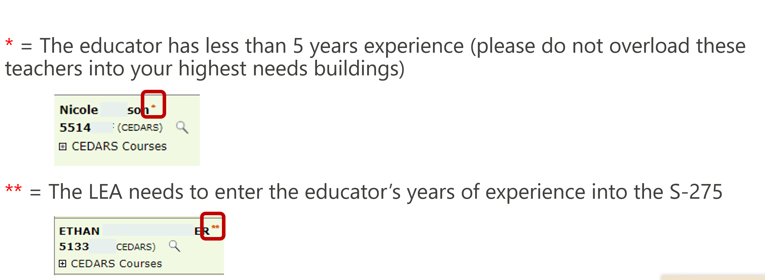
Building Tab: What Do the Asterisks Mean?
Notes:
We receive many questions regarding what the asterisks mean next to the teacher’s name.
A single asterisk next to a teacher’s name indicates that the teacher has less than 5 years experience. We are including this information to draw your attention to equity issues. If there is one asterisk, please consider where you assign beginning teachers.
Be sure to balance the inexperienced teachers to ensure they are not placed with the most vulnerable students.
Two asterisks next to a teacher name indicates that the LEA must enter the teacher's years of experience into the S-275 report.

Slide 18
Teacher Tab
The teacher tab shows certificate(s), endorsement(s) and course(s):
In this example, the endorsements held do not align to the course code, so the teacher is OTF.
Notes:
The teacher tab shows you the teacher's certification and courses taught.
* Looking at the top left of the page, you will see the teacher’s certification type, in this case a residency teacher first issue certificate.
* The second column is the issuance date of the certificate. You can see that this certificate was issued on July 27 before the start of the school year.
* The third column shows the expiration date. This column is blank because residency teacher certificates are issued without an expiration date. Once this teacher is reported as having 1.5 FTE experience, this teacher will need to apply to have the residency certificate reissued with an expiration date.
* The fourth column shows if the certificate was recommended by an institution. This column is not applicable to our work.
* The final column shows the endorsement code and endorsement name. Later, we show you how to use this information in the Assignment Tool.
* This teacher holds ELA and social studies endorsements, and is assigned to teach 6th grade art. Because these ELA and social studies endorsements are not aligned to the art course code, the teacher is flagging as OTF.

Slide 19
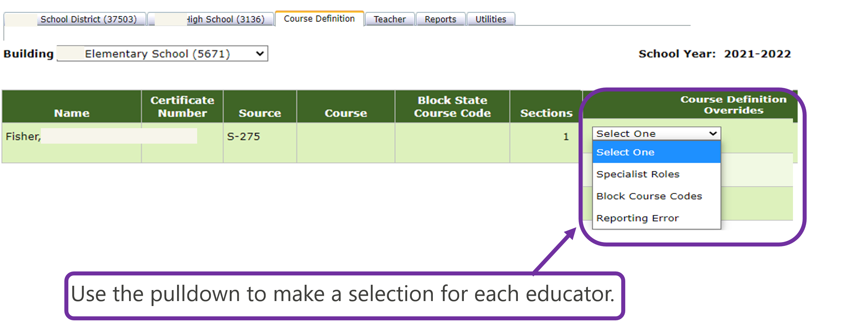
Course Definition Tab
Notes:
The Course Definition tab is the crosswalk between state and federal reporting.
Click on the course definition tab, then select the school to find the teachers who are reported in the S-275 but do not have a course codes, or who are assigned a block class code.
Select Specialist Roles for teachers who are in roles that do not require course codes such as special education teachers, librarians, and TOSAs.
Select Block Course Codes for teachers with block course codes such as humanities, as block course codes are allowed by state but not recognized by the feds.
Select Reporting Error for teachers with a reporting error that cannot be corrected such as teachers on leave for the entire year.
Be sure to check the course definition tab again once a new quarter/semester starts, or when a new teacher is hired.
Please note that if the teacher's endorsement doesn't match the content area entered into the course definition tab, they may flag as OTF on the building page.

Slide 20
Educator Equity Data Collection Tool Overview
Here’s the background information you need to know in order to understand and complete the EE Tool process.
Remember, the Assignment Tool and CEDARS Manual are your friends.
Notes:
Here is the background information you need to know in order to understand and complete the EE Tool process.
Remember, the Assignment Tool and CEDARS Manual are your friends.

Slide 21
EEDC Data Sources
The Educator Equity Data Collection (EEDC) Tool pulls data from four sources:
Professional Educator Standards Board (PESB) Assignment Tool
Comprehensive Education Data and Reporting System (CEDARS)
E-Certification E-Certification
Data is updated biannually, last update was in May 2021
Data is updated weekly when the LEA uploads data from their Student Information System into CEDARS (student enrollment, course codes, teacher indicator)
Data is updated in Real Time
S-275 S-275
Data is updated nightly (does not include staff hired after the S-275 deadline of November 24, 2021)
Notes:
PS
The EE Tool pulls from 4 data sources.
* PESB has rulemaking authority for educator preparation and certification, including assignments. They update the Assignment Table twice each year. We will show how to use Assignment Tool in a moment.
* CEDARS is the state-level data system. LEAs upload data from their student information system, such as Skyward, to CEDARS on a weekly basis.
* S-275 information is updated each evening; based on the October 1 counts (which were pushed back to November this year).
* Educator certification and endorsement information is pulled from E-Cert.
These are large data pulls which is why the EEDC is slower than other applications in EDS. The good news is that you should notice quicker loading speeds this year.
One timesaving trick is to avoid using the back arrows in the EE Tool as this will cause the data to reload. Instead, use the tabs in the EE Tool to move between the district, building and teacher tabs.

Slide 22
Determining Factors for OTF Based on Certificate Type
Residency, Professional, Emergency Teacher Certificates and Teaching Permits
Endorsement and Course Code Alignment
Career Technical Education (CTE)
V-Code Alignment
CIP Code Alignment
Limited Certificates
Conditional Teacher – may only be placed within endorsed assignments
First Peoples’ Language, Culture, and Oral Tribal Traditions Certificate
Special education endorsements are also screened for student enrollment
Emergency Substitute – requires parent notification if positions longer than 20 consecutive days in Title IA school
Lifetime Substitute – up to 180-day placement with plan of support on file
Certificate Alignment
Course Code Alignment
Not eligible for School Board OTF approval
Not eligible for School Board OTF approval
Not eligible for School Board OTF approval
Notes:
For most LEAs, the majority of your teachers will hold a certificate shown in the first column. For these certificates, OTF determinations are made by evaluating the certification type and specific teaching assignments as indicated by state course codes.
Note that special education endorsements are treated differently in the EE Tool. Teaching certificates and permits with Special Education endorsements are also screened for program requirements. The big takeaway here is that when the course sections are enrolled with 100% of students receiving services, Special Education endorsed teachers can teach any course.
Looking at the second column, you'll see that CTE certificates use V-Codes and CIP Codes to determine whether they are OTF. We will show you additional details and examples later in this presentation.
The third column shows limited certificates. Notice that these limited certificates are not eligible for school board OTF approval.
The fourth column shows the First Peoples’ certificate. These certificates are issued based on a government-to-government agreement between PESB and the tribe. These certificates align to specific course codes for tribal languages. Course codes for tribal culture are in development.

Slide 23
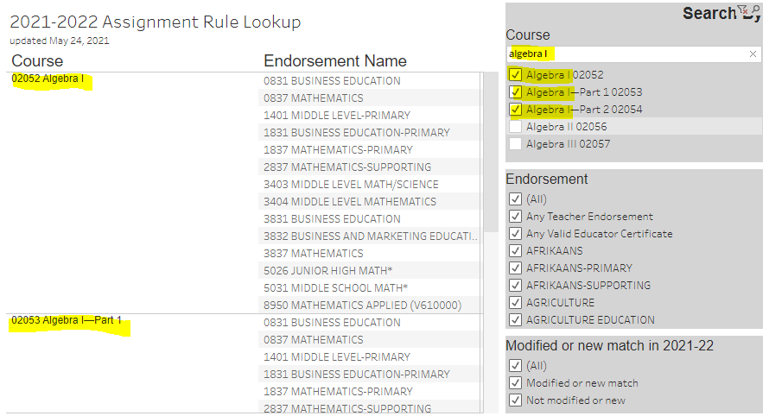
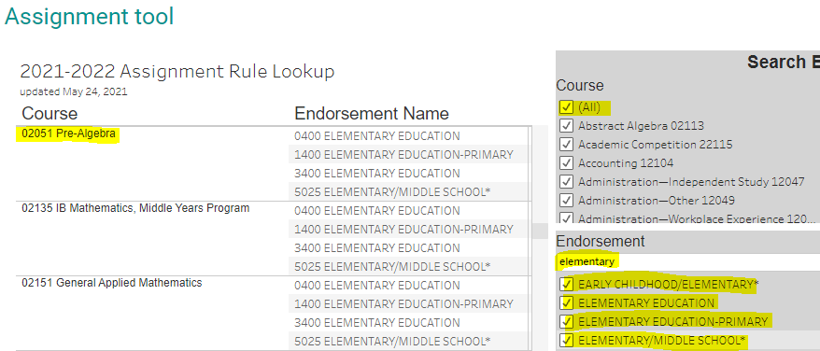
Assignment Tool
Assignment Tool link
Search by Course Name or Number
Deselect “All” from the course options
Search for or enter the course name or number
Search by Endorsement
Deselect “All” from the endorsement options
Search for or enter the endorsement name
Notes:
The Professional Educator Standards Board, or PESB, sets assignment policy that determines which endorsements are considered in-field matches for different state approved course codes.
There are directions on the Assignment Tool page explaining how to use the Assignment Tool. If you are a new user, be sure to read that section located right above the Assignment Tool.

Slide 24
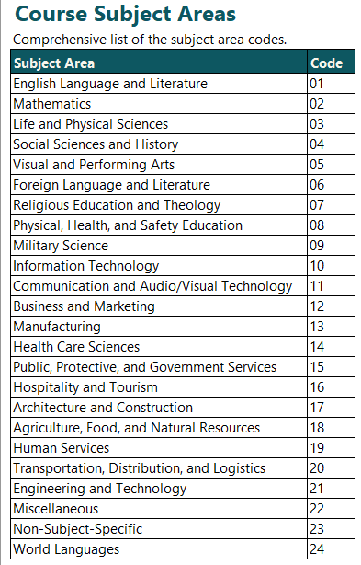
CEDARS State Course Codes (Appendix V)
Notes:
There may be a time when a teacher is flagging out for a course, and you want to find the correct course code. Appendix V of the CEDARS Manual will provide this info as it includes not only the course number and course name, but also a course description.
In short, use the Assignment Tool when trying to see which endorsements are aligned to a course, and which courses are aligned to an endorsement.
Use Appendix V in the CEDARS Manual when you don't know which course code is correct, so you're not sure what to even enter into the Assignment Tool.

Slide 25
CEDARS State Course Codes (Appendix V)
Notes:
Appendix V has every course code, name and description which makes it seem like an unwieldy document. We recommend sorting by the subject area code to narrow down your search.
The example on the screen shows that we filtered to show only subject area code 24 to find a Spanish course.
We don't have the subject area code numbers memorized, so we clicked on the course subject area tab at the bottom of Appendix V so we’d know which number to include in our sort.
I'll also quickly mention here that core and elective academic courses cannot be coded as miscellaneous 22999. These courses need to have a content specific course code.

Slide 26
Teachers Flagging as OTF?
Here's What to Do!
Notes:
That wraps up the overview of how to navigate the EE Tool. We’re going to dive deeper into the specific actions an LEA will take in the EE Tool when a teacher is flagging as OTF.

Slide 27
Properly Endorsed Teachers Flagging as OTF
Spoiler Alert:
It’s a Data Issue
Photo by Markus Spiske on Unsplash
Notes:
Sometimes a teacher will flag as OTF, or show in the course definition tab, when you know they are properly endorsed. So, we're going to look now at the three most common data issues that may need to be fixed. Data changes need to be made at the source—such as Skyward or the S-275—then the data will be uploaded into the EE Tool based on the timeline shown on slide 21. It’s important to note these timelines as the data changes you make may not show up until the next day or following week.

Slide 28
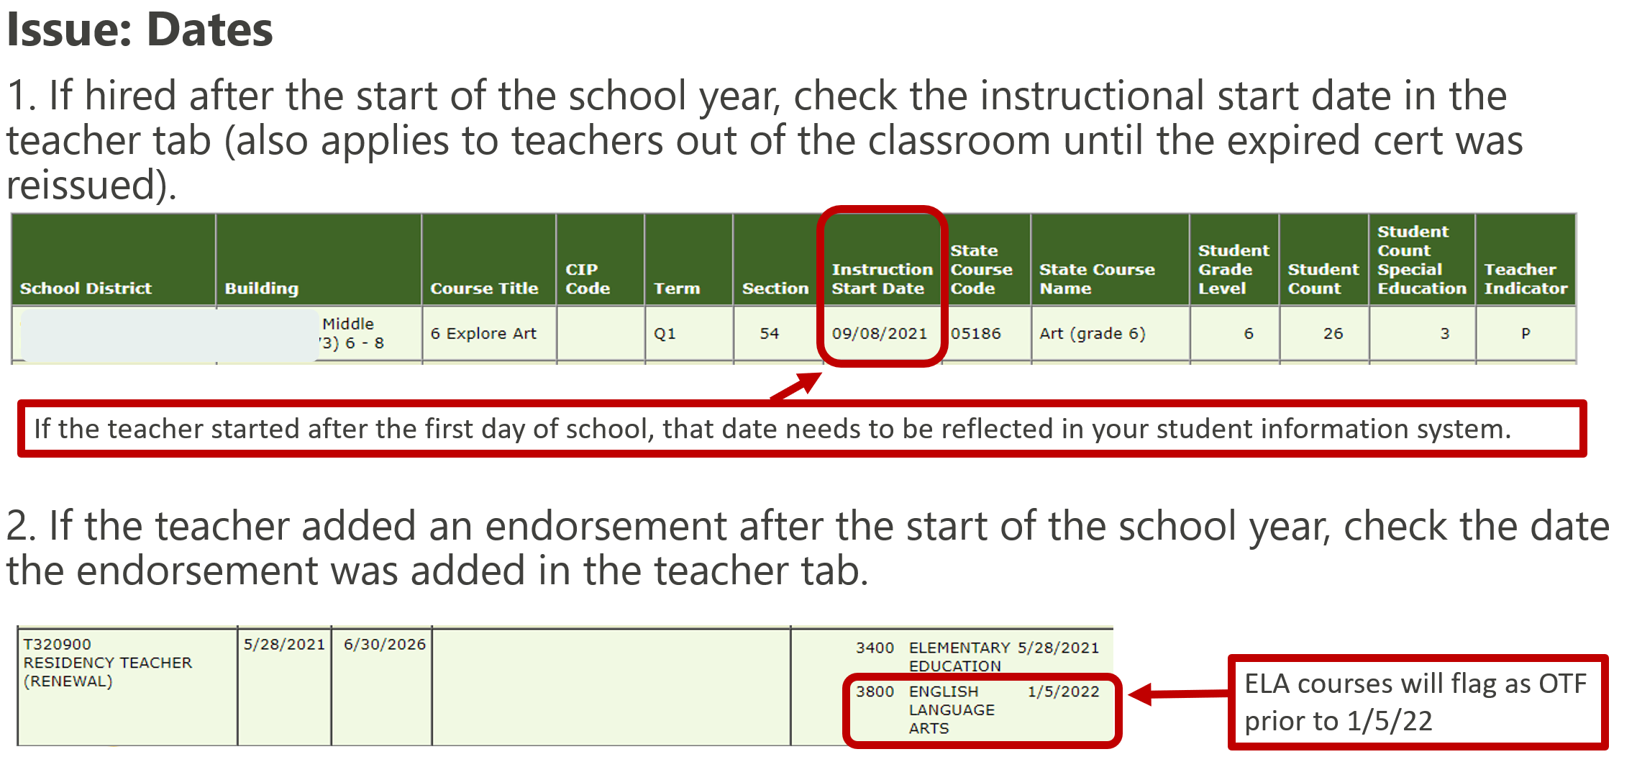
Issues that Trigger OTF Status When a Teacher is Properly Endorsed
Notes:
When a teacher holding the proper endorsement is flagging as OTF, it may be due to an incorrect date being entered. Here are two situations where this most often occurs.
1. The first example is a reminder to keep an eye on teachers who you hired after the school year. This includes teachers with expired certs who were out of the classroom until their certificate was reissued.
The problem is that sometimes registrars use the first day of school as the instructional start date for every teacher, no matter what day they actually started. In these cases, have the registrar fix instructional start date in your SIS.
2. Another common situation to keep an eye on is a teacher who adds an endorsement during the school year.
If the endorsement was added after instructional start date of course it’s aligned to, a plan of support is required along with uploading school board approval to the EE Tool.

Slide 29
Issues that Trigger OTF Status When a Teacher is Properly Endorsed
Issue: Generic Course Codes
WA0007 Elementary is an allowable course code (for a few more years), but will cause the teacher to flag as OTF. To avoid this problem, use specific elementary course codes.
WA0006 Middle School is no longer an allowable course code and must be changed.
Notes:
CP
Using generic course codes can also cause a teacher to flag as OTF.
The example on the screen shows elementary course code WA0007.
Best practice is to use grade/subject specific course codes.
* Clicking the link will take you to a 1-page summary of the most comment elementary course codes. Using the specific grade and subject course code will keep a properly endorsed teacher from flagging as OTF.
You can use the checkbox option for specialists, as shown on slide 16, but entering grade and subject specific course codes will allow you to skip having your specialists flag out each year.
Be sure to watch out for middle school content teachers with generic course code WA0006
WA0006 is no longer valid—you must use grade/subject specific course codes; school board approval not allowed for WA0006—it must be changed.

Slide 30
Teacher Indicators (CEDARS Element G10)
Issues that Trigger OTF Status When a Teacher is Properly Endorsed:
Teacher Indicators
Teacher Indicators | Impact on OTF Status
P = Primary
A = Alternate | Alternate teachers must meet certification and endorsement requirements.
T = Team-Primary
V = Team-Substitute
W = Team-Long Term Substitute | A long-term sub will show as OTF if the endorsement is not aligned to the course after 20 consecutive school days in the assignment.
S = Substitute
L = Long Term Substitute | A long-term sub will show as OTF if the endorsement is not aligned to the course after 20 consecutive school days in the assignment.
J = Job Share-Primary
C = Job Share-Substitute
D = Job Share-Long Term Substitute | A long-term sub will show as OTF if the endorsement is not aligned to the course after 20 consecutive school days in the assignment.
I = Special Education Co-Teaching Model | The special education co-teacher must be properly endorsed or both co-teachers will flag as OTF.
E = ELL/ESL Co-Teaching Model | The ELL/ESL co-teacher must be properly endorsed or both co-teachers will flag as OTF
F = LAP Co-Teaching Model | The LAP co-teacher must be properly endorsed or both co-teachers will flag as OTF.
Note: Do not enter a Teacher Indicator for student teachers.
Notes:
Another issue that can cause a properly endorsed teacher to flag as OTF is using an incorrect teacher indicator.
Correcting the teacher indicator will move the teacher out of OTF status.
In the chart, the L column = All Teacher Indicators
R column = Addresses common misunderstandings regarding the Teacher Indicator
For a description of each teacher indicator, see the CEDARS Reporting Guidance, pages 91-93.

Slide 31
OTF Teachers Placed in course(s) not aligned to endorsement(s)
Photo by Nick Page on Unsplash
Notes:
Once your data is correct, you can take the appropriate action for teachers who are flagging as OTF.

Slide 32
Out of Endorsement Action Items
School Board Approval (WAC 181-82-110)
LEAs are required to provide evidence of school board approval for those eligible teachers found out of endorsement through the Educator Equity Data Collection (EEDC) tool
LEAs are required to develop and maintain a mutually agreed upon plan of support for the teacher in an out-of-endorsement assignment
Kept in personnel file (not uploaded into EEDC tool)
Can include PLCs, common planning, professional development, or plans to add endorsements (Title II, Part A funds are eligible to support these efforts)
Teachers are not subject to non-renewal or probation based on their performance evaluation in out-of-endorsement assignments
School board approval must be prior to funding salary/benefits via Title IA
Notes:
I'll show you an example of how to address the top two items--show school board approval and the plan of support—on the next slide. Right now, I want to call your attention to the last box on this slide; specifically, teachers cannot be non-renewed based on their performance in an OOE assignment.

Slide 33
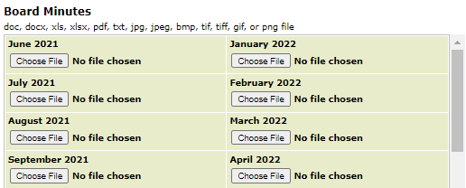
How to Show OTF Board Approval
Step 1: District Tab
Upload school board minutes
Board minutes do not need to be uploaded for every month, only for those when OTF approval occurred
Step 2: Building Tab
Use the pull-down to indicate which month/year the teacher received school board approval
Notes:
For most of your OTF teachers, the correct action is to get school board approval. Here are the two steps:
* In the district tab, you will find the Board Minutes chart. Only load minutes for any months when OTF approval occurred.
For those of you who have OTF approval on the consent agenda, be sure to include not only the minutes but also the document showing the teachers and subject areas that the board approved.
* In the building tab, use the pull down to indicate which month/year the teacher received school board approval (or use the specialist box, if applicable). If the pull-down menu has no options, that means no minutes have been uploaded yet to the Board Minutes chart in district tab.

Slide 34
Special Education
Notes:
There are some certificates and endorsements that have additional actions and rules, so we'll go over those now.
If you're new to this work, please know that the key steps in this process have been covered in the previous slides. If you feel like you cannot absorb any further information, that's OK, you’ll can schedule office hours for individualized support.
For our experienced users who have wondered about the specific rules and actions required for special education, CTE, and limited certs – this section of the presentation is for you.

Slide 35
Special Education Assignment Requirements
Certificates with Special Education Endorsement
Continuing, Residency, Professional, Emergency Teacher, and Teaching Permit
In-Field for special education assignments
Eligible for school board approval for general education assignments
Conditional
NOT eligible for OTF assignments nor school board approval
Special Education Pre-Endorsement Waivers (issued by OSPI)
In-Field for special education assignments
NOT eligible for OTF assignments nor school board approval
Temporary Out-of-Endorsement Assignment
OTF for special education assignment
LEA must verify educator has 9 quarters or 6 semester hours of special education coursework
In-Field for special education assignments
Special Education Pre-Endorsement Wavier Application
Notes:
Let's start by taking a look at the special education rules, then we'll look at two examples from the EE Tool.
1. Sped endorsements on a continuing, residency, professional, emergency, or teaching permit are considered in-field if 100% of their students are designated as receiving sped services as shown in CEDARS file K.
If these teachers have gen ed students, they need school board approval, unless they hold another endorsement aligned to the course.
2. Conditional cert teachers are also considered in-field when teaching students coded in CEDARS file K as receiving sped services.
They cannot, however, be placed in gen ed assignments, nor can a school board give approval to do so. If needed, they may have general education endorsements added to their continuing certificate.
3. Let's talk next about the sped pre-endorsement waiver. This waiver is for a certified teacher who has completed 24 quarter hours (or sixteen 16 semester hours) of required special education endorsement course work from an accredited teacher preparation program. Teachers with pre-endorsement waivers are not considered fully qualified under IDEA; but, they may still perform the duties of a special education teacher such as writing IEPs and committing district resources as the district's designee. We have a link on this slide if you need the application or additional information.
4. Let's move down to the final textbox regarding temporary sped OTF assignments.
These placements still require OTF approval, and are only allowed if the teacher has 9 qtr or 6 sem hours of sped coursework completed.
That was a lot to process, so let's look at two of the most common examples.

Slide 36
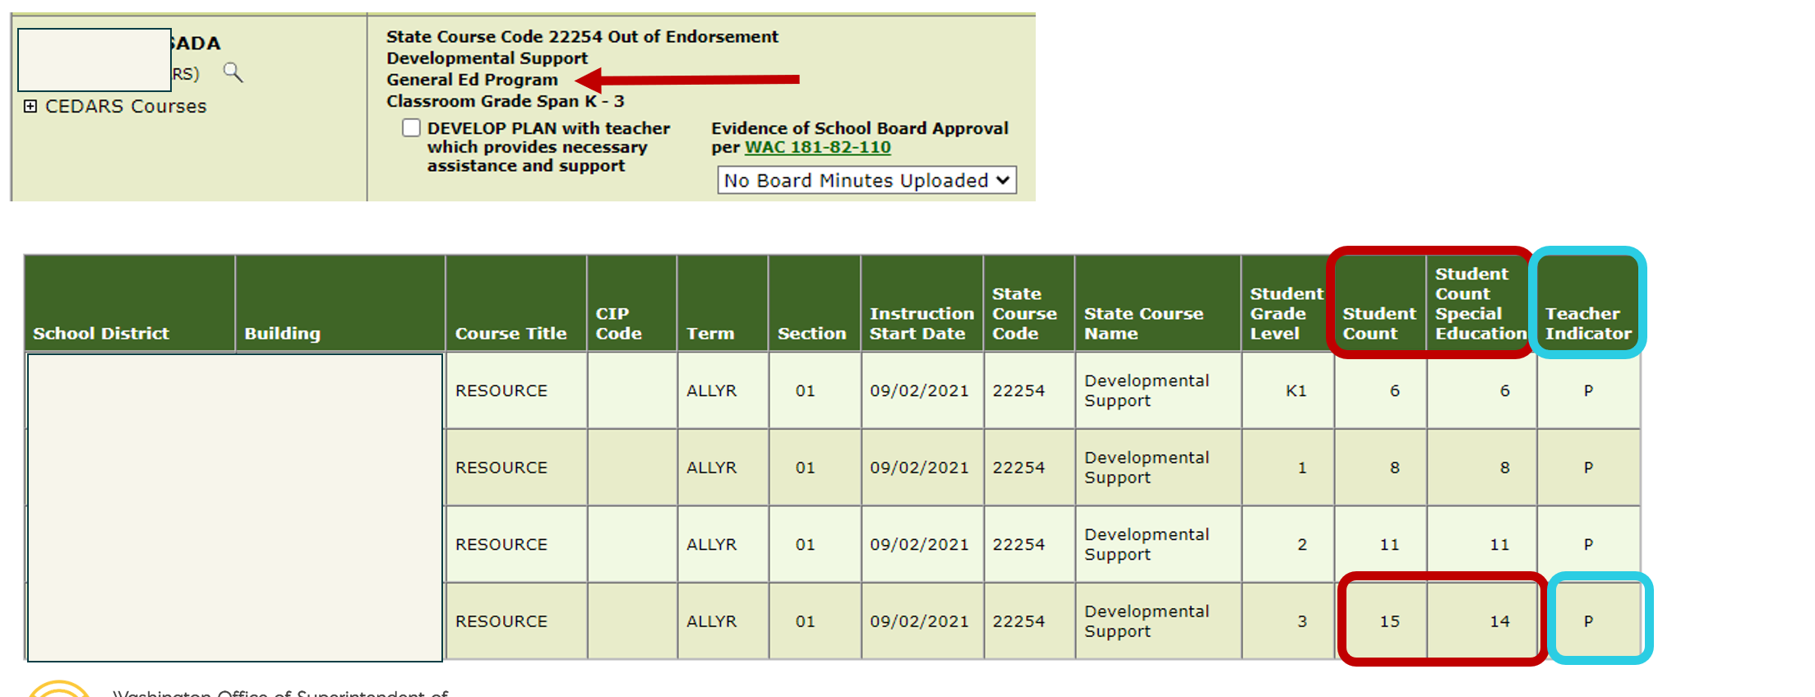
Special Education Issues that Trigger OTF Status
Special education teacher holding a special education endorsement who is teaching one or more general education students:
Notes:
Here's a teacher with only a special education endorsement who has been assigned a gen ed student.
I know this because I can see gen ed on the building page – notice where the arrow is pointing – and,
I can see it on the teacher page where the student count for 3rd grade students is 15, but the special ed count is 14. I know 1 grade 3 general ed student has been assigned to this teacher.
Be sure the IEP start/exit date in CEDARS file K are corrected. If the IEP dates are outside of the instructional dates, then OTF approval will be needed.

Slide 37
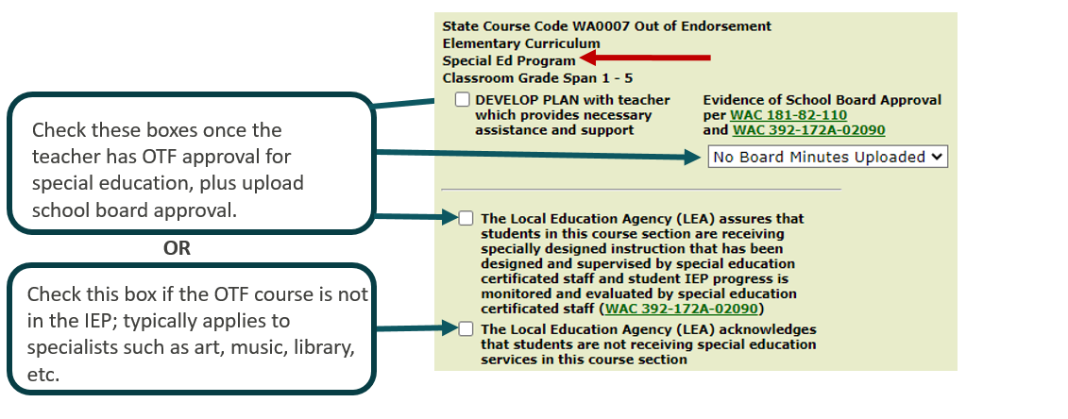
Special Education Issues that Trigger OTF Status
General education teacher with no special education endorsement teaching more than one student receiving special education services:
Notes:
On this slide you’ll see a teacher with an elementary endorsement who is flagging out for teaching more than one student receiving special education services. The action you take is dependent on the situation.
* The top two checkboxes and pulldown option is for teachers with OTF approval for special education.
* The last checkbox is for specialists who are teaching a subject area not included in the IEP.
It’s also possible that this teacher is co-teaching with a teacher holding a valid sped endorsement, in which case this is a data error and the special education teacher needs to have a teacher indicator of I for this course.

Slide 38
CTE Certificates & CTE Endorsements
Notes:
The section will explain the difference between CTE endorsements and CTE certificates.

Slide 39
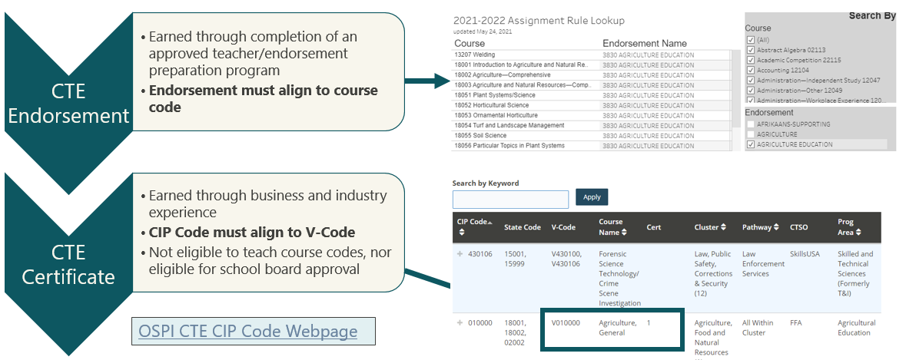
CTE and CIP Code/V-Code Alignment
OSPI CTE CIP Code Webpage
Notes:
There are CTE certificates and CTE endorsements:
CTE endorsements are on an initial/continuing and residency/professional certificates (Ag Ed, Business and Marketing, FACSE, Tech Ed). These CTE endorsements are earned through an approved teacher preparation program. * Use the Assignment Tool to see which courses may be taught by each of these endorsements.
* CTE certificates are earned through business and industry experience. These certificates have V-codes (Vocational Code), not endorsements. These certificates do not align to course codes as shown in the Assignment Tool. Instead, they align to CIP codes (Classification of Instructional Programs Code). CIP codes need to be entered by the LEAs CTE director.
V-Code (Vocational Code) This is tied to the certification code and dictates the courses that a teacher is certified to teach. The teachers’ education or industry experience is reviewed to determine the V-codes for certification. CIP Code (Classification of Instructional Programs Code) A federally accepted course code that identifies courses taught throughout the United States, this includes CTE courses. CIP codes are aligned to V-codes that clarify which courses the teacher has been certified to teach. CIP codes are also used for reporting purposes from the district to OSPI.

Slide 40
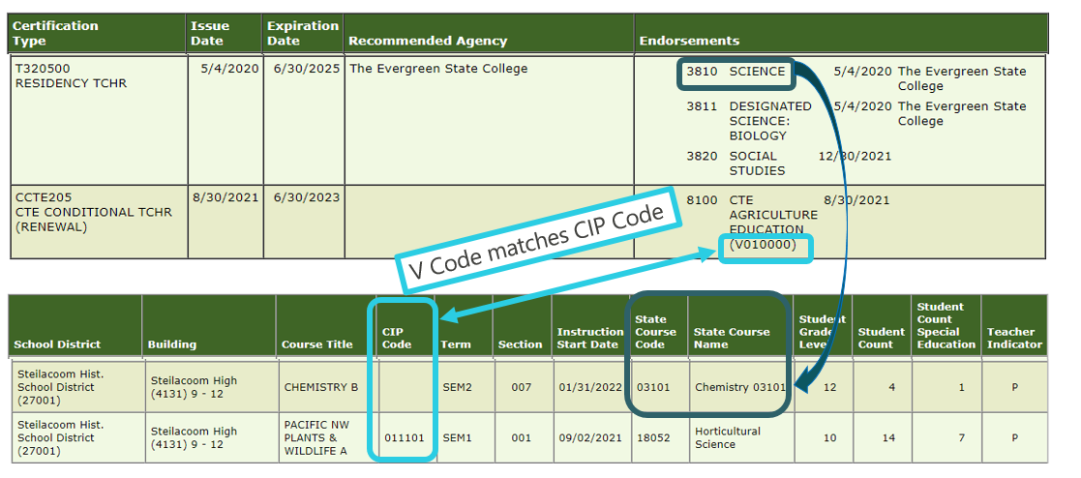
CTE Educators with OTF Assignments
Notes:
Here’s an example from the EE Tool of a teacher who holds a CTE endorsement and a CTE certificate.
Let’s look first at the CTE Certificate. You can see that the district entered a CIP code that is aligned to the CTE Ag Ed certificate, so this educator will not flag as OTF.
If you see that the CIP-code missing for a course aligned to a CTE certificate, then have your CTE director enter CIP code—there is no school board approval for CIP codes.
Now let’s look at this teacher’s CTE endorsement.
This teacher holds a science endorsement on his residency teacher cert, which is aligned to chemistry course code. So, this teacher does not need school board approval. If the course code was not aligned, the school board approval would be needed.
Please note:
Educators holding CTE certificates are not eligible for placement in a general education class. To teach a non-CTE course, the educator needs to also hold a PESB-endorsed certificate or Limited Certificate.
Teachers with Continuing CTE Certificates are eligible for Lifetime Substitute Certificates. In the example on the screen, this teacher holds a conditional CTE cert which would not qualify him for a lifetime sub cert; but, he would qualify based on his residency teacher cert.
For those new to our state, keep in mind that in WA, CTE does not include 5th or 6th grade. CIP codes and CTE certificates are only for grades 7 and higher.

Slide 41
Limited Certificates & Permits
Notes:
Here it is—the final section on how to complete the EE Tool. If you have been wondering about how limited certs are treated in the EE Tool, this next section is for you.

Slide 42
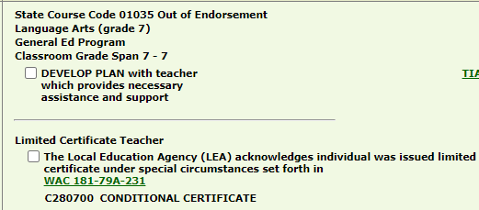
Limited Cert/Permit Issues that Trigger OTF Status
Both checkboxes are required:
The affidavit checkbox regarding developing the plan
The limited certificate checkbox (in this case, a conditional cert )
Gray line = action needed above the line AND below the line.
Notes:
Limited Certificates will cause a teacher to flag as OTF, even when the proper endorsement is on the certificate. In the example on the screen, the teacher has an elementary endorsement on a conditional cert, and that elementary endorsement is aligned to the grade 7 language arts course that is flagging as OTF.
To address the OTF issue, the LEA will need mark both checkboxes:
* the develop plan checkbox, and
* the limited certificate checkbox.
* Be sure to look for the gray line when taking an action on an OTF teacher. It’s signaling that more than one action is needed – you’ll need to take an action above the gray line AND below the gray line. In this case, there is only one option above and below the line, but you might see multiple options depending on the certificates held.

Slide 43
Limited Certificate Action Items
Parents Right-to-Know Requirement
Develop and maintain plans of support for educators operating with intern substitute certificates or emergency substitute certificates for assignments longer than 4 consecutive weeks.
LEA must ensure that they will provide timely notice to parents of students in Title I, Part A schools (school-wide and targeted assistance programs) who have been assigned to or have been taught for four (4) or more consecutive weeks by a teacher who holds a limited certificate at the grade level and subject area in which the teacher has been assigned.
ESEA, as amended by ESSA, Sec 1112(e)(1)(B)(ii)
Notes:
Title IA Parents Right-to-Know requirement
When a student in a Title IA building is taught for 4 consecutive weeks by an educator on an intern sub cert or emergency sub cert, the parent/guardian must be sent a Parents Right-to-Know letter. The top link provides additional details as well as a template letter available in 10 languages.
Also, teachers in Title IA school who are OTF must have school board approval prior to that position being funded by Title IA.

Slide 44
Upcoming EE Tool Changes
Notes:
Here are the changes to the EE Tool that are on track to be added later this year.

Slide 45
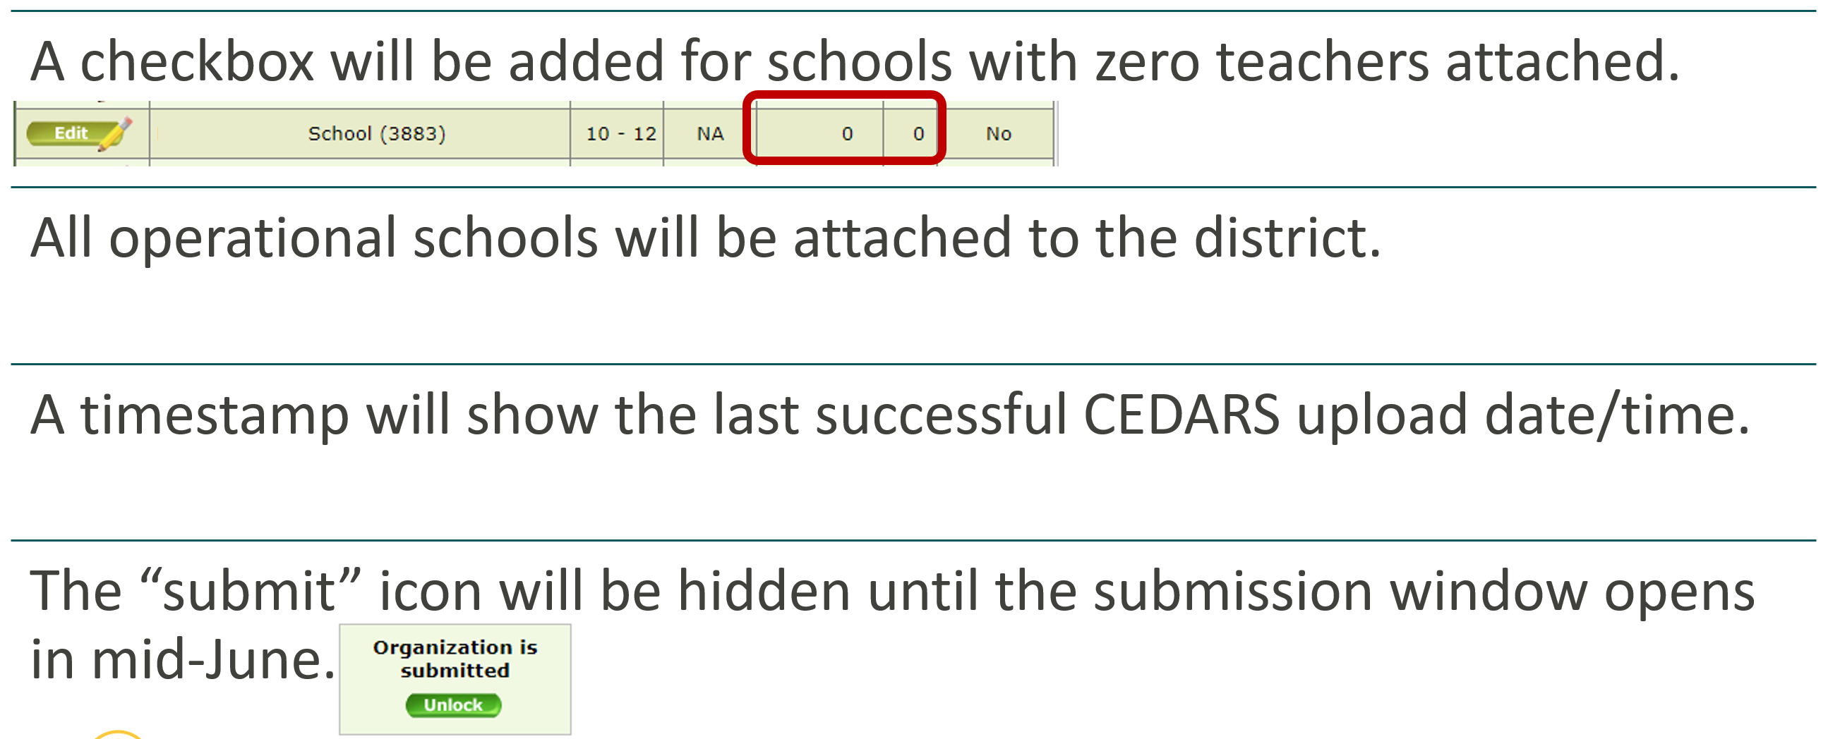
Upcoming Changes: District (Landing) Tab

Slide 46
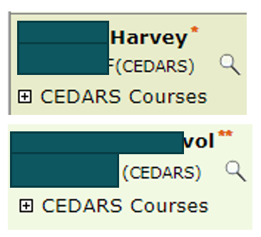
Upcoming Changes: Building Tab
An affirmation checkbox will be added for First Peoples’ certificate holders while the tribal culture course codes are being developed and approved.
The single asterisk will be replaced to show the years/months of teaching experience. The double asterisks will be replaced with a sentence notifying the LEA of the need to report the teacher’s years of experience in the S-275.
The “building lock” option will be hidden until the submission window opens in mid-June.

Slide 47
Upcoming Changes: Teacher Tab
OTF Courses
Expired Certs
The OTF courses will be highlighted.
No more searching through every course code taught each semester!​
A message will appear for a teacher who did not hold a valid certificate (based on the instructional start date entered) during the school year​.
The goal is to clarify that these educators do not need school board approval, but they do need to be reported to the Office of Professional Practices (OPP).​
Notes:
Upcoming changes to the teacher tab include:
Highlighting the OTF Courses: Right now, the only highlighting on the teacher page is blue which shows the courses with all students receiving sped services. We will add another highlight color to draw your attention to which rows are showing the OTF courses.
We’re also adding a message for teachers with an expired cert. Earlier in the presentation we showed you how to run an expired cert report in E-Cert. Once we add this notification, that step will be built into the EE Tool process.
Be sure to let us know of additional items that you would like to have addressed. We’re working to be sure the EE Tool becomes increasingly user friendly.

Slide 48
Why Data Matters
Notes:
We will now focus to how you can use the data from the EE Tool.

Slide 49
OSPI Equity Statement

Slide 50
Why Data Matters -Data Use to Work Towards Equity-
Create quantitative report for educators, districts, families, and communities to better understand and work towards
Equitable access to effective instruction by student groups, student grade range, content area, state course code, etc.
Equitable distribution of supports and resources for educator workforce
Notes:
Purpose of collection

Slide 51
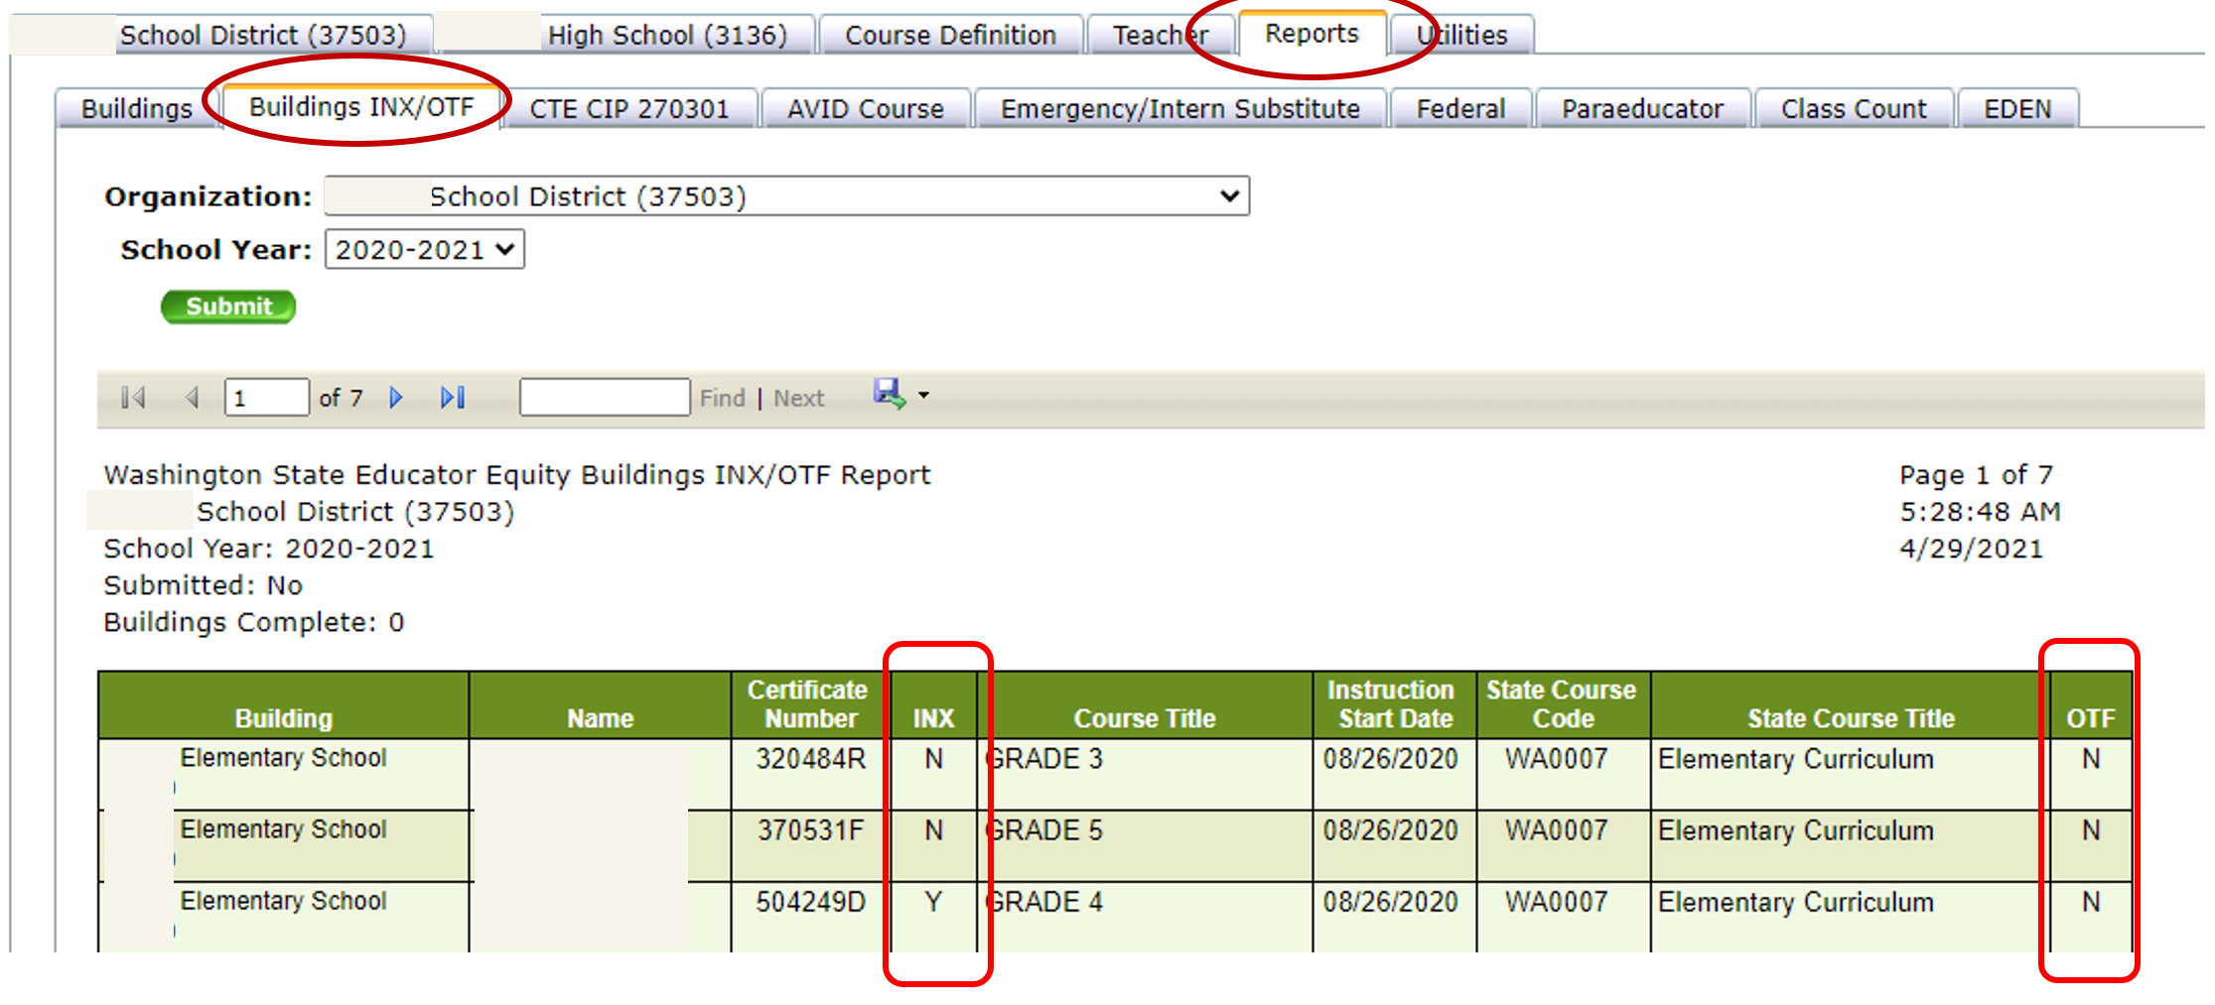
Reports Available in EE Tool
Notes:
LEAs are able to see their EE Tool reports for previous years. Once this year's EE Tool closes, you will be able to see this year's data available in the report tab.

Slide 52
Outline for Educator Data to Work Towards Equity
1. Overview of Data Elements and Sources
2. Data Elements of a Course
3. Building Communication Network
4. Data Use
5. Data Dive in the State Report Card
6. Research and Development Projects
(1) Equity Issues and Analyses in Educator Data
(2) Supporting tools for Educator Career Continuum

Slide 53
1. Overview of Data Elements and Sources
Where do we report about educators?
Fund Usage
and Educator Support
(iGrants: Title II A, TBIP, Title III, Title I A, LAP, and more)
District/School, Duty, Activity, and Program Assignment
(Personnel Report: S-275)
Professional Learning and Clock Hours (pdEnroller)
Educator Credentials
(E-Certification)
Educator Equity Tool
(Monitor and respond
to educator data)
Teaching Assignment
(Staff Schedule: CEDARS)
Photo by Dr. Terrence Underwood on Unsplash
Notes:
Validate feedback – we get educator data from many places

Slide 54
Journey of Educator Data
Data Submission
CEDARS
S275
ECert
Additional Data Submission
Data Validation
CEDARSEDE
EE Tool
Data Use
State Data Reporting
Legislative Report
Data Summary for State Policy Change
Federal Data Reporting
State Report Card
Federal mandatory report
Consolidated Program Review (CPR)
Data Request &
Public Record Request
Families and Community
Higher Education
Media
Legislator
OSPI Internal Office
Research and
Development
Educational Equity Issues and Analyses
Supporting tools for Educator Career Continuum

Slide 55
2. Building Communication Network
Who may be involved with data reporting?
Student and Educator Data
District and Building Admins
Training Coordinator
HR
Federal Prog. Coordinator
Learning and Teaching
Data Admins (SIS, CEDARS)
Notes:
But the important thing about our response is that we aim to facilitate communication between people in these roles by building a communication network
Title/role may change in LEAs

Slide 56
3. Data Elements of a Course -Teacher and Student Schedule-
Who is teaching what course?
1. Content Area (e.g., Math)
2. Course (e.g., State Course Code: Algebra I)
When are they teaching the course?
3. Term (e.g., All year, Term 1, 2, 3, and 4)
Which sections are they teaching?
4. Section (e.g., Section ID Math01, Math02 )
Who is/are teaching a section?
Photo by NeONBRAND on Unsplash
5. Teacher Indicator
(e.g., Primary Teacher, Co-teaching, Team teaching, Paraeducator)
Teachers course assignment
Student access to effective instruction

Slide 57
4. Data Use
EE Tool
Personnel information
Credential information
Teaching assignment
Student access to instruction
State Data Reporting
Legislative Report
Data Summary for State Policy Change
Federal Data Reporting
State Report Card
Federal mandatory report
Consolidated Program Review (CPR)
Data Request &
Public Record Request
Families and Community
Higher Education
Media
Legislator
OSPI Internal Office
Research and
Development
Educational Equity Issues and Analyses
Supporting tools for Educator Career Continuum

Slide 58
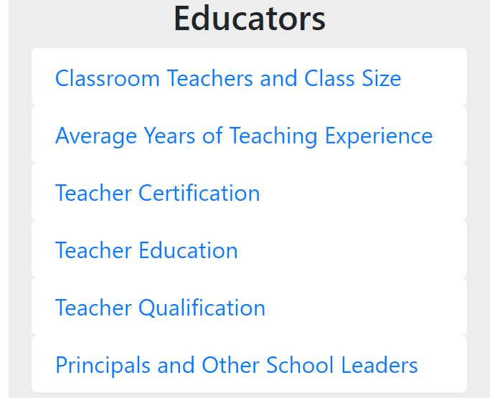
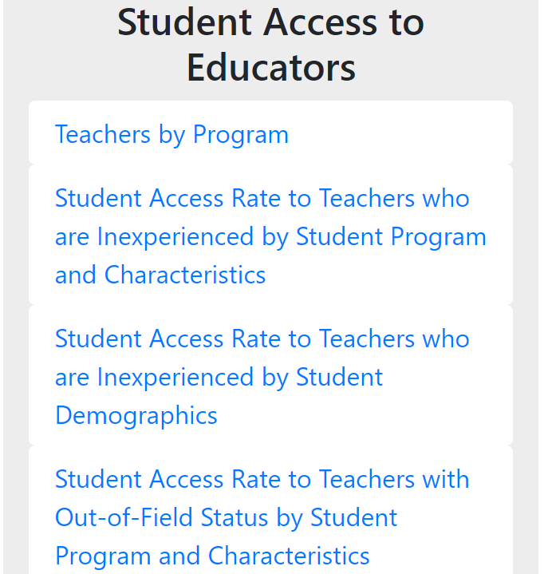
5. Data Dive in the State Report Card

Slide 59
Classroom Teachers for 2019-20 School Year This data is at the state-level. These reports are available to run at the LEA-level. 2020-21 school year's data will be available around the end of this February.
Number of Classroom Teachers: 67,841
Average Years of Teaching Experience: 13.1
Distribution of Years of Teaching Experience

Slide 60
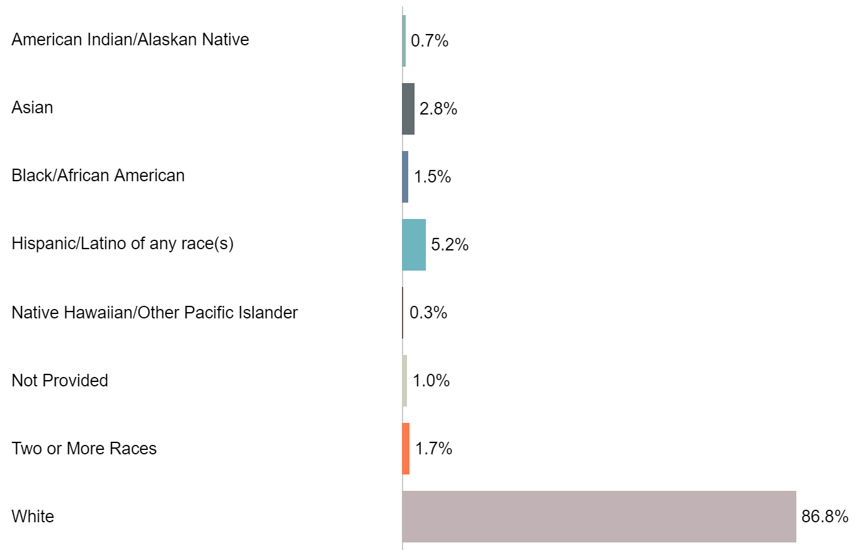
Classroom Teachers by Race/Ethnicity

Slide 61
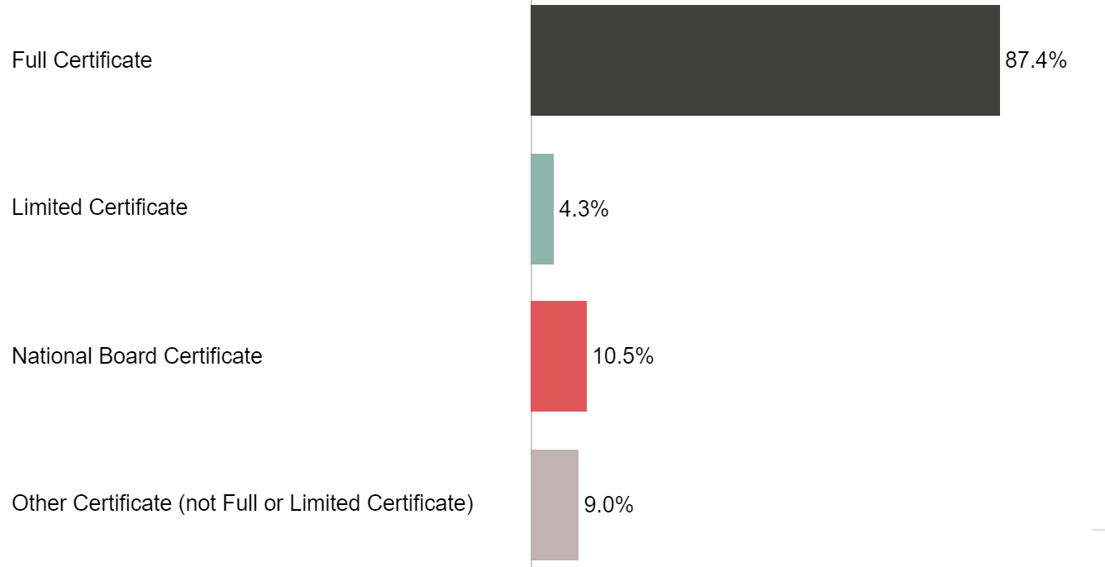
Classroom Teachers by Certificate Type

Slide 62
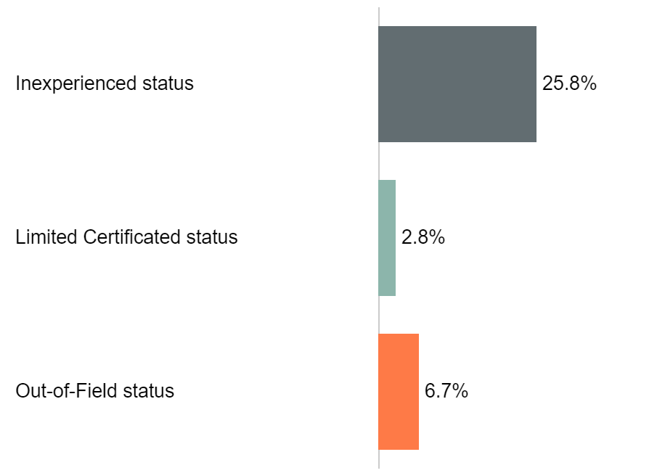
Classroom Teachers within each Qualification

Slide 63
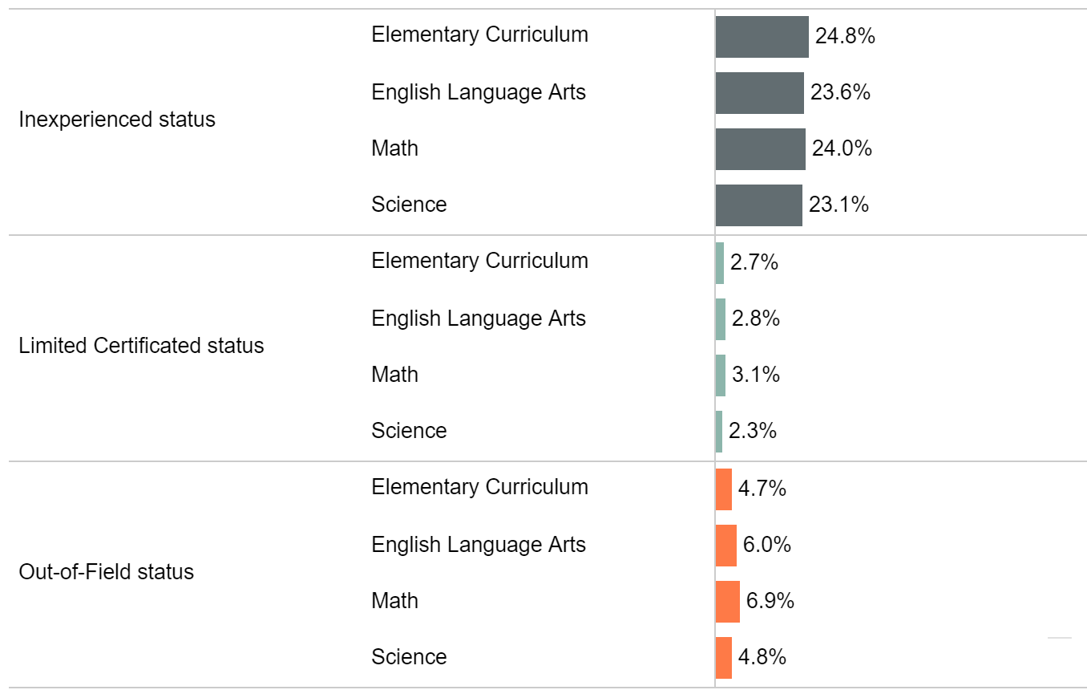
Courses Taught by each Teacher Qualification and Content Area

Slide 64
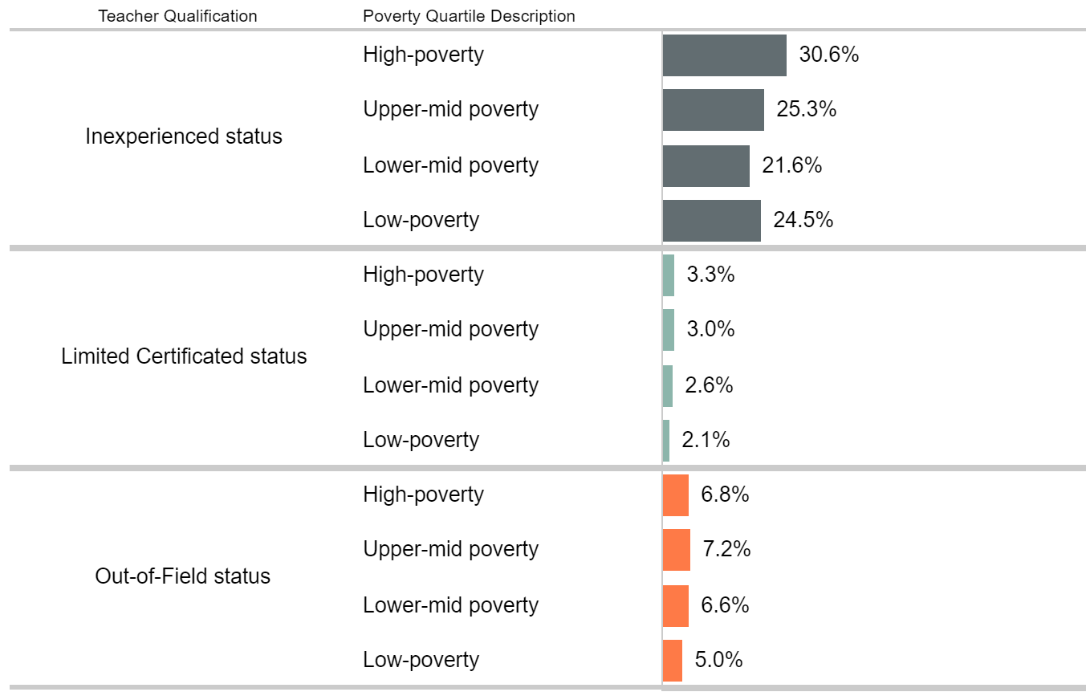
Teachers Qualification by School Poverty Quartile
Notes:
Students from families in poverty, especially high-poverty, are more likely to be taught by an inexperienced teacher, and are more likely to be taught by a teacher holding a limited certificate.
Students from families considered low poverty are most likely to be taught by teachers who are properly endorsed.

Slide 65
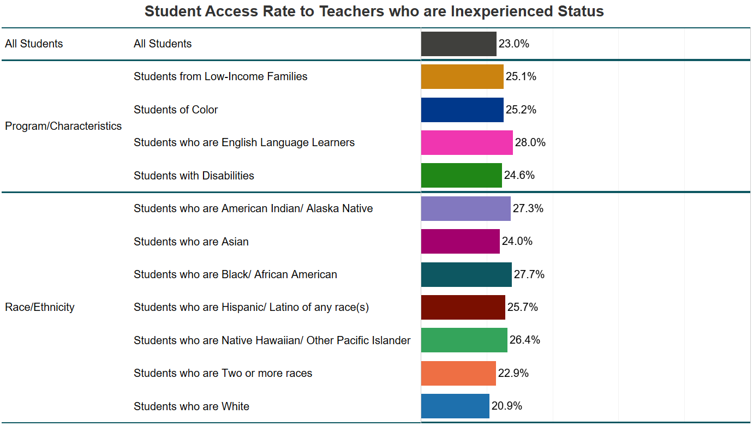
Student Access Rate to Teachers who have Inexperienced Status

Slide 66
Tips for Accurate Reporting

Slide 67
Course Information in CEDARS
Be consistent in your Curriculum and Course Masters –throughout the LEA– especially at middle/junior high schools and high schools.
Choose a state course code that best aligns with what is being taught; avoid using generic state course codes. For elementary, use content specific course codes when possible.
Report Co-Teaching models (SPED, ELL) and instructional assistant from paraeducator
Notes:
Elementary Curriculum, WA0007 – Report specialists in elementary buildings (e.g., Physical Education, Music, Art).

Slide 68
Educator Information in S275 & ECert
Race/Ethnicity information
Years of Teaching Experience

Slide 69
Using Educator Data – Next Steps

Slide 70
6. Research and Development Projects:
Equity Issues and Analyses in Educator Data
Supporting tools for Educator Career Continuum

Slide 71
Data for Educator Career Continuum
(1) Inventory
- Educator workforce information and distribution
- Educator credential information
(2) Demand
- Educator teaching assignment and credential
- Student equitable access to educators
(3) Support
- Educator professional learning and support
- Educator retention and mobility
(4) Supply
- Educator needs by endorsement at each district

Slide 72
(1) Equity Issues and Analyses in Educator Data
Washington State Longitudinal Data and System (SLDS) project in Educational Equity
Examine issues related to educational equity in the
public educational systems in the state
Conduct analysis and research and effectively inform
research findings to districts and decision-makers
Implement data driven strategies and supports
and continuous monitoring and evaluation

Slide 73
How do you define equity? What are the equity issues you identified?
How do we define and identify equity issues?
What type of equity issues do occur?
Where do equity issues occur?
Who do encounter equity issues?
When do equity issues occur?
Why do equity issues occur?
How do we support to close equity gap?

Slide 74
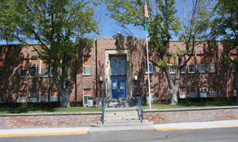
Where do equity issues occur? Who do encounter equity issues?
Do all schools equitably recruit, support, and retain fully qualified educators?
Is distribution of fully qualified educators equitable among schools in a district?
Do all educators get equitable supports and equitable working conditions?
Do all student groups have equitable access to Effective Instruction?

Slide 75
Does Your LEA Have Equitable Access
Across the Educator Career Continuum?
Attract & Prepare (Recruitment)
Equitable distribution of fully credential teachers
Districts have equitable access to higher education institutions (Title I, OSSI tiers, geographic location)
Teaching Assignment
Students have equitable access to effective instruction
Equitable distribution of mentors
Retain
Professional Learning
BEST program
Support & Develop
Equitable distribution of instructional coaches
Resources and supports to retain teachers
Affinity groups

Slide 76
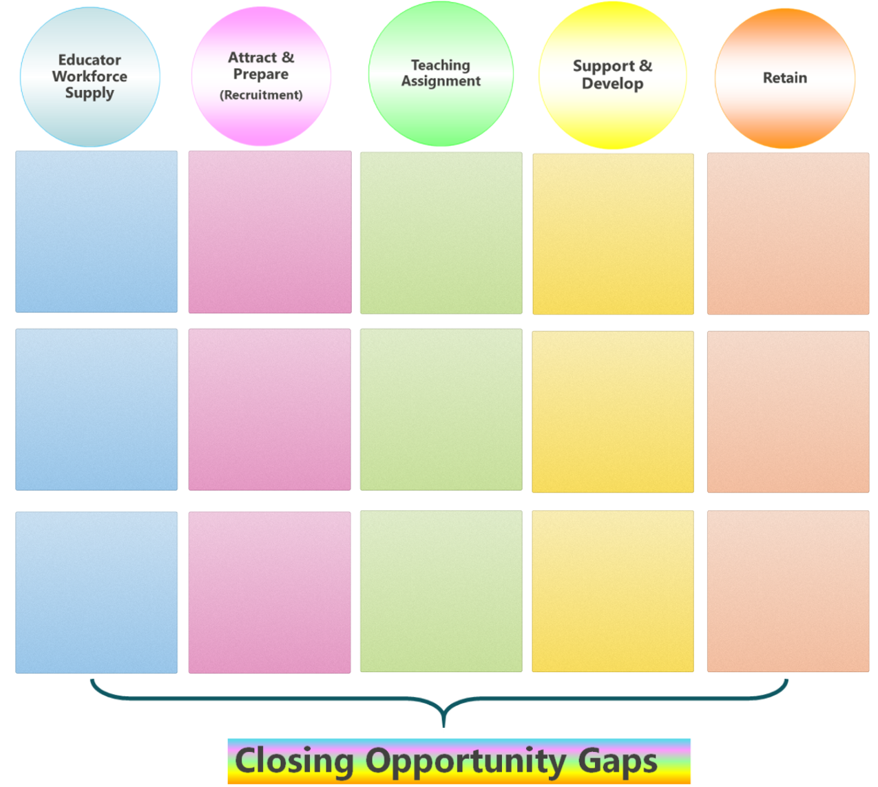
Educator Growth and Development (EGAD) Matrix
Educator Career Continuum
#1 What educational equity issues occur? How might they be measured?
#2 What existing resources, supports and strategies are available?
#3 What additional resources do PK-12 systems need?

Slide 77
Communication and Implementation
So What?
Where we are
What part is going well
What part needs more support
Questions
Analysis
Findings
Supports &
Resources
Practice
Now What?
What supports and resources are available
How to work toward
How to maintain and go above and beyond
Any tricks and strategies that other districts use

Slide 78
Communication and Implementation:
Implementation of Practices
External Stakeholders
Internal OSPI Partners
Equity in Education

Slide 79
(2) Supporting Tools for Educator Data
Data Validation Support Tool
- Data Visualizations Current School Year’s data
(EE tool ←→ The Support Tool → Report Card)
Educator Credential Information
Paraeducator Course Assignment Support Tool
Educator Career Continuum Support Tool
Educator Needs and Workforce Supply Tool
Put good data in and get great information out of it!

Slide 80
Using Educator Data – Next Steps
Monitor
Regularly monitor educator data using EE Tool and Data Validation Support Tool
Share
Share educator data with district and building administrators
Integrate
Integrate educator data into continuous improvement plans and needs assessments
Review
Review educator data when developing recruitment, induction, and professional learning plans
Please add your ideas to the chat! How does your LEA use EE data?
Notes:
Monitor
At a minimum, review the EEDC data in the fall and again during 2nd semester. Remember, any time a sub in placed in a role for 20 consecutive days, the endorsement requirement will be in effect so review the tool at that time as well.
Share
Sharing the data with building and district administrator will help improve accuracy as principals, registrars, and HR personnel are more likely to find errors that a CEDARS administrator may not recognize.
Integrate
Use the data to see how your LEA is meeting its equity goals. For example, if the lowest SES schools have the highest number of beginning or OTF teachers, changes need to be considered.
Review
Be sure to review the data when determining your LEA’s recruitment, induction and professional learning plans. Remember, Title IIA funds may be used for activities such as mentoring, TOSAs, affinity groups, and induction programs.

Slide 81
Connect With Us!
Be sure to select Title II, Part A to receive our announcements and updates.
Place your screenshot here
Notes:
LS

Slide 82
Title II, Part A and Educator Data Team Contact Information
Title2A@k12.wa.us, EducatorData@k12.wa.us
Office Hours (choose 30- or 60-min. appt.)
360-725-6340
Notes:
LS

Slide 83
Connect with us!

