Slide 1
April GATE Equity Webinar High School & Beyond 101: Increasing Engagement with High School & Beyond Planning
Exploring topics related to equity in graduation success
The webinar will begin soon.
While you wait, please share in the chat panel:
Use 6 words to describe your connection to the HSBP.
Notes:
Mic check 1-2

Slide 2
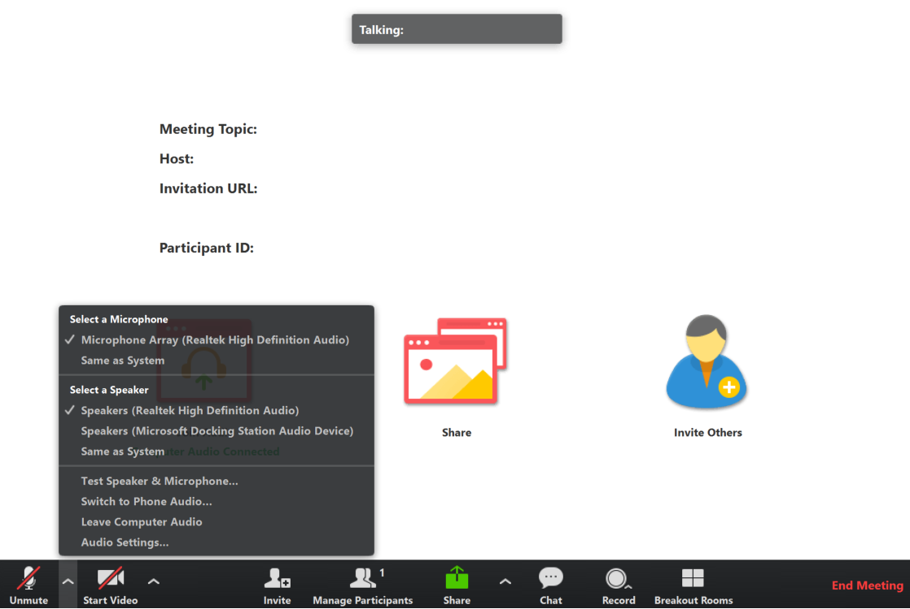
Connect to Audio
Welcome to the GATE Equity Webinar!
We’ll be starting in a few minutes.
You can join by computer audio or call in.
Dial +1 669 900 6833 or
+1 646 558 8656
Webinar ID: 122-657-497
Test Audio
4/7/2020 | 2
Notes:
We’re going to get started in a few minutes. You can test your audio in the bottom left hand corner of the menu.

Slide 3
Sound Check
Welcome to the GATE Equity Webinar!
We’ll be starting in a few minutes.
We’re going to get started in a few minutes.
Can you hear us?
Please let us know in the chat!
Test Audio
4/7/2020 | 3
Notes:
We’re going to get started in a few minutes. You can test your audio in the bottom left hand corner of the menu.

Slide 4
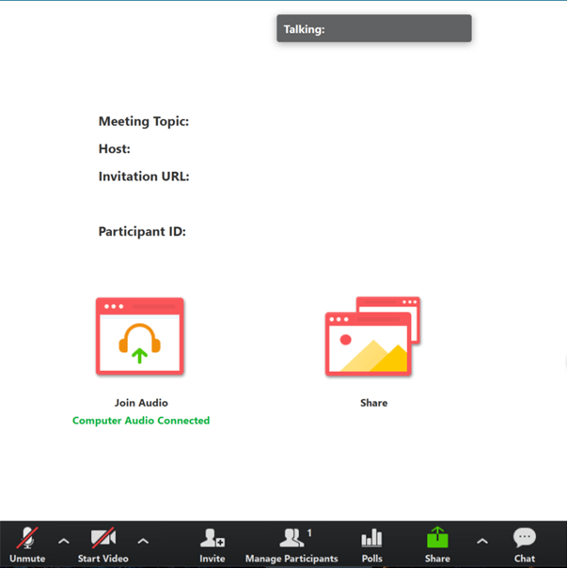
Tips for Participating
Share comments and ideas in the Chat panel (send to “All”)
Ask presenters questions in the Q&A panel
Slides are available on the GATE Equity Webinar page in the Archive now.
Recording will be available at the end of the month.
4/7/2020 | 4
Notes:
Thank you for sharing comments and ideas in the chat.
If you’d like our presenters to answer a question, please use the Q&A instead.
Our slides are available on the GATE Equity Webinar page now if you would like a copy.
We do record our webinars and they’re also on our page in the archive section. The recording from today should be available by the end of the month.

Slide 5
Virtual Etiquette
Focus on the topic, stay present
Assume positive intent
Growth mindset
Mute when appropriate
4/7/2020 | 5
Notes:
As we go through the webinar, please keep this webinar etiquette in mind.
We encourage a growth mindset, where you are open to thinking about new ideas and willing to push yourself to grow.
As with any professional development you’ll get out of it what you put into it. So thank you for staying present, focused, and positive!

Slide 6
April GATE Equity Webinar High School & Beyond: Increasing Engagement with High School & Beyond Planning
Exploring topics related to equity in graduation success
The webinar will begin soon.
While you wait, please share in the chat panel:
Use 6 words to describe your connection to HSBP.
Notes:
Thank you for joining us for the April GATE Equity Webinar.
This webinar will be recorded and will be posted in the next couple of weeks.
The PowerPoint is posted on OSPI on the GATE Equity Webinar page if you want to follow along.
I’m Kefi Andersen, OSPI Graduation Equity Program Supervisor.
Today’s topic is High School & Beyond 101: Increasing Engagement with High School & Beyond Planning
This topic is especially relevant today as we’re facing the challenges of COVID 19. Our education system is facing unprecedented changes that we know have been so hard for educators, families, and our communities. Our Superintendent said earlier this week, “Out of crisis come the roots and blossoms of innovation.” Your creativity is so valuable. Across the state truly brave professionals are converting their practices to a digital format.
With the announcement that school buildings won’t be opening again this year, many students are considering their futures and what will be happening next. There have been many questions about college entrance tests, course credits, and participation in clubs and activities that help students prepare for what’s next.
The High School and Beyond Plan is a graduation requirement, but in the right hands it can be so much more.
Having a plan is a way for a student to feel safe. Knowing you are on the way to achieving your dreams is also an avenue to investigating what you really care about. Who you want to become, who you are and how you become that is empowering because it inspires so much hope.
And although everything we say today may adjust with upcoming guidance, we are giving you the most current information we have so that you can offer some reassurance and begin to make informed choices in your own local responses.

Slide 7
Novel Coronavirus (COVID-19) Guidance & Resources Page
Continuous Learning During School Closures
Child Care
Special Education
Supporting Graduating Seniors
Teacher & Principal Evaluations
Meals & Nutrition
State & Federal Funding
Assessments
Allowable Building Activities
Waivers & Make-up Days
Considerations for Paid School Staff
Bullying & Harassment
Guidance & Resources from Partners
Notes:
One resource I want to highlight for everyone out there is the OSPI Novel Coronavirus (COVID-19) Guidance & Resources page. As you can see from these topics, we’ve released a lot of documents that may be helpful to you.

Slide 8
Do You Need Clock Hours?
We are offering 3 free Clock Hours for attending both of today’s webinars.
Register for clock hours.
Complete the pre-reading assignment.
Attend both the morning and afternoon live GATE Equity Webinars.
Complete the PDEnroller Evaluation.
Clock Hours will be released when attendance is verified, usually within a week.
Questions? Contact Ronnie.Larson@k12.wa.us
Clock Hour Instructions and Registration Here!
4/7/2020 | 8
Notes:
We’d love to see our listeners get clock hours for joining us, so if you are planning to watch both webinars live today you can use this link in the chat to get into PDEnroller and collect your hours.
This month’s pre-reading assignment was to read and talk to a colleague about Appendix A on page 7 – this doc is linked on the GATE Equity Webinar page. If you’ve done that, and registered with PDEnroller, all you have left to do is complete the PDEnroller evaluation, print, sign, and send back to Ronnie Larson.
We assigned this because Appendix A was developed to support IEP Transition Plans and the teamwork it takes to help students access meaningful supports. This resource is a great first step resource for who should be involved in the process.
We should have a confirmation to you by early next week.
We hope you can take advantage of this free offering!

Slide 9
Land Acknowledgement
School District & Nearest Federally Recognized Tribes
Washington Tribes Map
| 9
Notes:
We would like to acknowledge that this meeting is being held on the traditional lands of the Squaxin Island Tribe. We acknowledge the Tribes commitment to the resurgence of their traditional ways and their respect and protection of all people,
not only those who are living, but also those who have gone before and who are yet to be born.
We pay our respect to the elders both past and present and to the valued resource the Tribe has defined as their children. They are the Tribes future.
We ask that the participants of this meeting also honor the Tribal lands on which each of you are located today.
A resource you might consider for your own locale, is this School District & Nearest Federally Recognized Tribes document or the Washington Tribes map.
When you see the “within tribe boundaries” this is based on their current land not historical.
Best practice is for districts to engage in tribal consultation with the tribes nearest their district to determine their historical lands. Each tribe are the experts of their history.
We thank you for your participation.

Slide 11
Notes:
OSPI has developed an Equity Statement that we think helps frame our webinars. We believe each student family and community possesses strengths and cultural knowledge that benefit their peers, educators and schools.
In our leadership role, we examine the ways current policies and practices result in disparate outcomes for our students and work to intentionally consider historical contexts, ways to partner in decision making, and ways to dismantle systemic barriers so that the students in our schools can access instruction and support in our schools.

Slide 12
Office of System & School Improvement
We believe we are more likely to see school improvement across multiple measures if we:
Study
Focus on schools identified for supports
Support
Connect programming to specific needs
Serve
Build the health of systems
Elevate Provide professional learning on data inquiry and supportive resources and tools
4/7/2020 | 12
Notes:
This webinar is brought to you through the Office of System and School Improvement.

Slide 13
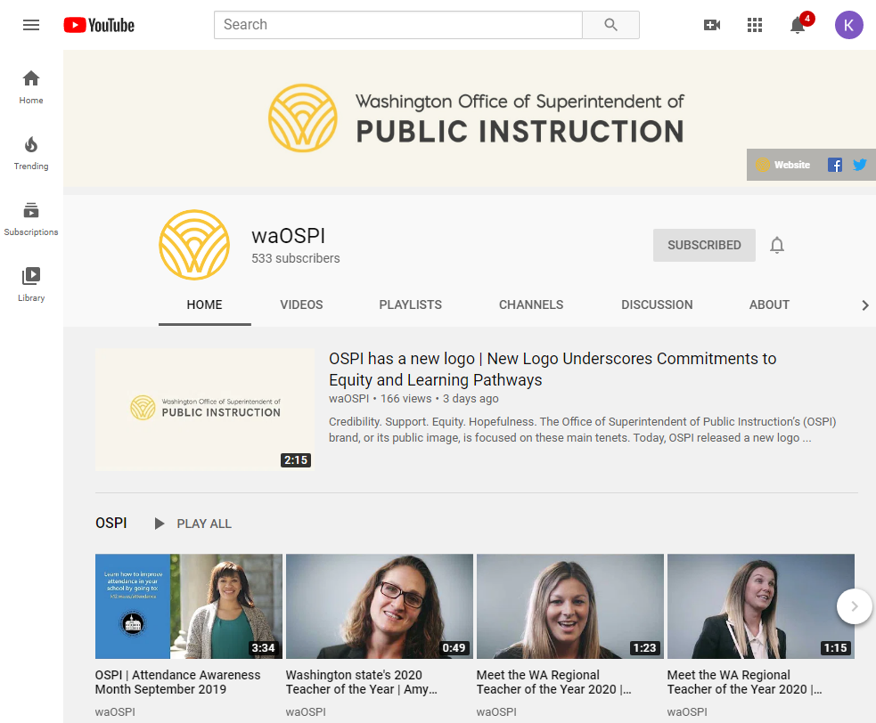
OSPI YouTube Channel
Did you know you can subscribe to the OSPI YouTube Channel?
Watch our past webinars!
Youtube.com/waOSPI
4/7/2020 | 13
Notes:
Did you know our webinars are all posted on our YouTube channel? If you want great ideas from Washington schools you should definitely subscribe!

Slide 14
More This Afternoon
3:00pm
High School & Beyond Planning 201:
Aligning High School & Beyond Plans with IEP Transition Plans
4/7/2020 | 14
Notes:
This afternoon we’ll be having a second GATE Equity Webinar – to talk about Aligning High School and Beyond Plans with IEP Transition plans.
We hope you’ll be able to check it out too.

Slide 15
MTSS PLC Webinars / OSPI-WSAC Webinar
April 10
May 8
Rhonda Nese
Providing alternatives to exclusion
Devon Minch
Engaging Families in MTSS
OSPI & WSAC staff share info on Transition Supports for Class of 2020
May 6
4/7/2020 | 15
Notes:
We have a sister webinar series, the MTSS PLC Webinar Series. They have a great line up of presenters and topics! This webinar would be useful for any school that wants to think more deeply about MTSS implementation. It was created to support early MTSS adopters in Washington and provides a great place to network and learn from other schools as well as nationally recognized experts in MTSS, we are linking to their bios, If you grab the slides. I know I’ll be there to soak up some knowledge, and hope you check it out too! 11-noon, usually second Friday of the month

Slide 16
Objectives
Implications of COVID-19 on High School & Beyond Plans
Understand recent changes from House Bill 1599 & some best practices for High School & Beyond Planning
Learn from a leader in the field how they are engaging students in alternative learning settings to plan for the future
Get resources to get started!
4/7/2020 | 16
Notes:
Our objectives for this webinar are to inform you about some Implications of COVID-19 on High School & Beyond Plans
To Understand recent changes from House Bill 1599 & some best practices for High School & Beyond Planning
You also will get to Learn from a leader in the field how they are engaging students in alternative learning settings to plan for the future.
And of course we’ll Get resources to get started!

Slide 17
Who Are We?
Kefi Andersen
Graduation Equity Program Supervisor
OSPI
Kim Reykdal
School Counseling Program Supervisor
OSPI
Kari Sutlovich
Director of Open Doors Programs
Green River College
4/7/2020 | 17
Notes:
I’m joined today by Kim Reykdal, our school counseling Program supervisor and Kari Sutlocich, the Director of Open Doors Programs at the Green River College.
I want to point out that planning and coordinating the content for this webinar took pretty extraordinary efforts from our presenters and I can’t express how grateful I am that we were able to make it work!
Thank you both for all the work you’ve done to share your experiences with our audience!

Slide 18
Questions & Polling 1
Who’s here?
Administrator
School Counselor
Teacher
Parent
ESD
District
Continuous Improvement Partner or Coach
Graduation Specialist
Community Based Organization
Paraprofessional
Other
Has your school been identified for Comprehensive or Targeted Supports by OSPI?
Yes
No
Not Sure
How familiar are you with our topic?
Very
Somewhat
It’s new!
4/7/2020 | 18
Notes:
We like to get to know who’s in our audience so that we can tailor our content to your needs. If you don’t fit any of our categories, please introduce your role in the chat.
We’ll pause for polls throughout the webinar today and check in with the questions you pose.

Slide 19
What is a High School & Beyond Plan? How can HSBP’s be Used, Even During School Closures, to Increase Engagement?
Notes:
Kim, with the school closures, High School and Beyond Planning may take some creativity. Can you share a little bit about what it is?

Slide 20
What Do You Know About High School & Beyond Plans?
Type up to 20 words in the chat box that explain what a HSBP is...
The tool that helps students, and their helpers, plan for their future and achieve their potential
A plan that relays a student’s hopes and dreams to the adults that support them
Students visualize their future and relate their high school experience to what they want to achieve
A roadmap to graduation and beyond that captures the student’s aspirations
4/7/2020 | 20
Notes:
Simple Definition
An annual exploration and planning process starting by 8th grade.
Provides students with opportunities to:
explore who they are and jobs that may be a good fit,
choose classes and activities aligned to their goals and interests to prepare for their first step after high school, and
assess academic progress, track achievements, and adjust goals
What it Does for Kids
Completing a HSBP helps students make informed choices to be ready for and pursue a post-high school goal that is meaningful to who they want to be and what they want to do.

Slide 21
Framework for Quality High School Beyond Planning
Assess academic progress
Results
An annual exploration and planning process
Explore who they are (skills, interests, goals)
Opportunities
Timeframe
Students make informed class choices
Choose classes and activities aligned to goals and interests
Track achievements
Prepares students to pursue a post-high school goal that is meaningful to who they want to be and what they want to do
Started by 8th grade
Ideally, all students engage in a range of developmentally appropriate K-12 career & college exploration and preparation activities
Adjust goals
Discover careers that fit
Schools are more responsive to students’ interests/goals
4/7/2020 | 21
Notes:
Simple Definition
An annual exploration and planning process starting by 8th grade.
Provides students with opportunities to:
explore who they are and jobs that may be a good fit,
choose classes and activities aligned to their goals and interests to prepare for their first step after high school, and
assess academic progress, track achievements, and adjust goals
What it Does for Kids
Completing a HSBP helps students make informed choices to be ready for and pursue a post-high school goal that is meaningful to who they want to be and what they want to do.

Slide 22
Washington Statewide Trends
38% of seniors said what they’re learning in school will be “very” or “quite” important for later in life (2018 HYS results for Class of 2020)
62% of on-time grads went on to a 2- or 4-year college (Class of 2016)
63% of 2-year college students stayed beyond 1 year (Class of 2015)
81%
Graduated in 4 years Class of 2019
84%
Graduated in 5 years Class of 2018
*OSPI Report Card , Education Research and Data Center & 2018 Healthy Youth Survey
4/7/2020 | 22
Notes:
31% said “fairly” important; 23% said “slightly and 7+% said “not at all”

Slide 23
Systems Level Supports and Strategies
Leadership & Staff
Toolkit
&
Template
Delivery Strategies
Guiding Questions
Data Mining
External Partners
4/7/2020 | 23

Slide 24
Leadership & Staff: Beliefs Matter!
Staff beliefs about ALL students’ ability to graduate ready for…?
Time allotted for new student intake & scheduling process
HSBP-IEP Transition Plan alignment: team approach!
Watch Rita Pierson’s
Every Kid Needs a Champion
4/7/2020 | 24

Slide 25
Guiding Questions: Sequence Matters!
Explore
Who Am I?
How do my interests, skills, and values connect to potential jobs and classes I can take?
Plan
What Can I Become?
Act
How Do I Become That?
What classes, Graduation Pathway(s), and post high school education & training could prepare me to reach my post-high school goals?
What jobs align with my interests, skills, goals, or problems I want to solve?
4/7/2020 | 25

Slide 26
Toolkit & Template: Updates Matter!
Get the Graduation Pathways Toolkit
HSBP Template
Career Bridge Washington
4/7/2020 | 26

Slide 27
HSBP Updates from HB1599
What We’ve Been Doing
What’s New This Year
Info about federal & state financial aid
Students with IEPs get same HSB Planning, with similar staff, as classmates
Check out OSPI’s new resources!
10th Grade HSBP Update: SBA scores* must inform 11th grade course choices
Starts by 8th grade
Career Interest Inventory
Career Goal(s)
Educational Goals
Dual Credit
College Bound Scholarship
CTE Equivalency Courses
Support classes (if needed)
Academic Course Plan
Résumé/Activity Log

Slide 28
Data Mining: Engagement Matters!
Data Mine
Make Connection
Relationship & Outreach
Provide Opportunity
in & out of school
Students engaged in HSBP
& finding the right fit for after High School
4/7/2020 | 28

Slide 29
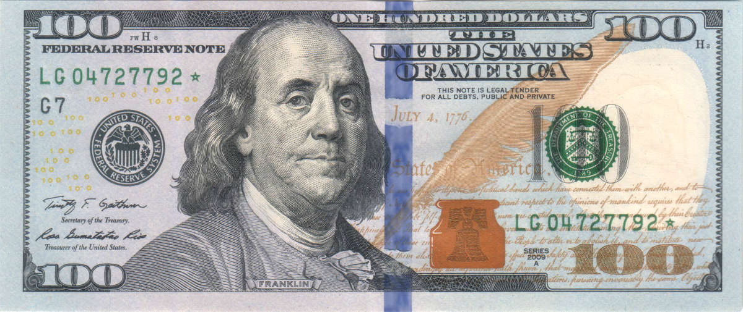
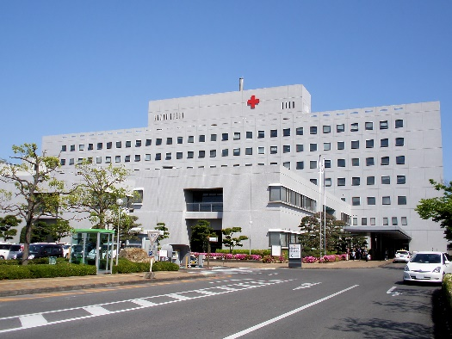
Data Mining: Help Me, Help You!
Field Trip Jan. 21st: County Hospital
You are receiving an invite to this field trip because you’ve saved a related career in your High School and Beyond Plan
You are receiving this scholarship, paid internship, or job information because it appears to be in line with your High School & Beyond Plan
4/7/2020 | 29

Slide 30
Delivery Strategies: Buy-In Matters!
School Counselor or CCR Specialist Delivered Lessons
Lessons given in classes or to whole grade (teachers stay)
Staff Delivered in Advisory/Homeroom
Counselor or CCR Specialist “trains”
Staff Delivered through HSBP “Units” in Select Classes
Résumé in ELA (10th/12th grade)
Small Groups if help is needed
1:1 Planning meetings
Staff buy-in & beliefs are key!
Career Guidance Washington Lessons
Financial Aid in math course(s)
Transition Course, AVID, Career Choices
Check out the NEW District HSBP Implementation Analysis Guide on OSPI’s Graduation webpage!
4/7/2020 | 30
Notes:
If you’re looking for robust HSBP implementation ideas, this slide links to the research I mentioned earlier about how staff delivery via advisory or homeroom can make a real difference in students’ career and college readiness. OSPIs report on the 2008-2016 College Readiness Initiative explains how schools across Washington with high populations of low-income students were able to increase college readiness through school wide implementation of career and college readiness supports. (CLICK)
This data shows a 20% increase overall in the % of students graduating eligible for a 4-year college, with significantly higher gains in several underrepresented student groups.
While this initiative saw positive outcomes across different student groups, there is still much work to be done to ensure that every student is being challenged and encouraged to achieve their potential. (CLICK)
% increase in student participation: 2008 → 2016:
MS Algebra: 22.1% → 28.6%
Advanced Math in HS: 60.7% → 80.8%
Chemistry in HS: 32.8% → 58.3%
Physics in HS: 10.8% → 21.6%
Increase in # students taking dual credit: 2010 → 2016
AP: 791 → 2,049 (159%)
RS: 180 → 307 (71%)

Slide 31
External Partners: Community Matters!
Credit Unions/ Banks & Local College
Local Businesses
Free education about financial literacy topics
Can provide online Q&A, career speakers, site tours, job shadows, internships, etc.
Resume support and mock interviews
College scholarships
Community Organizations
Provide mentors, tutors and career speakers
Volunteer opportunities
Internships
Scholarships, Awards, and Recognition
Basic needs resources
Childcare or after-school care
Financial Aid support to students and families (FAFSA/WASFA app, work study, understanding award letter, etc.)
Apprenticeships
4/7/2020 | 31
Notes:
In small school settings or in alternative settings it can be helpful to rely on some of the external partners in your community to help deliver critical content for the HSBP

Slide 32
What Advice Would You Give To Schools Starting This Work?
Leadership and Beliefs
Staff believe in ALL students & share HSBP delivery
HSBP’s inform master scheduling, hiring, clubs, etc.
Data Analysis
“State of HSBP” – what’s in place now? what gaps?
Use the HSBP to connect students to opportunities
Build Partnerships and Engagement
Staff, families & community partners!
Use HSBP to inform annual class registration
Support for annual HSBP updates / Student Led Conf.
Use the NEW District HSBP Implementation Analysis Guide
4/7/2020 | 32

Slide 33
High Leverage Supports Examples
Universal
Annual HSBP lessons & tasks
Student Led Conferences
Targeted
Alignment of HSBP & IEP Transition Plans
College Bound Scholarship support group
Personalized
1:1 HSBP planning meetings to instill HOPE
Connect 1st Generation students to college supports
Staff buy-in
“Campus” visits
Letters of Recommendation
Use common vocabulary
1
2
3
4/7/2020 | 33

Slide 34
Questions & Polling 2
Let’s help each other out! Do you have ideas you want to share?
Something innovative your school or district is doing that may help your colleagues
Ways to connect to students
Strategies for offering student supports
Tell us in the chat!
4/7/2020 | 34
Notes:
That brings us to our next poll. So let’s help each other out! Being online together is a great time to learn from the inspirational efforts of people across the state. We’d love to learn from your experiences so far and we want to give you a chance to share in the chat.
This can be something innovative that your school or district is doing
Ways you are connecting with students or families
Strategies for offering student support,
Or anything else that comes to mind.
Your great ideas are worth sharing, so please share an idea with us.

Slide 35
Implications for School Closures
Content
What do seniors need to finish?
Delivery
Post & send online directions
Support
Access to HSBP’s
What tasks can 6th, 7th, 9th and 11th grade students do?
“Sites” to explore!
Provide copies (HSBP packets)
Video directions
Staff office hours
Direct outreach to seniors who are behind
Transition into high school
8th graders?
10th graders?
Peer to peer as mentors
Bulletin 022-20 Senior Guidance
Continuous Learning Document
4/7/2020 | 35

Slide 36
Questions & Polling 3
Which description is closest to your school’s approach to providing High School and Beyond Planning?
We use a tiered approach so every student gets the basics, some get additional small group help, and a few have 1:1 support.
The students do HSBP activities in their advisory class as a group.
We set a plan when they enter our school and revise as needed.
We offer a course during which students develop their HSBP.
We have another method (tell us in the chat!)
4/7/2020 | 36

Slide 37
What Does it Look Like in Real Life? Open Doors at Green River College

Slide 38
Who Am I? Where Am I From?
Me
My School
My Past Experience
4/7/2020 | 38

Slide 39
Who We Serve in Open Doors
Student who are 16 - 21
Significantly credit deficient or disengaged
In partnership with three local school districts
4/7/2020 | 39

Slide 40
Educational Pathways Available:
High school Completion & Post secondary exposure and/or completion
GED®
Washington State Diploma
Associate’s Degrees & Technical Certificates
4/7/2020 | 40

Slide 41
Onboarding Process for Students
Information & application
Orientation & Testing
Advising, planning & registration
New students Two-day Workshop
4/7/2020 | 41
Notes:
All steps help to define student goals, which helps us to determine an Ed Plan based on the HSBP idea.
Relationships

Slide 42
Our Supports Related to HSBP
Universal
Unique future plan is necessary
General overview of requirements for each pathway
Targeted
Trade
Transfer
Personalized
Meet individually with each student quarterly.
High School credential only
Students spend time exploring options
Use plans as a framework for registration.
Make changes based on individual circumstance.
1
2
3
4/7/2020 | 42

Slide 43
Every plan is individual, but the steps are uniform:
Conversation
What are you goals? What do you like to do?
Why didn’t things work out before? Is university in your plan? Do you have a career goal?
Training
What resources are available to figure out what you need?
How can those resources be used for planning?
Regular Check-ins
How is it going? What do you know now? Are you enjoying what you’re learning/doing? Quarterly registration appointments
4/7/2020 | 43

Slide 44
Flexibility is Key
Plans are fluid & constantly changing
All based on unique situation and readiness of each student
Initial goal
New goal based on experience
New goal based on age & experience
4/7/2020 | 44

Slide 45
Questions for our Presenters

Slide 46
GATE Evaluation
This presentation will change my practice in the future:
Definitely
Probably
Not Sure
No – not helpful
This presentation was well organized with a variety of participant involvement:
Strongly agree
Agree
Disagree
Strongly Disagree
The presenters were content experts:
Strongly agree
Agree
Disagree
Strongly Disagree
The presentation met the stated learning objectives:
Strongly agree
Agree
Disagree
Strongly Disagree
GATE Feedback Survey
4/7/2020 | 46
Notes:
We would like to get more information from our audience about our webinars, so we’re going to try something new this month and run our evaluation as a poll.
Thank you for letting us know what you think! If something comes to you later, you also always have the option to share your thoughts through our web evaluation, which is linked on our webinar reminders.

Slide 47
Resources

Slide 48
Resources
Funding
Financial Aid Intro Presentation
Financial Aid Resources
Tools & Videos
ReadyWA – HSBP resources & videos for students, staff and families
Video – support 1st Gen. students
Websites
OSPI’s HSBP page
Career Guidance WA lesson plans
Washington State Board of Education HSBP resources
Washington Student
Free and downloadable materials, 12th Year Campaign, foster youth supports
Achievement Council
Continuous Learning Document
4/7/2020 | 48

Slide 49
Contact
Kefi Andersen
Graduation Equity Program Supervisor
OSPI
kefi.andersen@k12.wa.us
Kim Reykdal
School Counseling Program Supervisor Lead
OSPI
kim.reykdal@k12.wa.us
Kari Sutlovich
Director of Open Doors Programs
Green River College
Ksutlovich@greenriver.edu
Laurie Shannon
Youth Re-engagement Program Supervisor Lead
OSPI
laurie.shannon@k12.wa.us
4/7/2020 | 49
Notes:
We’re also available to answer your questions. Laurie Shannon is our Open Doors Youth Reengagement Program Supervisor Lead at OSPI and she is also a great resource for our alternative programs.

Slide 50
Get Personalized Assistance
Do you want personalized support?
We want to help connect you to the right people!
Use the Green Button!
4/7/2020 | 50
Notes:
Another resource we’ve developed is a green button. We want you to be able to contact a real live person to help answer any questions you have. If you want to learn more, connect to a program or get some fresh ideas, we are here for you! Just click on the button and an OSSI staffer will help you get whatever you need.

Slide 51
Creative Commons
Except where otherwise noted, this work by the Office of Superintendent of Public Instruction is licensed under a Creative Commons 4.0 International License.
4/7/2020 | 51

Slide 53
Discussion Questions for the Chat
What are your next leadership moves?
How will you put these ideas into action?
What questions do you still have?
What were the big ideas you got from today?
4/7/2020 | 53
Notes:
As we wrap up today, we want to encourage you to take a moment to reflect on the webinar and discuss these questions. You can use the chat, the people around you, or just jot down some thoughts on a sticky note.
What were the big ideas for you?
What are your next leadership moves?
What did you value?
What questions are you still wondering about?
We’ll be here to answer questions for a little while, so take advantage of the opportunity to talk to our presenters with the Q&A. Thank you for joining us for GATE Equity Webinar.
We’ll see you next month as we explore social emotional learning!
<mute>

