Slide 1
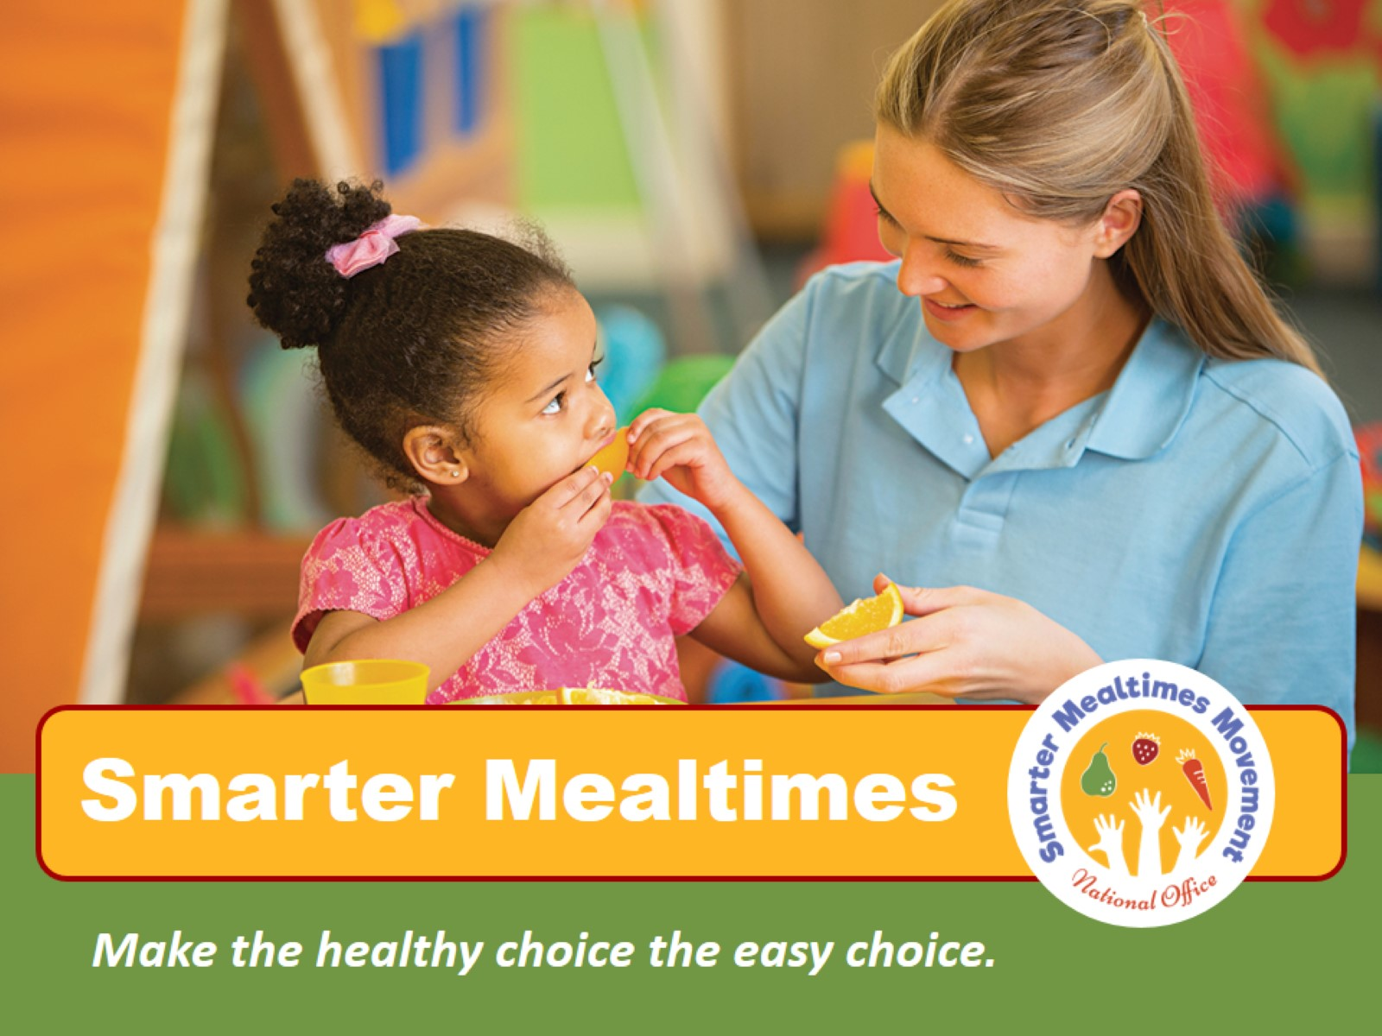
Smarter Mealtimes
Notes:
Welcome to Smarter Mealtimes. Today you will learn about evidence based strategies that make the healthy choice the easy choice for young children.

Slide 2
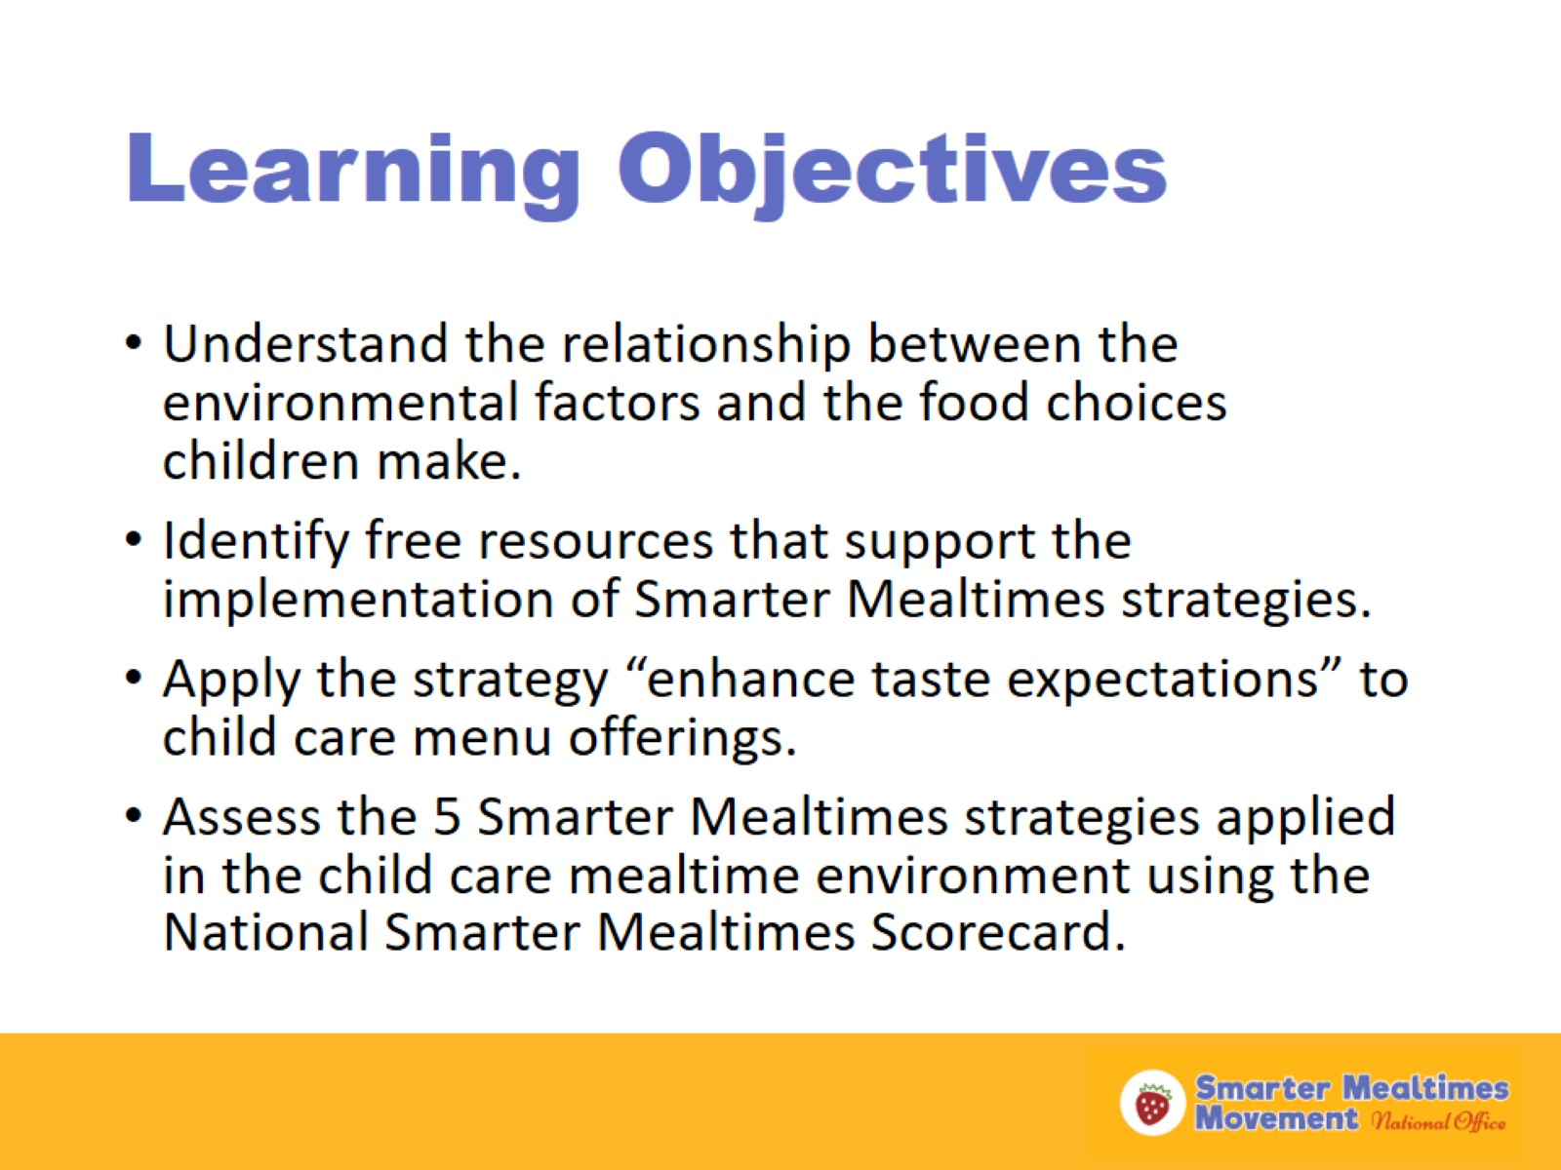
Learning Objectives
Notes:
(Review objectives)

Slide 3
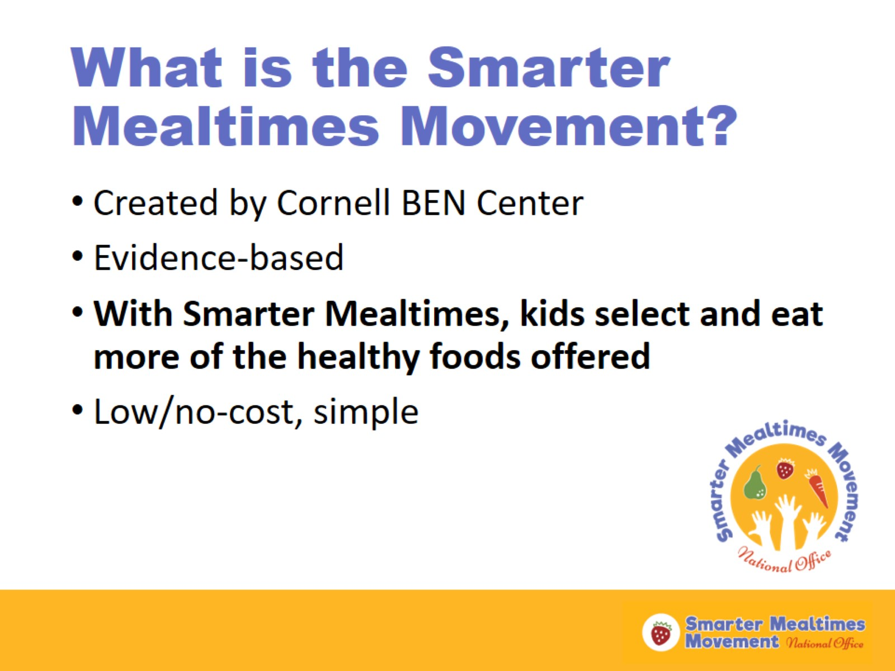
What is the Smarter Mealtimes Movement?
Notes:
Smarter Lunchrooms, an initiative focused on the school setting, was created by the Cornell BEN Center in 2009. Smarter Mealtimes takes some of the same concepts and applies them to the child care setting. Extensive research has been conducted on the Smarter Mealtimes concepts we will discuss today. The research shows that Smarter Mealtimes increase kids’ consumption of healthier choices (like fruits and vegetables) and decreases waste.
Creating a Smarter Mealtime does not have to take much time and most concepts don’t cost money.

Slide 4
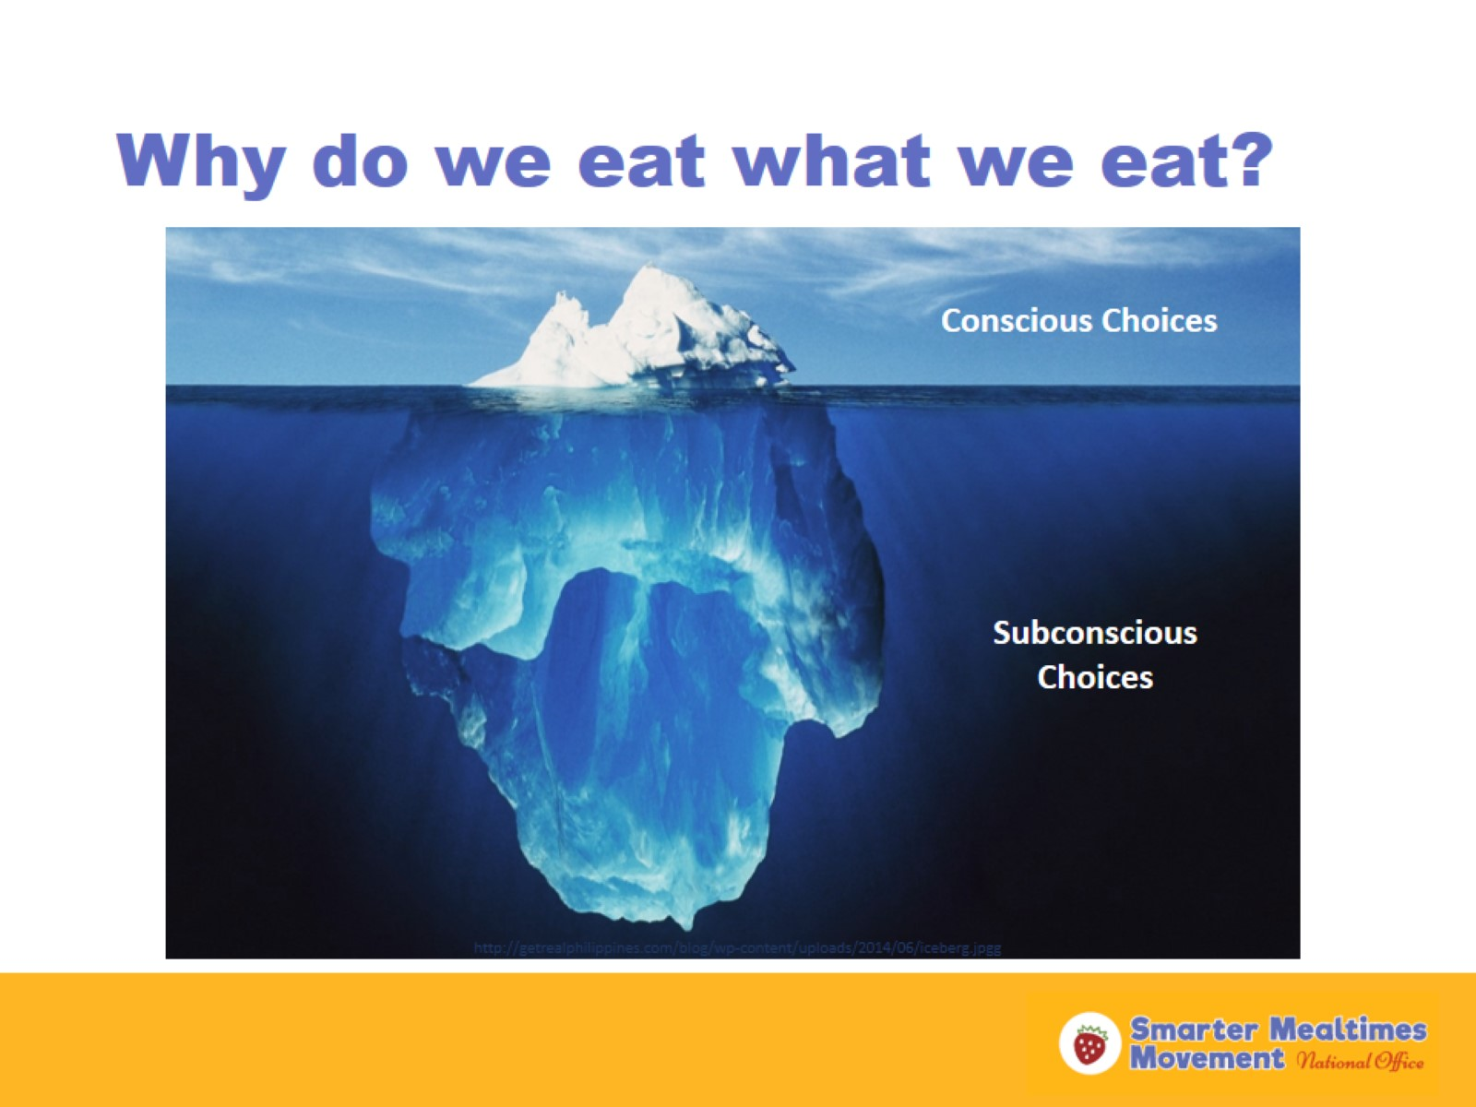
Why do we eat what we eat?
Notes:
We make hundreds of choices about food every day. In the world we live in, we don’t have time to focus on all of the food choices we make.
This iceberg depicts how some of our food choices are conscious, or rational, but many are subconscious, or mindless. This is true, even for people with a lot of nutrition-related knowledge. We make more conscious decisions about our food when we are trying to eat healthfully or when we are on a budget. We make more subconscious choices when we are stressed, in a rush, or not feeling well.
Often times, our environment guides the subconscious food decisions we make. If we are in an environment that promotes healthier foods, we are more likely to make healthier choices.
Creating a Smarter Mealtime means creating a mealtime environment that nudges kids towards the healthier choices, without eliminating choices.

Slide 5
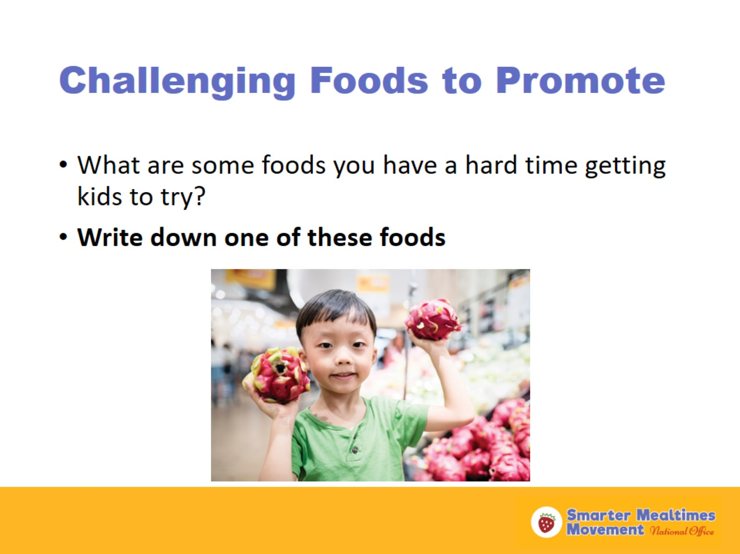
Challenging Foods to Promote
Notes:
Anyone who works with young children knows that mealtimes can be a challenge, at times. Young children are naturally picky eaters—this is a normal part of a child’s development. It can be challenging to encourage kids to try certain foods.
Take a moment to think about the foods you want kids in your program to be more excited about at mealtime. Write down at least one of these foods and share with the person next to you. (Ask if anyone would like to share their food(s) with the whole group.)
By the end of today’s training, you will walk away with at least one strategy to help you promote these foods better to children in your care.

Slide 6
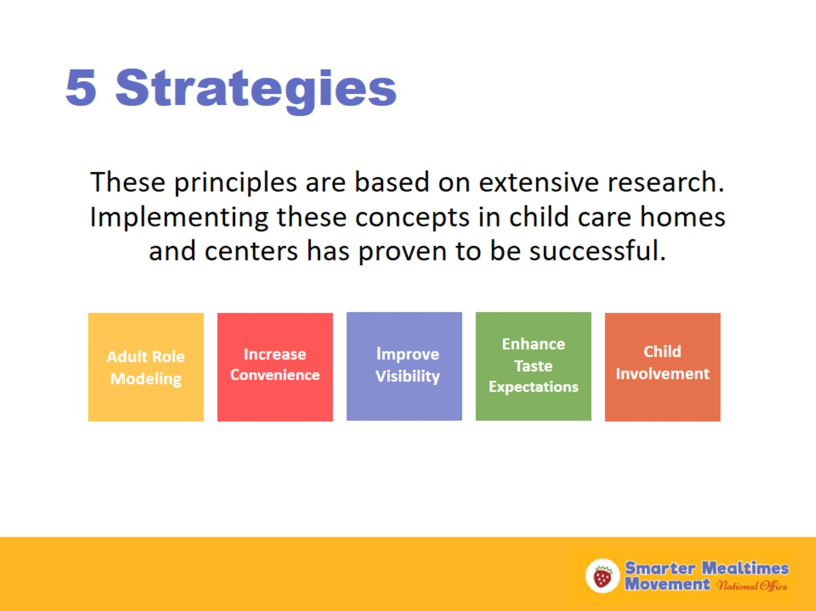
5 Strategies
Notes:
These are the 5 Smarter Mealtimes strategies. These core concepts are based on extensive research and have proven to be successful in a variety of child care settings—and even at home! I will talk about each of these strategies in more detail and provide some examples.

Slide 7
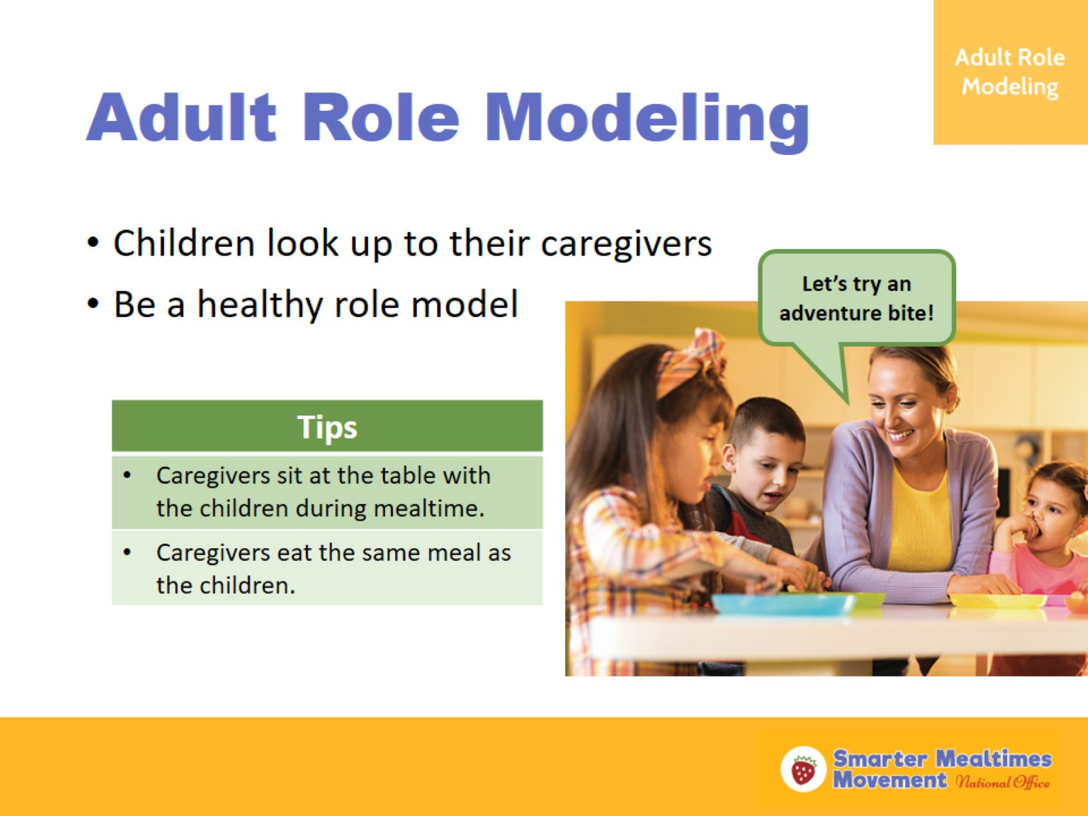
Adult Role Modeling
Notes:
Adult Role Modeling is the first strategy.
Whether or not you realize it, the kids in your care are learning from your behaviors as their caregiver. When the caregiver says they like to eat something, the kids are more likely to try it. On the other spectrum, if a child sees that their caregiver is not willing to try a food, they are less likely to want to try it. When kids see their caregiver consuming less healthy foods, the child is more likely to desire those foods. This is why it is important that caregivers are conscious of their eating behaviors and what they say about foods around children.
Here are some tips to keep in mind:
Caregivers should sit at the table with the children during mealtime. Mealtime is an important opportunity for caregivers to model healthy and positive mealtime behaviors. If they are not sitting at the table, caregivers are not able to model these behaviors. While sitting with the children at mealtime, it is important that caregivers used positive language to promote healthy choices to the children. For example, using the term “adventure bites” instead of “no thank you bites” is a more positive framework to encourage a child to try a bite of a food. We usually say “no thank you” to things we know we don’t want or like—we don’t want the kids to assume they don’t want or like a food without trying it first.
Caregivers should eat the same meal or at least some components of the same meal as the children. In one study, when caregivers ate the same foods at the table with the children in their care, the children ate more vegetables. If a caregiver has a health condition or a personal dietary practice that limits them from eating certain foods offered at mealtime, it is okay if they only eat some of the foods offered at mealtime. Caregivers don’t need to eat a full portion of the foods offered, either—eating one or two bites of each item is enough to model healthy eating to the children. However, caregivers can model appropriate portion sizes by putting the minimum portion size of food items on their plate. Caregivers can also model the appropriate behavior for trying a new or unfamiliar food. Teaching children how to spit food out into a napkin if they don’t like something they try is an important lesson. Kids feel safer about trying foods if they know they can politely spit out what they don’t like.

Slide 8
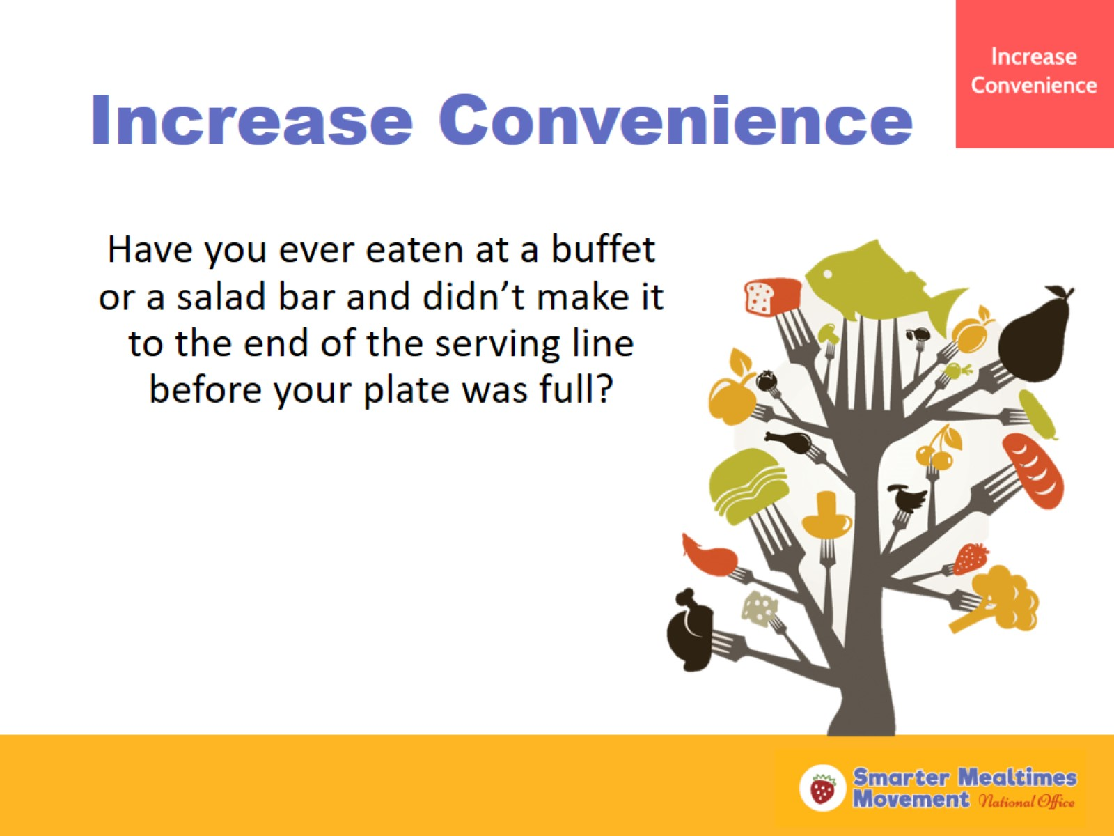
Increase Convenience
Notes:
Increase Convenience is the next strategy.
Think of the last time you ate at a buffet or a salad bar (read the question on the slide).
(Ask participants to share their experiences.)
Why do you think this happens? (Ask a couple participants to share what they think.)
Researchers at Cornell have looked into this phenomena to understand how people behave in self-serve dinning situations.

Slide 9
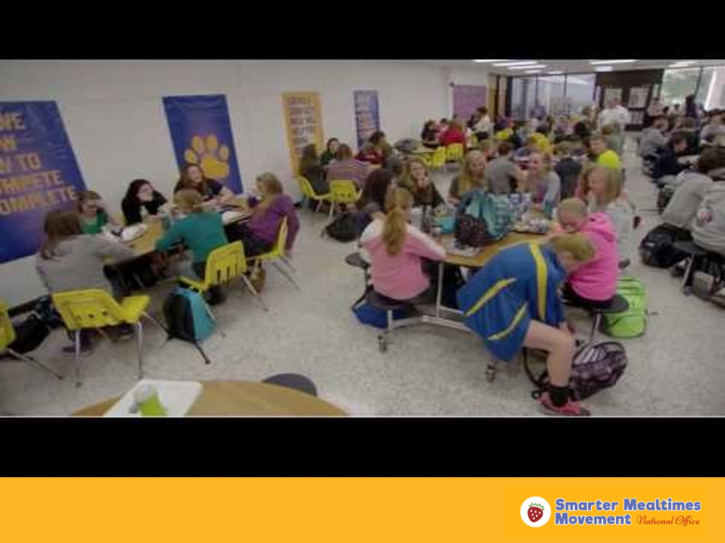
Buffet Video
Notes:
This video helps explain what Cornell discovered in their research. This video provides an example from the school setting, but we will discuss how this example applies to child care.
(Show video to group. Start the embedded video or upload the video on YouTube at https://www.youtube.com/watch?v=27RqzUbSQBE&spfreload=10)
As you saw in the video, people tend to take more of the foods they see first in self-serve dinning—even when they see the lighter foods first. Sometimes restaurant buffet lines are designed with the least expensive items first in the line and the most expensive items last. This is done to encourage people from taking more of the less expensive items and less of the more expensive items.
Now, let’s talk about how this applies to the child care setting.

Slide 10
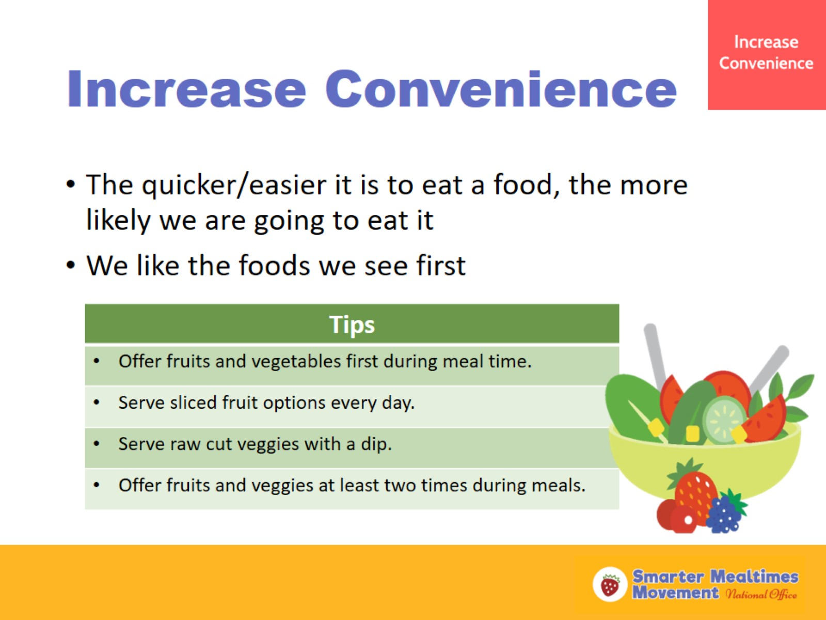
Increase Convenience
Notes:
At mealtime in child care, we want to make sure that the first items our kids are exposed to during meals are the ones we want to promote the most. For example, fruits and vegetables are often times the foods we need to promote more at mealtime. During family-style meals, pass around the fruit and vegetable options first at mealtime to encourage selection.
Offering sliced or cut fruit options has been shown to increase consumption of fruit in small children—avoid serving fruit and vegetables that are difficult for small children to physically handle and eat. Raw vegetables are often dry, have a crunchy texture, and can be bitter to some children. Serving raw cut vegetables with a dip can help make vegetables physically easier to eat (raw vegetables can be try and have rough texture) and encourage consumption. It’s okay to offer vegetables with a small portion of ranch or other dips, like hummus, plain yogurt, or nut and seed butters.
Offering fruits and vegetables a second time at the end of mealtime gives kids another opportunity to try them. Kids will often ask for seconds at mealtime when they still feel hungry. Offer seconds of fruits and vegetables first, especially when kids did not take a minimum portion size of fruits or vegetables on the first go around.

Slide 11
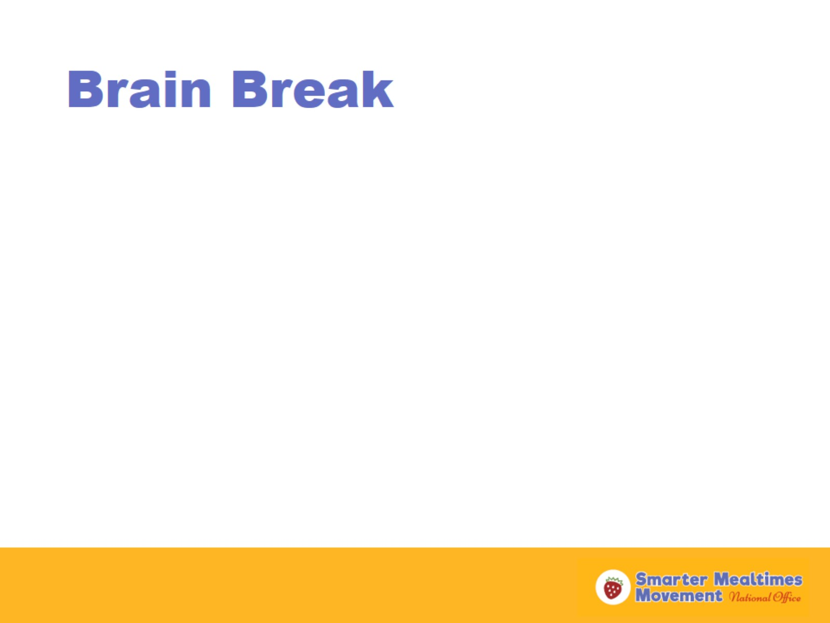
Brain Break
Notes:
Activity options:
Human rainstorm: Ask participants to rub hands, snap fingers, pat legs, stomp feet—10 seconds each, then reverse. This mimics the sound of a rainstorm. This works best for groups of 20 or more people.
Arm spelling: Stand up. Spell a place with your right arm then a person/food with your left arm—dream vacation (place and person to bring), favorite restaurant (place and food on menu)
Other activity (should be less than 5 minutes)

Slide 12
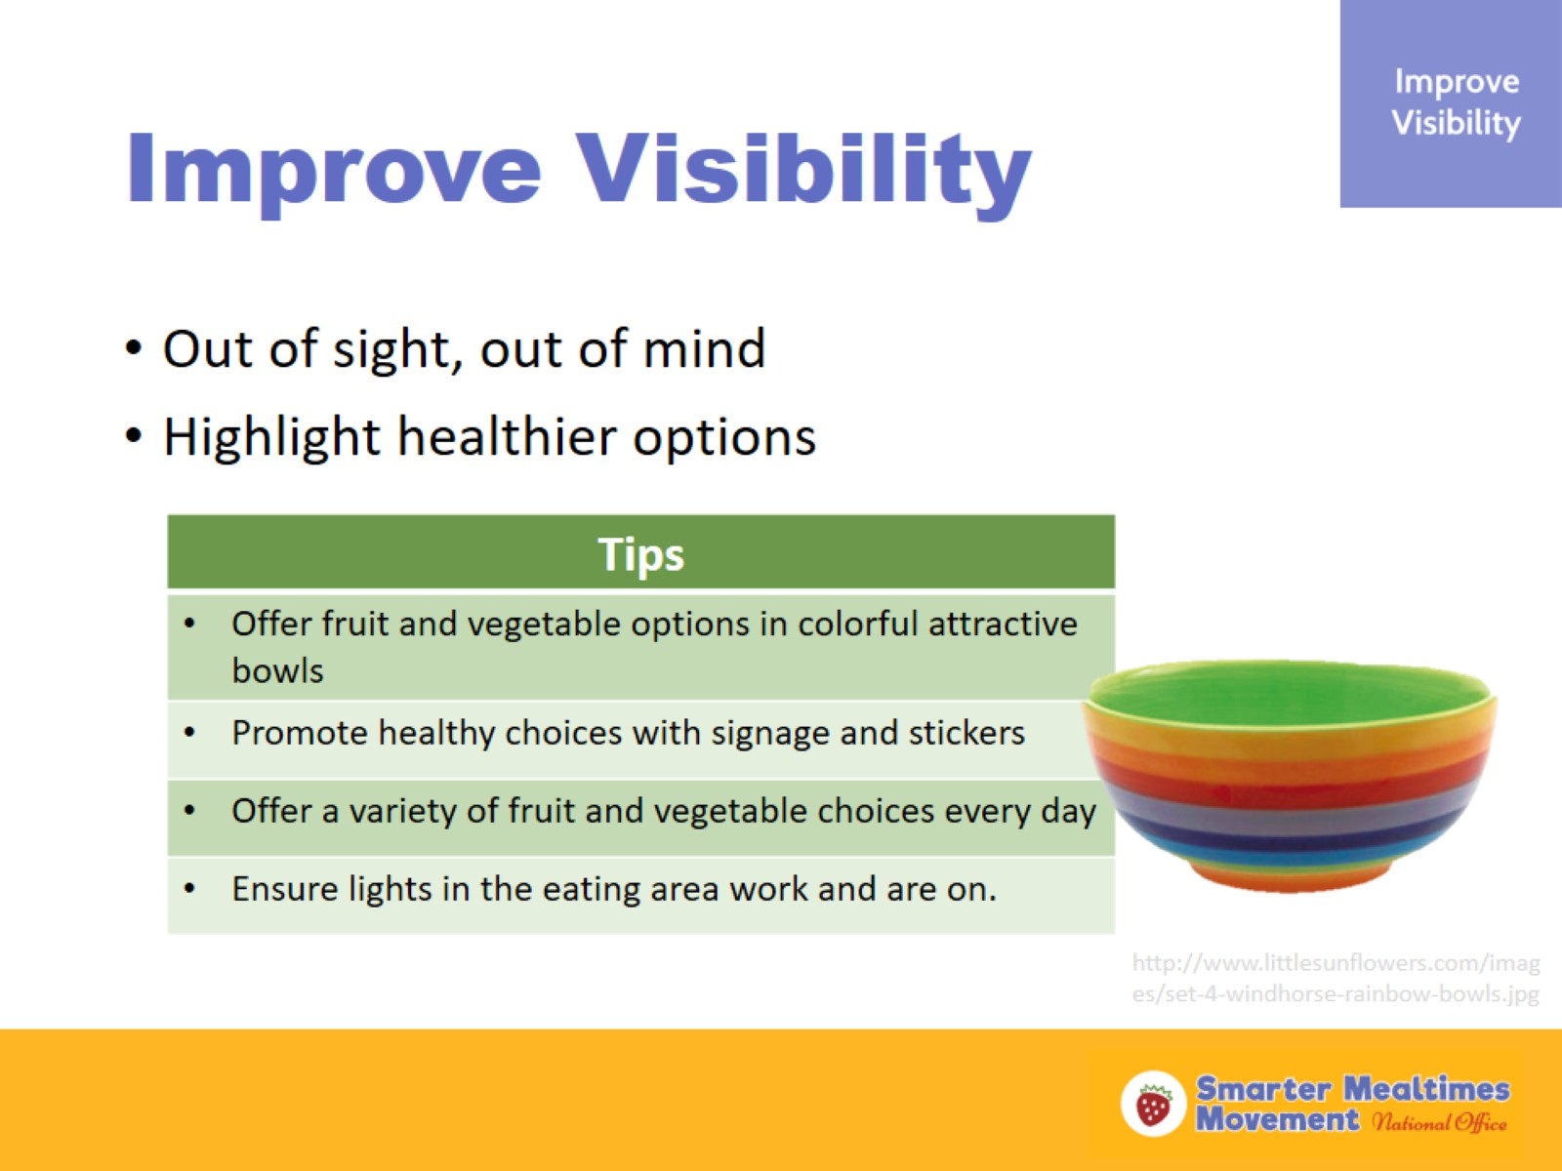
Improve Visibility
Notes:
If foods are out of sight, we are less likely to think about them or desire them. Have you ever tried hiding snacks and treats on the top shelf in your cupboard or a place in your kitchen you rarely look? Try this at home—you will probably start eating less of these foods. The opposite will happen if you put a bowl of fruit on your home kitchen counter. You and your family might start eating more fruit. We are easily influenced by visual cues!
When you highlight fruit and vegetable offerings with a colorful and/or decorative bowl, kids are more likely to notice and desire those offerings. Think about the cereal isle in the grocery store—what do you notice at kid eye-level? Usually there are colorful boxes with cartoon characters in the design. This marketing style is used on a variety of foods marketed to children and it works. Kids are attracted to foods with colorful packaging and cartoon caracters.
By making healthy foods a visual part of the learning and mealtime environment, you can make healthy foods a norm for the children in your care. With signage depicting healthy foods posted on the walls and other surfaces, kids will get frequent cues about healthy foods and are more likely to make those healthy choices on their own.
Stickers that include popular characters can also catch the eyes of small children. Offer a sticker with fruit and vegetable options to encourage selection.
Kids like having choices. Offering at least two different fruits and two different vegetables at mealtime can increase children’s selection and consumption of fruits and vegetables.
Lighting in the mealtime environment is connected with the choices we make. People tend to make less healthy choices when they eat in dimly lit rooms. Bright light triggers more consciousness in our food choices. Make sure the lights in your eating area are functioning and on during meals.

Slide 13
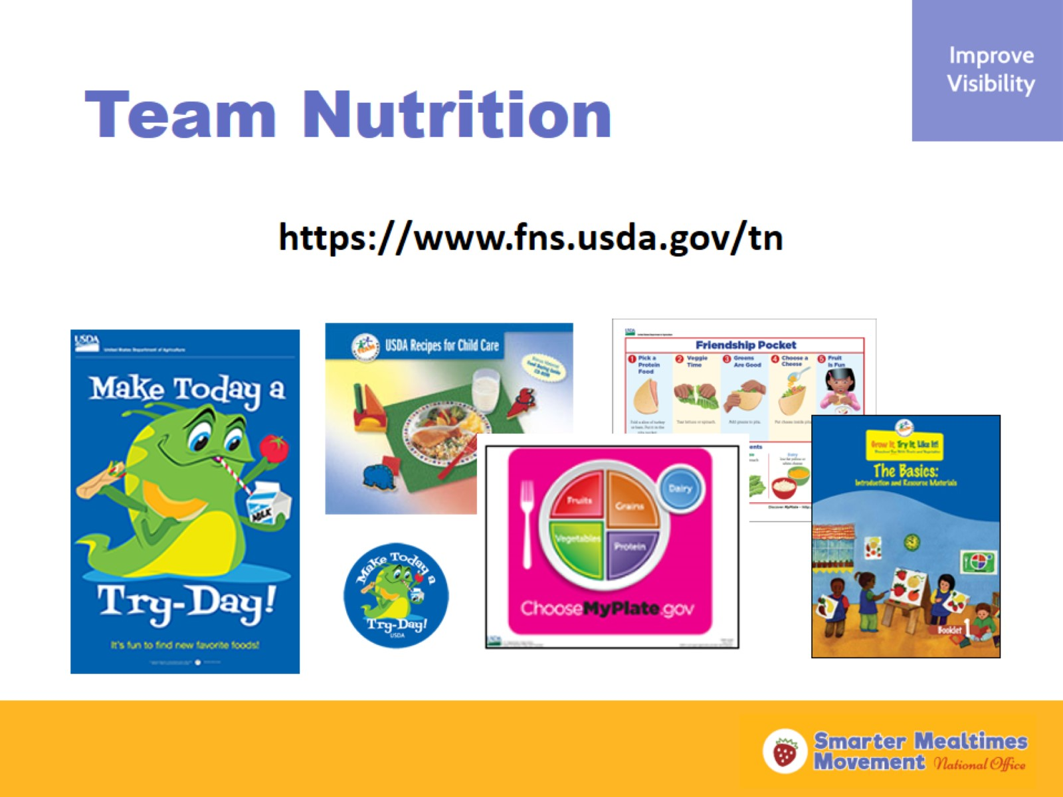
Team Nutrition
Notes:
How many of you have used the Team Nutrition resources in the past? (Ask for a raise of hands)
Team Nutrition materials are free for child care providers and school nutrition services staff to order online. I am going to show you all how to access these materials and order them online.
(Pull up the Team Nutrition webpage on the screen. Show participants how to access the free resources in the Resource Library and how to order materials through the Resource Order Form.)

Slide 14
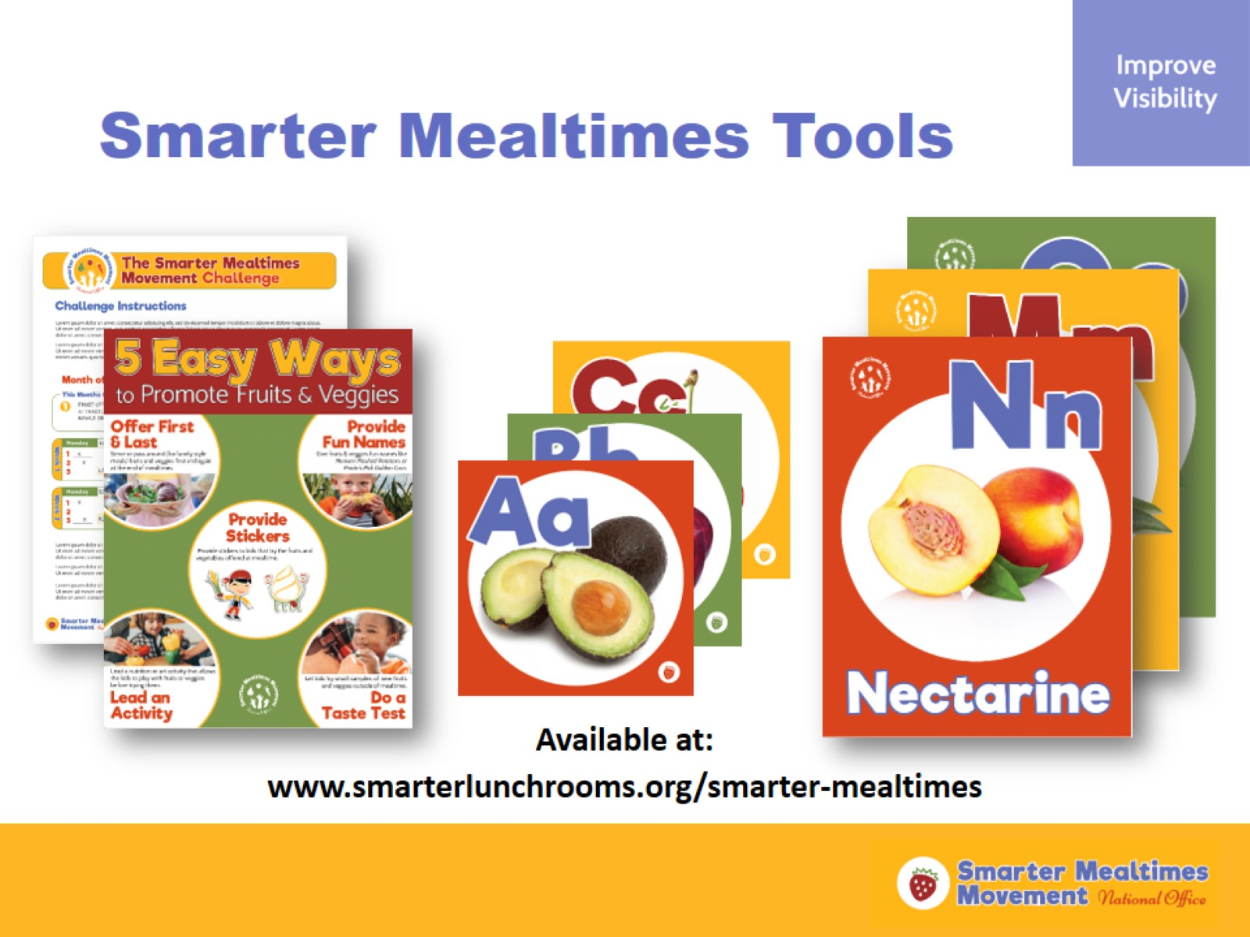
Smarter Mealtimes Tools
Notes:
Some resources were developed by the Cornell BEN Center and Washington Team Nutrition to make Smarter Mealtimes even easier to create. Here is how you can access these materials shown here, and many more:
www.smarterlunchrooms.org/smarter-mealtimes
(Pull up the Smarter Mealtimes webpage on the screen. Show participants how to access the Smarter Mealtimes Tools. Briefly describe some of the available materials, such as the ABCs Fruit and Veggie Posters.)

Slide 15
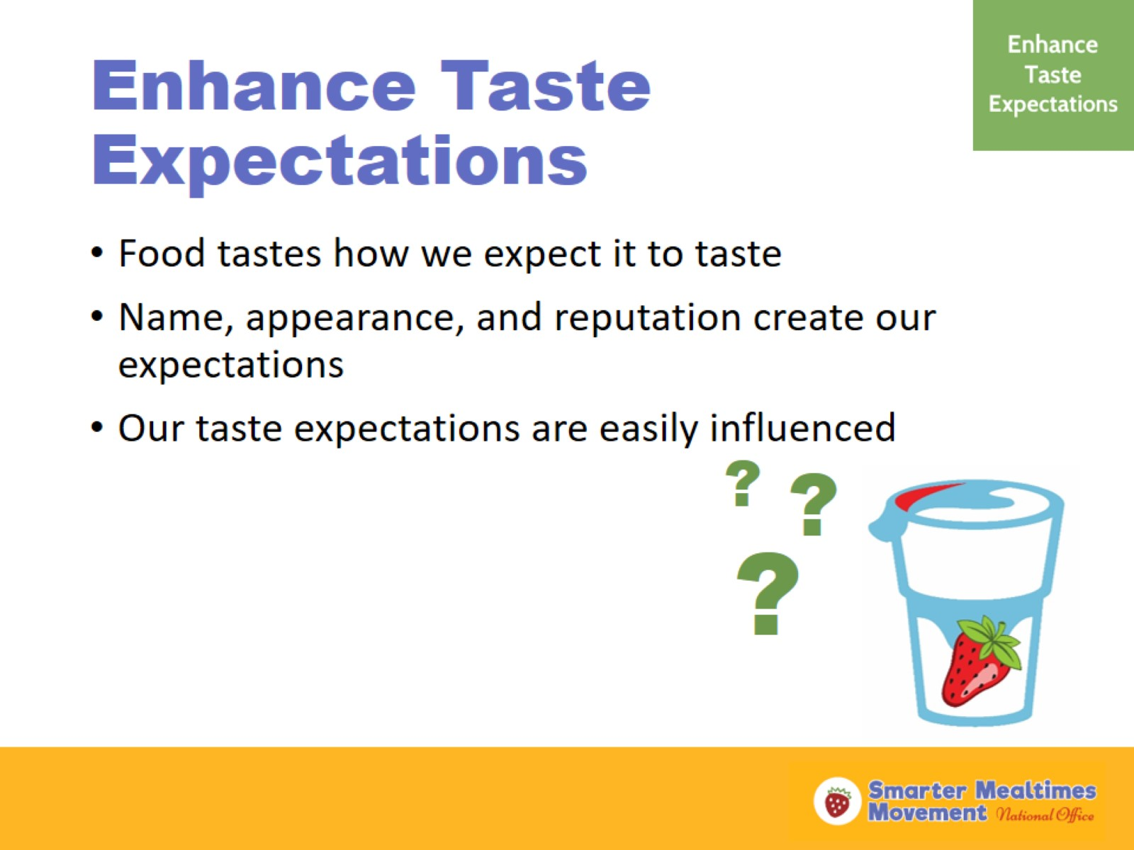
Enhance Taste Expectations
Notes:
Food tastes how we expect it to taste. Our expectations about food are very easily influenced by our environment. For example, the name of a food, its appearance, and its reputation might impact how we expect a food to taste.
A study was conducted by Cornell which shows us just how easily our expectations about a food can be influenced. College students were invited to a strawberry yogurt taste test. The students were blindfolded and given multiple samples of strawberry yogurt and asked to rank the strength of the strawberry flavor. At the end of the taste test, the blindfolds were removed and the participants were shown that what they were eating was not strawberry yogurt—it was chocolate flavored yogurt and had no strawberry flavor whatsoever. However, all of the participants were convinced that they actually tasted strawberry flavor when they ate the yogurt. Simply by expecting the yogurt to taste like strawberry, the participants actually tasted strawberry.

Slide 16
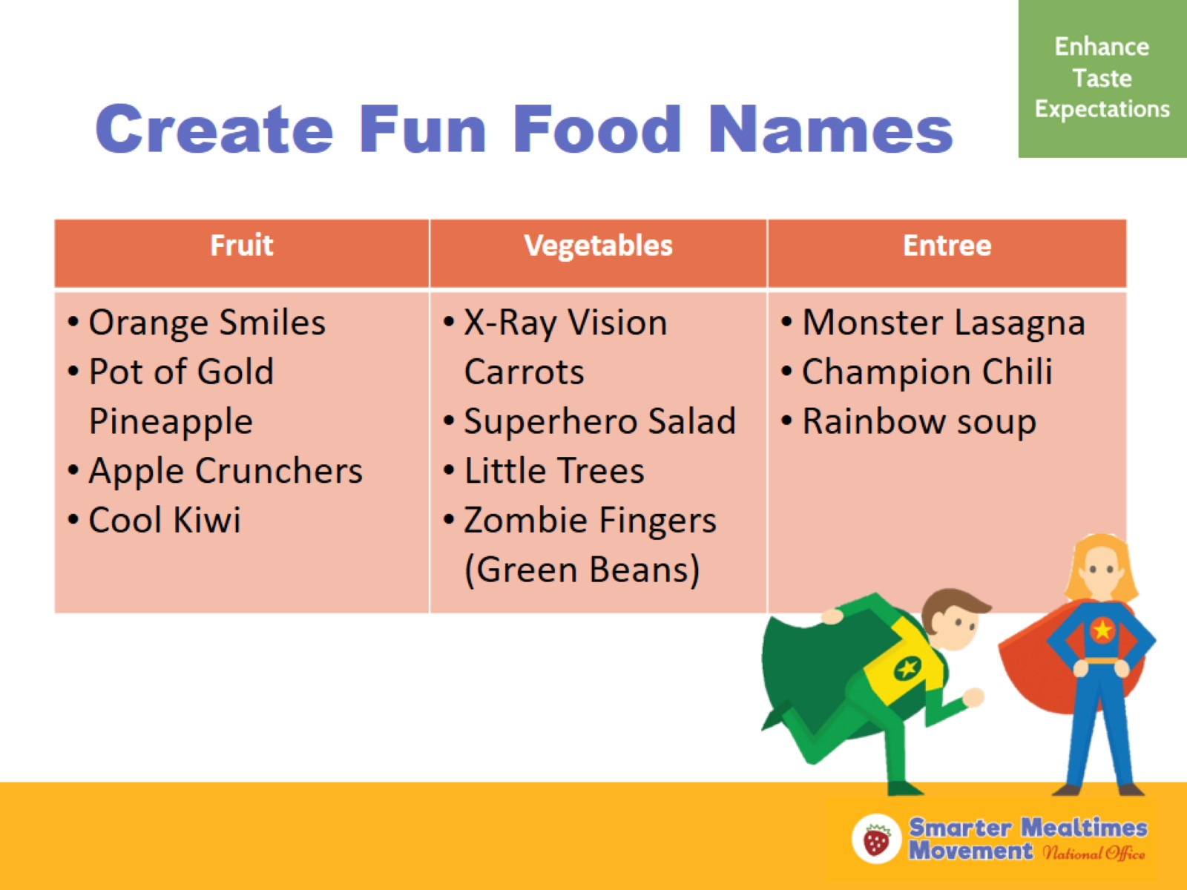
Create Fun Food Names
Notes:
This concept can be applied to the child care setting by simply providing fun names to menu offerings. Kids are more drawn to foods with fun, playful names. For example, tell the kids “We are having x-ray vision carrots today” instead of saying just “carrots.” This alone will get the kids more excited to try the carrots at mealtime. Use this strategy to encourage kids to try the foods that may be less familiar to them. Maybe there is a new vegetable that is offered one day or a new dish the kids have never tried—use this as an opportunity to provide a fun name to the food item to encourage the kids to try it.

Slide 17
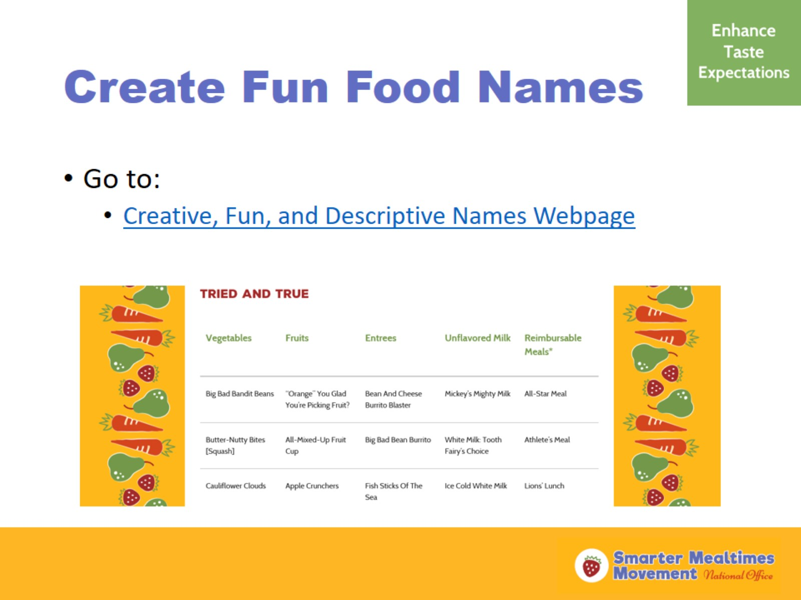
Create Fun Food Names
Notes:
(Show participants the “Descriptive Names” page on the Smarter Lunchrooms website (link on slide).)
Here is a list of fun food names created by others that might work in your program. This is a good place to start if you need some ideas for fun kid-approved food names.

Slide 18
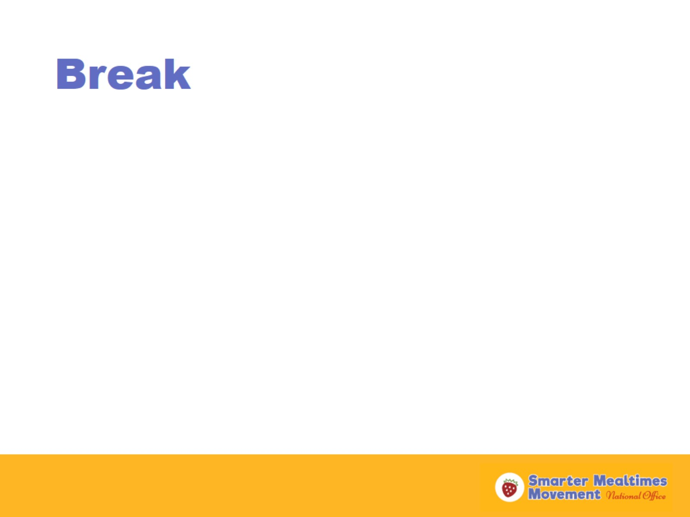
Break
Notes:
(Take a 5 minute break)

Slide 19
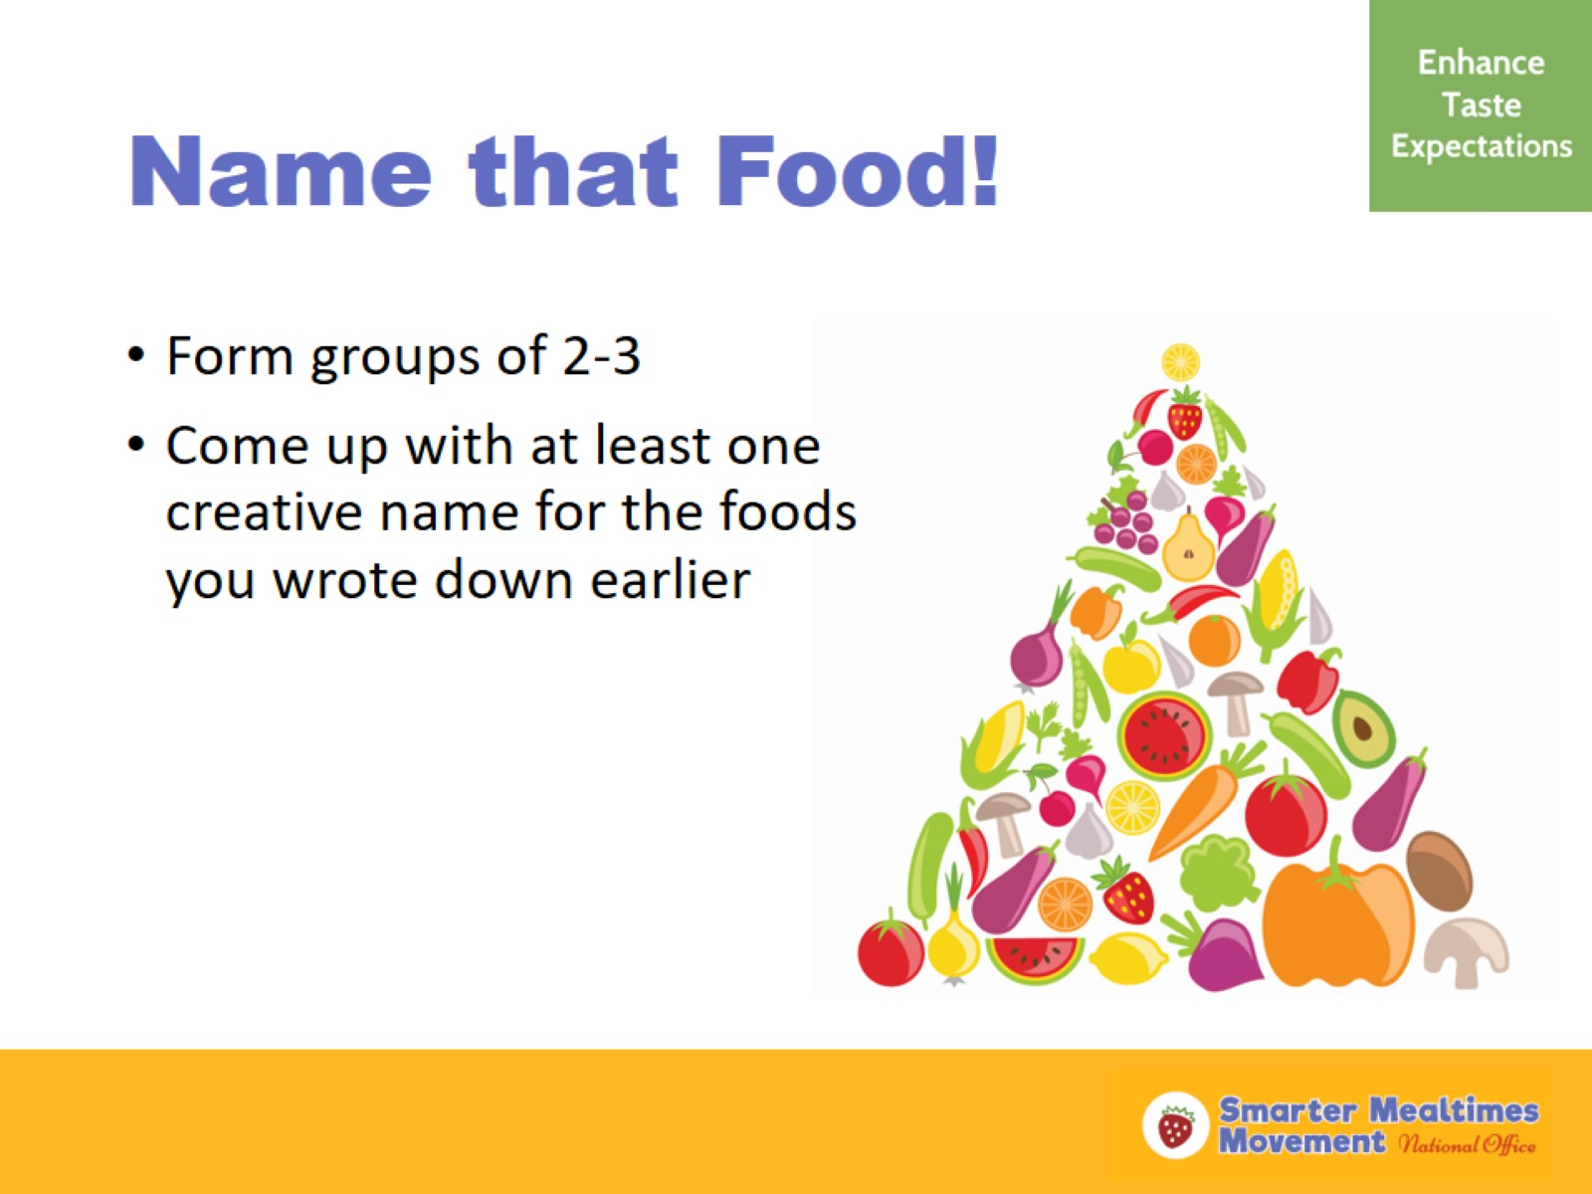
Name that Food!
Notes:
(Ask the participants to divide into groups of 2 -3. Give the groups 3 - 5 minutes to come up with creative names for the food items they identified at the beginning of the training (foods they want to promote better). Have each group stand up and share the creative fruit and vegetable names they came up with.)

Slide 20
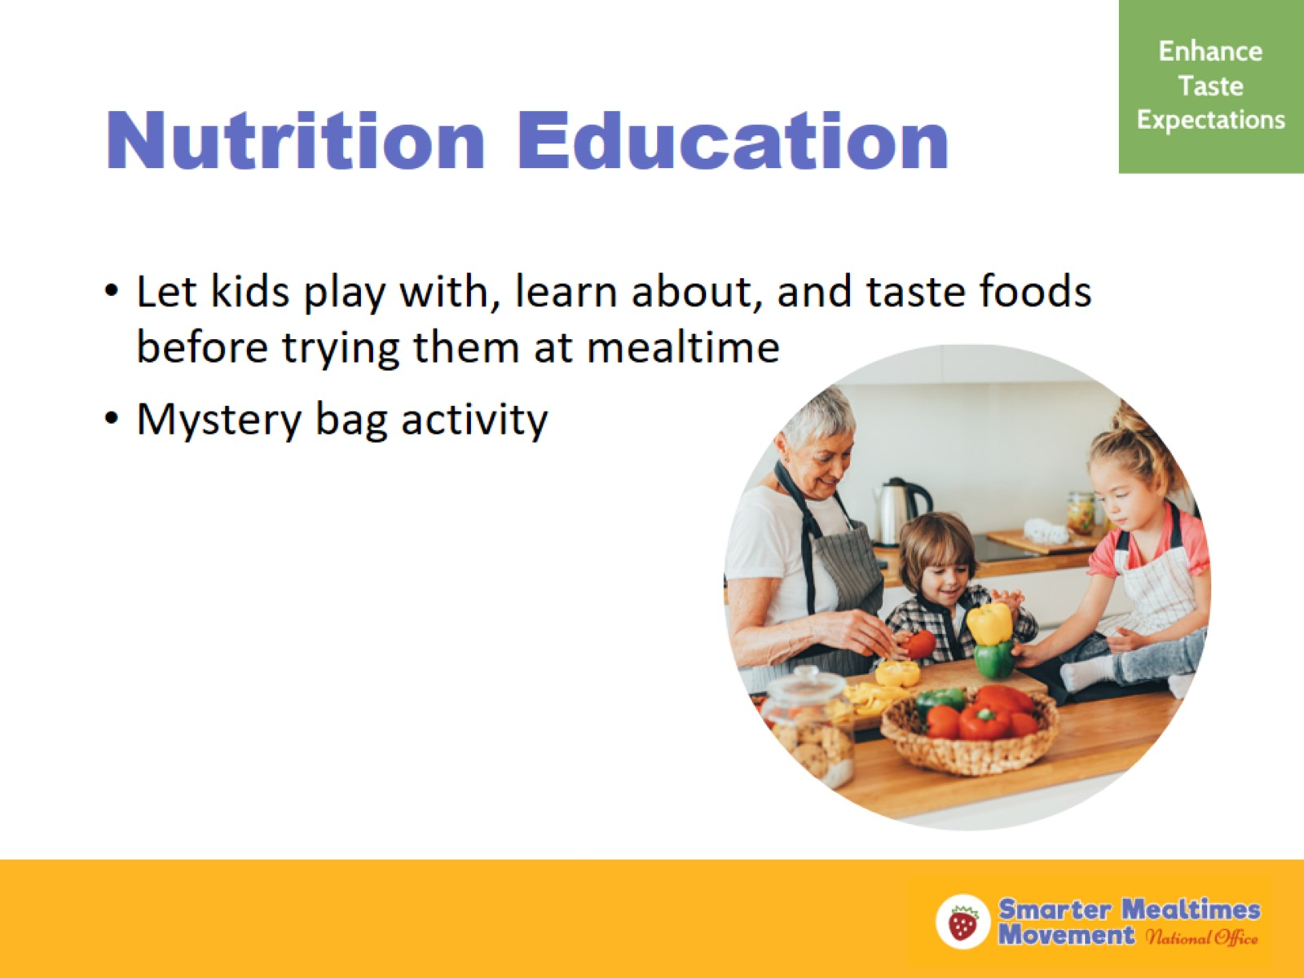
Nutrition Education
Notes:
Doing a fun activity involving a healthy food can get kids excited about trying the food and can enhance their taste expectations. Leading a nutrition lesson with preschoolers does not need to be challenging.
The mystery bag activity is a great simple way to introduce preschoolers to new fruits and vegetables. Leading this activity doesn’t require prior knowledge about nutrition. I am going to demonstrate this activity for you now.
(Ask for three volunteers to join you at the front of the classroom. Show the volunteers and the rest of the participants the mystery bag (see instructions for mystery bag below). Explain that there is a surprise fruit or vegetable in the bag and they will need to work together to figure out what it is. Ask the volunteers to reach inside the bag with out peeking and say a word that describes how the fruit or vegetable feels. After every volunteer has had a turn, ask the rest of the training participants to guess what they think the fruit or vegetable is based on the descriptions given by the volunteers. Explain that if you do this activity with preschoolers, you should let every child in the class reach inside the mystery bag and describe how it feels, then as a class, guess what the fruit or vegetable may be. You should prompt young children with descriptive words they can use. For example, ask, ”Is it bumpy or is it smooth?” or “Is it soft or is it rough?”)
(Reveal the mystery fruit or vegetable and ask the group if anyone knows what it is. Say what it is to the group. Ask the class to say what color it is. Ask if they think it is a fruit or a vegetable. Have a couple of fun facts about the mystery fruit or vegetable, such as how it grows or that it helps our body grow and be healthy when we eat it. Thank the volunteers for helping with the activity and allow them to sit back down.)
After reveling the mystery fruit or vegetable, you could enhance the activity by then allowing the children to explore the fruit or vegetable further. For example, you could pass the fruit or vegetable around again so that the kids can look at and feel the food at the same time. You might cut the fruit and vegetable open so that the kids can see what it looks like on the inside.
If you are able, the end of this activity would be a great opportunity to do a taste test of the fruit or vegetable being discussed. Give each child a small sample of the fruit or vegetable and a low-fat dip for raw vegetables. Ask the kids to describe what the item tastes like.
This activity is highly successful with getting kids excited to try new foods. When kids have the opportunity to experience foods in different ways (not just by taste) outside of mealtime,
Mystery Bag: You can use a drawstring bag (can be found at the dollar store), an empty pillowcase with a drawstring, or a shoe box with a hole cut out large enough for small hands to reach inside. If you want, draw or paint question marks on the outside of the bag or box.

Slide 21
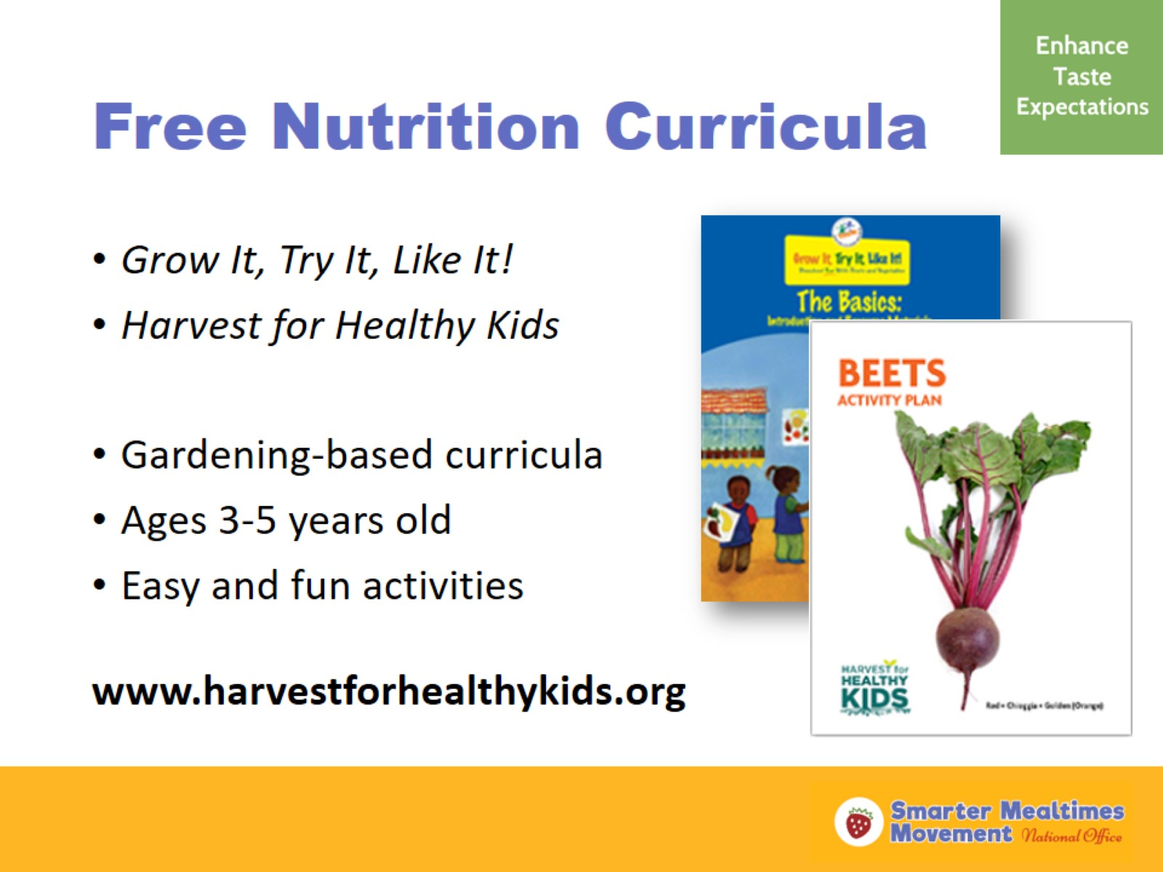
Free Nutrition Curricula
Notes:
The mystery bag activity is part of the Grow It, Try It, Like It! gardening-based curriculum for preschoolers. This is a free resource available for free on the Team Nutrition website. Harvest for Healthy Kids is another free curriculum that focuses on fruits and vegetables designed for preschoolers. Check out both of these curricula for more simple, fun nutrition activities you can use in your program.

Slide 22
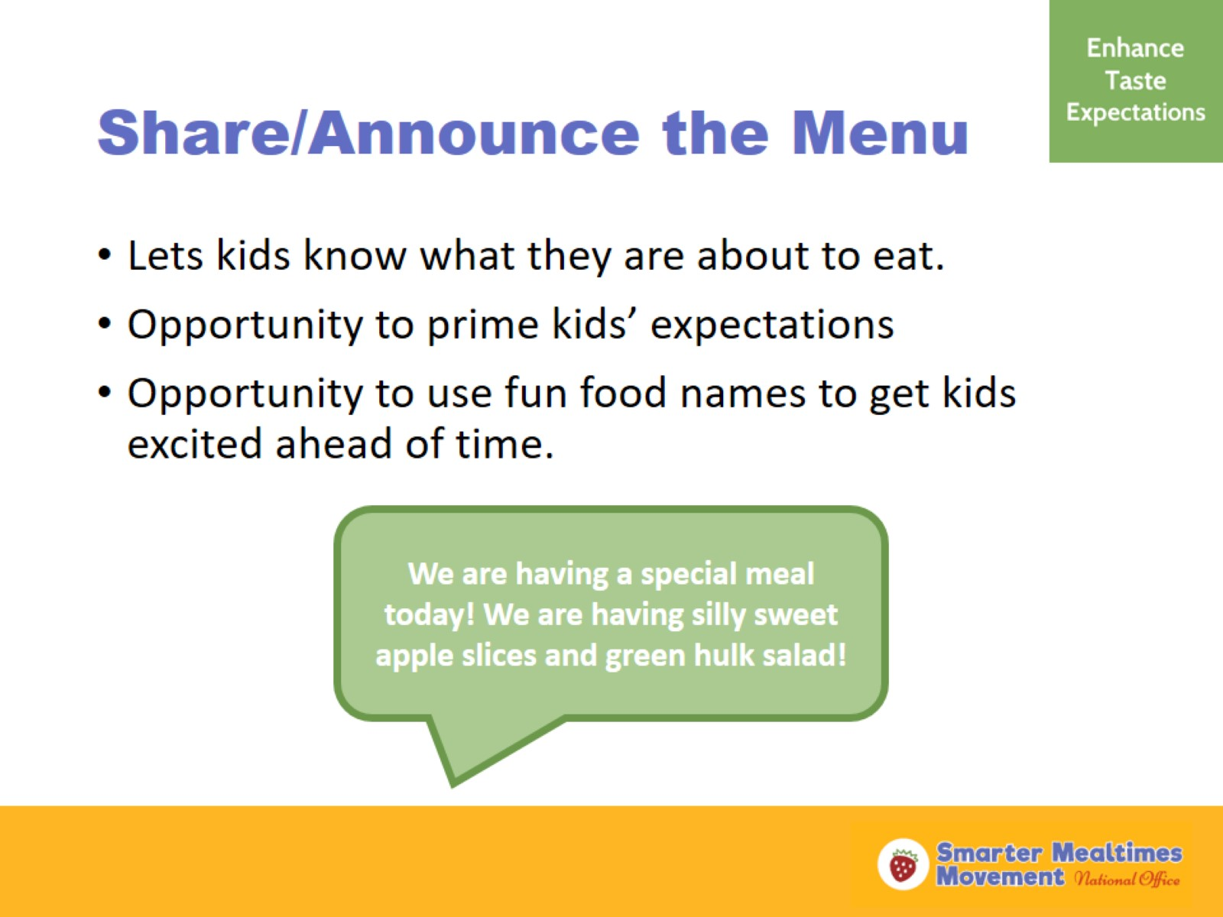
Share/Announce the Menu
Notes:
Announcing the menu in daily routine lets kids know what to expect in today’s meal. You can use this opportunity to sway kids towards the fruits and veggies or other food items before the meal is even served. Talk positively about the meal the kids are about to enjoy and highlight items with fun food names to encourage kids to try them. Providing a printed or online monthly menu to families to view keeps them in the loop about the foods their child is eating in child care and gives them the opportunity to promote the future menu offerings to their child at home.

Slide 23
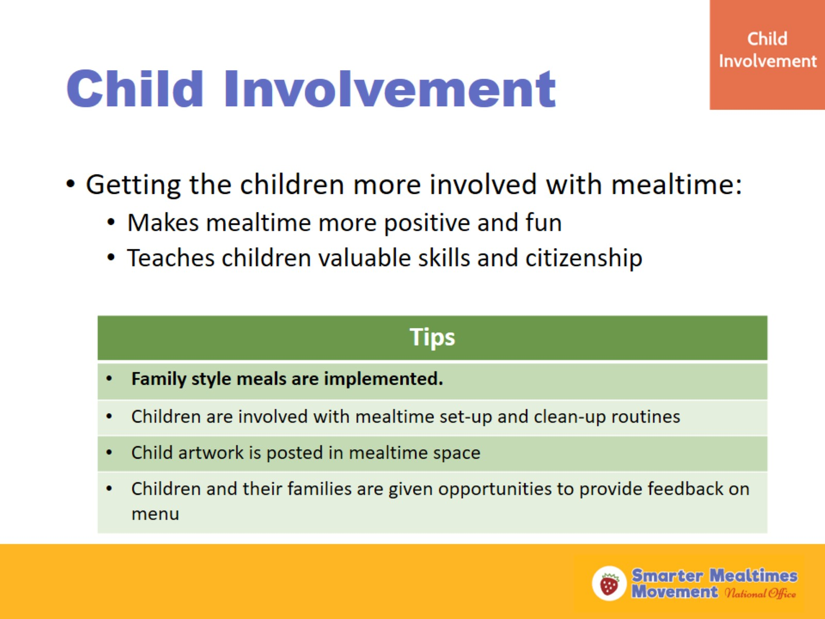
Child Involvement
Notes:
When you get the kids involved with mealtime, they learn practical skills and are more engaged around the healthy food offered at mealtime. Here are some tips: (read tips)
Family style meals are implemented.
Research has shown that having family style meals is a best practice in the child care setting. When children serve themselves at mealtime, they learn lessons of self-regulation and are more likely to eat what they put on their own plate than when an adult serves them.
Children are involved with mealtime set-up and clean-up routines
Children love helping at mealtime. Create child buy-in by assigning helper roles to interested kids at mealtime, including table setting and clean up responsibilities. Not only will this teach kids good citizenship and fine motor skills, but having a special role at mealtime also creates a more positive mealtime experience for a child. Happy kids are happier, more relaxed eaters.
Child artwork is posted in mealtime space
You can also create a happier, more inclusive mealtime environment by posting children’s artwork in the mealtime space. For example, you could use placemats that the children created in an arts and crafts activity as a functional table decoration the kids can use daily.
Children and their families are given opportunities to provide feedback on menu
Asking families for feedback has at least two major benefits—first, parents feel included in the planning of meals their child receives in child care; second, parents may provide beneficial feedback to help you improve your menu. For example, provide a short survey on the back of the menus you share with families and ask what they like about the menu and maybe one item they wish was on the menu. It’s also important to talk to the children about the foods served at mealtime. At the end of mealtime, take a couple minutes to ask the kids what their favorite part of the meal was today or allow kids the opportunity to vote on what vegetable choices they will have at lunch on Friday.

Slide 24
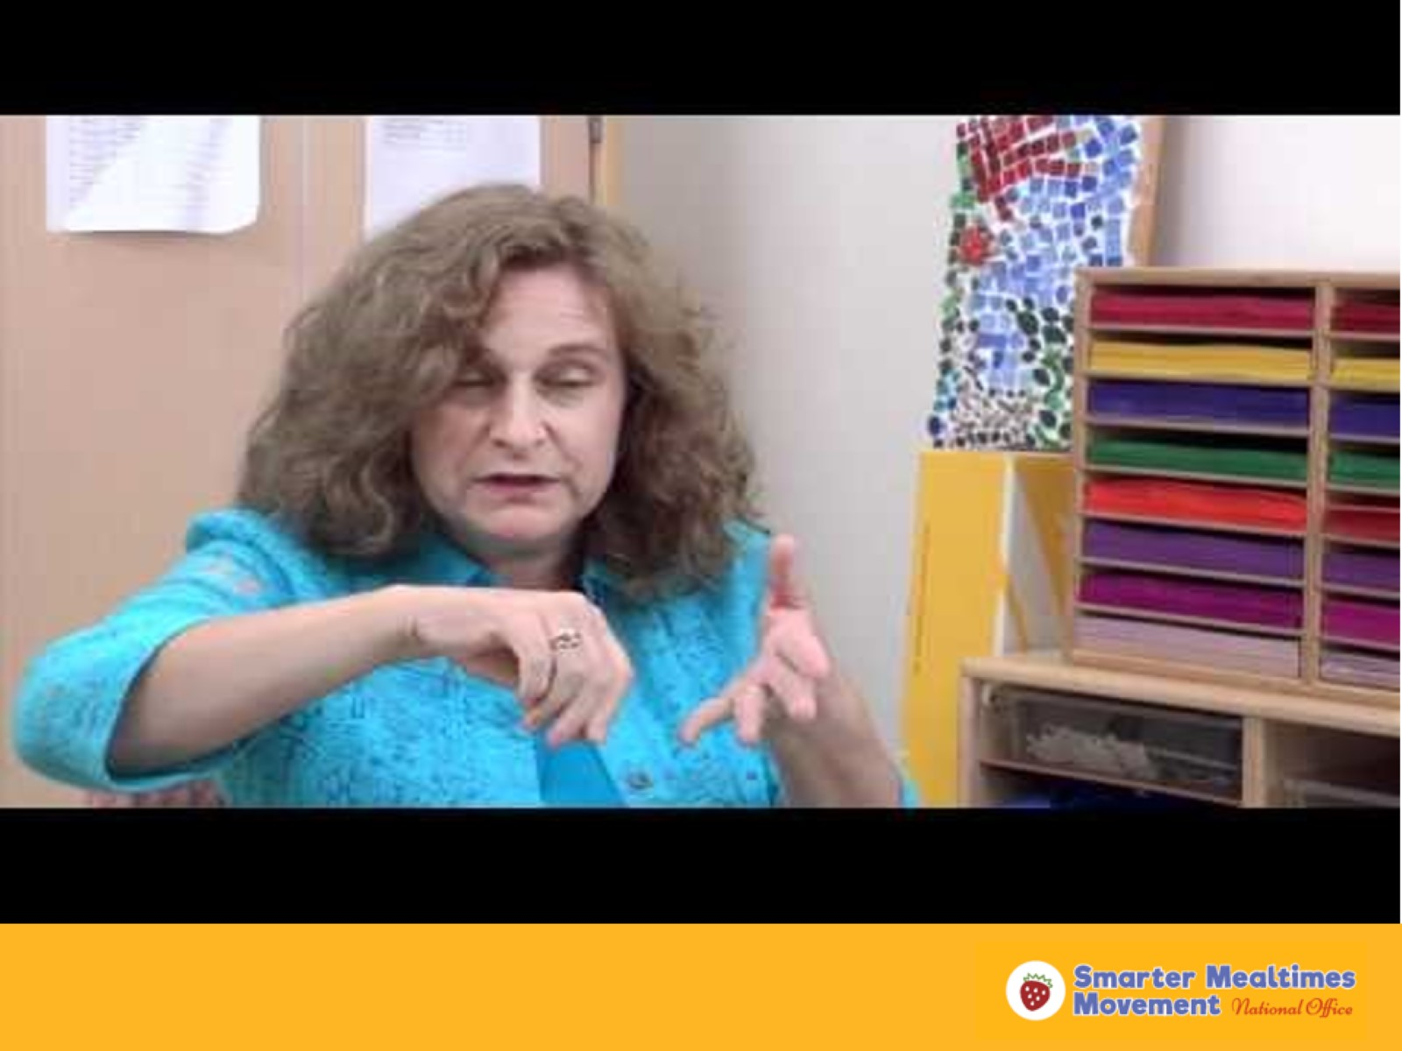
Family Style meals video
Notes:
Here is a video that demonstrates family style meals with 4-year-olds in a child care center setting. https://www.youtube.com/watch?v=rpwcKMgFoPg

Slide 25
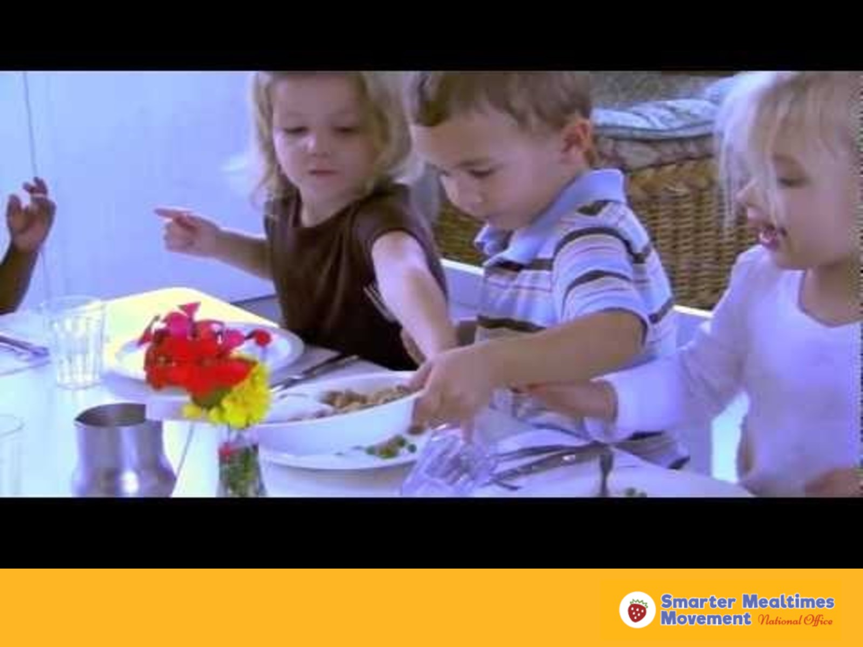
Family Style Meals video
Notes:
Here is a video that demonstrates family style meals with 2-year-olds in a child care center setting. https://www.youtube.com/watch?v=EIpanmnPhAg

Slide 26
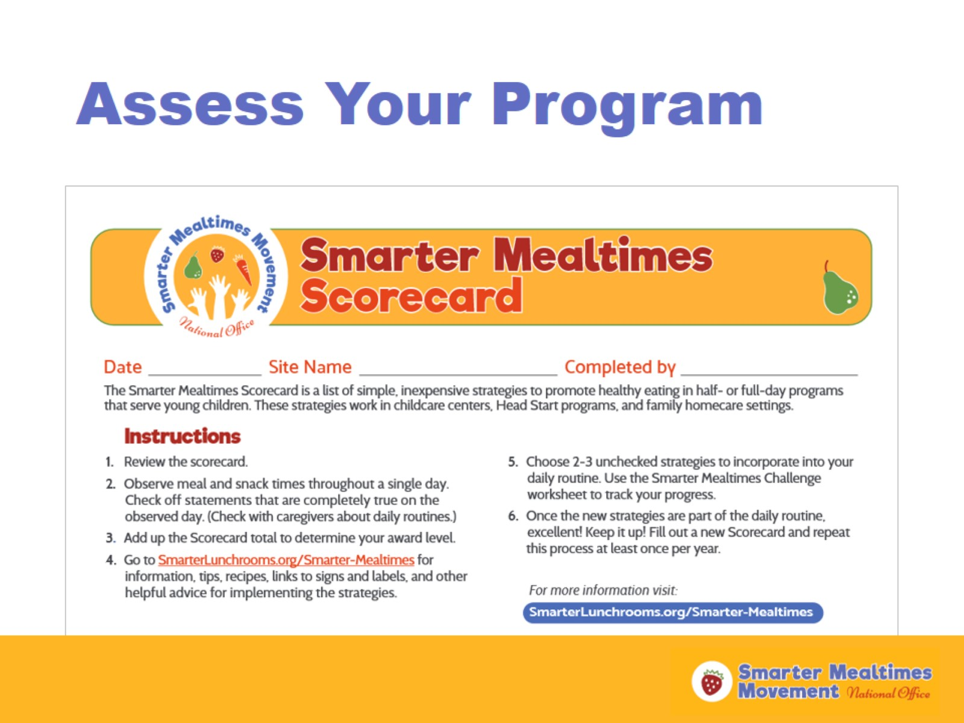
Assess Your Program
Notes:
Now that we have learned about all of the different Smarter Mealtimes Strategies, let’s talk about assessing your mealtime environments in child care. Each of you have received a copy of the Smarter Mealtimes Scorecard (passed out at the beginning of training). This scorecard contains a list of 20 evidence-based strategies that increase kids selection and consumption of healthy foods. Observe mealtime for one or more full meal period and check off the items that are taking place while you observe. Use the completed scorecard to see what you are doing well already and possible areas you could make improvements over time. Selecting 2-3 unchecked strategies to work on at a time is a best practice. Get the child care team involved with selecting what changes they want to work on. Reassess your program every year, or more frequently, by completing the scorecard again.

Slide 27
Questions?
Trainer Name
(555) 555-5555
traineremail@k12.us
Notes:
(Allow participants to ask questions.)
(This is a good place for the trainer to list their contact information or the contact information of a Smarter Mealtimes lead, if applicable.)

Slide 28

Thanks for Coming!

Slide 29
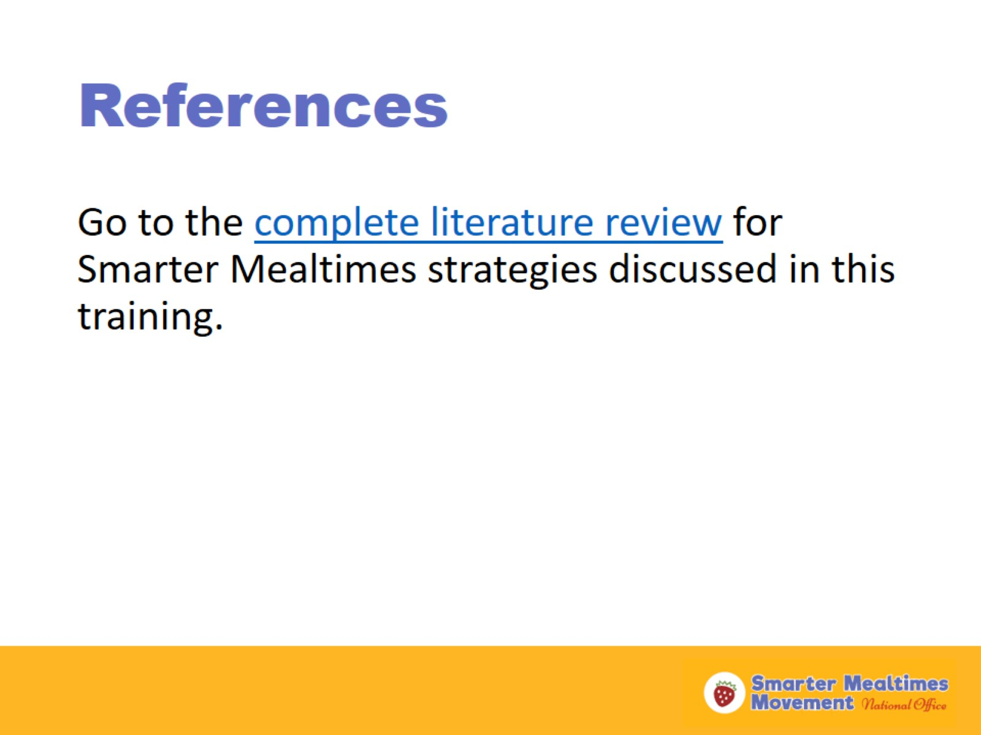
References

Slide 30
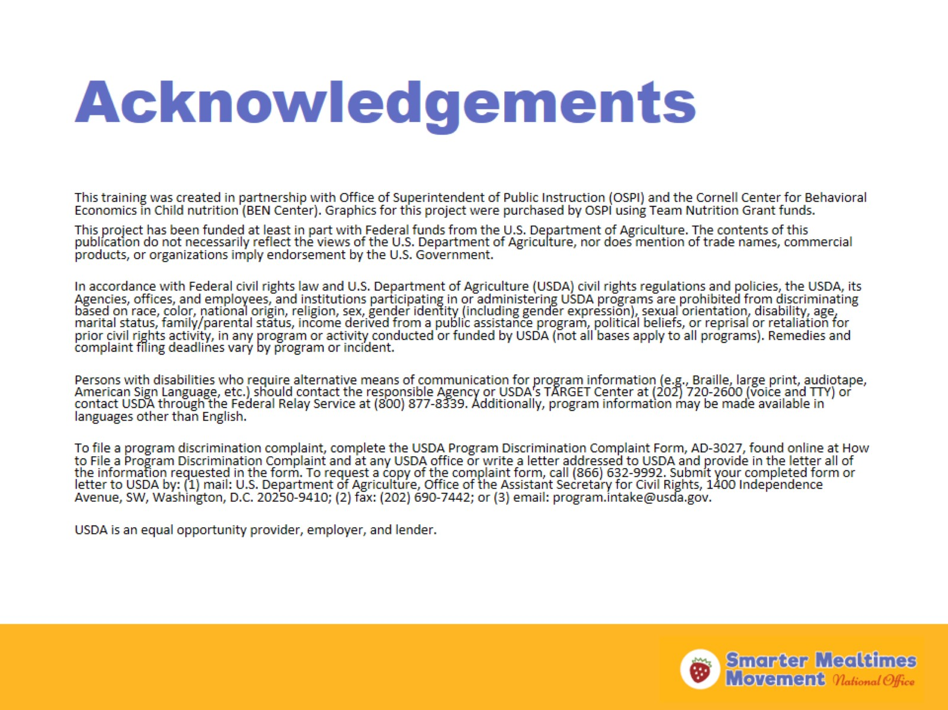
Acknowledgements

