Slide 1
Induction Leader Collaborative February 2024
BEST Grantees

Slide 2
Focus Topics for Today
Grantee Update(s)
Foundational Learning Updates/Refresh
In Person Pilot MA 101
SPED Supports- Defining Early Career Educator
Grantee Convening Spring 2025
EGMS Rollout May 2024
Questions to be asked?
Promising Practices – Patterns/Themes
ESAs
SPED- Supports
Content BEST Stakeholder Meetings
Questions/Collaboration
Notes:
What is next for BEST?
Program Focus - Maximize funds to Grantees, Build ESA Supports, Foundation Learning Refinement to meet current needs in BEST.
Topics and considerations surfaced at November Collaborative Conversation:
1. TPEP- Support to mentors in connection to student growth goals. What is BEST planning in support to the implementation?
2. Conditional Certs – What are supports offered by BEST and how might this group share promising practices? 3. CTE- Teachers from industry with less training- What supports are offered by BEST and what might be elevated?
4. Support to Building Leaders- Principals specifically
5. Affinity Groups
6. Models for Mentoring - How limited funds effect mentoring models.

Slide 3
Leader Introductions
Name
Grantee
Role – District/School
Notes:
Mike Esping, OSPI, Assistant Director BEST

Slide 4
Independent Review
Grant Support Progressions
Grant Assurances
OSPI BEST Website
Voices of teachers and mentors in BEST…
Events and Trainings OSPI BEST
Analysis Tool – New Teachers – Make a Copy
Notes:
During Independent Review… Contact Mike on OSPI Office Cell if you have any questions: 564-201-0982
Fall Site Visit Report Template - https://docs.google.com/document/d/1U6abF4_keDRYrAoFYnTpDlrufK99DFWX/edit?usp=drive_link&ouid=102268801347269265859&rtpof=true&sd=true
Definition of a Promising Practice:
A promising practice is a model, plan of action or initiative with evidence of effectiveness present in small-scale progression of implementation with the potential to generate actionable data that could assist in taking the practice to sale and generalizing the results to a broader set of educators and settings. Promising practices are not yet proven by the highest or strongest evidence but represent some data showing positive outcomes. (Adapted from National Association of Community Health Centers)

Slide 5
Definition of a Promising Practice:
Because this worked there and then, it might also work and be even better here, if…
Adapted from KESE, Nick Gillon, OSPI 12/7/2023
Notes:
A promising practice is a model, plan of action or initiative with evidence of effectiveness present in small-scale progression of implementation with the potential to generate actionable data that could assist in taking the practice to scale and generalizing the results to a broader set of educators and settings. Promising practices are not yet proven by the highest or strongest evidence but represent some data showing positive outcomes. (Adapted from National Association of Community Health Centers)

Slide 6
BEST Focus 2023-2024
What:
Foundational Learning Review/Refresh
ESAs- Provide, Build, Enhance and Extend
SPED- Enhance and Extend
Why:
Induction Stories- Promising Practices
How:
Grant Funding
Grant Assurances
Partnerships with Collaborators
Notes:
WEA, KESE, OSPI Departments
What is next for BEST?
Program Focus - Maximize funds to Grantees, Build ESA Supports, Foundation Learning Refinement to meet current needs in BEST.
Topics and considerations surfaced at November Collaborative Conversation:
1. TPEP- Support to mentors in connection to student growth goals. What is BEST planning in support to the implementation?
2. Conditional Certs – What are supports offered by BEST and how might this group share promising practices? 3. CTE- Teachers from industry with less training- What supports are offered by BEST and what might be elevated?
4. Support to Building Leaders- Principals specifically
5. Affinity Groups
6. Models for Mentoring - How limited funds effect mentoring models.

Slide 7
Standards for Beginning Induction - Effective Supports for Washington State Educators
Hiring
Orientation
Mentoring
Professional Learning
Feedback and Formative Assessment
Induction Program Assessment

Slide 8
What
What we do for Grantees and Induction Leaders, we do for Building Leaders, Mentors, and Mentees… and we do for our students served by the mosaic of support- BEST.
Notes:
Read Pages inductionstandards_final.pdf (ospi.k12.wa.us)
Page 1
Page 3-4
SPED Supports

Slide 9
Planning Forward - May/June
Ideas… Promising Practices
Define- SPED Early Career Educator
Planning Forward- May/June Promising Practices

Slide 10
BEST Grantee Convening March 2025
Input
Topics
Dates suggestions
In Person?
Grantee Reflections Input Opportunity (See page 7 for opportunity to add input)
Notes:
Grantee Reflections Input Opportunity https://docs.google.com/document/d/1gcSW0jGdj6lQki_Vf-aQex99-SAtdE_u/edit?usp=drive_link&ouid=102268801347269265859&rtpof=true&sd=true

Slide 11
Foundation Learning Workgroup
Current Foundational Learning- All available online:
Mentor Academy 101 12 hours
Mentor Academy 201 12 hours
Observation and Feedback 6 Hours
What is working? What should be enhanced/expanded? Why?
Foundational Learning Input Opportunity (see page 8 for space to add input)

Slide 12
Thank you!
What was helpful today? What do you need more of? What was absent that can be of support to your work?

Slide 13
KESE
Keeping Exceptional Special Educators
Initial Recommendations and District Strategies
Last updated: October 17, 2023
Notes:
Nick

Slide 14
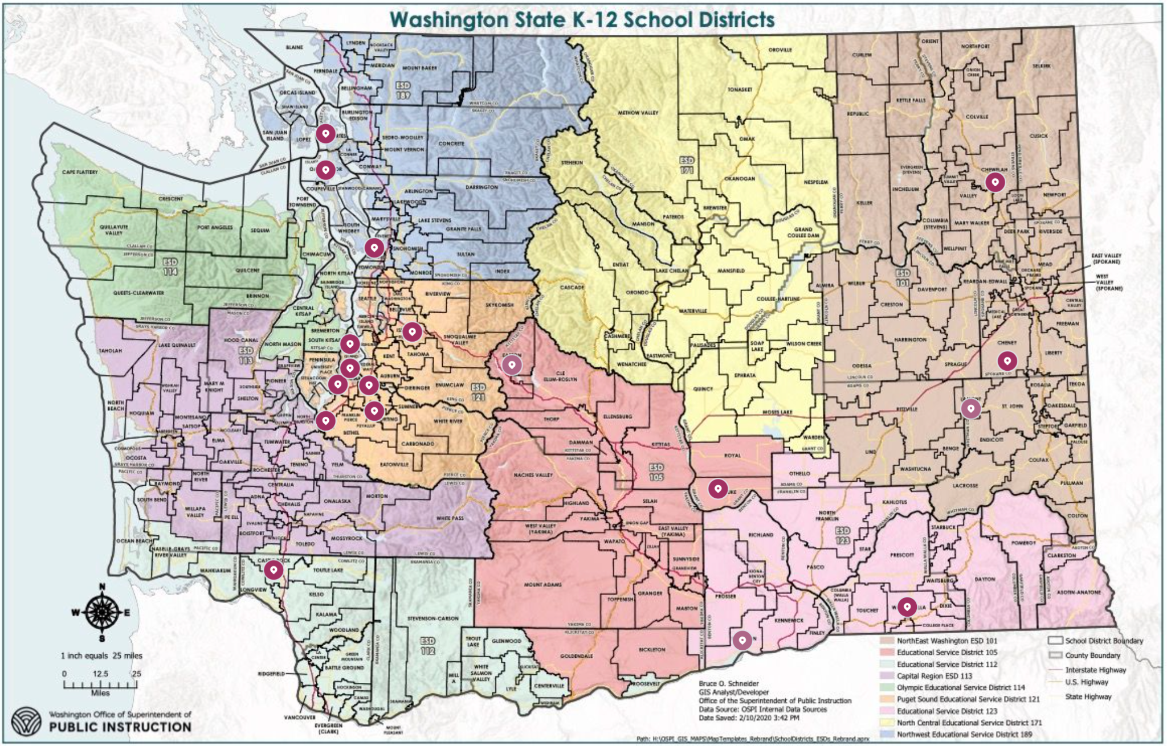
Statewide Recruitment and Retention Planning
https://view.genial.ly/63ed667c3b4e0e001150a10c/presentation-kese-title-iia-grant-partner-map
Notes:
Nick

Slide 15
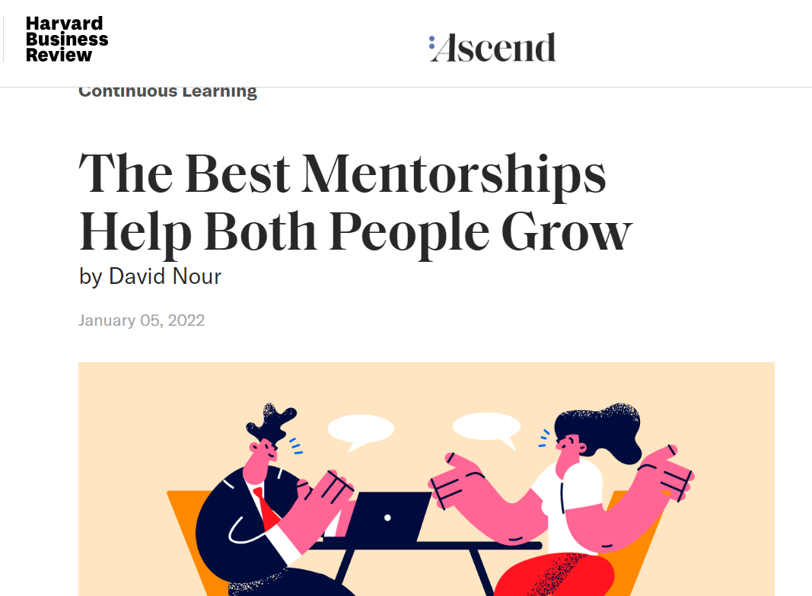
What does this mean to you?
Notes:
The Best Mentorships Help Both People Grow (hbr.org)

