Slide 1
Pre-Bid Conference Request for Qualifications 2024-13 Continuous Improvement Partners
March 12, 2024
Liza Hartlyn, OSSI
Mary Adams, OSSI

Slide 2
Purpose
To provide background for and summarize Office of Superintendent of Public Instruction’s RFQ 2024-13 for the Continuous Improvement Partner position
Audience
Experienced education leaders and coaches interested in contracting with OSPI as a Continuous Improvement Partner for the 2024-2025 school year

Slide 3
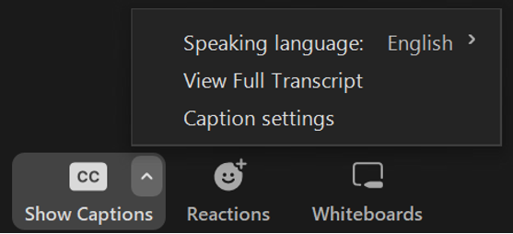
Closed Captions are Available!
Options can be found in the Captions button options menu in the Zoom toolbar.

Slide 4
Tribal Land Acknowledgement
I would like to acknowledge the Indigenous people who have stewarded this land since time immemorial and who still inhabit the area today, the Steh-Chass Band of Indigenous people of the Squaxin Island Tribe.

Slide 5
All students prepared for post-secondary pathways, careers, and civic engagement.
Vision
Mission
Transform K–12 education to a system that is centered on closing opportunity gaps and is characterized by high expectations for all students and educators. We achieve this by developing equity- based policies and supports that empower educators, families, and communities.
Values
Ensuring Equity
Collaboration and Service
Achieving Excellence through Continuous Improvement
Focus on the Whole Child

Slide 6
Equity Statement
Each student, family, and community possesses strengths and cultural knowledge that benefits their peers, educators, and schools.
Ensuring educational equity:
Goes beyond equality; it requires education leaders to examine the ways current policies and practices result in disparate outcomes for our students of color, students living in poverty, students receiving special education and English Learner services, students who identify as LGBTQ+, and highly mobile student populations.
Requires education leaders to develop an understanding of historical contexts; engage students, families, and community representatives as partners in decision-making; and actively dismantle systemic barriers, replacing them with policies and practices that ensure all students have access to the instruction and support they need to succeed in our schools.

Slide 7
Disclaimer
All oral and written communications will be considered unofficial and non-binding on Washington State Department of Enterprise Services (DES). Should bidders rely on any other communication, including statements made by state employees other than the Procurement Coordinator, they do so at their own risk and expense. Bidders should only rely on written amendments issued via Washington’s Electronic Business Solution (WEBS).

Slide 8
All Questions/Communications pertaining to RFQ:
Name: | Kyla Moore
Address: | 600 Washington Street South P.O. Box 47200 Olympia, WA 98504-7200
Email Address: | contracts@k12.wa.us

Slide 9
Purpose of RFQ
Seek highly qualified educational specialists with expertise in continuous school improvement systems.
Focus on:
elevating anti-racist and anti-bias practices;
identifying, providing, and growing equitable systems of supports within learning communities;
development of strong leadership at all levels;
use of data inquiry and improvement processes;
improvement of core instructional practices; and
implementing a multi-tiered system of support.

Slide 10
Office of System and School Improvement Veronica Gallardo, Assistant Superintendent
Continuous Improvement
Data & Implementation
Migrant Education
Multilingual Education
Institutional Education
Foster Care
Homeless Education

Slide 11
Office of System and School Improvement
The Office of Sy​stem and School Improvement (OSSI) oversees how the state supports districts and schools that have been identified as eligible for improvement supports (e.g., Comprehensive, Targeted, Required Action District) by state and federal accountability processes.
A goal of OSSI is to deliver resources and supports to schools identified as eligible for improvement supports to eliminate educational equity gaps so all student outcomes increase and to do this in collaboration with internal and external partners.

Slide 12
About the Office of System and School Improvement
What is the primary purpose of OSSI?
To deliver resources and supports to schools identified for improvement to eliminate educational equity gaps so all student outcomes increase.
Who do we directly serve?
District, school, and ESD leaders driving continuous school improvement planning and activities.
What policy and program areas does OSSI have primary responsibility for?
Supporting the conditions for continuous improvement to take root in schools;
Increasing School Quality or Student Success (SQSS) outcomes;
Ensuring equity in graduation; and
Strengthening system and school improvement infrastructure.

Slide 13
Every Student Succeeds Act & OSSI Supports
Every Student Succeeds Act (ESSA)
Washington State Consolidated ESSA Plan
Comprehensive (Tier 3 & Tier 3 Plus), Targeted Supports (Tier 2), & Required Action District (RAD)
School improvement plans and progress monitoring
Continuous Improvement Partners—direct supports for leadership teams in districts where buildings are eligible for Tier 3 supports.

Slide 14
Washington State Improvement Framework (WSIF) At a Glance
WSIF Indicators and Measures:
Achievement
Math
English Language Arts
Growth
Math
English Language Arts
Graduation Rate
English Learner Progress
WIDA
School Quality or Student Success (SQSS)
Regular Attendance
9th Graders on Track
Advanced Course Taking (Dual Credit)
Student Groups:
All Students
American Indian/Alaska Native
Asian
Black/African American
Hispanic/Latino
Native Hawaiian/Pacific Islander
Two or More Races
White
English Language Learners
Students with Disabilities
Low Income

Slide 15
WSIF Cycle Identification
Tier 3 Plus Supports
Tier 3 Supports
Comprehensive
Graduation
Compound (Title I)
Tier 2 Supports
Targeted 3+
Targeted EL Progress
Tier 1 Supports
Targeted 1-2
Foundational Supports

Slide 16
Cycle Identification Calculation
All-Schools Threshold
Title-I Threshold
ELP Threshold
Compounding Requirements
Used three Thresholds
Balanced federal requirements with state accountability requirements
Considered a school’s 2023 Title I status
Thresholds
Requirements are not an ideal match
Balance
Only Title I schools were considered for compounding identification
Title I
POINT 4

Slide 17
Tier 3 Plus
Comprehensive Plus
Comprehensive - Graduation Plus
Tier 3
Comprehensive
Comprehensive - Graduation
Compounded
2023 WSIF
Cycle 3 Schools in Improvement
Foundational
Tier 2
Targeted 3+
Targeted - English Learner Progress
Tier 1
Targeted 1-2 student groups
Foundational
Eligible to exit Cycle 2 Comprehensive or Targeted Supports

Slide 18
WSIF Cycle 2 and Cycle 3 Timelines for Identification and Supports
 | SY 2022-2023 | SY 2023-2024 | SY 2024-2025 | SY 2025-2026 | SY 2026-2027
WSIF Cycle 1
WSIF Cycle 2
WSIF Cycle 3
KEY
Identification
Support
Exit Eligible
Additional Support
Foundational Cycle 3, Eligible for one more year of Supports or Exit

Slide 19
Equity and Continuous Improvement Defined
Continuous Improvement
Multiple iterative cycles of inquiry and activity aimed at increasing capacity to produce successful outcomes (Bryk, Gomez, Grunow, & LeMahieu, 2015)
Educational Equity
“An approach to ensuring equally high outcomes for all by removing the predictability of success or failure that currently correlates with any racial, social, economic, or cultural factor” (Safir, S., & Dugan, J., 2021)

Slide 20
Continuous Improvement Partner Defined
Continuous Improvement Partners (Partners) are contractors who align with and extend OSSI’s strategy to create the conditions for continuous school improvement systems.
Collaborate with OSSI, educational service districts, and school district and building leadership teams.
Provide direct systems-level support to district and school leadership teams.
Leverage expertise and resources to increase equitable supports within continuous school improvement systems.

Slide 21
What is a Continuous Improvement Partner?
Continuous Improvement Partners (Partners) are contractors who align with and extend OSSI’s strategy to create, implement and sustain networks and partnerships that leverage resources to create a coordinated improvement system and build capacity for engagement in cycles of data inquiry that inform and guide ongoing continuous school improvement.
Partners provide direct services to assigned districts with schools identified for support, in collaboration with OSSI and educational service districts, by creating, implementing, and sustaining networks and partnerships that leverage expertise and resources to increase equitable supports within continuous school improvement systems.

Slide 22
Scope of Work
Facilitate the development and implementation of continuous school improvement systems at the building and district level through OSSI’s Continuous Improvement Framework:
Elevation of anti-racist practices
Identification, provision, and growth of equitable supports within learning communities
Development of strong leadership at all levels
Use of data inquiry and improvement science principles
Focus on improving core instructional practices
Implementation of multi-tiered systems of support

Slide 23
Essential Elements & Themes of Improvement
 | Anti-Racist Practices | Equitable Supports | Development of strong leadership at all levels | Use of data inquiry and improvement science principles | Improvement of core instructional practices | Implementation of multi-tiered systems of support
Clarity of Purpose
Technical Competence
Capacity Building
Human Interaction Skills

Slide 24
Scope of Work Continued: School Improvement Planning
Support the development, evaluation, and adjustment of high-quality school improvement plans that:
have specific, measurable, attainable, relevant, time-bound, inclusive and equitable high-priority goals;
are informed by data inquiry and needs assessment(s);
have clear roles and responsibilities for elements of the plan and progress monitoring;
implement evidence-informed best practices;
undergo regular progress monitoring and adjustment using Plan-Do-Study-Act cycles; and
scale, spread, and sustain effective practices, behaviors, and systems.

Slide 25
Scope of Work Continued
Collaborate with Improvement Leads and other Partners working within an Educational Service District.
Provide supports aligned with specific OSSI programming related to improving student outcomes.
Conduct bi-annual progress monitoring reviews and feedback of School Improvement Plans.
Assigned professional learning events.
Regular OSSI-specified meetings and planning.
Programmatic evaluation efforts led by OSSI staff.

Slide 26
Minimum Qualifications
Licensed to do business in Washington State
Master’s and/or doctorate degree in education or a related field
Proof of past or present K-12 teaching and/or administrative certification
Ability to travel to and within the region of assignment, and to attend all required activities both virtually and in-person
At least five (5) years of experience working in an educational leadership role
Proficiency using Microsoft Office Suite, and using and facilitating virtual meeting programs like Zoom

Slide 27
Examples of Desired Qualifications
Multi-year experience in the following areas:
building inclusive education systems to close equity gaps for students served in each student group identified in the WSIF;
data use, visualization and modeling to inform equitable supports within continuous school improvement systems and school improvement plans; and
alternative or reengagement programs.
*This list of Desired Qualifications is not exhaustive: please refer to the RFQ for a full list of Desired Qualifications

Slide 28
Submitting Proposals
This solicitation will remain open until further notice. To be considered for a contract beginning August 1, 2024:
Consultants are encouraged to submit proposals prior to 3:00 p.m. Pacific Standard Time on Monday, April 15, 2024

Slide 29
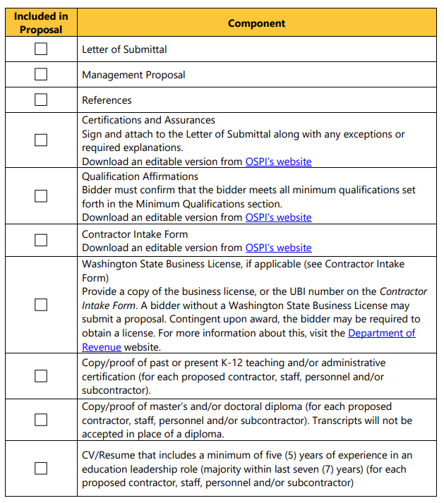
Proposal Checklist
Ensure that you have submitted all required materials in the required format.
Find this Proposal Checklist as Exhibit H of the RFQ.

Slide 30
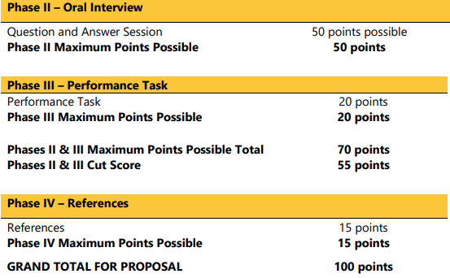
Scoring/ Evaluation
Proposals ranked by OSPI Evaluation Team
Consultants who meet Phase I Cut Score contacted for Oral Interview and Performance Task

Slide 31
Selection of Apparent Successful Bidders
OSPI reserves right to award contracts to bidders whose proposals are deemed in the best interest of and most advantageous to OSPI and Washington State.
Date of announcement of the Apparent Successful Bidder (ASB) will be date the announcement letter is postmarked or, if emailed, date email is sent.
The State will enter into contract negotiations with the ASB.
Proposals that have not been selected for further negotiation or award will be notified via email by RFQ Coordinator.

Slide 32
Estimated Schedule for RFQ
Item | Action | Date
1. | OSPI issues RFQ | February 26, 2024
2. | Question and Answer period: Q&A will be updated as needed throughout the RFQ posting period | February 26, 2024-until RFQ closes
3. | OSPI conducts Pre-Bid Conference Webinar for RFQ | March 12, 2024
4. | Complaints due | April 5, 2024
5. | Proposals due (*for initial round of evaluation and August 1 start date) | 3:00 pm Monday, April 15, 2024*
6. | OSPI conducts evaluation of written proposals | April 12 – May 3, 2024 (or as proposals are received after initial screening)
7. | OSPI conducts oral interviews with finalists (if determined necessary by OSPI) | May 6 – May 24, 2024 (or as proposals are received after initial screening)
8. | OSPI announces “Apparent Successful Bidders” and sends notification to unsuccessful Bidder(s) | June 3, 2024 (or as proposals are received after initial screening)
9. | OSPI conducts debriefing conferences (if requested) | As requested, per debriefing instructions
10. | Contract negotiation begins | June 3, 2024
11. | Anticipated contract start date | August 1, 2024

Slide 33
Period of Performance
August 1, 2024 – July 31, 2025
OSPI reserves the right to amend to extend the contract for one (1) additional contract year through 2026 or issue an alternate RFQ requiring reapplication

Slide 34
References
Bryk, A. S., Gomez, L., Grunow, A., & LeMahieu, P. (2015). Learning to improve: How America’s schools can get better at getting better. Harvard Education Publishing.
Safir, S., & Dugan, J. (2021). Street data: A next-generation model for equity, pedagogy, and school transformation. Corwin.

Slide 35
Question & Answer

Slide 36
Disclaimer
All oral and written communications will be considered unofficial and non-binding on Washington State Department of Enterprise Services (DES). Should bidders rely on any other communication, including statements made by state employees other than the Procurement Coordinator, they do so at their own risk and expense. Bidders should only rely on written amendments issued via Washington’s Electronic Business Solution (WEBS).

Slide 37
Connect With Us!

