Slide 1
Presenter Instructions
Purpose: The purpose of these materials is to assist schools in training staff about their responsibilities to identify, report, and respond to discrimination. Under WAC 392-190-020, each school district and public charter school in Washington must provide training to all administrators and certificated and classroom personnel to prevent bias and ensure staff are aware of their responsibility to identify and address discrimination.
Time needed for training: Approximately 30–45 minutes
Intended audience: All school district and charter school staff at the district and building level
Before you begin:
Carefully review the slides and presenter notes for each slide.
Insert information for your school or district, such as contact information and policy numbers. Areas that require school- or district-specific information are noted in [red brackets]
Provide the slides and referenced policies and procedures for participants
Delete this slide before you print handouts and present!
Need help?
OSPI Equity and Civil Rights Office | 360-725-6162 | equity@k12.wa.us | www.k12.wa.us/equity
These materials are for informational purposes only. They do not provide legal advice or establish an attorney-client relationship. Please contact an attorney for legal advice specific to the facts and circumstances of your individual situation.

Slide 2
Protecting Students from Discrimination in Washington Public Schools
AN overview of Discrimination & Complaint Procedures
These materials are for informational purposes only. They do not provide legal advice or establish an attorney-client relationship. Please contact an attorney for legal advice specific to the facts and circumstances of your individual situation.

Slide 3
Objectives
This training provides a basic introduction to:
School employees’ responsibilities under state and federal nondiscrimination laws
Identifying and reporting discriminatory and sexual harassment
Preventing discrimination in school programs, activities, and services
Discrimination complaint procedures
Notes:
PRESENTER NOTES
This training provides a basic introduction to:
School employees’ responsibilities under state and federal nondiscrimination laws
Identifying and reporting student-on-student discriminatory and sexual harassment
Preventing discrimination in school programs, activities, and services
Discrimination complaint procedures
This training is a brief introduction to these topics. For more in-depth information, please review the resources listed at the end of the presentation.

Slide 4
Scope: Students’ Rights
While many of the civil rights protections and complaint procedures discussed in this training also apply to employees, this training focuses on the rights of students and the responsibility of school staff to prevent and protect students from discrimination.
For information about employment discrimination and complaint procedures:
Nondiscrimination Policy and Procedure (staff): [Policy #]
Sexual Harassment Policy and Procedure (staff): [Policy #]
Additional resources regarding employment discrimination:
Washington State Human Rights Commission | www.hum.wa.gov
U.S. Equal Employment Opportunities Commission (EEOC) | www.eeoc.gov
Notes:
INSTRUCTIONS
Update slide with the staff nondiscrimination and sexual harassment policy numbers for your school district
You may provide the policies and procedures referenced on the slide as handouts for participants, or you may add a link to the policies and procedures on the slide
PRESENTER NOTES
While many of the civil rights protections and complaint procedures discussed in this training also apply to employees, this training focuses on the rights of students and the responsibility of school staff to prevent and protect students from discrimination.
While this training will not cover employment discrimination, you can learn more about your rights, as an employee, regarding discrimination in the workplace by reviewing the district’s nondiscrimination and sexual harassment policies and procedures.
You can also learn more about the protections against employment discrimination by visiting the Washington State Human Rights Commission’s website, or the U.S. Equal Employment Opportunities Commission’s website.

Slide 5
What is discrimination?
Discrimination is unfair or unequal treatment of a person or group because they are part of a defined group, known as a protected class.
For example:
Treating someone differently
Denying access to programs or services
Failing to accommodate a person with a disability
Harassment and sexual harassment
Notes:
PRESENTER NOTES
All school districts and charter schools must provide students with equal access to all programs, activities, and services without discrimination.
Discrimination is unfair or unequal treatment of a person or group because they are part of a defined group, known as a protected class.
In the school setting, discrimination can occur when a person or a group is treated differently or denied access to school programs or services because they are part of a protected class.
Discrimination can also occur when a school or district fails to accommodate a student’s or employee’s disability.
Harassment, when it is based on a protected class, and sexual harassment can also be forms of discrimination.

Slide 6
Protected Classes
Sex
Race and color
Religion and creed
National origin
Disability and the use of a service animal
Sexual orientation
Gender expression
Gender identity
Veteran and military status
Chapter 392-190 WAC
In some contexts, additional protected classes may be covered by local, state, or federal law.
Notes:
PRESENTER NOTES
To be unlawful discrimination, harassment or unfair treatment must be based on a protected class. A protected class is a group of people who share common characteristics and are protected from discrimination by federal and state laws.
Protected classes in Washington schools include:
Sex
Race and color
Religion and creed
National origin, which can include the language that a person speaks
Disability and the use of a service animal
Sexual orientation
Gender expression
Gender identity, which includes transgender students and staff
Veteran and military status, which generally refers to employment
BACKGROUND/CONTEXT
Additional Protected Classes (in some contexts)
The protected classes listed on the screen focus on nondiscrimination laws regarding students in public schools, specifically those listed in Chapter 392-190 of the Washington Administrative Code (WAC), which is noted at the top of the screen. This includes all of the protected classes listed in education-related civil rights laws, including chapters 28A.640 and 28A.642 of the Revised Code of Washington (RCW) and the protected classes under federal law (Title VI of the Civil Rights Act of 1964, Title IX of the Education Amendments of 1972, Section 504 of the Rehabilitation Act of 1973, and the Americans with Disabilities Act).
In some contexts, local, state, and federal laws cover additional protected classes. For example:
Federal employment discrimination laws also prohibit discrimination on the basis of genetic information
The Washington Law Against Discrimination (RCW 49.60) additionally prohibits discrimination in employment on the basis of age (40+) and marital status
Some city and county ordinances include additional protected classes
Definitions
Creed: Defined broadly and includes religion, observance, practice, and belief
National origin: a person’s ethnicity, country of origin, or ancestry, which may include persons with limited English proficiency
Disability: the presence of a sensory, mental, or physical impairment that is medically cognizable or diagnosable; exists as a record or history; or is perceived to exist whether or not it exists in fact. This includes students covered under Section 504 of the Rehabilitation Act of 1973, the Individuals with Disabilities Education Act (IDEA), and the Americans with Disabilities Act (ADA)
Service animal: an animal that is trained to do work or perform tasks for a person with a disability
Gender expression: A person’s external expression of their own gender (e.g., masculine, feminine, androgynous, both, neither, other, fluid). Gender expression could also refer to the manner in which a person represents or expresses gender to others, often through behavior, clothing, hairstyles, activities, voice, or mannerisms
Gender identity: A person’s internal sense of their own gender (e.g., male, female, both, neither, other, genderfluid)
Veteran or military status: a person who is a veteran as defined in RCW 41.04.007 or an active or reserve member in any branch of the armed forces of the United States.

Slide 7
Two common forms of discrimination that may impact students
DISCRIMINATORY & SEXUAL
HARASSMENT
Two common forms of discrimination that may impact students
DENIAL OF ACCESS TO PROGRAMS AND SERVICES
Notes:
PRESENTER NOTES
During this training, we will focus on two common types of discrimination that may impact students:
Discriminatory harassment and sexual harassment
Discrimination in access to school programs, activities, and services
For information on other forms of discrimination in schools, you may review the resources listed at the end of the presentation.

Slide 8
Two common forms of discrimination that may impact students – discriminatory and sexual harassment
DISCRIMINATORY & SEXUAL
HARASSMENT
Notes:
PRESENTER NOTES
First, we will cover discriminatory and sexual harassment.

Slide 9
Discriminatory Harassment
Harassment is a form of discrimination when it:
Is based on a protected class, and
Creates a hostile environment
WAC 392-190-0555
Notes:
PRESENTER NOTES
Harassing conduct is a form of discrimination when the behavior:
Is based on a student’s protected class and
Creates a hostile environment

Slide 10
Discriminatory Harassment 2
Harassment is a form of discrimination when it:
Is based on a protected class, and
Creates a hostile environment
Protected classes:
Sex, race, color, religion, creed, national origin, sexual orientation, gender identity, gender expression, disability, use of a service animal, and veteran or military status
Notes:
PRESENTER NOTES
First, discriminatory harassment is based on a protected class.
Let’s refresh ourselves on the list of protected classes we covered earlier:
Sex
Race
Color
Religion
Creed
National origin
Sexual orientation
Gender identity
Gender expression
Disability
Use of a service animal
Veteran or military status

Slide 11
Discriminatory Harassment 3
Harassment is a form of discrimination when it:
Is based on a protected class, and
Creates a hostile environment
When conduct is so severe, persistent, or pervasive that it limits a student’s ability to participate in or benefit from the school’s programs or activities.
Notes:
PRESENTER NOTES
Next, it creates a hostile environment for the targeted student or other students (e.g., bystanders). A hostile environment is created when conduct is so severe, persistent, or pervasive that it limits a student’s ability to participate in or benefit from any of the school’s programs or activities.
Note that the harassment must be severe, persistent, OR pervasive – the harassing conduct does not need to be all three. For example, one incident may be so severe that it, alone, creates a hostile environment.
How might harassment limit a student’s ability to participate in or benefit from a program or activity?
Are the student’s grades suffering because of the harassment?
Is the student having difficulty concentrating?
Has the student had to drop a class or change academic plans?
Is the student feeling increased anxiety about coming to school?
Is the student increasingly absent?
Does the student feel unsafe at school? At recess? In their athletic program?
Is the stress of the harassment impacting the student’s relationships with friends, family, teachers, or peers?
Is the student reluctant to participate in extracurricular activities or athletics out of fear of harassment?

Slide 12
Discriminatory Harassment 3
HIB v.
Harassing conduct can be both bullying and discriminatory harassment.
If harassing conduct is based on, related to, or motivated by any protected class, the district must respond and investigate under both procedures.
Notes:
PRESENTER NOTES
As school staff, you may already be familiar with the school or district’s Harassment, Intimidation, and Bullying (or “HIB”) policy and procedure, which covers any student-on-student bullying.
It is important to keep in mind that harassing conduct can be both bullying and discriminatory harassment.
If harassing conduct is based on, related to, or motivated by any protected class, the district must respond and investigate under both procedures: HIB and discrimination.

Slide 13
HIB v. Discriminatory Harassment
HIB v. Discriminatory Harassment
 | Harassment, Intimidation, and Bullying (HIB) | Discriminatory Harassment
What is the conduct based on? | Can be based on any characteristic | When harassing conduct is based on a protected class
School’s response | The school’s response might be limited to disciplining the perpetrators | Often requires a systemic response, beyond simply disciplining the perpetrators
District policies and procedures | HIB Policy/Procedure [Policy #] | Sexual Harassment and Nondiscrimination Policies/Procedures [Policy #s]
District Coordinator | HIB Coordinator | Civil Rights Coordinator Title IX Coordinator Section 504 Coordinator
Notes:
INSTRUCTIONS
Update slide with following policy numbers:
Harassment, Intimidation, and Bullying (HIB)
Sexual Harassment (students)
Nondiscrimination (students)
You may also add the name and contact information for your district coordinators (HIB coordinator, civil rights coordinator, Title IX coordinator, and Section 504 coordinator)
You may provide the policies and procedures referenced on the slide as handouts for participants, or you may add a link to the policies and procedures on the slide
PRESENTER NOTES
Let’s review some of the differences between bullying—under the HIB policy—and discriminatory harassment.
A key distinction between bullying and discriminatory harassment is what the conduct is based on, or motivated by.
HIB: Bullying can be based on any characteristic including, for example, height or weight.
Discriminatory harassment: That same type of behavior can become a form of discrimination when it is based on a protected class (e.g., sex, race, religion, sexual orientation)
The school’s response may differ depending on whether the behavior is bullying or is also discriminatory harassment.
HIB: When addressing bullying, the school’s response might be limited to disciplining the perpetrators.
Discriminatory harassment: When addressing discriminatory harassment, however, the school’s response must often be more systemic in nature and extend beyond disciplining the perpetrators. The school must take steps to stop the harassment, eliminate the hostile environment, prevent it from recurring, and remedy its effects on any students impacted.
Two different district policies and procedures apply.
HIB: The HIB Policy and Procedure, which provides for a building-level complaint with a short investigation timeline
Discriminatory harassment: The Sexual Harassment and Nondiscrimination Policies and Procedures, which provide for a district-level complaint with a longer investigation timeline, which can help uncover school climate and systemic issues
And different district-level coordinators may be involved.
HIB: HIB Coordinator
Discriminatory harassment: Civil rights coordinator, Title IX coordinator (for sexual harassment), and Section 504 coordinator (for disability discrimination)
Remember: If harassing conduct is based on, related to, or motivated by any protected class, the district must respond and investigate under both procedures: HIB and discrimination.

Slide 14
Student-on-Student Sexual Harassment
Unwelcome conduct or communication
Sexual in nature
Creates a hostile environment
WAC 392-190-0555
Notes:
PRESENTER NOTES
Student-on-student sexual harassment is also a form of discriminatory harassment.
Sexual harassment occurs when a student is subjected to unwelcome conduct or communication that is sexual in nature and that creates a hostile environment.

Slide 15
Student-on-Student Sexual Harassment
A student’s submission to the conduct or failure to complain does not necessarily mean the conduct was welcome
Unwelcome conduct or communication
Sexual in nature
Creates a hostile environment
Notes:
PRESENTER NOTES
Conduct is considered unwelcome if the student did not request or invite it and considered the conduct to be undesirable or offensive.
The age of the student, the nature of the conduct, and other relevant factors affect whether a student was capable of welcoming the sexual conduct from a peer.
A student’s submission to the conduct or failure to complain does not mean that the conduct was welcome.
As an example, consider a situation where a female high school student willingly kisses a male student on one occasion. When the male student subsequently attempts to kiss her again, she objects, but he kisses her anyway. This subsequent kiss is considered to be unwelcome even though the student welcomed the first kiss.

Slide 16
Student-on-Student Sexual Harassment
For example:
Unwelcome touching
Making sexual jokes, rumors, or suggestive remarks
Pressuring a person for sexual favors
Distributing sexually explicit texts, emails, or photos
Physical violence, including rape and sexual assault
Unwelcome conduct or communication
Sexual in nature
Creates a hostile environment
Notes:
PRESENTER NOTES
Next, the conduct must be sexual in nature.
This can include, for example:
Unwelcome touching
Making sexual jokes, spreading rumors, or making suggestive remarks
Pressuring a person for sexual favors
Distributing sexually explicit texts, emails, or photos
Physical violence, including rape and sexual assault

Slide 17
Student-on-Student Sexual Harassment
Unwelcome conduct or communication
Sexual in nature
Creates a hostile environment
When conduct is so severe, persistent, or pervasive that it limits a student’s ability to participate in or benefit from the school’s programs or activities.
Notes:
PRESENTER NOTES
Next, the conduct creates a hostile environment for the targeted student, or other students (e.g., bystanders).
As we covered earlier in the presentation, a hostile environment is created when conduct is so severe, persistent, or pervasive that it affects a student’s ability to participate in or benefit from the school’s programs or activities.

Slide 18
School’s duty to respond
If a school knows, or should have known, about discriminatory or sexual harassment it must:
Investigate, and
Take prompt and effective steps to:
Stop the harassment
Eliminate the hostile environment
Prevent harassment from recurring
Remedy the effects of the harassment
WAC 392-190-0555
Notes:
PRESENTER NOTES
As public school employees, we have a duty to respond to discriminatory harassment and sexual harassment.
If a school knows, or should have known, about discriminatory or sexual harassment, it must:
Investigate to determine what happened, and
If the school finds that harassment has occurred, take prompt and effective steps to:
Stop the harassment,
Eliminate the hostile environment for the targeted student and any other students impacted,
Prevent the harassment from recurring, and
Remedy the effects of the harassment on the targeted student and any other students impacted
The school must take these steps regardless of whether anyone has filed a complaint or asked the school to take action.

Slide 19
When am I on notice?
A school has notice of possible harassment if a responsible employee knew, or in the exercise of reasonable care should have known, about the harassment.
WAC 392-190-0555
Notes:
PRESENTER NOTES
When are we on notice?
The school has notice if a responsible employee knew, or in the exercise of reasonable care should have known, about the harassment.

Slide 20
When am I on notice?
A school has notice of possible harassment if a responsible employee knew, or in the exercise of reasonable care should have known, about the harassment.
WHO IS A RESPONSIBLE EMPLOYEE:
has the authority to take action to redress discrimination
has been given the duty of reporting incidents of discrimination
whom a student could reasonably believe has this authority or duty
Notes:
INSTRUCTIONS
In advance, research if your district has any employees who serve as confidential resources and are not responsible employees for reporting. For example, these employees may serve in counseling or medical capacities. It can often be easier to explain to staff who is a responsible employee by noting who is not.
PRESENTER NOTES
Who is a “responsible” employee?
A responsible employee includes any employee: who has the authority to take action to redress discrimination; who has been given the duty of reporting incidents of discrimination or any other misconduct by students to the Civil Rights/Title IX/Section 504 coordinator or other appropriate school designee; or whom a student could reasonably believe has this authority or duty.
ADDITIONAL CONTEXT
Whether an employee is a responsible employee will vary depending on factors such as the age and education level of the student, the type of position held by the employee, and consideration of both formal and informal school practices and procedures. As an example, it may be reasonable for an elementary school student to believe that a custodial staff member or cafeteria worker has the authority or responsibility to address student misconduct.

Slide 21
When am I on notice?
A school has notice if a responsible employee knew, or in the exercise of reasonable care should have known, about the harassment.
EXAMPLES OF ACTUAL NOTICE OF HARASSMENT:
Student or parent files a complaint
Student or parent shares concerns with principal, teacher, or other school staff
Staff member witnesses harassing conduct
Staff hear about the conduct indirectly (e.g., news report or community gossip)
Notes:
PRESENTER NOTES
First, let’s look at when an employee is considered to have known about harassment.
For example:
Staff hear about the conduct indirectly, such as through a news report or community gossip
A staff member witnesses the harassing conduct
A student or parent shares concerns with the principal, teachers, or other school staff
A student or parent files a complaint
Questions for group discussion:
Can you think of other examples of when you may have actual notice of possible harassment?

Slide 22
When am I on notice?
A school has notice if a responsible employee knew, or in the exercise of reasonable care should have known, about the harassment.
EXAMPLES WHEN STAFF SHOULD BE AWARE OF HARASSMENT:
Conduct is happening openly in the hallways or during school activities
Graffiti in public areas
Students are referred for discipline for harassing conduct
During activities under staff supervision (e.g., recess, classroom, cafeteria)
Notes:
PRESENTER NOTES
Next, when should staff be aware of harassment, even if they didn’t witness it directly or receive a complaint?
Examples:
Harassing conduct is occurring during activities under staff supervision, such as during recess, in the classroom, or in the cafeteria
Students are referred for discipline for harassing conduct
Graffiti—such a racial epithets—in public areas, such as restroom stalls or lockers
Harassing conduct is happening openly in the hallways or during school activities
Questions for group discussion:
Can you think of other examples of when you should know of possible harassment?
What about social media interaction?

Slide 23
Receipt of a Report
What to do when you receive actual notice of discrimination?
AFFIRM
INFORM
REPORT
Notes:
PRESENTER INSTRUCTIONS:
PRESENTER NOTES
If a student comes to you to share information about discrimination (including sexual harassment or sexual violence) that they have experienced, there are a few helpful steps to remember so that you feel prepared.
First, affirm the student’s decision to share information with you.
Second, inform the student of your role and obligations to report, of support services (as applicable), and the District’s prohibition on discrimination (using age appropriate language).
Then, report to the Civil Rights Compliance Coordinator, Title IX Coordinator, or Section 504 Coordinator, as appropriate.

Slide 24
Receipt of a Report
What to do when you receive actual notice of discrimination?
AFFIRM
LISTEN without judgment.
SUPPORT the student by responding to their disclosure appropriately.
“I’m sorry you’re going through a difficult time.”
“What would be helpful to you right now?”
Notes:
PRESENTER NOTES
When affirming the student or parent’s decisions to share their experience with you, affirm them by listening without judgment and supporting them by responding to their disclosure appropriately.
For example, “I’m sorry you’re going through a difficult time,” “ I am so sorry to hear about your experience,” and “What would be helpful to you right now?”
Especially during an initial disclosure of an incident in which the student may have experienced trauma, school staff do not need to “interview” the student at the time of their disclosure. Generally speaking, the initial report is not the time to determine if what occurred is “true,” but to affirm the student in sharing the information and trusting the school staff to share their experience. Your most important role is to act as a bridge between the student and the school administrator or civil rights coordinator.

Slide 25
Receipt of a Report
What to do when you receive actual notice of discrimination?
INFORM
If you are a Responsible Employee, in addition to affirming, when appropriate, inform the student of your role and reporting obligations.
Notes:
PRESENTER NOTES
If you are a Responsible Employee, in addition to affirming, you should also inform the student of your role and reporting obligations. Being forthcoming about this with the student from the beginning helps them understand what will happen next and that as a teacher or administrator, you are not betraying their trust by reporting up.
For example, “Thanking you for coming to me with this. I want you to know that in my role as a [teacher] I need to share what you told me with [the principal etc.] and I cannot keep it completely ’secret’”

Slide 26
Receipt of a Report
What to do when you receive actual notice of discrimination?
INFORM
Prohibition on Discrimination, in age appropriate terms
Complaint options, including providing the district’s complaint procedure
Support Services, such as school counseling or other support services
Notes:
PRESENTER NOTES
It is also important to inform the student about the schools’ prohibition on discrimination and the support services available to the student.
Prohibition on Discrimination: In age appropriate terms, inform the student it is not okay for any student at this school to be treated differently based on their [sex, race, national origin, ability, etc.].
Complaint options: For parents or older students, explain that the district has a discrimination complaint procedure to ensure that concerns of discrimination are looked into (investigated) and addressed. Provide a copy if you have it available, if not, either follow up to provide a copy or inform the compliance coordinator so that they may provide the procedure promptly.
Support Services: Inform the student that the school has counseling or other support services that may be available to talk to. When possible, refer the student using the counselor’s name and tell them what will happen next (i.e. Who should they tell if they would like to talk to a counselor?)

Slide 27
Receipt of a Report
What to do when you receive actual notice of discrimination?
REPORT
Civil Rights Coordinator:
[INSERT NAME]
Title IX Coordinator:
[INSERT NAME]
Section 504 Coordinator:
[INSERT NAME]
Notes:
PRESENTER NOTES
School staff should promptly report the student’s disclosure to the appropriate district-level coordinator.
Overall, if you are not sure how to respond to a student’s report, it is alright to say something like, “What you’re sharing is important and I want to make sure I give you the right information. Can I talk with you again later today?” and then quickly contact the coordinator to get the right information to share with the student.

Slide 28
It’s up to us to recognize discriminatory harassment
If harassment or bullying
is based on any protected class,
the school district must assess the behavior for civil rights implications.
Notes:
PRESENTER NOTES:
Regardless of what it’s labeled, or what you perceive it to be, if harassment or bullying is based on any protected class, the school district must assess it for civil rights implications.
The label used to describe an incident (e.g., bullying, hazing, teasing) does not determine how the district should respond. Rather, the nature of the conduct itself must be assessed to determine if it is discriminatory or sexual harassment.
Remember, even if the behavior is already covered under the district’s bullying policy, the school district is responsible for taking prompt and appropriate action to investigate and address discriminatory and sexual harassment, which may require a more extensive investigation and additional remedies.

Slide 29
Scenario: Part 1
A principal receives a written bullying report. It appears to be related to a student’s race.
What should the principal do?
Investigate under the district’s HIB procedure
Ask the civil rights coordinator to investigate potential discriminatory harassment under the district’s nondiscrimination procedure
Inform the complainant that their complaint will be investigated under both procedures: HIB and nondiscrimination
All of the above
WAC 392-190-059
WAC 392-190-065
Notes:
PRESENTER NOTES:
A principal receives a written bullying report. It appears to be related to a student’s race.
What should the principal do?
Investigate under the district’s HIB procedure
Ask the civil rights coordinator to investigate potential discriminatory harassment under the district’s nondiscrimination procedure
Inform the complainant that their complaint will be investigated under both procedures: HIB and nondiscrimination
All of the above
Answer: D. All of the above. (Click slide to reveal answer)
BACKGROUND/CONTEXT
Under WAC 392-190-059, staff must notify the civil rights coordinator when an HIB complaint indicates possible discrimination or if, during an HIB investigation, the district becomes aware of potential discrimination.
Under WAC 392-190-065(4), when a district receives a complaint alleging discrimination, the coordinator must provide the complainant a copy of the district’s discrimination complaint procedure and ensure that the district conducts a prompt and thorough investigation into the allegations.

Slide 30
Scenario: Part 2
After investigating, the civil rights coordinator finds that two student athletes used racial slurs toward another student during a pep rally. The students are in several classes together.
What actions could the school and district consider?
Actions to consider when taking a comprehensive approach to harassment:
Disciplining the perpetrators
Offering counseling or academic support to targeted students
Developing a safety plan
Separating students into different areas or classrooms
Excusing harassment-related absences
Conducting a school climate survey
Providing staff training
Planning school- or district-wide anti-harassment activities or discussions
Disseminating complaint procedures
Strengthening the student handbook and code of conduct
Hosting community dialogues
Other…
Notes:
PRESENTER NOTES
After investigating, the civil rights coordinator finds that two student athletes used racial slurs toward another student during a pep rally. The students are in several classes together. What actions could the school and district consider?
Remember: The school district needs to take a comprehensive approach to address discriminatory harassment. This includes taking steps to stop the harassment, eliminate the hostile environment, prevent harassment from recurring, and remedy the effects of the harassment.
Actions that the school and district could consider:
Disciplining the perpetrators
Offering counseling or academic support (e.g., tutoring, make-up work) to targeted students
Developing a safety plan
Separating students into different areas or classrooms to avoid contact while at school
Excusing harassment-related absences, particularly if a student missed school to avoid the harassment
Conducting a school climate survey to determine the extent of a hostile environment
Providing staff training on how to identify and respond to harassment
Planning school- or district-wide anti-harassment activities or discussions
Disseminating complaint procedures to students, families, and staff
Strengthening the student handbook and code of conduct, and make sure students are informed the racial harassment will not be tolerated
Hosting community dialogues
Other…

Slide 31
Scenario: Part 2
A student returns from lunch appearing very upset and shares with their teacher that another student touched their “private area” during the lunch.
What should the teacher do?
AFFIRM
INFORM
REPORT
Notes:
INSTRUCTIONS
Note: It may make sense here to address your district protocol for informing the student’s parent as well.
PRESENTER NOTES:
After recess, a student shares with their teacher that another student touched their “private area.”
Affirm: The teacher should thank the student for sharing the information with them and affirm that type of behavior is not expected or permitted at school.
Inform: The teacher should tell the student that they will need to tell [the principal] about what the student shared and that [the principal] may want to talk with them too. It may help to remind the student that if [the principal] asks to talk with them that not mean that they are in trouble for sharing this with the. If available, the teacher may offer the student the opportunity to talk with the school counselor or another support person.
Report: The [Teacher or Principal] should contact the compliance coordinator.
ADDITIONAL CONTEXT
Other considerations for the teacher:
Consider age-appropriate language in the response.
It is also helpful to make a note of the instruction covered following this type of report as the student may not be in a space to take in the information. Also, consider any needed accommodations, such as extension of due dates, for related assignments.

Slide 32
See or hear something? Contact the compliance coordinator:
Civil Rights Coordinator
Title IX Coordinator
Section 504 Coordinator
[Name]
[Title]
[Email]
[Phone]
[Name]
[Title]
[Email]
[Phone]
[Name]
[Title]
[Email]
[Phone]
[Photo] (optional)
[Photo] (optional)
[Photo] (optional)
Notes:
INSTRUCTIONS
Insert the name, title, email, phone number, and photo (optional) of each of the district coordinators:
Civil Rights Coordinator (…)
Title IX Coordinator (…)
Section 504 Coordinator (…)
PRESENTER NOTES
If you suspect that a student is experiencing discriminatory or sexual harassment, please contact our compliance coordinators! When in doubt, discuss with a compliance coordinator.

Slide 33
Two common forms of discrimination that may impact students
DISCRIMINATORY & SEXUAL
HARASSMENT
Two common forms of discrimination that may impact students
ACCESS TO PROGRAMS AND SERVICES
Notes:
PRESENTER NOTES
In the beginning of the presentation, I shared that I would be focusing on two common types of discrimination that may impact students:
Discriminatory harassment and sexual harassment
Discrimination in access to school programs, activities, and services

Slide 34
Two common forms of discrimination that may impact students
ACCESS TO PROGRAMS AND SERVICES
Notes:
PRESENTER NOTES
Let’s move on to access to programs and services.

Slide 35
Access to programs and services
Each student should have equal access to any program, activity, or service the school offers.
Our schools cannot deny or limit a student’s participation because of a student’s sex, race, creed, religion, color, national origin (including limited English proficiency), sexual orientation, gender expression, gender identity, disability, or use of a service animal.
Notes:
PRESENTER NOTES
Each student must have equal access in any program, activity, or service the school offers. This includes academic programs, extracurricular activities, transportation, and athletics.
We need to make sure our schools do not deny or limit any student’s participation because of a student’s sex, race, creed, religion, color, national origin (which includes a student’s or parent’s limited English proficiency), sexual orientation, gender expression, gender identity, disability, or use of a service animal.
ADDITIONAL CONTEXT
Some programs or activities have entrance criteria. For example, many sports teams have a cut policy based on skill. Prerequisites and entrance criteria are allowable so long as the criteria are justified by the nature of the program or activity, are applied equally to all students, and are subject to modification when necessary to avoid discrimination (e.g., providing disability-related accommodations, allowing a student to take an entrance exam in their home language). Schools may not, for example, categorically deny admission to a program because the student needs English language development services, special education, or health services.

Slide 36
Access to programs and services
For example, we must make sure our schools…
Allow students to benefit from all programs, including Highly Capable Programs, Advanced Placement, and Career and Technical Education, regardless of race, sex, language, or disability
Provide accommodations, aids, and services for students with disabilities when needed
Administer discipline fairly and equitably
Provide equitable athletic opportunities for girls and boys
Provide language services for English learners and parents with limited English proficiency
Notes:
PRESENTER NOTES
Here are just a few examples of how we can ensure students have equal access to our programs and services.
First, we must make sure our schools allow students to benefit from all programs, including Highly Capable Programs, Advanced Placement, and Career and Technical Education, regardless of race, sex, language, or disability.
We must make sure our schools provide accommodations, aids, and services for students with disabilities when needed.
We must make sure to administer discipline fairly and equitably.
We must provide equitable athletic opportunities for girls and boys.
And, we must provide language services for English learners and parents with limited English proficiency.

Slide 37
Access to programs and services
Learn more!
Equity and Civil Rights Office
Office of Superintendent of Public Instruction
www.k12.wa.us/equity
Notes:
PRESENTER NOTES
Because this training is only a brief introduction, we will not be going into detail on each of these topics. You can learn more about these topics—and more—on OSPI’s Equity and Civil Rights webpage.

Slide 38
Have questions? Concerns? Contact our compliance coordinators!
Civil Rights Coordinator
Title IX Coordinator
Section 504 Coordinator
[Name]
[Title]
[Email]
[Phone]
[Name]
[Title]
[Email]
[Phone]
[Name]
[Title]
[Email]
[Phone]
[Photo] (optional)
[Photo] (optional)
[Photo] (optional)
Notes:
INSTRUCTIONS
Insert the name, title, email, phone number, and photo (optional) of each of the district coordinators:
Civil Rights Coordinator
Title IX Coordinator
Section 504 Coordinator
PRESENTER NOTES
If you have any questions or concerns about equal access to any programs, activities, of services in our school or district, please contact our compliance coordinators!

Slide 39
Discrimination Complaints
Notes:
PRESENTER NOTES
The final topic we will cover in this presentation is discrimination complaints.

Slide 40
What does a complaint look like?
In writing
Mail | Email | Fax | Hand-Delivered
Sent to any school or district administrator
Alleges discrimination, e.g., includes any allegation of unfair treatment or harassment based on a protected class
How to file a formal complaint
WAC 392-190-065
Notes:
PRESENTER NOTES
What does a discrimination complaint look like?
It can be anything in writing—including by mail, email, fax, or hand-delivered.
It can be sent to any school or district administrator.
And it is anything that alleges discrimination or describes something that would be a violation of nondiscrimination laws, rules, or guidelines. This includes any allegation of unfair treatment or harassment based on a protected class.
Anyone can file a complaint, including students, parents, employees, advocates, and community members.
Note: A formal complaint does not need to include the word “complaint.” It simply must be in writing.

Slide 41
What do I do when I receive a complaint?
Tell the civil rights coordinator immediately!
The civil rights coordinator will coordinate an investigation and respond to the complaint within 30 calendar days.
Give the complainant a copy of the complaint procedure
Nondiscrimination
Students: [Procedure #] | Staff: [Procedure #]
Sexual Harassment
Students: [Procedure #] | Staff: [Procedure #]
How to file a formal complaint
WAC 392-190-065
Notes:
INSTRUCTIONS
Insert the procedure numbers for the following:
Nondiscrimination (students)
Nondiscrimination (staff)
Sexual Harassment (students)
Sexual Harassment (staff)
PRESENTER NOTES
What do you do if you receive a complaint?
Report to the civil rights coordinator immediately. The civil rights coordinator will coordinate an investigation and must respond to the complainant within 30 calendar days.
Next, make sure the complainant receives a copy of the complaint procedure so they can understand the process.
ADDITIONAL CONTEXT
Under WAC 392-190-065, when a district receives a complaint alleging discrimination, the coordinator must provide the complainant a copy of the district’s discrimination complaint procedure and ensure that the district conducts a prompt and thorough investigation into the complaint.
The school district may establish a complaint filing deadline. This deadline must be one year or longer from the date of the alleged discrimination.

Slide 42
Discrimination Complaints
Complaint to School District
WAC 392-190-065
Appeal to School Board
WAC 392-190-070
Complaint to OSPI
WAC 392-190-075
Notes:
PRESENTER NOTES
Once the district receives a complaint, it triggers the complaint procedure. The district has 30 days to:
Conduct an investigation,
Complete an investigative report, and
Respond to the complainant with the results of the investigation and any corrective measures the district will take.
These requirements are outlined in WAC 392-190-065.
ADDITIONAL CONTEXT
The school district and the complainant can agree to extend the 30 day deadline. Under rare circumstances, the school district may also extend the deadline if exceptional circumstances related to the complaint require an extension.
Once the district investigates, the written response must include:
A summary of the investigation results
Whether the district has failed to comply
Notice of the complainant’s right to appeal, including where and to whom appeal must be filed
Any corrective measures needed to correct the noncompliance. Such corrective measures must be put in place as quickly as possible, but no later than 30 calendar days after written response issued (unless otherwise agreed to by complainant).

Slide 43
Discrimination Complaints
Complaint to School District
WAC 392-190-065
Appeal to School Board
WAC 392-190-070
Complaint to OSPI
WAC 392-190-075
Notes:
PRESENTER NOTES
The complainant can appeal the school district’s decision to the school board.

Slide 44
Discrimination Complaints
Complaint to School District
WAC 392-190-065
Appeal to School Board
WAC 392-190-070
Complaint to OSPI
WAC 392-190-075
Notes:
PRESENTER NOTES
After the school board’s decision, the complainant can file a complaint with OSPI.
At any time, the complainant can also file a complaint with the U.S. Department of Education or the Washington State Human Rights Commission.

Slide 45
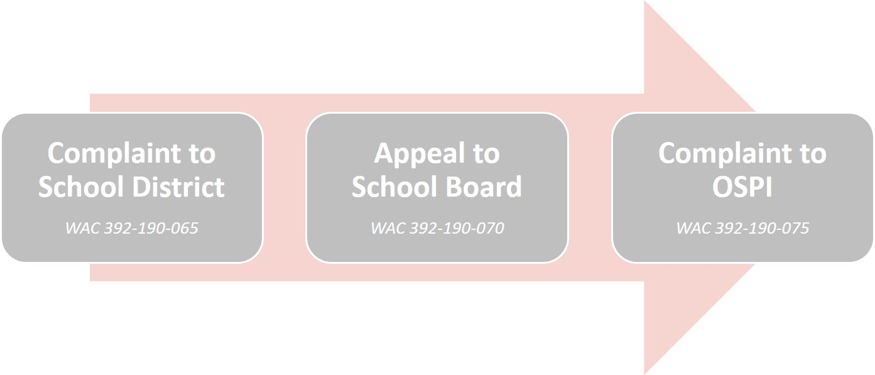
Discrimination Complaints
Review the following policies and procedures for timelines and details:
Nondiscrimination
Students: [Policy #]
Staff: [Policy #]
Sexual Harassment
Students: [Policy #]
Staff: [Policy #]
Notes:
INSTRUCTIONS
Insert the procedure numbers for the following:
Nondiscrimination (students)
Nondiscrimination (staff)
Sexual Harassment (students)
Sexual Harassment (staff)
Review the policies and procedures in advance to ensure they are aligned with current state law, chapter 392-190 WAC, which was last revised in December 2014.
PRESENTER NOTES
Please review the following policies and procedures for more details and specific timelines.

Slide 46
Resources
Equity and Civil Rights Office
Office of Superintendent of Public Instruction (OSPI)
State and federal civil rights laws, rules, guidelines, and resources for schools and districts
www.k12.wa.us/equity
Office for Civil Rights (OCR)
U.S. Department of Education
Federal civil rights regulations, policy interpretations, and example complaint resolutions
www.ed.gov/ocr
Notes:
PRESENTER NOTES
For more information on any of these topics—and more—please visit the OSPI Equity and Civil Rights Office’s website or the U.S. Department of Education Office for Civil Rights’ website.

Slide 47
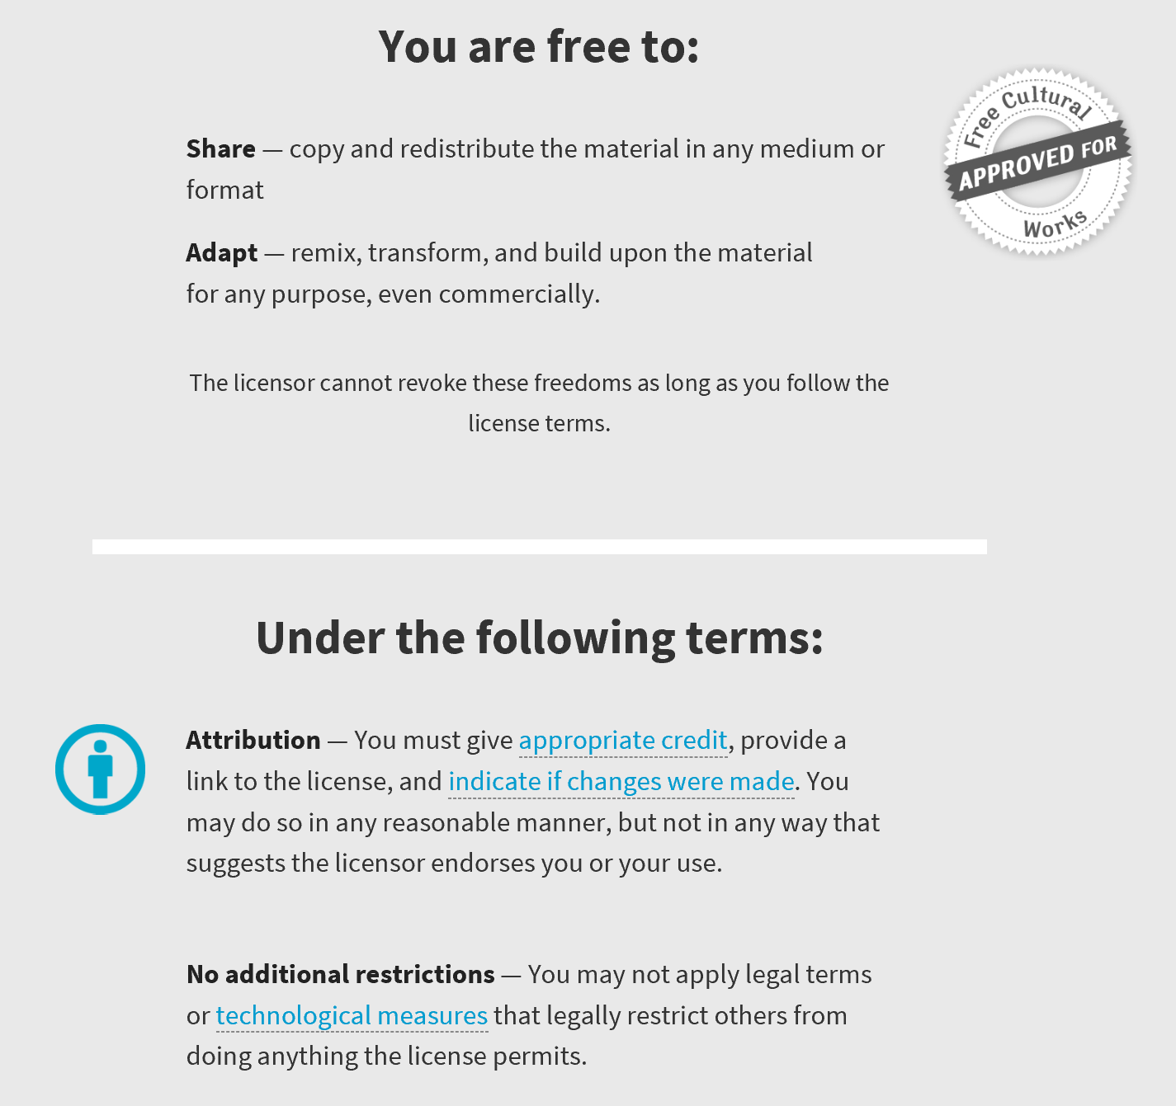
An Open Educational Resource
This work is licensed under a
Creative Commons Attribution 4.0 International License.

