Slide 1
Discipline Training: Classroom Procedures
Behavioral Expectations, Behavioral Violations, Other Forms of Discipline, and Classroom Exclusion

Slide 2
Webinar Q&A Protocols
Please submit questions in writing through the question log
Please keep questions related to the webinar content
OSPI staff and guests will not be able to answer questions about specific scenarios, students, or experiences
OSPI staff is readily available to provide technical assistance following the webinar
There will be a 5 minute break between the presentation and Q&A portions of the webinar
OSPI staff will review and group questions for Q&A portion

Slide 3
OSPI Equity Statement
Each student, family, and community possesses strengths and cultural knowledge that benefit their peers, educators, and schools.
Ensuring educational equity:
Goes beyond equality; it requires education leaders to examine the ways current policies and practices result in disparate outcomes for our students of color, students living in poverty, students receiving special education and English Learner services, students who identify as LGBTQ+, and highly mobile student populations.
Requires education leaders to develop an understanding of historical contexts; engage students, families, and community representatives as partners in decision-making; and actively dismantle systemic barriers, replacing them with policies and practices that ensure all students have access to the instruction and support they need to succeed in our schools.
https://www.k12.wa.us/about-ospi/about-agency

Slide 4
Discipline Training: Classroom Procedures
Behavioral Expectations, Behavioral Violations, Other Forms of Discipline, and Classroom Exclusion

Slide 5
Legal Disclaimer
These materials constitute OSPI’s interpretation of discipline policies and procedures under chapter 28A.600 RCW and chapter 392-400 WAC and are provided to support school districts’ understanding of their obligations under these laws. The information in these materials is subject to change based on future legal and policy changes. Before taking action based on the information in these materials, please review state and federal laws and regulations or consult with legal counsel familiar with your particular circumstances. These materials are intended for informational purposes only and do not constitute legal advice.

Slide 6
Training Considerations
OSPI discipline training contains some content related to Multi-Tiered System of Supports (MTSS), Positive Behavioral Interventions and Supports (PBIS), restorative justice practices, culturally responsive teaching, family engagement, trauma-informed approaches, function-based thinking, classroom management strategies, etc.
However, effective implementation of MTSS/PBIS frameworks or any particular best practices and strategies, interventions, or approaches should include ongoing and job-embedded professional learning.
OSPI discipline training can be used to support such efforts, but the content is not comprehensive. Therefore, participants should identify areas where school and district staff could benefit from additional training and supplemental resources.

Slide 7
Learning Objectives
Identify strategies for adopting positive behavioral expectations and clearly defined behavioral violations
Integrate best practices and strategies into district, school, and classroom discipline policies and procedures
Describe differential selection and equitable approaches to reducing disproportionality in discipline
List the conditions for using classroom exclusion and related procedures

Slide 8
Classroom Decision-Making
Differential Selection
“School discipline processes generally begin with an office referral, most often made by a classroom teacher.” (Anyon, et al., 2014, p. 380)
Disparities in discipline begin at the classroom level
Primarily minor and subjective categories (e.g. defiance and disrespect), instead of major and objective categories (e.g. firearms possession)
Racial/ethnic disparities persist even when accounting for student characteristics that include family income and likelihood of misbehavior
(Anyon, et al., 2014; Gregory, Skiba, & Noguera, 2010)

Slide 9
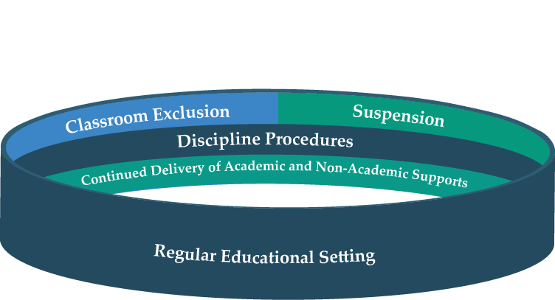
The Discipline Continuum
Selection (Teacher)

Slide 10
Administrative Decision-Making
Differential Processing
“There is tremendous local flexibility in the types of infractions that move forward from the classroom to the office and in the types of consequences issued by administrators.” (Gregory, Skiba, & Noguera, 2010, p. 63)
Following a classroom exclusion, school administrators are primarily responsible for deciding and assigning consequences
Subjective discipline situations “have the greatest potential for bias in processing, as administrators' behavioral expectations – like those of teachers' and students' – are shaped by perception, culture, and context” (Anyon, et al., 2014, p. 380)
(Anyon, et al., 2014; Gregory, Skiba, & Noguera, 2010)

Slide 11
The Discipline Continuum
Selection (Teacher)
Processing (Principal)

Slide 12
Behavioral Expectations

Slide 13
Proactive Supports in Regular Educational Settings
Continuum of supports for students and staff
Screening for additional supports (academic, social-emotional, and behavioral)
Intervention programs (push-in, pull-out, or extended learning opportunities)
Progress monitoring to determine whether the intervention should be changed or modified
Diagnostic data to align interventions with students’ strengths and needs
Clear entrance and exit criteria for intervention programs
Implementation fidelity and program evaluation

Slide 14
Purpose of Discipline Rules
One of the purposes of OSPI discipline regulations is to ensure that school districts in Washington:
“Administer discipline in ways that respond to the needs and strengths of students, support students in meeting behavioral expectations, and keep students in the classroom to the maximum extent possible;” See WAC 392-400-010(5)

Slide 15
Defining Regular Educational Setting
The particular classroom, instructional or activity area in which a student is provided the instructional program of basic education as required under WA law.
Universal Design for Learning (UDL)
Differentiated instruction
Supplemental instruction and services
Academic standards and rigor
Behavioral expectations

Slide 16
Behavioral Expectations: Reflection
Make a list of behavioral expectations and examples that are common in your school setting.
CC0 Public Domain via Pixabay.com

Slide 17
Behavioral Expectations: Positive with Examples
Positive behaviors that are well-defined for students and staff: Schools should develop common language around positively stated behavioral expectations. School staff should teach, model, and reinforce desired behaviors. Negative practices that are identified for change can be reframed positively.
Examples that are identified for specific school settings: Schools should identify common locations where behavioral expectations can be demonstrated and observed. Schools should then provide examples of what positive behaviors look like in various school settings.

Slide 18
Behavioral Expectations: Feedback
Transitioning from reprimanding negative behavior:
To acknowledging positive behavior:
You are being very disrespectful. Correct your behavior now and stop interrupting me.
You are listening very attentively. Thanks for actively engaging in the lesson.
(Approach: shaming, punitive, deterring)
(Approach: acknowledging, positive, reinforcing)

Slide 19
Establishing Behavioral Expectations
The establishment of classroom norms and behavioral expectations should:
Promote inclusive and reflective processes through culturally responsive decision-making that respects the cultural values of the surrounding community and diverse students’ funds of knowledge
Establish high standards for all students that serve a legitimate purpose within the school setting (i.e. school safety) without devaluing family norms and values in different cultures and home settings
(González, Moll, & Amanti, 2005; Green, et al., 2015; Gregory, Skiba, & Mediratta, 2017; Leverson, Smith, McIntosh, Rose, & Pinkelman, 2019)

Slide 20
Behavioral Expectations Activity
Look at your list of behavioral expectations and examples. Label each expectation as either positive (P) or negative (N) and each example as either specific (S) or general (G).
Are there more behavioral expectations on your list that are framed negatively than positively? Why?
Are the examples on your list more general or specific to a variety of common school settings (i.e. classroom, hallway, bathroom, cafeteria, etc.)
Are the behavioral expectations known by students, families and staff? Are they modeled consistently by all staff? If not, why and under what conditions would they be modeled?
Are the behavioral expectations primarily representative of dominant white cultural values? Do they serve a legitimate purpose within the school settings?
Are there any behavioral expectations or specific examples that have not been explicitly identified and taught?

Slide 21
Behavioral Expectations: School Environments
Behavioral expectations must be taught:
Embedded in existing curriculum
Delivered through ongoing explicit instruction
Re-taught through instructional interventions
Inclusive of the English language levels of all learners to ensure equitable and shared understandings
Behavioral expectations should be visible:
Student handbooks and communication with families
Posters and visual displays throughout the building

Slide 22
Teaching Behavioral Expectations
Students need to be taught context-specific behavioral expectations within school settings.
All school staff need to model and actively teach behavioral expectations to:
Build fluency among students, parents, and staff
Evaluate student’s understanding
Give students opportunities to demonstrate skills
Reinforce staff and student agreement about expectations

Slide 23
Behavioral Expectations: Practical Example
“Keep It Clean” by A&M Consolidated High School.
https://www.youtube.com/watch?v=SILZ82YEpcM

Slide 24
Content Break
Drink
Think
Digest
Discuss
Journal
Kinesthetic activity
Notes:
Image: https://farm5.staticflickr.com/4071/4459735887_dbfe19bbd8.jpg

Slide 25
Behavioral Violations

Slide 26
Behavioral Violation
WAC 392-400-025(1) “Behavioral violation" means a student's behavior that violates a school district's discipline policy adopted under WAC 392-400-110.
In accordance with WAC 392-400-100, district policies and procedures must:
(a) Clearly state the types of behaviors for which discipline, including suspension and expulsion, may be administered;
(b) Have a real and substantial relationship to the lawful maintenance and operation of the school district including, but not limited to, the preservation of the health and safety of students and employees and the preservation of an educational process that is conducive to learning;

Slide 27
Defining Behavioral Violations
Behaviors that constitute a behavioral violation should be operationally defined:
Specific: clearly defined in detail
Observable: action that can be seen
Measurable: action that can be counted or timed
(Borgmeier, C., 2018; Green, et al., 2015)

Slide 28
Categorizing Behavioral Violations
Behavioral violations should be organized into minor and major categories or levels of severity with distinct procedures for responding to each:
Minor
Handled at the classroom level
May not result in classroom exclusion or suspension
Major
Referred to a school administrator
May result in an administrative decision to suspend or expel
(Green, et al., 2015)

Slide 29
Behavioral Expectations and Violations
Not meeting behavioral expectations
Behavioral violation

Slide 30
Behavioral Violations and Implicit Bias
Implicit bias can play a role in interpreting student behaviors:
Subjectively defined behavioral violations
Assumptions about students’ family environment or norms
Labeling (media stereotypes, tracking, program eligibility, etc.)
Educator over-attention (expect certain misbehavior)
Educator under-attention (minimalize certain misbehavior)
Cultural mismatch
Low expectations
Developmentally unrealistic expectations
(Bal, Schrader, Afacan, & Mawene, 2016; Bradshaw, Mitchell, O’Brennan, & Leaf, 2010; Gilliam, et al., 2016; Hatt, 2012; Morris & Perry, 2017; Smolkowski, Girvan, McIntosh, Nese, & Horner, 2016)

Slide 31
Classroom Practices: Protective Factors
Increased positive adult interactions
High academic expectations
Engaging instruction
Self-regulation techniques to mitigate impact of educator biases
Opportunities to respond
Behavioral expectations explicitly taught and modeled
Culturally responsive teaching
Commitment to racial equity
Continuum of developmentally and age-appropriate responses
Trauma-informed strategies that foster resiliency
Classroom routines and environmental arrangements
(Cook, et al., 2018; Green, et al., 2015; Larson, Pas, Bradshaw, Rosenberg, & Day-Vines, 2018)

Slide 32
Adult Interpretations of Student Behavior
“School suspensions are an adult behavior” Rosemarie Allen TEDxTalks
https://www.youtube.com/watch?v=f8nkcRMZKV4&feature=youtu.be
Notes:
https://www.youtube.com/watch?v=f8nkcRMZKV4&feature=youtu.be

Slide 33
Content Break
Drink
Think
Digest
Discuss
Journal
Kinesthetic activity
Notes:
Image: https://farm5.staticflickr.com/4071/4459735887_dbfe19bbd8.jpg

Slide 34
Equitable Systems & Data-Based Decision-Making

Slide 35
Identifying Inequities in School Discipline
Setting Event
Poor instruction and few positive adult interactions
Antecedent
Directives and perceptions of neglect, injustice, or illegitimacy
Behavior
Resistance, deviance, attention-seeking, or disengagement
Consequence
Involuntary compliance and exclusionary discipline
(Curran, 2016; McIntosh, Girvan, Horner, & Smolkowski, 2014; McIntosh & Payno, 2018; Perry & Morris, 2014; Way, 2011)

Slide 36
Increasing Equity in School Discipline
Setting Event
Engaging instruction and frequent positive adult interactions
Antecedent
Opportunities to respond and perception of fairness
Behavior
Pro-social skills and human error
Consequence
Positive feedback and instructional discipline
(Curran, 2016; McIntosh, Girvan, Horner, & Smolkowski, 2014; McIntosh & Payno, 2018; Perry & Morris, 2014; Way, 2011)

Slide 37
Data Collection Tools and Strategies
Data Collection Tools
Antecedent-Behavior-Consequence (ABC) forms
Incident Reports
Office Discipline Referral (ODR)
Time Out of Class form or Missed Instruction log
Data Collection Strategies
Consistent entry of school enrollment and discipline data by student race/ethnicity, gender, etc.
Standardized definitions and data collection methods
Format to use data for principal and parent notice

Slide 38
Data Analysis Strategies
Patterns of disproportionality to identify differential selection that is occurring early in the discipline continuum (behavior types, times/days/months, location, setting events, triggers, possible motivations, referring staff)
Disaggregated by student subgroups (demographics and characteristics)
Disaggregated by behavior types (severity level and categories)
Cross-tabulated at the student level (demographics and characteristics) and school level (e.g. behavior type and location)
Integrated analysis to identify correlations between student academic and behavioral outcomes

Slide 39
Vulnerable Decision Points
Contextual variables that increase the likelihood of implicit bias influencing discipline decision-making:
Subjective behavior (ambiguously defined, adult-rated level of severity, etc.)
School setting (classrooms, academic tasks, etc.)
Time of day (stress, hunger, fatigue, etc.)
Unfamiliar with student (in-group bias, etc.)
(McIntosh, Girvan, Horner, & Smolkowski, 2014; McIntosh & Payno, 2018; Smolkowski, Girvan, McIntosh, Nese, & Horner, 2016)

Slide 40
Vulnerable Decision Points
Promising strategies for neutralizing implicit bias:
Delay decision (interrupt potential escalation and model calm behavior)
Reframe the situation (assume student is communicating a need, etc.)
Self-awareness (recognition of internal state and personal biases)
Self-regulate (internal check, breathing techniques, etc.)
(McIntosh, Girvan, Horner, & Smolkowski, 2014; McIntosh & Payno, 2018; Smolkowski, Girvan, McIntosh, Nese, & Horner, 2016)

Slide 41
Exclusionary Adult Behaviors
Exclusionary practices are adult behaviors that:
May provide temporary relief
Do not support students in meeting behavioral expectations
May incentivize repeated use of exclusionary practices
Educators that overly rely on exclusionary practices:
Are capable of learning replacement behaviors
Should receive support through professional learning opportunities, additional classroom or school personnel, coaching, etc.
(Cook, et al., 2018; Gregory, 2016; Larson, Pas, Bradshaw, Rosenberg, & Day-Vines, 2018; Okonofua, Paunesku, & Walton, 2016)

Slide 42
Vulnerable Decision Points & Classroom Exclusion Analysis
WHAT problem behaviors are associated with disproportionate classroom exclusions?
WHERE are there disproportionate classroom exclusions (i.e., for what locations)?
WHEN are there disproportionate classroom exclusions (i.e., for what times of day/days of the week/months of the school year)?
WHAT MOTIVATIONS are associated with disproportionate classroom exclusions (e.g., for what perceived functions of problem behavior)?
WHO is issuing disproportionate classroom exclusions (e.g., for what staff)?
(Adapted from McIntosh, Barnes, Eliason, & Morris, 2014 p. 16)

Slide 43
Equitable Learning Environments Example
“Why We Need Trauma-Sensitive Schools” by Trauma Sensitive Schools
https://www.youtube.com/watch?v=vyQdOLl6d2c
Notes:
https://www.youtube.com/watch?v=vyQdOLl6d2c

Slide 44
Content Break
Drink
Think
Digest
Discuss
Journal
Kinesthetic activity
Notes:
Image: https://farm5.staticflickr.com/4071/4459735887_dbfe19bbd8.jpg

Slide 45
Other Forms of Discipline and Classroom Exclusion

Slide 46
Classroom Exclusion: Definition
WAC 392-400-025 defines classroom exclusion as “the exclusion of a student from a classroom or instructional or activity area for behavioral violations” and provides that “[c]lassroom exclusion does not include actions that result in missed instruction for a brief duration when:
(a) a teacher or other school personnel attempts other forms of discipline to support the student in meeting behavioral expectations, and
(b) the student remains under the supervision of the teacher or other school personnel during such brief duration.

Slide 47
Other Forms of Discipline Definition
"Other forms of discipline" refers to actions used in response to behavioral violations, which may involve the use of best practices and strategies included in the state menu for behavior. See WAC 392-400-025(9)
Identify other forms of discipline. See WAC 392-400-110(1)(e)
Attempt other forms of discipline. See WAC 392-400-330(2)

Slide 48
Classroom Best Practices and Strategies
Teach, model, and reinforce behavioral expectations
Parent communication
Active supervision
Correct misbehaviors in private
Increase opportunities to respond
Restorative practices
Environmental adjustments
Collaborative problem-solving
Function-based thinking/assessment

Slide 49
Classroom Exclusion: Teacher Authority & RCW 28A.600.020(2)
Teachers and principals must develop shared understandings, establish agreed upon protocols, and receive ongoing professional learning related to:
District and building definitions of behavioral violations considered disruptive enough to the educational process that a classroom exclusion would be allowable
District and building policies and procedures for first attempting one or more other forms of discipline
District and building procedures for the principal and teacher to confer following a classroom exclusion

Slide 50
Classroom Exclusion Procedures
Conditions and Limitations
Procedures
Behavioral Violation
Other Forms of Discipline
Classroom Exclusion
Principal Notice
Parent Notice
Grievance Procedure
District and Building Policy
Teacher
Principal or Designee
Process for principal and teachers to confer regarding building disciplinary standards (e.g. classroom-managed / office-managed)
RCW 28A.400.110; RCW 28A.600.020(3)
Process for principal and teacher to confer regarding the classroom exclusion and returning the student to class
RCW 28A.600.020(2)

Slide 51
Classroom Exclusion Considerations
Emergency circumstances
Exclusion duration
Removal from school
Brief duration of missed instruction
Educational services
Non-curricular activities
Student Discipline Rules Q&A: A Technical Guide

Slide 52
Recess Exclusions
Washington laws do not prohibit school districts from excluding students from recess in response to behavioral violations but research demonstrates that limiting physical activities can increase problem behaviors.
The Washington State School Directors’ Association (WSSDA) model policy explicitly provides that “[p]hysical activity during the school day (including but not limited to recess, brain boosters/energizers, or physical education) will not be used or withheld as punishment for any reason.” See WSSDA 6700P Procedure – Nutrition, Health, and Physical Fitness. www.wssda.org
The SHAPE America Position Statement on Using Physical Activity as Punishment and/or Behavior Management considers withholding recess time as a consequence for behavioral violations to be an inappropriate and unsound educational practice. www.shapeamerica.org

Slide 53
Reasons to Contest Discipline Decisions
Disagree that student committed behavioral violation and with discipline action
Agree student committed behavioral violation but disagree with discipline action
Concerned that discipline action was too severe
Concerned about impact on educational progress

Slide 54
Options to Contest Discipline Decisions
Courts
Appeal process for emergency expulsion, long-term suspension, and expulsion
Appeal process for short-term and in-school suspension
Grievance procedure
Mediation
Informal conversation

Slide 55
Grievance Procedures Considerations
School districts must establish grievance procedures to address parent or student grievances related to classroom exclusions and other forms of discipline
At a minimum, provide the student an opportunity to share their perspective and explanation regarding the behavioral violation
Opportunities for grievance procedures at the building, district, and school board levels
Parent and student notification regarding the student and parent’s right to address grievances through the district’s procedures

Slide 56
Content Break
Drink
Think
Digest
Discuss
Journal
Kinesthetic activity
Notes:
Image: https://farm5.staticflickr.com/4071/4459735887_dbfe19bbd8.jpg

Slide 57
Procedures Knowledge Test

Slide 58
True or False? A classroom exclusion includes any instance where a teacher might send a student from the classroom to another location in the school.
False
Classroom exclusion must be in response to a behavioral violation.
Sending a student to another classroom, the nurse, the counselor’s office, etc. for reasons unrelated to a behavioral violation is not a classroom exclusion.
Taking actions in response to a behavioral violation—such as issuing an office discipline referral (ODR) to send a student to the dean’s office—would constitute a classroom exclusion.
Asking a student to step out into the hallway to have a brief conversation for the purpose of re-teaching or reviewing classroom expectations would not constitute a classroom exclusion

Slide 59
True or False? The student’s parent(s) must be informed about a classroom exclusion.
True
The student’s parent(s) must be informed as soon as reasonably possible.
The person responsible for making parent contact can be the teacher, principal, or other school personnel.
School districts must ensure language access when communicating to parents with limited-English proficiency.
The timeliness and medium of communication (e.g. phone, email, in-person, etc.) may depend on parent preference.

Slide 60
True or False? If a student is sent to the office, library, or other location in the school for a behavioral violation but the student is provided coursework from their regular class to complete, then it is not exclusionary.
False
It is not the absence or presence of educational or behavioral services (or the quality of such services) that define an action as exclusionary or not—it is the act of excluding a student from a particular “classroom or instructional or activity area” in response to an alleged behavioral violation. See RCW 28A.600.015(8); RCW 28A.600.020(2).
RCW 28A.600.015(8) provides that “[s]chool districts may not suspend the provision of educational services to a student as a disciplinary action.”
If a teacher excludes a student from their classroom in response to a behavioral violation that disrupts the educational process that action would constitute a classroom exclusion—regardless of what location the student is excluded to and what services the student is receiving in that location.

Slide 61
True or False? Unless it’s an emergency situation, a teacher must always attempt one or more other forms of discipline prior to administering a classroom exclusion.
True
In the majority of circumstances a teacher is required to first attempt one or more other forms of discipline before resorting to classroom exclusion
However, in emergency circumstances a teacher may immediately exclude a student.
Emergency circumstances are limited to rare instances when the student’s presence poses an immediate and continuing danger to other students or school personnel, or an immediate and continuing threat of material and substantial disruption of the educational process.
In emergency circumstances, the teacher must immediately notify the principal or designee, and the principal or designee must meet with the student as soon as reasonably possible to administer appropriate discipline.

Slide 62
Effective Implementation

Slide 63
Family Engagement and District Procedures
RCW 28A.600.020(3) educators “make every reasonable attempt to involve the parent or guardian and the student in the resolution of student discipline”
RCW 28A.320.211(3) School districts, in consultation with school district staff, students, families, and the community, shall periodically review and update their discipline rules, policies, and procedures.
District procedures “shall be developed with the participation of parents and the community”
“must provide for early involvement of parents in attempts to improve the student's behavior.”

Slide 64
Discipline Procedures Review Strategies
Build trust with the families and the community
Establish cultural awareness of the entire community
Gain an understanding of histories between groups
Listen and respond respectfully
Create spaces for engagement and collaboration
Provide opportunities for diverse participation
Consider transportation and language accessibility
Promote open and honest discussion
Include school personnel
Encourage participation from diverse viewpoints
Provide clear messaging and goals
Provide agendas in advance and set timelines for follow-up
Ensure consistent communication across all groups
(Davis, 2017)

Slide 65
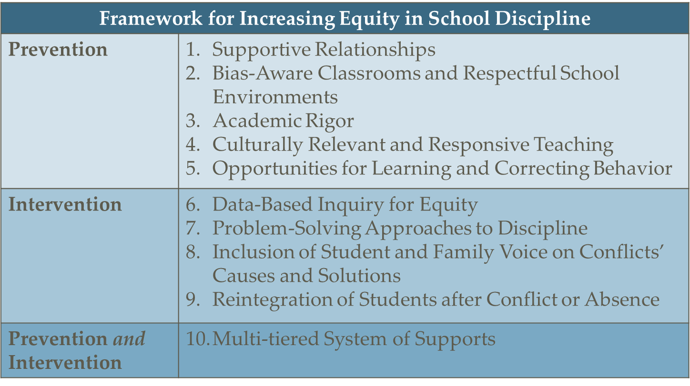
Research-Based Framework: Equity in School Discipline
(Gregory, Skiba, & Mediratta, 2017, p. 255.)

Slide 66
Implementation Stages
Exploration
Installation
Initial
Full
“It is clear that implementation is not an event, but a process, involving multiple decisions, actions, and corrections to change the structures and conditions through which organizations and systems support and promote new program models, innovations, and initiatives.”— Metz & Bartley, 2012

Slide 67
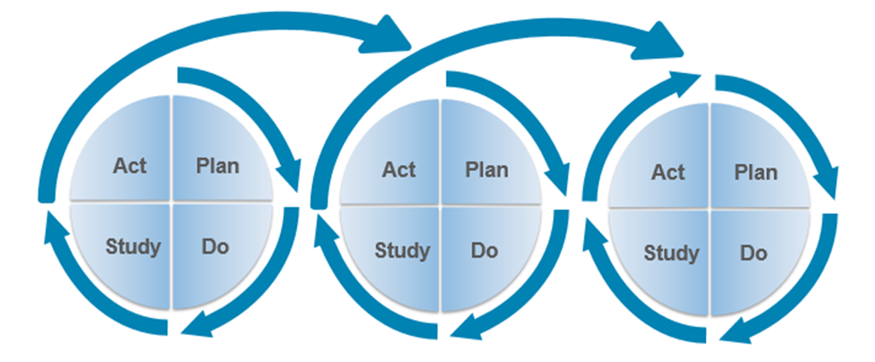
Implementation Iterative Processes
Image from sisep.fpg.unc.edu CC BY-NC-ND

Slide 68
The Discipline Continuum
Selection (Teacher)
Processing (Principal)

Slide 69
References
Anyon, Y., Jenson, J. M., Altschul, I., Farrar, J., McQueen, J., Greer, E., Downing, B., & Simmons, J. (2014). The persistent effect of race and the promise of alternatives to suspension in school discipline outcomes. Children and Youth Services Review, 44, 379–386.
Bal, A., Schrader, E. M., Afacan, K., & Mawene, D. (2016). Using learning labs for culturally responsive positive behavioral interventions and supports. Intervention in School and Clinic, 52, 122–128.
Borgmeier, C. (2018). Understanding and supporting Students with Challenging Behavior: Building Capacity in Teachers and Schools [PowerPoint slides]. Retrieved from http://www.oregonrti.org/copy-of-resources-handouts-annual-conference-april-2018
Bradshaw, C. P., Mitchell, M. M., O'brennan, L. M., & Leaf, P. J. (2010). Multilevel exploration of factors contributing to the overrepresentation of black students in office disciplinary referrals. Journal of Educational Psychology, 102, 508.
Cook, C. R., Duong, M. T., McIntosh, K., Fiat, A. E., Larson, M., Pullmann, M. D., & McGinnis, J. (2018). Addressing discipline disparities for Black male students: Linking malleable root causes to feasible and effective practices. School Psychology Review, 47, 135-152.
Curran, F. C. (2016). Estimating the effect of state zero tolerance laws on exclusionary discipline, racial discipline gaps, and student behavior. Educational Evaluation and Policy Analysis, 38, 647–668.
Davis, C. R. (2017). " Why Are the Black Kids Being Suspended?" An Examination of a School District's Efforts to Reform a Faulty Suspension Policy Through Community Conversations. School Community Journal, 27, 159.
Gilliam, W. S., Maupin, A. N., Reyes, C. R., Accavitti, M., & Shic, F. (2016). Do early educators’ implicit biases regarding sex and race relate to behavior expectations and recommendations of preschool expulsions and suspensions?. Yale Child Study Center, September, 991–1013.
González, N., Moll, L. C., & Amanti, C. (Eds.). (2005). Funds of knowledge: Theorizing practices in households, communities, and classrooms. Routledge.

Slide 70
References
Green, A. L., Nese, R. N. T., McIntosh, K., Nishioka, V., Eliason, B., & Canizal Delabra, A. (2015). Key elements of policies to address disproportionality within SWPBIS: A guide for district and school teams. OSEP Technical Assistance Center on Positive Behavioral Interventions and Supports.
Gregory, A., Hafen, C. A., Ruzek, E., Mikami, A. Y., Allen, J. P., & Pianta, R. C. (2016). Closing the racial discipline gap in classrooms by changing teacher practice. School Psychology Review, 45, 171–191.
Gregory, A., Skiba, R. J., & Mediratta, K. (2017). Eliminating Disparities in School Discipline: A Framework for Intervention. Review of Research in Education, 41, 253–278.
Gregory, A., Skiba, R. J., & Noguera, P. A. (2010). The achievement gap and the discipline gap: Two sides of the same coin?. Educational Researcher, 39, 59–68.
Hatt, B. (2012). Smartness as a cultural practice in schools. American Educational Research Journal, 49, 438-460.
Larson, K. E., Pas, E. T., Bradshaw, C. P., Rosenberg, M. S., & Day-Vines, N. L. (2018). Examining how proactive management and culturally responsive teaching relate to student behavior: Implications for measurement and practice. School Psychology Review, 47, 153-166.
Leverson, M., Smith, K., McIntosh, K., Rose, J., & Pinkelman, S. (2019). PBIS Cultural Responsiveness Field Guide: Resources for trainers and coaches. OSEP Technical Assistance Center on Positive Behavioral Interventions and Supports.
McIntosh, K., Barnes, A., Eliason, B., & Morris, K. (2014). Using discipline data within SWPBIS to identify and address disproportionality: A guide for school teams. OSEP Technical Assistance Center on Positive Behavioral Interventions and Supports.
McIntosh, K., Girvan, E. J., Horner, R., & Smolkowski, K. (2014). Education not incarceration: A conceptual model for reducing racial and ethnic disproportionality in school discipline. Journal of Applied Research on Children, 5, 1–22.

Slide 71
References
McIntosh, K., & Payno, R., (2018). Neutralizing Implicit Bias in School Discipline [PowerPoint slides]. Retrieved from https://www.pbis.org/presentations/chicago-forum-18
Metz, A., & Bartley, L. (2012). Active implementation frameworks for program success: How to use implementation science to improve outcomes for children. Zero to Three, 32, 11-18.
Morris, E. W., & Perry, B. L. (2017). Girls behaving badly? Race, gender, and subjective evaluation in the discipline of African American girls. Sociology of Education, 90, 127-148.
Okonofua, J., Paunesku, D., & Walton, G. (2016). Brief intervention to encourage empathic discipline cuts suspension rates in half among adolescents. Proceedings of the National Academy of Sciences, 201523698.
Perry, B. L., & Morris, E. W. (2014). Suspending progress: Collateral consequences of exclusionary punishment in public schools. American Sociological Review, 79, 1067–1087.
Smolkowski, K., Girvan, E. J., McIntosh, K., Nese, R. N., & Horner, R. H. (2016). Vulnerable decision points for disproportionate office discipline referrals: Comparisons of discipline for African American and White elementary school students. Behavioral Disorders, 41, 178-195.
Way, S. (2011). School discipline and disruptive classroom behavior: The moderating effects of student perceptions. The Sociological Quarterly, 52, 346–375.

Slide 72
Except where otherwise noted, this work by Office of Superintendent of Public Instruction is licensed under a Creative Commons Attribution 4.0 International License. All logos and trademarks are property of their respective owners. This presentation may contain or reference links to websites operated by third parties. These links are provided for your convenience only and do not constitute or imply any affiliation, endorsement, sponsorship, approval, verification, or monitoring by OSPI of any product, service, or content offered on the third party websites. In no event will OSPI be responsible for the information or content in linked third party websites or for your use of or inability to use such websites. Please confirm the license status of any third-party resources and understand their terms of use before reusing them. The information contained in this presentation and power point is an overview of student discipline requirements. The presentation is not intended as legal advice. The state regulations that implement student discipline statutes under Chapter 28A.600 RCW are located under Chapter 392-400 WAC. Outside resources are not intended to be an endorsement of any service or product. District personnel should always review their district’s procedures and review questions with their administrative staff.

Slide 73
Content Break
Drink
Think
Digest
Discuss
Journal
Kinesthetic activity
Notes:
Image: https://farm5.staticflickr.com/4071/4459735887_dbfe19bbd8.jpg

Slide 74
Webinar Q&A Protocols
Please submit questions in writing through the question log
Please keep questions related to the webinar content
OSPI staff and guests will not be able to answer questions about specific scenarios, students, or experiences
OSPI staff is readily available to provide technical assistance following the webinar

Slide 75
Questions?
Joshua Lynch, Program Supervisor, Student Discipline, Behavior & Readiness to Learn
Office of Superintendent of Public Instruction
email: joshua.lynch@k12.wa.us

