Slide 1
Welcome to GATE Advisory
Introductions
Please add your name and title to the chat
Notes:
Welcome by Tennille

Slide 2
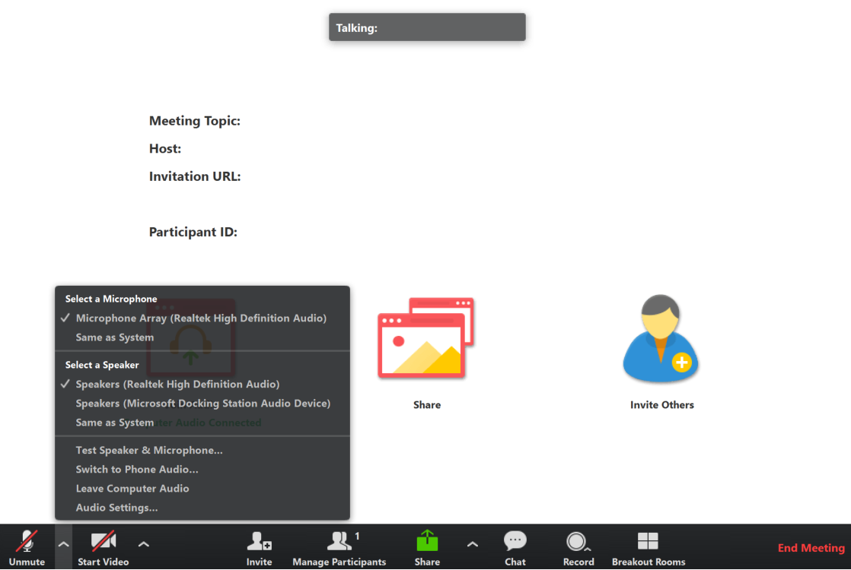
Connect to Audio
Welcome!
We’ll be starting in a few minutes.
You can join by computer audio or call in.
Dial +1 669 900 6833 or
+1 253 215 8782
Meeting ID: 941 5529 0919
Test Audio
5/11/2020 | 2
Notes:
We’re going to get started in a few minutes. You can test your audio in the bottom left hand corner of the menu.

Slide 3
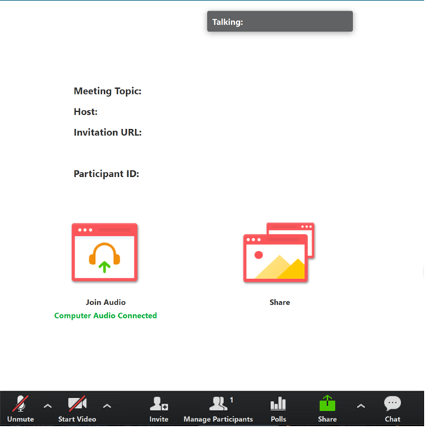
Tips for Participating
Share comments and questions in the Chat panel (send to “All”)
Comments and questions may be shared verbally to group, towards the end of the presentation
Not all questions will be addressed during this webinar, but we will provide follow up to submitted questions
Questions may always be submitted to jason.boatwright@k12.wa.us following this meeting
5/11/2020 | 3

Slide 5
Equity Statement
Requires education leaders to examine the ways current policies & practices result in disparate outcomes for our:
Requires education leaders to:
Partners in Decision-Making
Actively dismantle systemic barriers
replacing them with policies & practices
that ensure all students have access to the instruction and support they need to succeed in our schools.
Policies & Practices
students of color
students living in poverty
students receiving special education
English Learner services
students who identify as LGBTQ+
highly mobile students
develop an understanding of historical contexts
engage students,
families, &
community representatives
as partners in decision-making
Examine Disparate Outcomes
Ensuring educational equity goes beyond equality.
Beyond Equality
Each student, family, and community possesses strengths & cultural knowledge that benefit their peers, educators, & schools.
Notes:
Tapping into the strength of the schools and communities we serve
We need to look for the way our current system is resulting in disparate outcomes
Requires us to engage students, families and community representatives as partners in decision making
Work to dismantle barriers and replace them with policies and practices that ensure access for all students to the supports they need to be successful.

Slide 6
Purpose of GATE Advisory
Graduation: A Team Effort (GATE) is a collective impact initiative to support youth to graduate from high school prepared for life.
GATE Advisory participants include: policy leaders, and representatives from state agencies and statewide youth and family serving organizations.
GATE Advisory provides a forum to discuss cradle to career issues, and formulate recommendations for action.
Notes:
Celebrate a successful year:
Community partnerships and substance abuse
Dual Credit and multiple pathways
Keeping on track thru authentic connections
Promoting regular attendance thru removing barriers and promoting engagement

Slide 7
Agenda
Welcome and Introductions
Dual Credit Overview and
Partnership Presentation
Discussion and panel questions

Slide 8
After today you will be able to:
Understand some of the Why, How, and What of Dual Credit
Establish meaningful partnerships to promote dual credit for students
Recognize key players in developing relationships to support student success in dual credit

Slide 9
Katherine Mahoney
Asst. Director for Policy
Office of System and School Improvement

Slide 10
Why focus on dual credit?
High school success
Postsecondary transition and persistence
Reduction in postsecondary costs
Notes:
Education Commission of the States, 2018
“A substantial and growing body of research indicates that, all other factors being equal, students who dually enroll are more likely than their non-dually enrolling peers to finish high school, matriculate in a postsecondary institution and experience greater postsecondary success.”

Slide 11
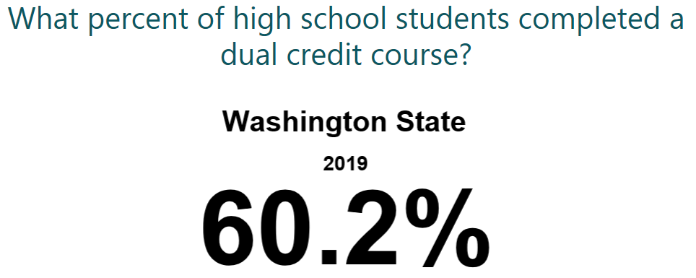
Measuring Dual Credit
Source: WA State Report Card https://washingtonstatereportcard.ospi.k12.wa.us

Slide 12
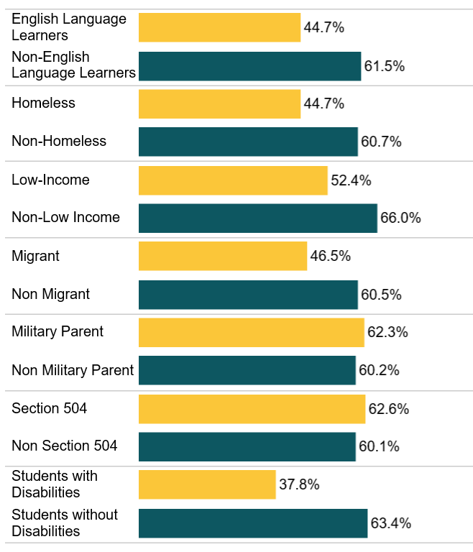
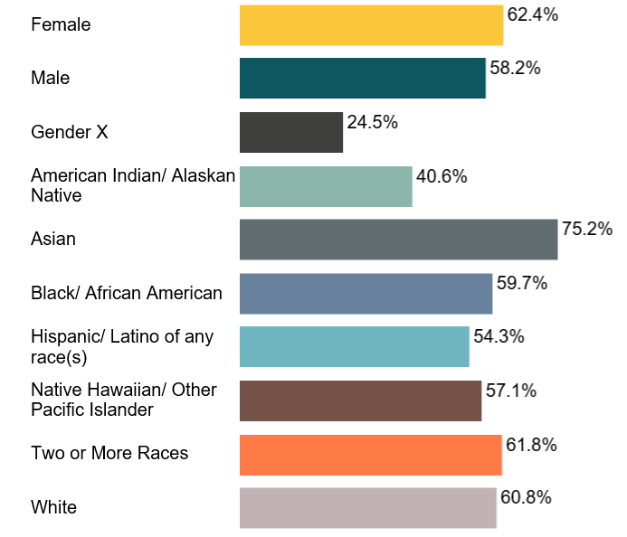
Dual Credit Completion 2018-19
Source: WA State Report Card https://washingtonstatereportcard.ospi.k12.wa.us

Slide 13
OSPI’s Policy Priority – Close Equity Gaps
Fully cover dual credit costs for students
Change policies/practices limiting equitable access
Resource equitable expansion of dual credit
Partner to ensure earned credits count

Slide 14
Jason Boatwright
Dual Credit Program Supervisor
OSPI

Slide 15
Dual Credit – The Why, The How, The What
WHY
Why is it important to develop equitable, sustainable dual credit options for students?
HOW
How do you develop sustainable dual credit programs that students can access equitably?
WHAT
What types of dual credit best suit your student and program needs to ensure equitable access that is sustainable?

Slide 16
Dual Credit Definition ( the what)
Dual Credit provides students with the potential to earn high school and college credit at the same time. Dual credit options can be course or exam based.
Exam Based
Advanced Placement (AP)
International Baccalaureate (IB)
Cambridge International (CI)
Course Based
Career and Technical Education (CTE)
College in the High School (CHS)
Running Start

Slide 17
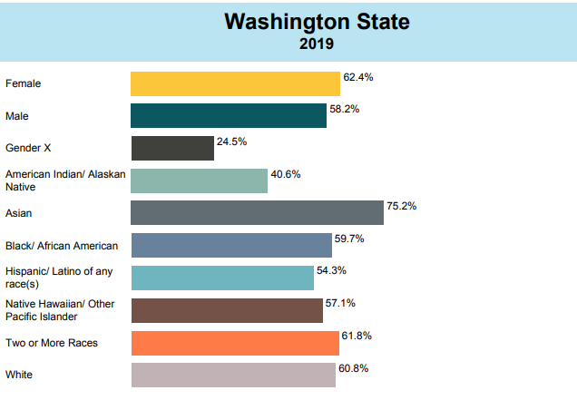
Dual Credit – The Why, The How, The What
The WHY:
70% of current* jobs require some post-secondary education
How will the COVID pandemic change this?
Dual Credit now counts towards graduation pathway
Large disparities still exist in participation
Statewide Dual Credit Participation by Student Demographic
2019

Slide 18
Dual Credit – Importance of Partnership/Communication
STUDENTS
INFLUENCERS/
INFORMERS
Parents
Consistent and Accurate Messaging
Work
Job
Career
Friends
High School
CTC
Information Overload
Or
Lack of Correct Information
What are the top 3 things you want a student to know?
1.
2.
3.
University
WSAC
Financial Aid
College Preparatory Orgs

Slide 19
Partnerships and Collaboration
Griff Shelley – Eastern Washington University
Doug Edmonson – Mead School District
Leslie Lloyd – Spokane Falls Community College
Jessica Dempsey – Spokane Community College

Slide 20
Goals of Partnering:
Increase student access to dual credit options.
Clarify pathway options so students find the best fit.

Slide 21
Leveraging Local Partnerships
University & Community Colleges
Provided K-12 professional development
K-12 Partners
Local ESD
Focused on equitable access across districts:
Decided collaboration was key between institutions:
Developed new options for students under HB 1599
Created the CCS Running Start Equivalency Guide
Agreed access to all pathway options is most important:
Combined dual credit info nights
Prioritized student needs
Hosted an inclusive dual credit night for students 8th-11th grades

Slide 22
Clarifying Dual Credit Pathways
In the Skill Centers:
CTE Dual Credit
In the High School:
CTE Dual Credit
College in the High School
At the college:
Running Start
Running Start for Careers
Gateway to College
H.S. Diploma +
College Credit

Slide 23
Breakout Room Participation (15min) Make sure to note which breakout room you are in!!
Individual Reflection
Discuss
Record
Report
What do I think?
What do we think?
What stands out?
What do we want people to know?
Notes:
4 minutes for whole group share out and pivot to break
Image source: https://www.videoblocks.com/video/speech-bubbles-on-white-background-animated-flat-design-hij-jn_feizdx3lk8

Slide 24
Discussion Questions
What are the barriers to this?
What questions do you have for the panel?
What can the state do to support the effort?
How are you leveraging partnerships to expand equitable use of dual credit?
Notes:
What are the entry points for embedding Language Learner supports and programming into your efforts?
What are the barriers to this?
How can we collaborate?
What can the state do to support the effort?

Slide 25
GATE Equity Webinars
Register on the GATE Equity Webinar page

Slide 26
“Leading Through the Master Schedule”, presented by Steven Gering of ABL
Learn how to leverage the master scheduling to drive academic intensity and ensure all students graduate ready for post-secondary success.
ATTEND DEEP DIVE WEBINARS IN MAY: The additional deep-dive sessions that build upon this webinar series will be delivered in May. These sessions will be available to sign up for on PDEnroller shortly, and registrants will also receive communications reminding you to sign up leading up to the events. Mark your calendars:
Wed 5/13 10am-11am -- Narrowing & Adding Courses
Wed 5/20 10am-11am -- Removing Barriers & Supporting Students
Wed 5/27 10am-11am -- Career Readiness & Other Topics from the Field

Slide 27
Contact Information
Griff Shelley – Eastern Washington University
gshelley@ewu.edu
Doug Edmonson – Mead School District
doug.edmonson@mead354.org
Leslie Lloyd – Spokane Falls Community College
Leslie.Lloyd@sfcc.spokane.edu
Jessica Dempsey – Spokane Community College
Jessica.Dempsey@scc.spokane.edu
Jason Boatwright- OSPI
jason.boatwright@k12.wa.us
Katherine Mahoney - OSPI
Katherine.Mahoney@k12.wa.us
Dixie Grunenfelder - OSPI
Dixie.Grunenfelder@k12.wa.us
Kefi Andersen - OSPI
kefi.andersen@k12.wa.us

Slide 28
See you next year!

