Slide 1
March GATE Equity Webinar
Implementing and Sustaining Inclusionary Practices: Master Scheduling
Exploring topics related to equity in graduation success
The webinar will begin soon.
While you wait, please share in the chat panel:
In the chat, briefly tell us what you know about inclusionary practices and master scheduling

Slide 2
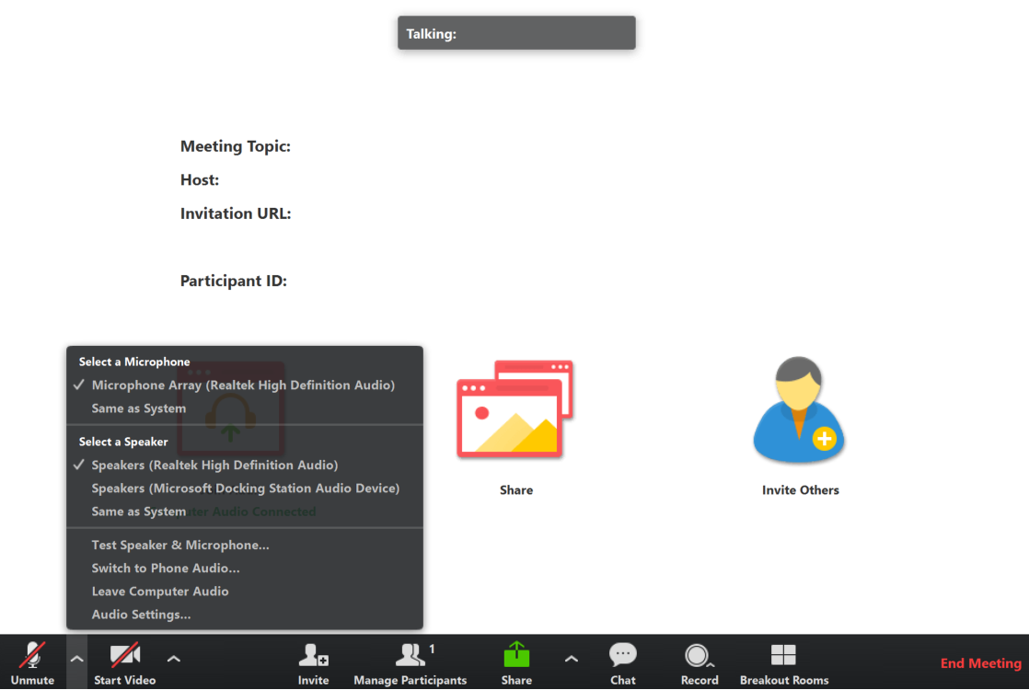
Connect to Audio
Welcome to the GATE Equity Webinar!
We’ll be starting in a few minutes.
You can join by computer audio or call in.
Dial +1 669 900 6833 or
+1 646 558 8656
Webinar ID: 122-657-497
Test Audio
Notes:
We’re going to get started in a few minutes. You can test your audio in the bottom left hand corner of the menu.

Slide 3
Sound Check
Welcome to the GATE Equity Webinar!
We’ll be starting in a few minutes.
We’re going to get started in a few minutes.
Can you hear us?
Please let us know in the chat!
Test Audio
Notes:
We’re going to get started in a few minutes. You can test your audio in the bottom left hand corner of the menu.

Slide 4
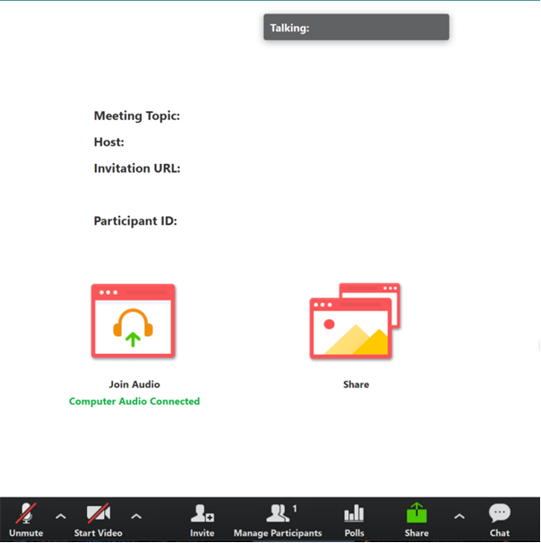
Tips for Participating
Share comments and ideas in the Chat panel (send to “All”)
Ask presenters questions in the Q&A panel
Slides are available on the GATE Equity Webinar page in the Archive now.
Recording will be available at the end of the month.
Notes:
Thank you for sharing comments and ideas in the chat.
If you’d like our presenters to answer a question, please use the Q&A instead.
Our slides are available on the GATE Equity Webinar page now if you would like a copy.
We do record our webinars and they’re also on our page in the archive section. The recording from today should be available by the end of the month.

Slide 5
Webinar Etiquette
Focus on the topic, stay present
Assume positive intent
Growth mindset
Notes:
As we go through the webinar, please keep this webinar etiquette in mind.
We encourage a growth mindset, where you are open to thinking about new ideas and willing to push yourself to grow.
As with any professional development you’ll get out of it what you put into it. So thank you for staying present, focused, and positive!

Slide 6
March GATE Equity Webinar
Implementing and Sustaining Inclusionary Practices: Master Scheduling
Exploring topics related to equity in graduation success
The webinar will begin soon.
While you wait, please share in the chat panel:
In the chat, briefly tell us what you know about inclusionary practices and master scheduling
Notes:
Thank you for joining us for March GATE Equity Webinar. Today’s topic is Implementing and Sustaining Inclusionary Practices: Master Scheduling

Slide 7

Do You Need Clock Hours?
We are offering 3 free Clock Hours for attending both of today’s webinars.
Register for clock hours.
Complete the pre-reading assignment.
Attend both the morning and afternoon live GATE Equity Webinars.
Complete the PDEnroller Evaluation.
Clock Hours will be released when attendance is verified, usually within a week.
Questions? Contact Ronnie.Larson@k12.wa.us
Clock Hour Instructions and Registration Here!
Notes:
If you need clock hours, and watched both webinars live today you can use this link in the chat to get into PDEnroller and collect your hours.
Instead of a pre-reading assignment, we are asking you to complete the Self Assessment “Self Assessment for Creating Safe and Inclusive School” at https://greatlakesequity.org/sites/default/files/201501011128_equity_tool.pdf. Once you’ve done that, and registered with PDEnroller, all you have left to do is complete the PDEnroller evaluation. Within a few days, you will find proof of clock hours in your pdEnroller account.
We should have a confirmation to you by early next week.
We hope you can take advantage of this free offering!

Slide 9
Notes:
OSPI has developed an Equity Statement that we think helps frame our webinars. We believe each student family and community possesses strengths and cultural knowledge that benefit their peers, educators and schools.
In our leadership role, we examine the ways current policies and practices result in disparate outcomes for our students and work to intentionally consider historical contexts, ways to partner in decision making, and ways to dismantle systemic barriers so that the students in our schools can access instruction and support in our schools.

Slide 10




Office of System & School Improvement
We believe we are more likely to see school improvement across multiple measures if we:
Study
Focus on schools identified for supports
Support
Connect programming to specific needs
Serve
Build the health of systems
Elevate
Provide professional learning on data inquiry and supportive resources and tools
Notes:
This webinar is brought to you through the Office of System and School Improvement.

Slide 11
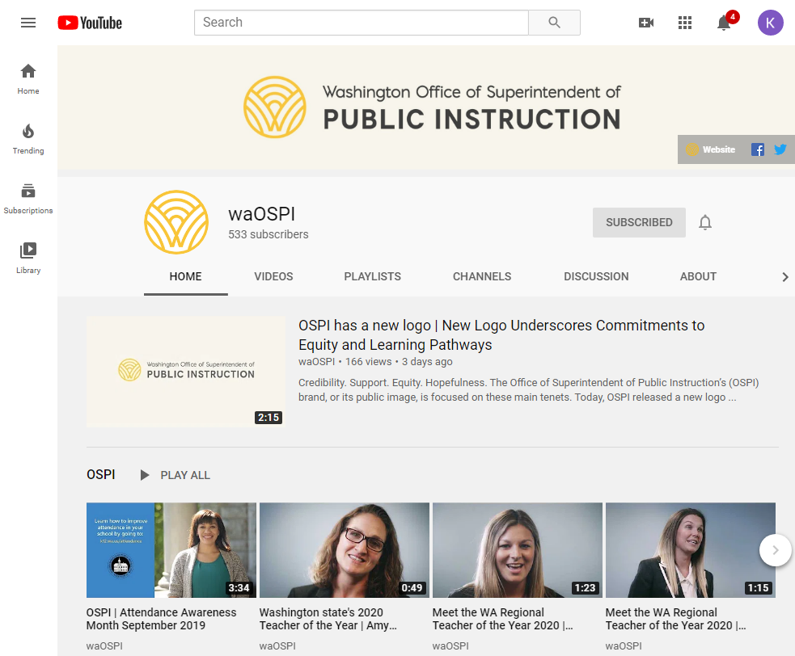
OSPI YouTube Channel
Did you know you can subscribe to the OSPI YouTube Channel?
Watch our past webinars!
Youtube.com/waOSPI
Notes:
Did you know our webinars are all posted on OSPI’s YouTube channel? If you want great ideas from Washington schools you should definitely subscribe!

Slide 12

Next Month
April 8, 2019
High School & Beyond Plan101: Increasing Engagement with High School & Beyond Planning
10 a.m. – 11 a.m.
High School & Beyond 201: Collaborating for Student Success: Alignment of High School & Beyond Planning and IEP’s
3 p.m. – 4 p.m.
Notes:
Next month we’re going to be talking about how High School and Beyond Planning.
These links will be in the chat if you want to register now. Please share this link with friends who may be interested!

Slide 13

Objectives
  Understand how to engage expertise to support inclusive practices
  Hear how to reduce barriers to inclusive practices
  Learn from a district how scheduling drives inclusive practices
  Identify resources to support inclusive efforts

Slide 14
Who Are We?
Bonnie Zimmerman
Tiered Supports Program Specialist
OSPI
Paula Kitzke
Program Review Supervisor
OSPI
Dr. Cassie Martin
Senior Inclusion Specialist/Ties Project Manager/Demonstration Sites Lead
University of Washington
Megan Funes
Principal
Endeavour Elementary Issaquah School
District
Alexandria Haas
Principal
McMicken Heights Elementary Highline School District
Notes:
Joining us today from OSPI’s Special Education Department is Paula Kitzke, Program Review Supervisor.
Paula invited Dr. Cassie Martin, Senior Inclusion specialist/Ties Project Manager and Demonstration Sites Lead from the University of Washington; Alexandria Haas, Principal, McMicken Elementary, Highline School District; and Megan Funes, Principal, Endeavor Elementary, Issaquah School District.
Thanks for all the work you’ve done to share your experiences with our audience!

Slide 15

Questions & Polling 1
Who’s here?
Administrator
Counselor
Teacher
Parent
ESD
District
Continuous Improvement Partner or Coach
Grad Specialist
Community Based Organization
Paraprofessional
Other
Has your school been identified for Comprehensive or Targeted Supports by OSPI?
Yes
No
Not Sure
How familiar are you with our topic?
Very
Somewhat
It’s new!
Notes:
We like to get to know our audience so that we can tailor our content to your needs.

Slide 16
Implementing and Sustaining Inclusionary Practices: Master Scheduling

Slide 17
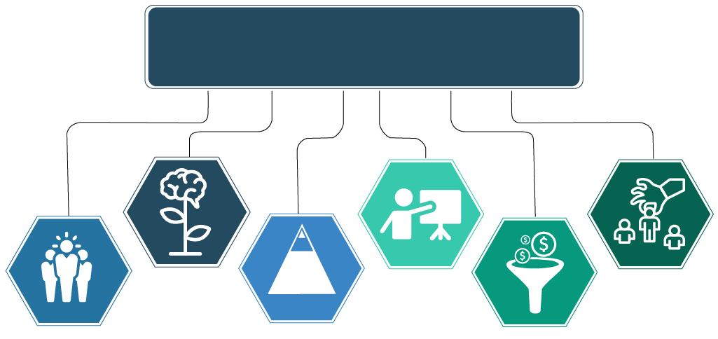
OSPI Priorities
OSPI Priorities:
Improving Outcomes for All Students
Growth Mindset
Increased expectations of
students with disabilities
(e.g., standards, instruction,
graduation, assessments,
attendance, IEP-related
Decisions, and post-school outcomes).
Professional Development
Joint training for general
educators, special educators,
paraeducators, administrators,
and parents/families (e.g., IEP
team members).
Recruitment & Retention
Preparation programs for administrators, general educators, special educators, related service providers, and paraeducators focused around instruction and support for students with disabilities.
Leadership
Support students with disabilities (including increased collaboration and ownership of school administrators and staff) and coordinated efforts with community organizations to improve results and reduce disproportionality.
Evidence-Based Practices
Instruction and interventions
within an MTSS framework and inclusionary practices
leading to increased access
and progress in Washington
grade-level learning standards.
Resource Allocation
Braided funding, consolidated grant application, reducing costs for administrative tasks, increasing direct support to students, and data-based decision making.
Notes:
Why do we as a state and as school counselors need to think differently about how we serve SWD?

Slide 18

Inclusionary Practices Implementation
In 2019, the legislature passed ESHB 1109:
$25M for inclusionary professional development
($10M for 2019-20; $15M for 2020-21)
To implement & support inclusionary practices, with an emphasis on coaching and mentoring for public school teachers
Data-informed decision making
Project Implementation webpage

Slide 19


Statewide Trends from Washington Report Card & the Healthy Youth Survey
9th Grade SWDs On-track 59.4%
67.5% of SWDs are engaged in education, training or employment
Graduation Rate SWD 62.1%
57.7% of SWDs spend 80-100% of the day in the general education classroom
62.1%
SWD Graduated in 4 years Class of 2019
*OSPI Report Card & Healthy Youth Survey data
Notes:
Research consistently supports a positive link between access to instruction in general education settings and improved outcomes for students. Research (& our student demographics!) also show 85-90% of students with disabilities can progress in grade-level curriculum with appropriate supports. Washington State is in the lowest quintile for inclusion nationwide, with 58% of students with disabilities included in general education settings for 80–100% of the school day. For students of color, that level of access falls to 48.7%. Extensive research on the efficacy of inclusion shows that inclusionary teaching yields significant improvements in student academic performance (in all subjects) and improvements in social and emotional outcomes as compared to teaching in separate settings. Inclusionary practices have been shown to reduce behavioral infractions, student absences, and referrals to special education. In inclusive schools, students not only have access to the general education curriculum but they also receive the supports they need to participate in this instruction and to be successful.
Reference data…
The data bolsters a sense of urgency to commit to a culture of equity through implementation of inclusionary practices.

Slide 20
Systems Level Supports for Inclusionary Practices
Locale
Roles
Leadership
Staffing
Experience
Notes:
Staffing: Schools that implement innovative inclusionary practices support clarity of the vision with effective staffing structures. Those structures are recognized as creating some staffing discomfort while creating new opportunities to address successful academic and behavioral outcomes for students with disabilities. Practitioners may find themselves providing support to new groups of students – they may also identify discomfort in their new learning.
Locale: Consideration of the location of instructional settings supports inclusionary practices. Are students assigned to home schools/campuses? Are students placed into general education classroom as a first consideration? Are special education instructional places integrated within the school facility? Are student placements based on need – not labels or presumed services?
Roles: Schools that implement inclusionary practices identify shared responsibilities among staff and students along with newly shared resources. Questions arise such as who is now responsible for things such as report cards? parent conferences? and monitoring course work completing? Each of those require attention to staff scheduling. Without clarification of role responsibilities, misunderstandings may occur which lead to subpar services and ineffective schedules.
Leadership: In special education research, school and district leaders are routinely referred to as “ground zero” for any change initiative.
Schools that implement inclusionary practices have leaders that recognize the need shifts in scheduling for instruction, assessment, communications, record keeping, common planning times, grade level meetings, and basic knowledge of the students that need to be served.
Experience: School leaders, teachers, practitioners, families, students, and community partners who have been implementing inclusionary practices are vital resources as school identify their needs for targeted learning opportunities.

Slide 21
Big Ideas
Reimagine
Culture
Collaboration
Notes:
Reimagine: redefining roles of school leaders, teachers, paras, students. Need to be able to rely on a cohesive school structure. Shared responsibilities. Shared resources. Shifts may be identified for content or grade level professional development, grade level or subject matter resources, creating effective student assistance teams, developing meeting schedules that are sustainable overtime and providing coaches in effective, timely capacities.
Culture: the provision of extra common planning time, and fiscal, human, technological, and organizational resources to motivate experimentation with new practices; and the collaborative development and communication of a well-formulated plan of action for transforming the culture and practice of a school
Collaboration: The National Center on Educational Restructuring and Inclusion, reported that creating planning teams, scheduling time for teachers to work and teach together, recognizing teachers as problem solvers, conceptualizing teachers as frontline researchers, and effectively collaborating with parents are all dimensions reported as crucial to successful collaboration.(The National Center on Educational Restructuring and Inclusion, 1995). MTSS & RtI – are systems that blur the lines between general education and special education in inclusive schools.

Slide 22
High Leverage Support Examples
Universal
Targeted
Frameworks
Personalized
Schedules
Strategies
PD
Equity
Accountability
Notes:
(Revise Notes)
Universal Design for Learning (UDL)
Data - dives
Master Scheduling to support inclusion
Frameworks:
Differentiated instruction
Students engaged in core content
Multitiered Systems of Support (MTSS)
Positive Behavior Interventions & Support (PBIS)
Coteaching and coplanning
Inclusive IEPs
PD:
Flexible service delivery
Leadership development
Blended learning
Family/community partnerships
Schedules:
Embedded academic instruction in general education
Use of assistive technology (AT)
Social emotional learning (SEL)
Culturally responsive pedagogy
Visible learning
Data literacy and data analysis protocols
Teacher collaboration
Inclusive extracurricular activities
PLCs that include inclusive viewpoints
Embedded nonacademic instruction in general education
Inclusive vision and mission
Teaching self determination
Person-centered/Strengths based planning
Personalized : Successful personalized learning requires prepared and supported educators. Leaders must know the strengths and needs of educators and provide continued professional development and support so educators can better meet the needs of all students. https://www.ncld.org/wp-content/uploads/2016/04/PL-RoadmapForLeaders.Fin_.pdf

Slide 23
What Advice Would You Give To Schools Starting This Work?
Developing
Recognize the urgency
Implementing
Ready, set, go!
Involve students
Sustaining
Recognize opportunities
Practice reflection
Common goals
Notes:
Developing : Identify necessary human, social and material resources. Create committed teams. Communicate expectations. How will you support ongoing collaboration? Build capacity for engagement, reflection ( what is working , what is not and why not?) ,
Implementing: Provide requisite training to staff. Gather feedback and impact data.
Sustaining: Identify and implement actions for improvements. What outcomes are you striving to maintain and improve – staff/ students (academic, social, behavioral,)

Slide 24
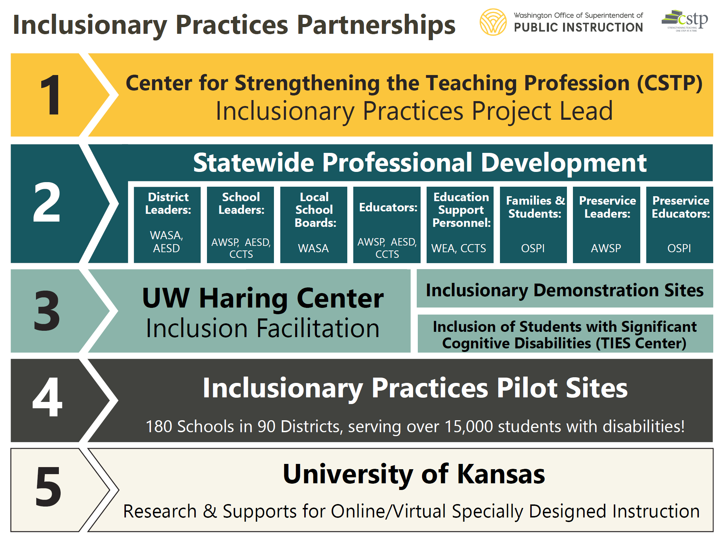
Inclusionary
Practices

Slide 25
Questions & Polling 2
Please type in the chat: What systems level supports are you currently implementing?

Slide 26
What Does it Look Like in Real Life?
McMicken Heights Elementary

Slide 27
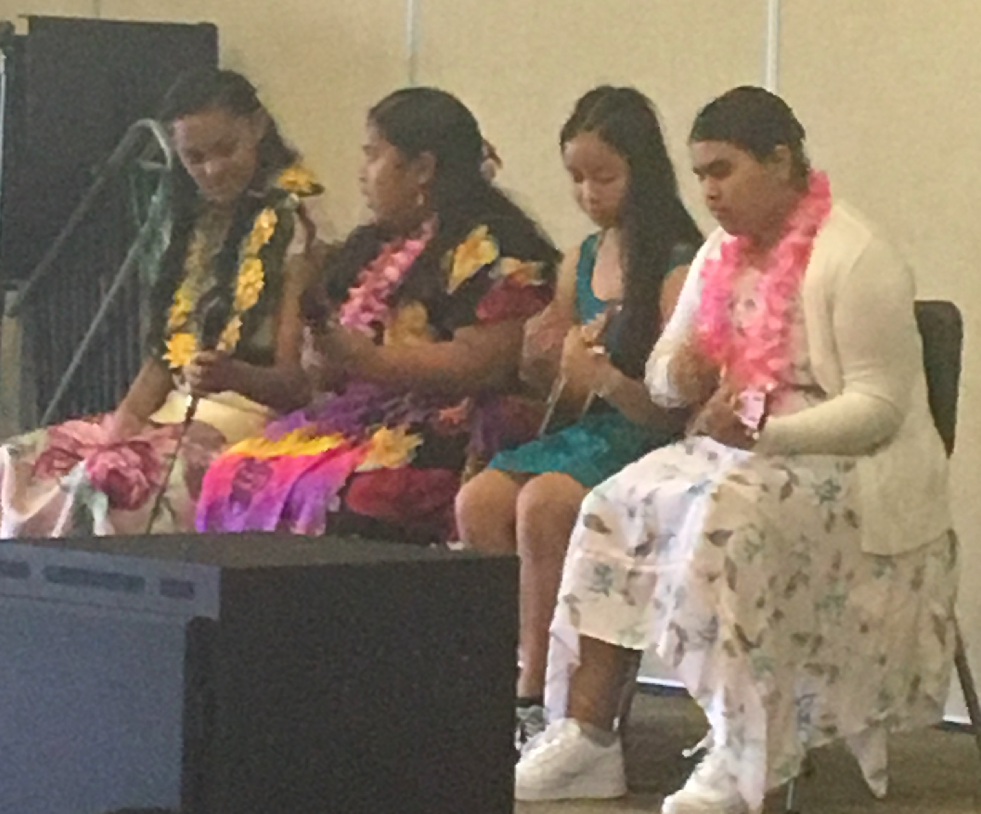
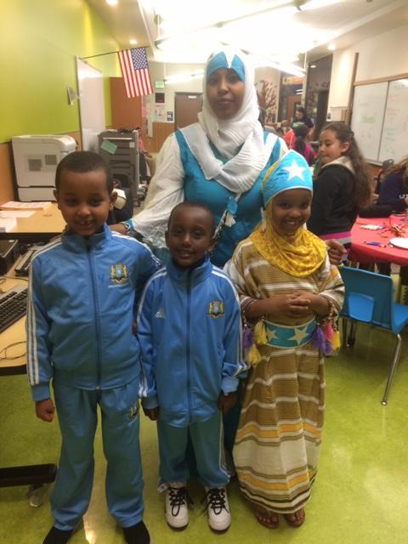
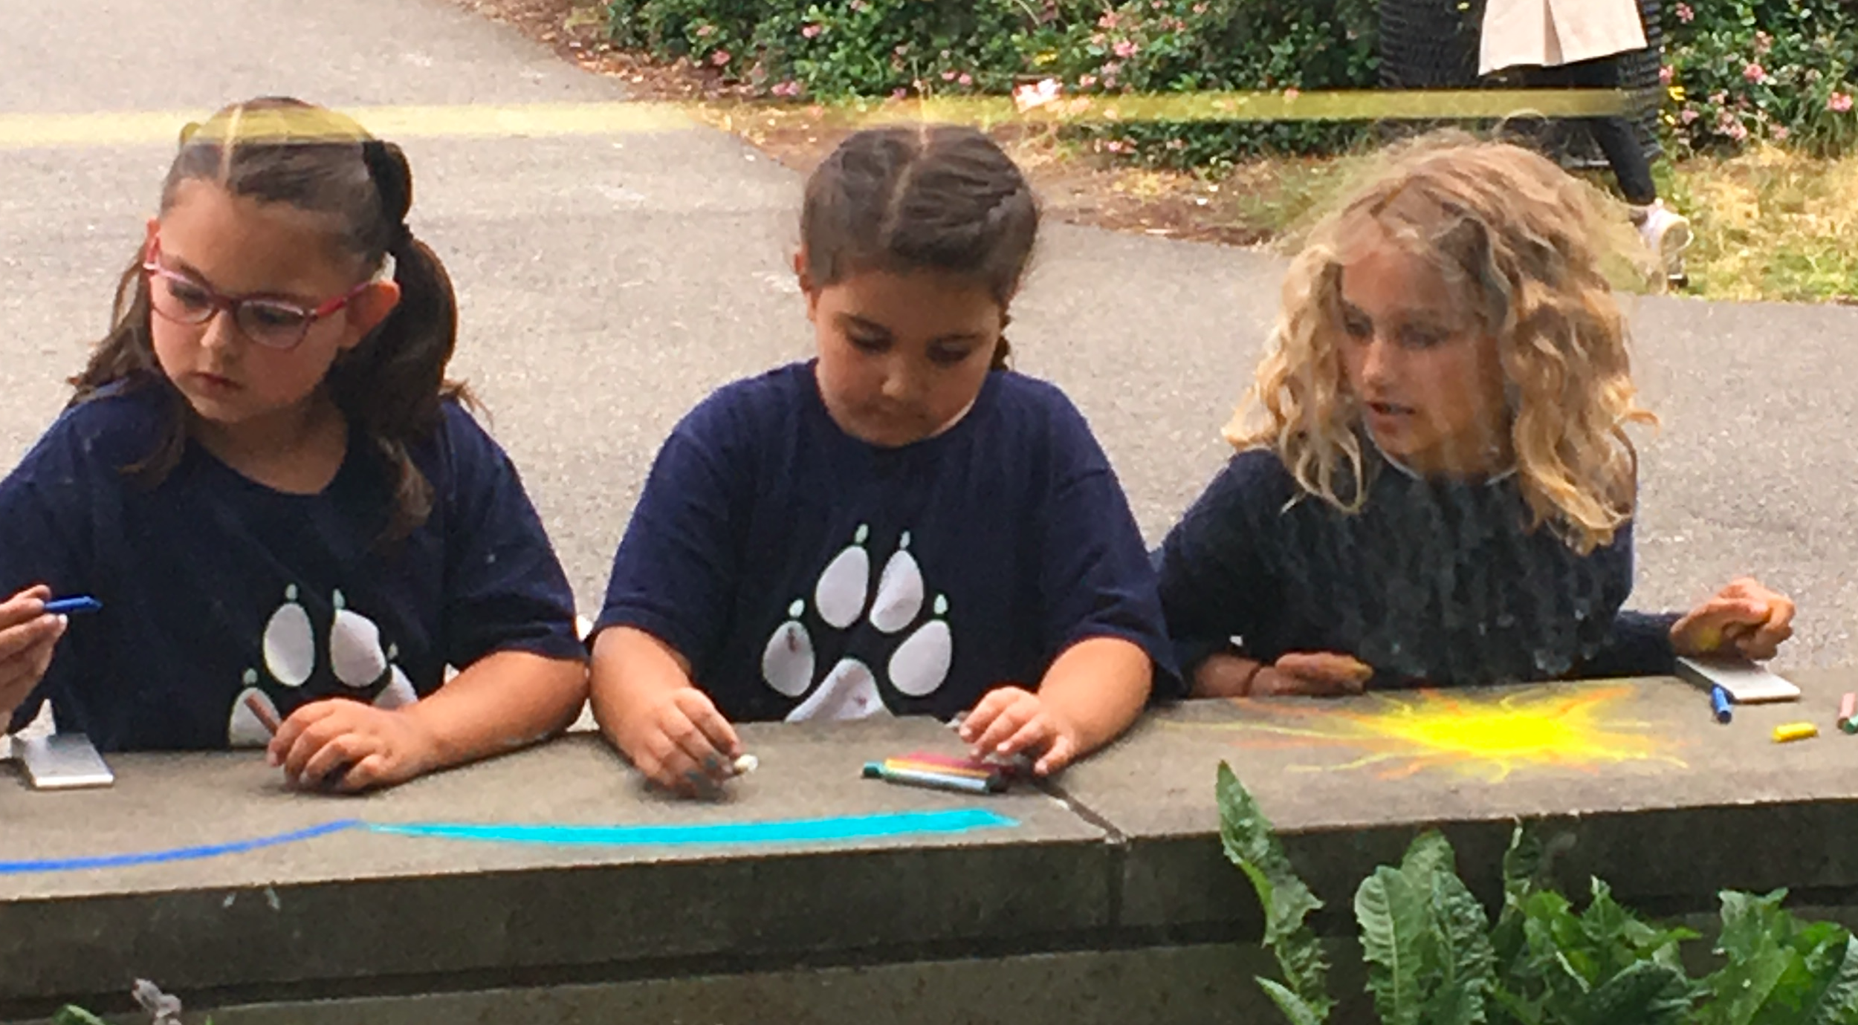
We are McMicken Elementary
27
Notes:
Demographics, about the school - Alex

Slide 28
Our Journey
Taking
Taking our first steps: Laying the groundwork
Learning
Learning along the way: Navigating the twists and turns
Reaching
Reaching our destination: Reflection and next steps
Notes:
Alex points 1-2
Cassie points 3-4
Megan 5
We knew there were a lot of good things happening, and we were looking at how we could take those strengths, move forward and have a huge impact on students learning and staff were examining what it meant to be an inclusive school – taking all the pieces to build a master schedule to support the practices
Focus school for Special Education
Commitment to equity and McMicken has a highly diverse student body, including diverse learning needs
In the process of examining ways to maximize resources and improve student outcomes
Provided a unique opportunity to partner with consultant, Dr. Cassie Martin, who had a vision for an inclusive education labsite
Engaged, collaborative and reflective teaching community that had been cultivated to move inclusive practices forward
The destination is really that we are on a path of continuous improvement – always responding to the needs of our students

Slide 29
Developing a multiyear vision and plan
Vision:
Create an inclusive culture wherein we truly own all students and collaborate in order to design and implement a rigorous, accessible and equitable instructional program.
Notes:
McMicken Heights selected as a lab site to engage with UW in bottom up school reform to support inclusionary practices (Cassie)
4 year plan (bring up Alex’s 5 year plan document and walk through with group) (Alex)
The evolution of the master schedule – just an overview of what the impetus behind the work was, then we get into more detail later (Megan)
Alex talks about 5 year plan and then Megan talk about how the master schedule drove this work

Slide 30
Laying the groundwork
Implementation of research-based practices: Tier 1 supports and MTSS/RTI Models
Exploration of Co-Teaching: creating a model classroom
Supporting student needs outside of the core block: (success groups)
Master Schedule to support Co-Teaching: (specialist, common planning) creating a model classroom
Professional Development (turning over staff meetings to team time, DAP, inclusive PD, Release Days)
ALL staff are part of this work, through teacher leadership: Personalized/Visible Learning, SEL/PBIS systems, community partnerships, etc.
Notes:
Alex – Talk about where teachers were, what they understood, where they were because none of this was in place
Talk about year 1 rolls out of success blocks, then talk about coteach pilot, talk about data analysis protocols and progress monitoring,and what you put in place to support staff - - release days, common planning, etc.) – then refer back to 5 year plan to talk about how all this ties together to support inclusive education.

Slide 31
Master Scheduling
Special education services drives the Master Schedule
  Success Groups
  Co-teaching schedules
Common Planning Time for grade level teams (along with 3 Release Days throughout the year)
  Work with district departments to make sure itinerants can support the needed sections
Notes:
Megan -I changed LC to special education services, because EBC is included here too

Slide 32
Process For Building A Master Schedule
Support Staff (Recess, Lunch, In-Class Support)
Intervention/
SpEd Schedules
Grade Level Block Schedules
Need to make sure there is enough coverage for recesses/lunches Intervention blocks are supported by classified staff – can’t overlap with other activities | Work with LRC/EBC/Co-Teachers to determine the time and content of each intervention block Determine the classified staff that will support each intervention block | Once support schedule is figured out – grade level teams can determine when core content will be taught so it is not interrupted by pull out supports
Notes:
Megan

Slide 33
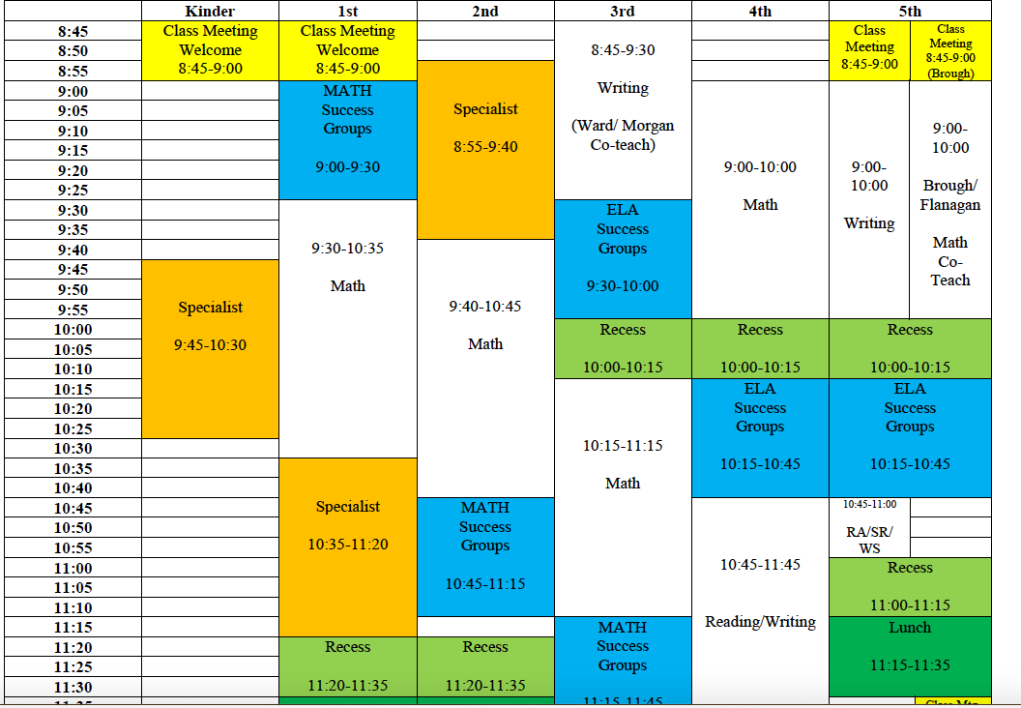
Master Schedule
33
Notes:
Megan

Slide 34
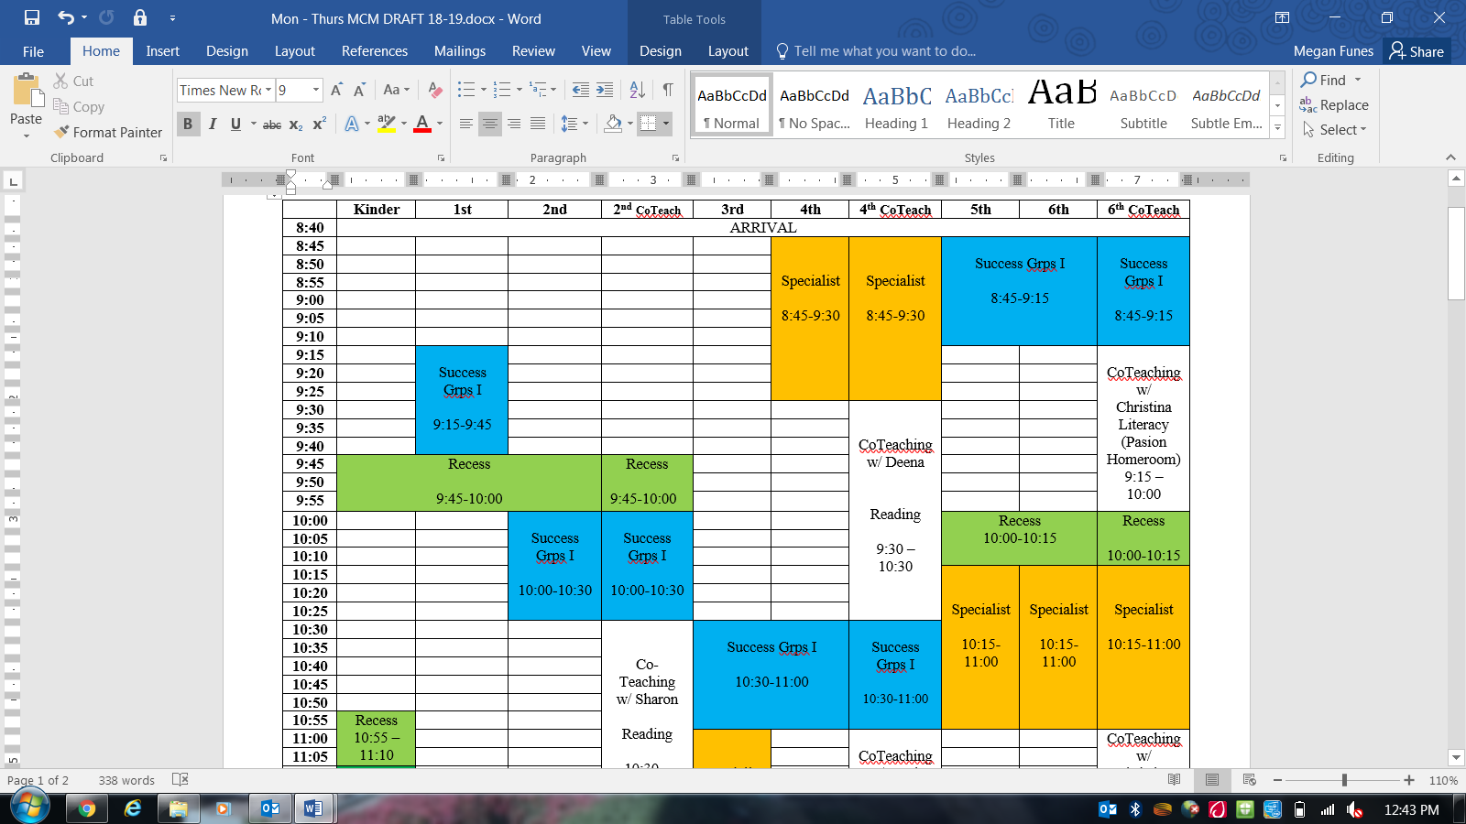
Master Schedule
Notes:
Megan

Slide 35
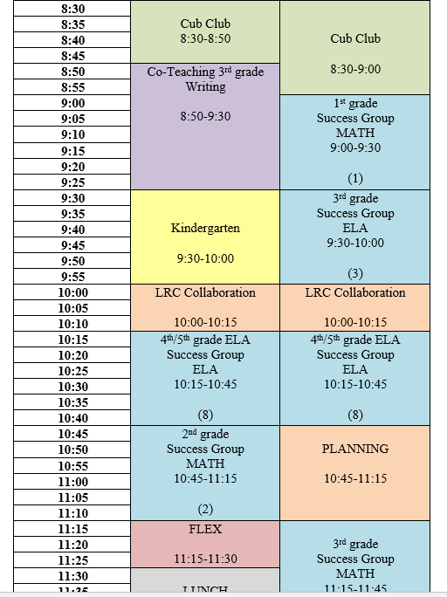
LRC Schedule Examples
LRC 1 |  | LRC 2
8:30-8:50 | Cub Club Support | 8:30-9:00 | Cub Club Support
8:50-9:30 | Co-Teach Writing w Ward | 9:00-9:30 | 1st grade Success Groups (1)
9:30-10:00 | Kindergarten Support | 9:30-10:00 | 3rd grade Success Groups (3)
10:00-10:15 | LRC COLLABORATION | 10:00-10:15 | LRC COLLABORATION
10:15-10:45 | 4th/5th Success Groups (ELA) (8) | 10:15-10:45 | 4th/5th Success Groups (ELA) (8)
10:45-11:15 | 2nd grade Success Groups (2) | 10:45-11:15 | PLANNING
11:15-11:30 | FLEX | 11:15-11:45 | 3rd grade Success Groups (3)
11:30-12:00 | LUNCH | 11:45-12:15 | LUNCH
12:00-12:30 | 1st grade Success Groups (1) | 12:15-12:45 | PLANNING
12:30-1:15 | PLANNING | 12:45-1:15 | 5th grade Success Groups (MATH) (4)
1:15-1:45 | 2nd grade Success Groups (2) | 1:15-2:15 | Co-Teach Reading
1:45-2:15 | FLEX | 2:15-3:05 | Kindergarten
2:15-2:45 | 4th grade Success Groups (MATH) (1) | 3:05-3:15 | Cub Club Check Out
2:45-3:05 | Extra Academic Service Block
3:05-3:15 | Cub Club Check Out
Notes:
Support vs Case Managers – look at numbers and determine if one or both LRC staff (or how many support staff) are needed to make sure students at that grade level receive their SDI
**Elementary Example – with limited to no experience at the secondary level, may not work the same when there are more moving parts.** Slide 34 is more universal

Slide 36
Inclusionary Practices that Support a strong Master Schedule
Changing mindsets: educating the whole community
Budget constraints: creative resource allocation
Tighten up tiered supports
Inclusion as a cultural initiative: Inclusionary practices are embedded in everything we do
Notes:
Cassie - bullet 1
Alex – bullet 2
Megan – bullet 3
Cassie – bullet 4

Slide 37
Our Supports for Students with Disabilities
Coteach in all intermediate classrooms
Coteach coach for all classrooms (differentiation)
Common planning times and release times for professional development
Flexibility based on student need, students receive the supports and services they needed through creative collaboration and intentional planning
Strong multitiered supports provided an infrastructure for data based decision making and shared expectations
Quarterly coteach meetings (focus on next steps and reflection and sharing “what works”)
Targeted SDI as part of the Success Group Blocks
Notes:
Alex – bullet 1, 2, 3, 4
Megan, bullet 5
Alex bullet 6,7

Slide 38
Findings
Increase in iReady scores and improved SBA comparison data
Removal from Focus school status for special education
Increased number of students in cotaught classrooms met their IEP goals, even as goals became more rigorous
Teachers reported greater and broader use of accommodations
Students reported feeling more confident and engaged
Teachers reported collateral benefit of professional growth
Special education teachers reported shared ownership of student outcomes for all students
Notes:
Megan – bullet 1 (say that we are going to be looking at the data in a minute)
Alex – bullet 2,
Cassie, bullets 3, 4, 5, 6 7

Slide 39
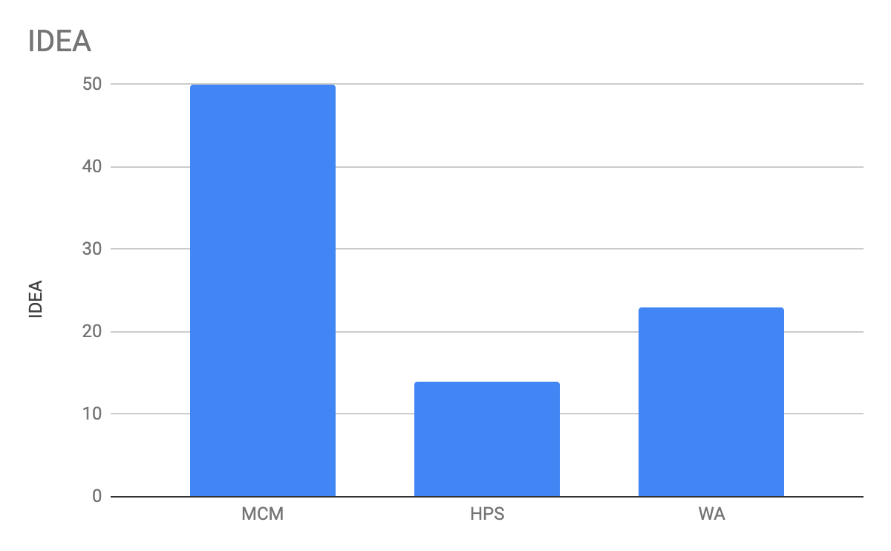
SBA 2019 Comparison: 4th Grade ELA
Notes:
Alex

Slide 40
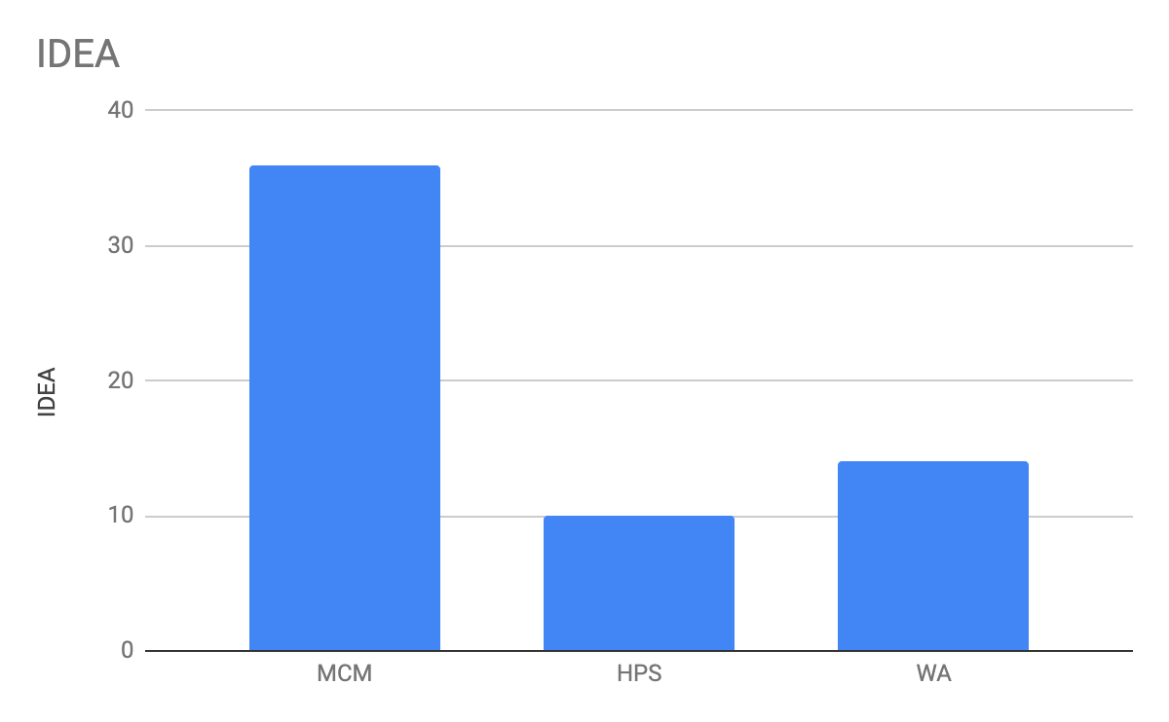
SBA 2019 Comparison: 5th Grade Math
Notes:
Alex

Slide 41
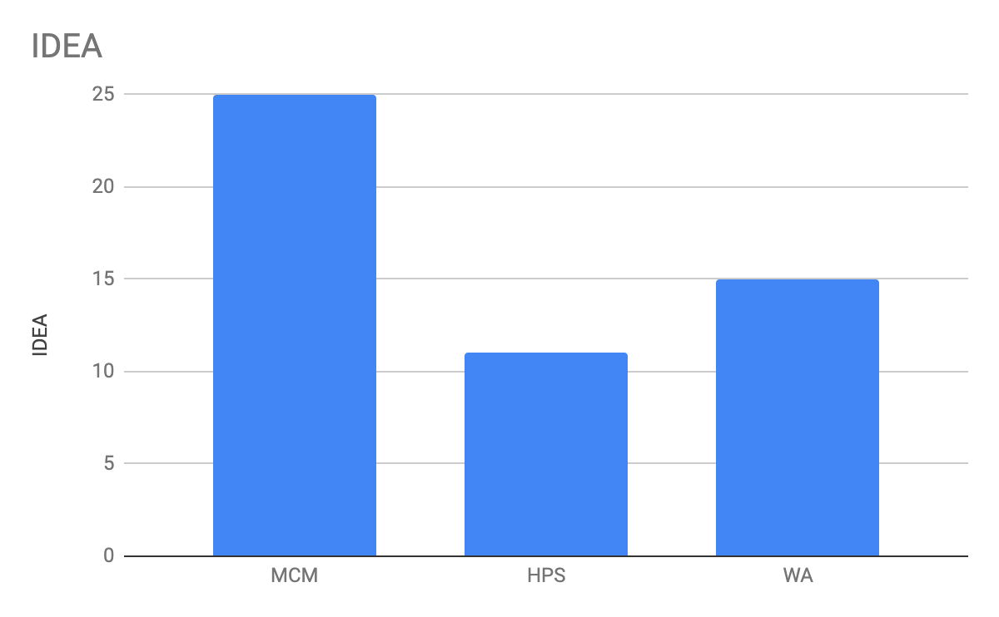
SBA 2019 Comparison: 6th Grade ELA
Notes:
Alex

Slide 42
What do our students say?
Most of the time when we were pulled and had to leave the classroom we were doing Science. We were doing all sorts of fun projects and we would have to leave the classroom. I don’t want to miss Science. I want to do my reading and math and get to do Science. Now I can do that. -6th grade student
I have grown in my writing because I get more individual help. I can use outlines and it helps me organize my writing. I have more tools I can use in class. - 5th grade student
I used to get really annoyed when teachers would tell me, “Oh, you don’t have to do this test, you can just read a book.” Or something cool was happening in class and I would get pulled out and wouldn’t get to do it because I had to go somewhere else and do my reading. I didn’t like it. Now I get to stay in class. -6th grade student
Notes:
Megan

Slide 43
Let’s hear from our teachers
Coteaching has given me more ideas about groupings or even how to structure a block of time in different ways to deliver core content. My differentiating practices have become much more fluid and responsive. We group and regroup students as needed, and we group ALL students, not just students with IEPs. Also, all of our students with IEPs met all their math goals and we were able to begin working on new goals. - 3rd Grade coteacher
My professional practice has changed because I have more knowledge about unit pacing and how to teach various math content areas. I am better at using data to drive instruction – this has been huge for me and I’m applying it to other content areas. It has been easier and more fun than I imagined it would be. – EBC teacher, 5th grade coteacher
Notes:
Alex

Slide 44
What Advice Would You Give To People Starting This Work?
Takeaway 1
Focus on what is working to aid in school based reform
Takeaway 2
Approach inclusion as a cultural initiative instead of a special education initiative
Takeaway 3
Identify which changes will have the greatest impact on student learning
Takeaway 4
Takeaway 5
Consider how the master schedule serves as the foundation for making it all work
Continuously improve
Notes:
Cassie

Slide 45
GATE Evaluation
This presentation will change my practice in the future:
Definitely
Probably
Not Sure
No – not helpful
This presentation was well organized with a variety of participant involvement:
Strongly agree
Agree
Disagree
Strongly Disagree
The presenters were content experts:
Strongly agree
Agree
Disagree
Strongly Disagree
The presentation met the stated learning objectives:
Strongly agree
Agree
Disagree
Strongly Disagree
GATE Feedback Survey
Notes:
We would like to get more information from our audience about our webinars, so we’re going to try something new this month and run our evaluation as a poll.
Thank you for letting us know what you think! If something comes to you later, you also always have the option to share your thoughts through our web evaluation, which is linked on our webinar reminders.

Slide 46
Resources

Slide 47
Resources
Funding
OSPI Unlocking Federal and State Program Funds to Support Student Success
Tools & Videos
About Inclusion
Creating an Inclusive Environment : A model for school Leaders
Websites
IRIS Center– Creating an Inclusive School Environment: A Model for School Leaders
May 20 – WASA/AWSP/WSSDA Equity Conference
Events
NCD – Segregation and SWD
CAST–The Universal Design for Learning Guidelines
LRE Self-Assessment (adapted from WestEd)
Trainer: Elise Brente, Visions for Learning LLC
Washington Middle School’s Peer Mentor Program – Featuring Melissa Charette ESD 113 Regional Teacher of the Year
GATE Equity Webinar: Building Inclusion into Culture: Mentoring Students with Disabilities - Featuring Melissa Charette ESD 113 Regional Teacher of the Year
3/11/2020 | 47

Slide 48
Contact us…….
Bonnie Zimmerman
Tiered Supports Program Specialist
OSPI
Bonnie.Zimmerman@k12.wa.us
Paula Kitzke
Program Review Supervisor
OSPI
Paula.Kitzke@k12.wa.us
Dr. Cassie Martin
Senior Inclusion Specialist/Ties Project Manager/Demonstration Sites Lead
cassiem@uw.edu
Megan Funes
Principal
Endeavour Elementary Issaquah School
District
FunesM@issaquah.wednet.edu
Alexandria Haas
Principal
McMicken Heights Elementary Highline School District
Alexandria.Haas@highlineschools.org
Notes:
Joining us today from OSPI’s Special Education Department is Paula Kitzke, Program Review Supervisor.
Paula invited Dr. Cassie Martin, Senior Inclusion Ppecialist/Ties Project Manager and Demonstration Sites Lead from the University of Washington; Alexandria Haas, Principal, McMicken Elementary, Highline School District; and Megan Funes, Principal, Endeavor Elementary, Issaquah School District.
Thanks for all the work you’ve done to share your experiences with our audience!

Slide 49

Get Personalized Assistance
Do you want personalized support?
We want to help connect you to the right people!
Use the Green Button!
Notes:
Another resource we’ve developed is a green button. We want you to be able to contact a real live person to help answer any questions you have. If you want to learn more, connect to a program or get some fresh ideas, we are here for you! Just click on the button and an OSSI staffer will help you get whatever you need.

Slide 51

Creative Commons
Except where otherwise noted, this work by the Office of Superintendent of Public Instruction is licensed under a Creative Commons 4.0 International License.

Slide 52
MTSS PLC Webinar Series
April 10
May 8
Rhonda Nese
Providing alternatives to exclusion
Devon Minch
Engaging Families in MTSS
Notes:
We have a sister webinar series, the MTSS PLC Webinar Series. They have a great line up of presenters and topics! This webinar would be useful for any school that wants to think more deeply about MTSS implementation. It was created to support early MTSS adopters in Washington and provides a great place to network and learn from other schools as well as nationally recognized experts in MTSS, we are linking to their bios, If you grab the slides. I know I’ll be there to soak up some knowledge, and hope you check it out too! 11-noon, usually second Friday of the month

Slide 53

2019-2020
Professional Learning Theme Calendar
August
Attendance
September
School Climate
October
Behavioral Health
November
9th Grade Success
December
Hope Science
January
College & Career Readiness
February
Language Learners
March
Students With Disabilities
April
High School & Beyond
May
Dual Credit & Multiple Pathways
June
Graduation Equity

Slide 54
Discussion Questions for the Chat
What are your next leadership moves?
What did you value in the presentation?
What questions do you still have?
What were the big ideas you got from today?
Notes:
As we wrap up today, we want to encourage you to take a moment to reflect on the webinar and discuss these questions. You can use the chat, the people around you, or just jot down some thoughts on a sticky note.
What were the big ideas for you?
What are your next leadership moves?
What did you value?
What questions are you still wondering about?
We’ll be here to answer questions for a little while, so take advantage of the opportunity to talk to our presenters with the Q&A. Thank you for joining us for GATE Equity Webinar.
We’ll see you next month as we explore social emotional learning!
<mute>

