Slide 1
Interpreting WCAS Item Specifications for Classroom Assessment
Notes:
[4 minutes]
Welcome participants to the professional learning module, Interpreting Washington Comprehensive Assessment of Science (WCAS) Item Specifications for Classroom Assessment.
If in-person, direct participants to sit at grade-level or school-team tables depending on the desired groupings.
Introduce facilitator and allow time for participants to introduce themselves. Introductions may not be necessary if the participants are all from the same site.

Slide 2
Objectives
Participants will gain an understanding of how WCAS design and development can be used to inform classroom instruction and assessment that is aligned to the state science standards. The state science standards are the Next Generation Science Standards (NGSS).
Participants will build their capacity to interpret the item specifications to develop multidimensional items aligned to classroom instruction for formative and/or summative use.
Notes:
[1 minute]
Provide participants with a general overview of the content that will be covered and the goals of the professional learning module.
Clarify that participants will write single items, not an item cluster (set of stimuli and items), during this module.

Slide 3
Contents
Introduction to WCAS Test Design and Item Specifications
Structure of an Item Specification
Using an Item Specification to Write Items Aligned to Instruction
Using a New S E P to Write Items Aligned to Instruction
Notes:
[30 seconds]
Quickly review the content that will be covered during the workshop and some of the activities the participants will be asked to participate in.

Slide 4
Introduction to the WCAS Test Design & Item Specifications
Notes:
[1 minute]
Remind participants that the first section is an introduction to the WCAS Test Design and Item Specifications document.
Have participants make their version of the document (hard-copy or online) easily available.

Slide 5
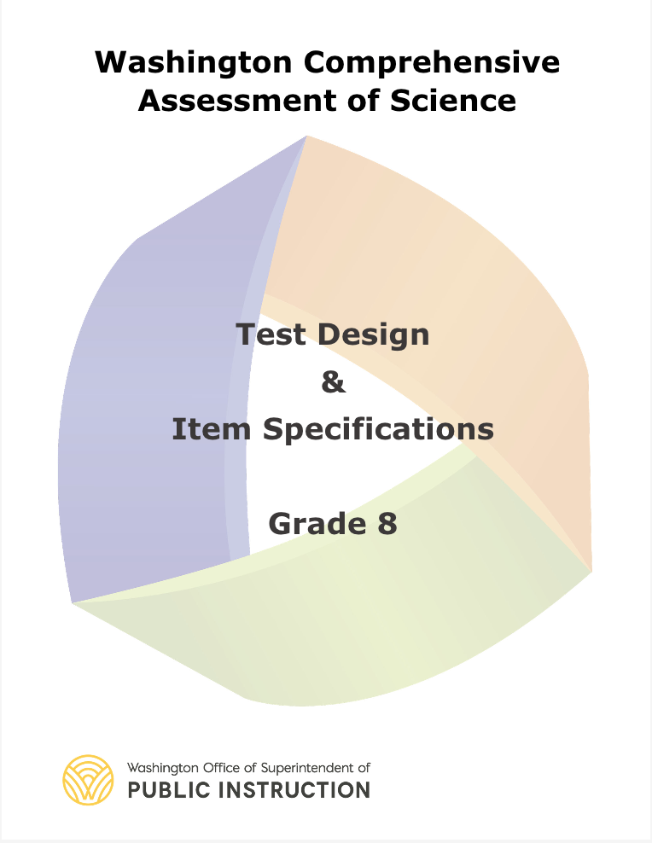
WCAS Test Design & Item Specifications Overview
This document includes:
Purpose
Structure of the Test
Item Types
Test Design
Standards Overview
Resources and References
Item Specifications
S E P, DCI, and CCC Vocabulary
Notes:
[1 minute]
Provide an overview of the document.
There is a Test Design and Item Specifications document for each grade band—grade 5, grade 8, and high school.
The first 15 pages of each document describe the structure of the WCAS:
the item types students will interact with;
the design of the test--such as testing length, testing time, and blueprints; and
an overview of the state science standards.
The remainder of each document includes the item specifications, followed by a vocabulary word list.

Slide 6
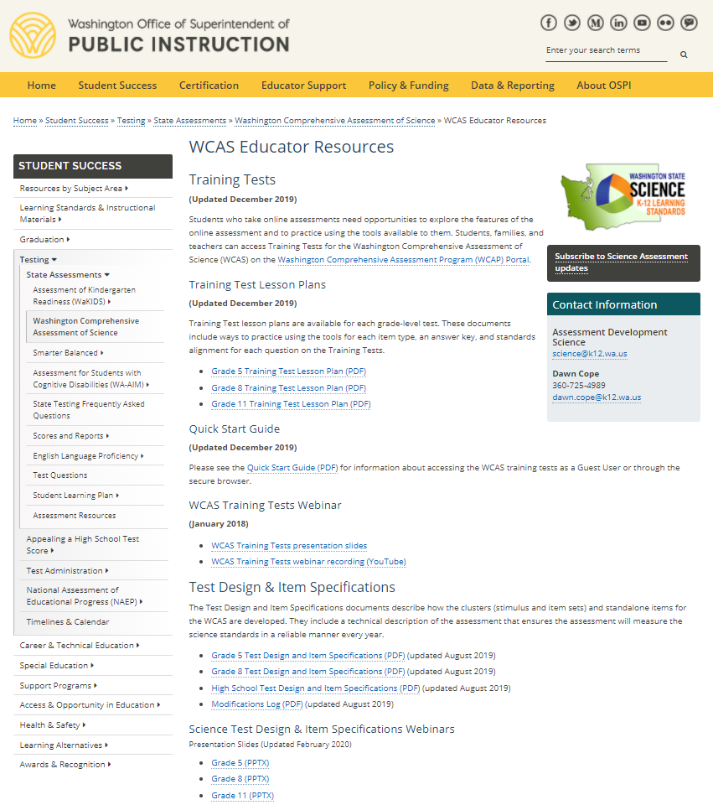
WCAS Educator Resources https://k12.wa.us/student-success/testing/state-testing-overview/washington-comprehensive-assessment-science/wcas-educator-resources
Notes:
[15 seconds]
To access the Test Design and Item Specifications documents, see the WCAS Educator Resources webpage (https://k12.wa.us/student-success/testing/state-testing-overview/washington-comprehensive-assessment-science/wcas-educator-resources).

Slide 7
WCAS Educator Resources https://k12.wa.us/student-success/testing/state-testing-overview/washington-comprehensive-assessment-science/wcas-educator-resources
Notes:
[15 seconds]
Additional resources found on this page include:
Training Tests

Slide 8
WCAS Educator Resources https://k12.wa.us/student-success/testing/state-testing-overview/washington-comprehensive-assessment-science/wcas-educator-resources
Notes:
[15 seconds]
Training Test Lesson Plans

Slide 9
WCAS Educator Resources https://k12.wa.us/student-success/testing/state-testing-overview/washington-comprehensive-assessment-science/wcas-educator-resources
Notes:
[15 seconds]
WCAS Training Tests Webinar

Slide 10
WCAS Educator Resources https://k12.wa.us/student-success/testing/state-testing-overview/washington-comprehensive-assessment-science/wcas-educator-resources
Notes:
[15 seconds]
Science Test Design & Item Specifications Webinars

Slide 11

Science Assessment Professional Development Opportunities https://k12.wa.us/student-success/resources-subject-area/science/science-assessment-professional-development-opportunities
Notes:
[1 minute]
It is strongly recommended that participants take the WCAS Clusters Nuts and Bolts Moodle Course (https://k12.wa.us/student-success/resources-subject-area/science/science-assessment-professional-development-opportunities) prior to participating in this professional learning module. Six free STEM clock hours are available upon completion of the course and the evaluation.
During the Moodle course, participants will:
learn how the performance expectations (PEs) from the state science standards are bundled for WCAS item clusters;
learn how phenomena are used to develop an item cluster;
learn how stimuli and items are written to form an item cluster;
learn how items and item clusters align to the three-dimensional WCAS Item Specifications and the three-dimensional state science standards; and
explore the WCAS online training tests.

Slide 12
Structure of an Item Specification
Notes:
[15 seconds]
Transition to a deep dive into the structure of an item specification.

Slide 13
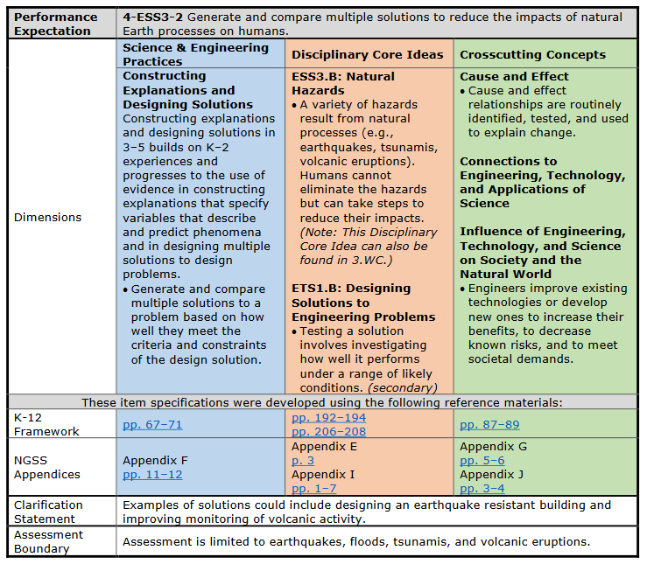
4-E S S 3-2
Front Page
Notes:
USE THIS SLIDE FOR A GRADES 3-5 GROUP
[30 seconds]
The Item Specification for a Performance Expectation (PE) is two pages. Most of the front-page language is copied from the NGSS.
For example, the arrow is pointing at the Performance Expectation Statement from the NGSS at the top of the page.

Slide 14
4-E S S 3-2
Front Page
Notes:
USE THIS SLIDE FOR A GRADES 3-5 GROUP
[1.5 minutes]
The foundation boxes, derived from the K-12 Framework for Science Education, show the dimensions that were used to construct this performance expectation (PE). The foundation boxes are indicated by the arrow that points to “Dimensions”.
The foundation box on the left is blue and describes the Science and Engineering Practice (SEP).
The foundation box in the middle is orange and describes the Disciplinary Core Ideas (DCIs).
The foundation box on the right is green and describes the Crosscutting Concepts (CCCs).

Slide 15
4-E S S 3-2
Front Page
Notes:
USE THIS SLIDE FOR A GRADES 3-5 GROUP
[1.5 minutes]
There are four rows under the foundation boxes.
The first row is indicated by the arrow and labeled K-12 Framework. The K-12 Framework links take you directly to pages with information about the SEP, DCI, and CCC for the PE. (Link to the K-12 Framework for Science Education: https://www.nap.edu/catalog/13165/a-framework-for-k-12-science-education-practices-crosscutting-concepts)
The second row is labeled NGSS Appendices. The NGSS Appendices describe the progression of each of the dimensions across K-12, detailing the targets for students at each grade band. The Appendices links take you directly to pages with information about the SEP, DCI and CCC for the PE.
(Link to the NGSS Appendices: https://www.nextgenscience.org/resources/ngss-appendices)
The third and fourth rows list the clarification statement and assessment boundary which also have language directly from the PE. Although the assessment boundary describes limitations for the WCAS, it is not intended to limit classroom instruction.

Slide 16
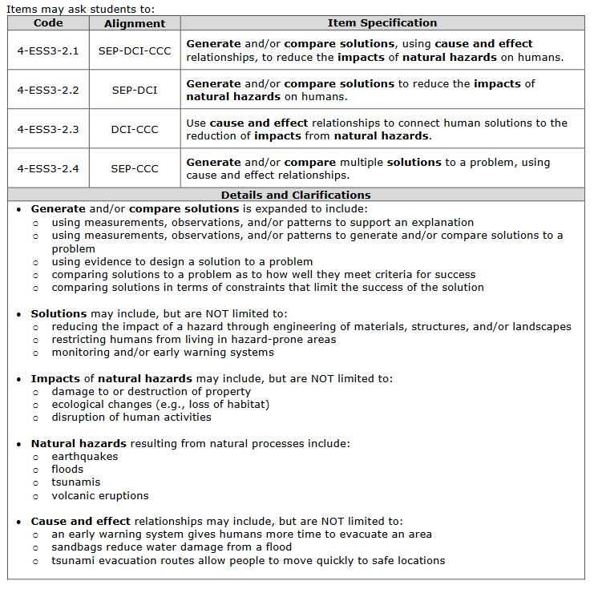
4-E S S 3-2
Back Page
Notes:
USE THIS SLIDE FOR A GRADES 3-5 GROUP
[3 minutes]
The back page of each item specification is specific to the development of items for the WCAS. This page always starts with a table of four item specification statements.
The code for the first item specification statement here is 4-ESS3-2.1. The first item specification statement describes how a three-dimensional item is written to assess the SEP, DCI, and CCC.
The second item specification statement, 4-ESS3-2.2, describes how a two-dimensional item is written to assess the SEP and DCI.
The third item specification statement, 4-ESS3-2.3, describes how a two-dimensional item is written to assess the DCI and CCC.
The fourth item specification statement, 4-ESS3-2.4, describes how a two-dimensional item is written to assess the SEP and CCC.
When you read each of the four specification statements, you’ll notice key words are bolded.

Slide 17
4-E S S 3-2
Back Page
Notes:
USE THIS SLIDE FOR A GRADES 3-5 GROUP
[12 minutes to allow for discussion and sharing out]
The “Details and Clarifications” section includes information that helps unpack those key words that are bold in the item specification statement at the top. It is important to note that the details and clarifications section provides EXAMPLES only, NOT exhaustive lists.
Let’s take a closer look at the Details and Clarifications.
You can see from the first set of bullets in the details and clarifications section that items assessing the SEP, Constructing Explanations and Designing Solutions, are not limited to only the language from the PE—“Generate and compare multiple solutions to . . . ” There are several ways to assess this SEP, as described in the sub-bullets. For example, you could write an item in which students are:
using measurements, observations, and/or patterns to support an explanation;
using measurements, observations, and/or patterns to generate and/or compare solutions to a problem;
using evidence to design a solution to a problem;
comparing solutions to a problem as to how well they meet criteria for success; OR
comparing solutions in terms of constraints that limit the success of the solution.
The second set of bullets unpacks the key word “solutions” by describing some examples of solutions to a problem in the context of the DCI, like:
reducing the impact of a hazard through engineering of materials, structures, and/or landscapes
restricting humans from living in hazard-prone areas
monitoring and/or early warning systems
The third set of bullets unpacks the key words “impacts” and “natural hazards.” These bullets describe some examples of the impacts of natural hazards on humans, like:
damage to or destruction of property
ecological changes (e.g., loss of habitat)
disruption of human activities
The fourth set of bullets provides additional examples of natural hazards, including:
earthquakes
floods
tsunamis
volcanic eruptions
The fifth set of bullets unpacks the key words “cause and effect” from the crosscutting concept. These bullets describe a few examples of cause-and-effect relationships, like:
an early warning system gives humans more time to evacuate an area
sandbags reduce water damage from a flood
tsunami evacuation routes allow people to move quickly to safe locations
Discussion: Have participants take a few minutes to consider other examples of natural hazards they might add to these bullets based on their experience, classroom instructional practices, and knowledge of their student population.
[Pause to allow for individual think time, small group conversation, and/or sharing with the large group. Examples of additional natural hazards might include events such as heat waves, drought, landslides, hurricanes, freezing rain, and/or forest fires.]

Slide 18
Details and Clarifications: A Closer Look
Notes:
USE THIS SLIDE FOR A GRADES 3-5 GROUP
[10 minutes to allow for discussion and sharing out]
Although each item specification is specific to the associated PE, there is consistency in the organization of the Details and Clarifications.
The first set of bullets always provides examples of how to incorporate the SEP into an assessment item.
The sub-bullets are templated in this section, meaning these sub-bullets are the same for all PEs within the grade band that have Constructing Explanations and Designing Solutions as the SEP. These sub-bullets were derived, in part, from the progressions in Appendix F—Science and Engineering Practices in the NGSS and in part from experience developing the WCAS.
Discussion: Have participants compare these bullets to the bullets in the item specifications for 4-PS3-4, 3-LS3-2, 4-ESS1-1, and 3-5-ETS1-2. For each of these, notice the consistency in the sub-bullets as well as the variation in the statement that precedes the sub-bullets. Consider the following questions for discussion:
How do the statements that precede the sub-bullets in each of the item specifications compare to each other?
How do these statements compare to the language of the PE statement on the first page of the item specification?
How do these statements compare to the grades 3-5 language for this SEP in Appendix F?
These are the specifications used for assessing the SEP on the WCAS. What are other ways you might address this SEP in a classroom assessment?
[Pause to allow for individual think time, small group conversation, and/or sharing with the large group.]

Slide 19
Details and Clarifications: A Closer Look
Notes:
USE THIS SLIDE FOR A GRADES 3-5 GROUP
[2 minutes]
The remainder of the bullets in the Details and Clarifications will vary significantly across the item specifications.
For this item specification, these three sets of bullets describe key components of the DCI and provide some specific DCI-related examples to clarify the intent of the DCI for an item assessing this PE. Remember, these lists are examples rather than exhaustive lists. When developing an assessment item for your classroom, keep in mind your students’ interests and their experiences, both within and beyond the classroom.

Slide 20
Details and Clarifications: A Closer Look
Notes:
USE THIS SLIDE FOR A GRADES 3-5 GROUP
[10 minutes to allow for activity and sharing out]
The last set of bullets gives some examples of how the CCC, Cause and Effect in this case, can be integrated with the DCI. You will likely have other examples from instruction aligned to this PE.
Discussion: Have participants compare the DCI- and CCC-related bullets in this example to one or two of the other item specifications (4-PS3-4, 3-LS3-2, 4-ESS1-1, and 3-5-ETS1-2). Ask participants to keep these questions in mind as they do their comparisons:
In what ways are the DCI-related bullets similar across the examples? In what ways are they different?
In what ways are the CCC-related bullets similar across the examples? In what ways are they different?
How could you use the examples in the Details and Clarifications to support you in developing classroom-based assessment items?
[Pause to allow for individual think time, small group conversation, and/or sharing with the large group.]

Slide 21
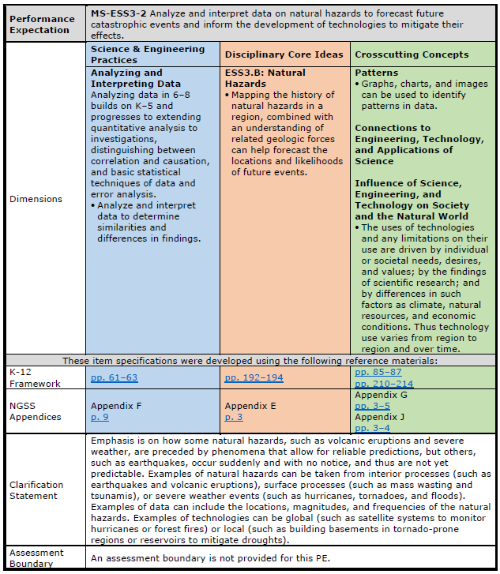
MS-E S S 3-2
Front Page
Notes:
USE THIS SLIDE FOR A GRADES 6-8 GROUP
[30 seconds]
The Item Specification for a Performance Expectation (PE) is two pages. Most of the front-page language is copied from the NGSS.
For example, the arrow is pointing at the Performance Expectation Statement from the NGSS at the top of the page.

Slide 22
MS-E S S 3-2
Front Page
Notes:
USE THIS SLIDE FOR A GRADES 6-8 GROUP
[1.5 minutes]
The foundation boxes, derived from the K-12 Framework for Science Education, show the dimensions that were used to construct this performance expectation (PE). The foundation boxes are indicated by the arrow that points to “Dimensions”.
The foundation box on the left is blue and describes the Science and Engineering Practice (SEP).
The foundation box in the middle is orange and describes the Disciplinary Core Ideas (DCIs).
The foundation box on the right is green and describes the Crosscutting Concepts (CCCs).

Slide 23
MS-E S S 3-2
Front Page
Notes:
USE THIS SLIDE FOR A GRADES 6-8 GROUP
[1.5 minutes]
There are four rows under the foundation boxes.
The first row is indicated by the arrow and labeled K-12 Framework. The K-12 Framework links take you directly to pages with information about the SEP, DCI, and CCC for the PE.
(Link to the K-12 Framework for Science Education: https://www.nap.edu/catalog/13165/a-framework-for-k-12-science-education-practices-crosscutting-concepts)
The second row is labeled NGSS Appendices. The NGSS Appendices describe the progression of each of the dimensions across K-12, detailing the targets for students at each grade band. The Appendices links take you directly to pages with information about the SEP, DCI and CCC for the PE.
(Link to the NGSS Appendices: https://www.nextgenscience.org/resources/ngss-appendices)
The third and fourth rows list the clarification statement and assessment boundary which also have language directly from the PE. Although the assessment boundary describes limitations for the WCAS, it is not intended to limit classroom instruction.

Slide 24
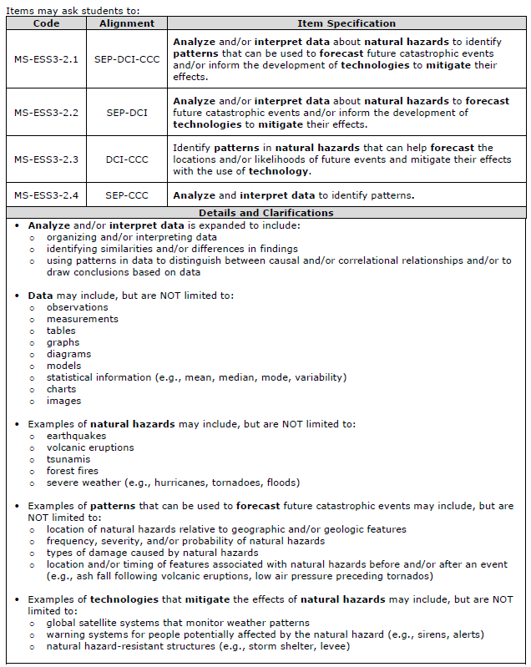
MS-E S S 3-2
Back Page
Notes:
USE THIS SLIDE FOR A GRADES 6-8 GROUP
[3 minutes]
The back page of each item specification is specific to the development of items for the WCAS. This page always starts with a table of four item specification statements.
The code for the first item specification statement here is MS-ESS3-2.1. The first item specification statement describes how a three-dimensional item is written to assess the SEP, DCI, and CCC.
The second item specification statement, MS-ESS3-2.2, describes how a two-dimensional item is written to assess the SEP and DCI.
The third item specification statement, MS-ESS3-2.3, describes how a two-dimensional item is written to assess the DCI and CCC.
The fourth item specification statement, MS-ESS3-2.4, describes how a two-dimensional item is written to assess the SEP and CCC.
When you read each of the four specification statements, you’ll notice key words are bolded.

Slide 25
MS-E S S 3-2
Back Page
Notes:
USE THIS SLIDE FOR A GRADES 6-8 GROUP
[12 minutes to allow for discussion and sharing out]
The “Details and Clarifications” section includes information that helps unpack those key words that are bold in the item specification statements at the top. It is important to note that the details and clarifications section provides EXAMPLES only, NOT exhaustive lists.
Let’s take a closer look at the Details and Clarifications.
You can see from the first set of bullets in the details and clarifications section that items assessing the SEP, Analyzing and Interpreting Data, are not limited to only the language from the PE —“Analyze and interpret data . . . ” There are several ways to assess this SEP, as described in the sub-bullets. For example, you could write an item in which students are:
organizing and/or interpreting data
identifying similarities and/or differences in findings
using patterns in data to distinguish between causal and/or correlational relationships and/or to draw conclusions based on data
The second set of bullets unpacks the key word “data” by listing some examples of types of data that could be included, like:
observations
measurements
tables
graphs
diagrams
models
statistical information (e.g., mean, median, mode, variability)
charts
images
The third set of bullets unpacks the key words “natural hazards” by listing examples of natural hazards:
earthquakes
volcanic eruptions
tsunamis
forest fires
severe weather (e.g., hurricanes, tornadoes, floods)
The fourth set of bullets incorporates the crosscutting concept by describing examples of patterns that can be used to forecast future catastrophic events:
location of natural hazards relative to geographic and/or geologic features
frequency, severity, and/or probability of natural hazards
types of damage caused by natural hazards
location and/or timing of features associated with natural hazards before and/or after an event (e.g., ash fall following volcanic eruptions, low air pressure preceding tornados)
The fifth set of bullets gives some examples of technologies that mitigate the effects of natural hazards:
global satellite systems that monitor weather patterns
warning systems for people potentially affected by the natural hazard (e.g., sirens, alerts)
natural hazard-resistant structures (e.g., storm shelter, levee)
Discussion: Have participants take a few minutes to consider other examples of natural hazards and/or technologies that they might add to these bullets based on their experience, classroom instructional practices, and knowledge of their student population.
[Pause to allow for individual think time, small group conversation, and/or sharing with the large group. Examples of additional natural hazards might include events such as heat waves, freezing rain, drought, and/or landslides.]

Slide 26
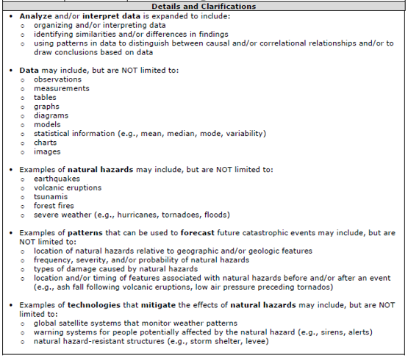
Details and Clarifications: A Closer Look
Notes:
USE THIS SLIDE FOR A GRADES 6-8 GROUP
[10 minutes to allow for discussion and sharing out]
Although each item specification is specific to the associated PE, there is consistency in the organization of the Details and Clarifications.
The first set of bullets always provides examples of how to incorporate the SEP into an assessment item.
The sub-bullets are templated in this section, meaning these sub-bullets are the same for all PEs within the grade band that have Analyzing and Interpreting Data as the SEP. These sub-bullets were derived, in part, from the progressions in Appendix F—Science and Engineering Practices in the NGSS and in part from experience developing the WCAS.
Discussion: Have participants compare these bullets to the bullets in the item specifications for MS-PS3-1, MS-LS4-3, and MS-ETS1-3. For each of these, notice the consistency in the sub-bullets as well as the variation in the statement that precedes the sub-bullets. Consider the following questions for discussion:
How do the statements that precede the sub-bullets in each of the item specifications compare to each other?
How do these statements compare to the language of the PE statement on the first page of the item specification?
How do these statements compare to the grades 6-8 language for this SEP in Appendix F?
These are the specifications used for assessing the SEP on the WCAS. What are other ways you might address this SEP in a classroom assessment?
[Pause to allow for individual think time, small group conversation, and/or sharing with the large group.]
For this item specification, the second set of bullets further clarifies the SEP by listing examples of types of data that may be included on the assessment.

Slide 27
Details and Clarifications: A Closer Look
Notes:
USE THIS SLIDE FOR A GRADES 6-8 GROUP
[2 minutes]
The remainder of the bullets in the Details and Clarifications will vary significantly across the item specifications.
The third set of bullets in this item specification provides some DCI-related examples to clarify the intent of the DCI for an item assessing this PE. Remember, these lists are examples rather than exhaustive lists. When developing an assessment item for your classroom, keep in mind your students’ interests and their experiences, both within and beyond the classroom.

Slide 28
Details and Clarifications: A Closer Look
Notes:
USE THIS SLIDE FOR A GRADES 6-8 GROUP
[10 minutes to allow for discussion and sharing out]
The fourth set of bullets gives some examples of how the CCC, Patterns in this case, can be integrated with the DCI. You will likely have other examples from instruction aligned to this PE.
This PE also has a second crosscutting concept from Influence of Science, Engineering and Technology on Society and the Natural World. The fifth set of bullets describes examples of how that crosscutting concept can be integrated with the DCI.
Discussion: Have participants compare the DCI- and CCC-related bullets in this example to one or two of the other item specifications (MS-PS3-1, MS-LS4-3, and MS-ETS1-3). Ask participants to keep these questions in mind as they do their comparisons:
In what ways are the DCI-related bullets similar across the examples? In what ways are they different?
In what ways are the CCC-related bullets similar across the examples? In what ways are they different?
How could you use the examples in the Details and Clarifications to support you in developing classroom-based assessment items?
[Pause to allow for individual think time, small group conversation, and/or sharing with the large group.]

Slide 29
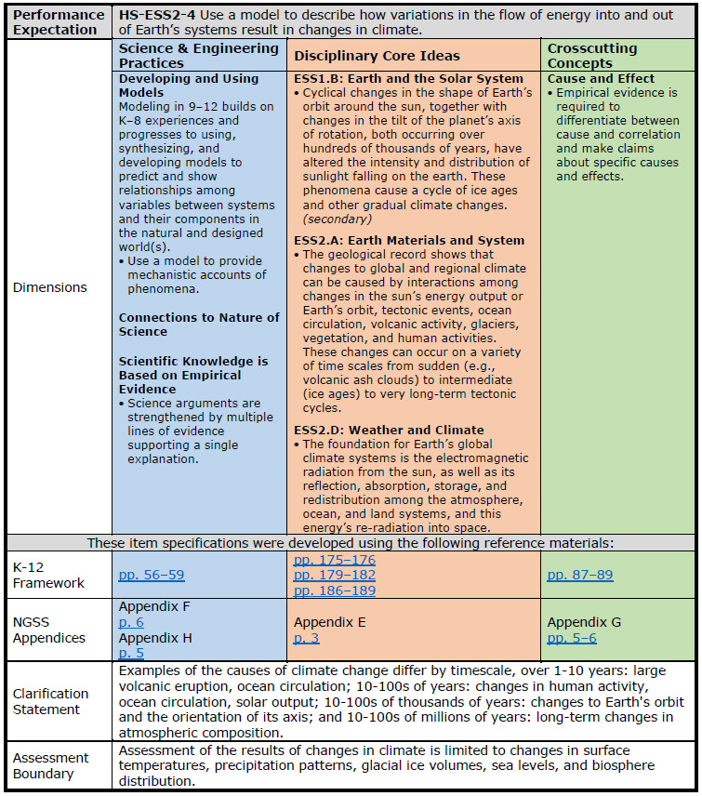
HS-E S S 2-4
Front Page
Notes:
USE THIS SLIDE FOR A HIGH SCHOOL-LEVEL GROUP
[30 seconds]
The Item Specification for a Performance Expectation (PE) is two pages. Most of the front-page language is copied from the NGSS.
For example, the arrow is pointing at the Performance Expectation Statement from the NGSS at the top of the page.

Slide 30
HS-E S S 2-4
Front Page
Notes:
USE THIS SLIDE FOR A HIGH SCHOOL-LEVEL GROUP
[1.5 minutes]
The foundation boxes, derived from the K-12 Framework for Science Education, show the dimensions that were used to construct this performance expectation (PE). The foundation boxes are indicated by the arrow that points to “Dimensions”.
The foundation box on the left is blue and describes the Science and Engineering Practice (SEP).
The foundation box in the middle is orange and describes the Disciplinary Core Ideas (DCIs).
The foundation box on the right is green and describes the Crosscutting Concepts (CCCs).

Slide 31
HS-E S S 2-4
Front Page
Notes:
USE THIS SLIDE FOR A HIGH SCHOOL-LEVEL GROUP
[1.5 minutes]
There are four rows under the foundation boxes.
The first row is indicated by the arrow and labeled K-12 Framework. The K-12 Framework links take you directly to pages with information about the SEP, DCI, and CCC for the PE.
(Link to the K-12 Framework for Science Education: https://www.nap.edu/catalog/13165/a-framework-for-k-12-science-education-practices-crosscutting-concepts)
The second row is labeled NGSS Appendices. The NGSS Appendices describe the progression of each of the dimensions across K-12, detailing the targets for students at each grade band. The links take you directly to Appendices pages with information about the SEP, DCI and CCC for the PE.
(Link to the NGSS Appendices: https://www.nextgenscience.org/resources/ngss-appendices)
The third and fourth rows list the clarification statement and assessment boundary which also have language directly from the PE. Although the assessment boundary describes limitations for the WCAS, it is not intended to limit classroom instruction.

Slide 32
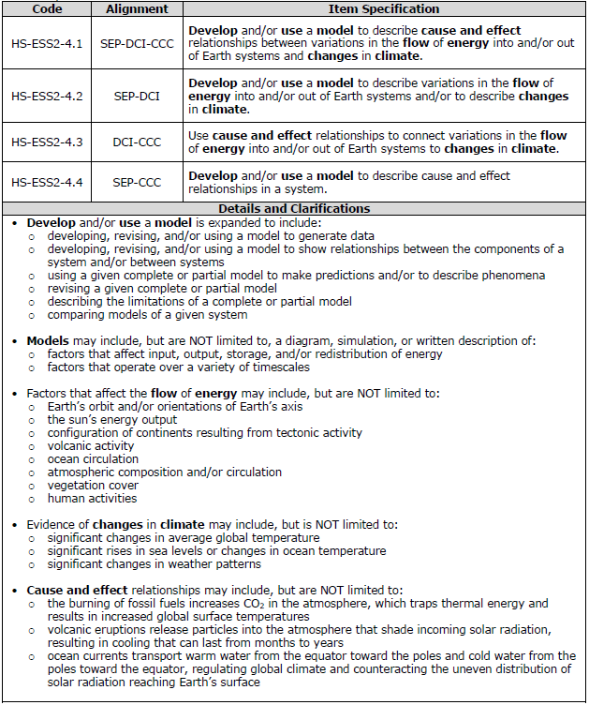
HS-E S S 2-4
Back Page
Notes:
USE THIS SLIDE FOR A HIGH SCHOOL-LEVEL GROUP
[3 minutes]
The back page of each item specification is specific to the development of items for the WCAS. This page always starts with a table of four item specification statements.
The code for the first item specification statement here is HS-ESS2-4.1. The first item specification describes how a three-dimensional item is written to assess the SEP, DCI, and CCC.
The second item specification statement, HS-ESS2-4.2, describes how a two-dimensional item is written to assess the SEP and DCI.
The third item specification statement, HS-ESS2-4.3, describes how a two-dimensional item is written to assess the DCI and CCC.
The fourth item specification statement, HS-ESS2-4.4, describes how a two-dimensional item is written to assess the SEP and CCC.
When you read each of the four specification statements, you’ll notice key words are bolded.

Slide 33
HS-E S S 2-4
Back Page
Notes:
USE THIS SLIDE FOR A HIGH SCHOOL-LEVEL GROUP
[12 minutes to allow for discussion and sharing out]
The “Details and Clarifications” section includes information that helps unpack those key words that are bold in the item specification statements at the top. It is important to note that the details and clarifications section provides EXAMPLES only, NOT exhaustive lists.
Let’s take a closer look at the Details and Clarifications.
You can see from the first set of bullets in the details and clarifications section that items assessing the SEP, Developing and Using Models, are not limited to only the language from the PE —“Use a model to describe how . . . ” There are several ways to assess this SEP, as described in the sub-bullets. For example, you could write an item in which students are:
developing, revising, and/or using a model to generate data
developing, revising, and/or using a model to show relationships between the components of a system and/or between systems
using a given complete or partial model to make predictions and/or to describe phenomena
revising a given complete or partial model
describing the limitations of a complete or partial model
comparing models of a given system
The second set of bullets unpacks the key word “models” by listing some examples of types of models that could be included, like:
A diagram, simulation, or written description of:
factors that affect input, output, storage, and/or redistribution of energy
factors that operate over a variety of timescales
The third set of bullets unpacks the key words “flow of energy” by listing examples:
Earth’s orbit and/or orientations of Earth’s axis
the sun’s energy output
configuration of continents resulting from tectonic activity
volcanic activity
ocean circulation
atmospheric composition and/or circulation
vegetation cover
human activities
The fourth set of bullets describes examples of evidence of changes in climate:
significant changes in average global temperature
significant rises in sea levels or changes in ocean temperature
significant changes in weather patterns
The fifth set of bullets unpacks the key words “cause and effect” by describing examples of cause and effect relationships, like:
the burning of fossil fuels increases CO₂ in the atmosphere, which traps thermal energy and results in increased global surface temperatures
volcanic eruptions release particles into the atmosphere that shade incoming solar radiation, resulting in cooling that can last from months to years
ocean currents transport warm water from the equator toward the poles and cold water from the poles toward the equator, regulating global climate and counteracting the uneven distribution of solar radiation reaching Earth’s surface
Discussion: Have participants take a few minutes to consider other examples of models, evidence of climate change and/or cause and effect relationships that they might add to these bullets based on their experience, classroom instructional practices, and knowledge of their student population.
[Pause to allow for individual think time, small group conversation, and/or sharing with the large group. Other examples of additional evidence of climate change might include the shrinking of ice sheets, glacial retreat, or ocean acidification.]

Slide 34
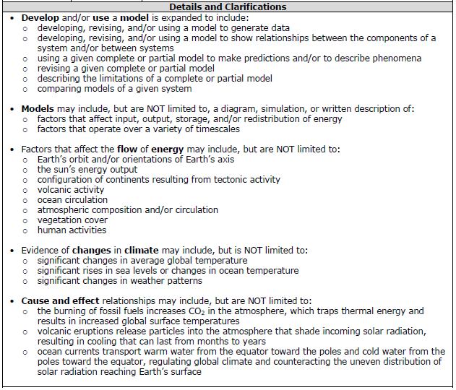
Details and Clarifications: A Closer Look
Notes:
USE THIS SLIDE FOR A HIGH SCHOOL-LEVEL GROUP
[10 minutes to allow for discussion and sharing out]
Although each item specification is specific to the associated PE, there is consistency in the organization of the Details and Clarifications.
The first set of bullets always provides examples of how to incorporate the SEP into an assessment item.
The sub-bullets are templated in this section, meaning these sub-bullets are the same for all PEs within the grade band that have Developing and Using Models as the SEP. These sub-bullets were derived, in part, from the progressions in Appendix F—Science and Engineering Practices in the NGSS and in part from experience developing the WCAS.
Discussion: Have participants compare these bullets to the bullets in the item specifications for HS-PS3-2, HS-LS2-5, and HS-ESS2-6. For each of these, notice the consistency in the sub-bullets as well as any variations in the statement that precedes the sub-bullets. Consider the following questions for discussion:
How do the statements that precede the sub-bullets in each of the item specifications compare to each other?
How do these statements compare to the language of the PE statement on the first page of the item specification?
How do these statements compare to the grades 9-12 language for this SEP in Appendix F?
These are the specifications used for assessing the SEP on the WCAS. What are other ways you might address this SEP in a classroom assessment?
[Pause to allow for individual think time, small group conversation, and/or sharing with the large group.]

Slide 35
Details and Clarifications: A Closer Look
Notes:
USE THIS SLIDE FOR A HIGH SCHOOL-LEVEL GROUP
[2 minutes]
The remainder of the bullets in the Details and Clarifications will vary significantly across the item specifications.
For this item specification, the second set of bullets further clarifies the SEP in the context of the DCIs by listing examples of models that may be included on the assessment.
The third and fourth sets of bullets provide some DCI-related examples to clarify the intent of the DCI for an item assessing this PE. Remember, these lists are examples rather than exhaustive lists. When developing an assessment item for your classroom, keep in mind your students’ interests and their experiences, both within and beyond the classroom.

Slide 36
Details and Clarifications: A Closer Look
Notes:
USE THIS SLIDE FOR A HIGH SCHOOL-LEVEL GROUP
[10 minutes to allow for discussion and sharing out]
The fifth set of bullets describes examples of how the CCC, Cause and Effect in this case, can be integrated with the DCI. You will likely have other examples from instruction aligned to this PE.
Discussion: Have participants compare the DCI- and CCC-related bullets in this example to one or two of the other item specifications (HS-PS3-2, HS-LS2-5, and HS-ESS2-6). Ask participants to keep these questions in mind as they do their comparisons:
In what ways are the DCI-related bullets similar across the examples? In what ways are they different?
In what ways are the CCC-related bullets similar across the examples? In what ways are they different?
How could you use the examples in the Details and Clarifications to support you in developing classroom-based assessment items?
[Pause to allow for individual think time, small group conversation, and/or sharing with the large group.]

Slide 37
Item Writing Part A:
Using an Item Specification to Write Items Aligned to Instruction
Notes:
[15 seconds]
Transition to using an item specification to support writing a multi-dimensional item.

Slide 38
From PE to Instruction to Assessment
PEs describe what students should know and be able to do at the end of instruction.
Instruction aligned to a PE begins with a phenomenon and ends with students making sense of the phenomenon.
Assessment aligned to a PE elicits evidence of student learning for either summative or formative purposes.
Notes:
[1 minute]
The PEs provide guidance for both instruction and assessment.
A phenomenon is an observable event that can be explained or made sense of using SEPs, DCIs, and CCCs. By the end of instruction, the learning goal is that the student has made sense of and/or can explain the phenomenon. Assessment should be designed to elicit evidence that the learning goal has been achieved.
The purpose of formative assessment is to help students and teachers understand where students are in their learning and to use that information to move learning toward the learning goal. The purpose of summative assessment is to help students and teachers understand whether students have met the learning goal.

Slide 39
Item Development Process
Developing an item aligned to a PE is a multi-step process:
  Review the PE and the associated item specification
  Determine a phenomenon and a context
  Find authentic data to support the context
  Choose an item type
  Draft the item
Notes:
[30 seconds]
The following slides will walk you through each step in the item development process.

Slide 40
Reviewing the PE and Item Specification (1)
An item specification provides guidance for the development of two- and three-dimensional items. Work in your small group to:
  Choose a PE and its item specification. Read the PE, foundation boxes, assessment boundary (if present) and clarification statement (if present).
  Identify the dimensions addressed by each set of bullets in the Details and Clarifications on the second page.
  For each set of bullets, brainstorm one or two additional examples that are relevant to your students and your instruction.
Notes:
[20 minutes to allow for activity]
Activity 1: Participants should work in groups of two to three for this activity. Direct each group to choose the item specification pages for a PE that is relevant to their instruction. If the group is grade-level or content specific, having the entire group use the same item specification may lead to richer discussions as they compare their work across groups.
The back page of the item specification for a PE provides guidance for developing items aligned to that PE for the summative assessment. The bullets on the slide describe how the item specification might be used to begin the process of developing an aligned item.
[Provide markers and chart paper for an in-person meeting so that the draft items can be easily shared with the large group. Provide a google doc or other online interactive platform for a virtual meeting. The goal of the activity is only to brainstorm around each dimension, not to develop an actual item at this point. Note that for the bullets describing the DCI, the brainstorming should consider the contexts used during the instruction of the PE, as well as the interests and experiences of students.]
Direct participants to the NGSS Appendices E, F, and G for additional clarification of each dimension at each grade band: https://www.nextgenscience.org/resources/ngss-appendices.
Gallery walk with sticky notes for feedback:
I like this because . . .
One suggestion I have . . .
A connection I’m making . . .
A question I have . . .

Slide 41
Scientific Phenomena
The NGSS website defines scientific phenomena as observable events that students can use the three dimensions (S E P, DCI, CCC) to explain or make sense of.
The use of phenomena in item development provides:
  a context in which to demonstrate transfer of knowledge and skills,
  a focus for combining knowledge and abilities from multiple dimensions, and
  an element of interest and motivation for the student.
  Sample phenomena:
  Sunflowers in my garden follow the sun; sometimes the moon can be seen during the day; the tetherball rope broke and the ball flew off in a straight line; water on the sidewalk in sunny areas evaporates faster than water in shady areas; my mother’s silver ring tarnished but her gold ring did not; one of my teacher’s cats has six toes.
Notes:
[2 minutes]
See the module document “Useful Links for Item Development” for links to resources for scientific phenomena.

Slide 42
Reviewing the PE and Item Specification (2)
Work in your small group to identify the item specification statement for the dimensions your group will use to draft an item idea.
  For example, the second item specification statement, designated by “.2”, would be used to develop an item aligned to the S E P and the DCI.
Use the examples brainstormed for the bullets in the Details and Clarifications to draft an item idea aligned to the chosen item specification statement.
The item idea should include: a scientific phenomenon, a brief description of what you want to ask students, and a brief description of a correct student answer.
Notes:
[20 minutes to allow for activity]
Activity 2: Direct each small group to choose one of the item specification statements at the top of the second page of the item specification. If multiple small groups are all working with the same PE, you may want to suggest that each group choose a different item specification statement.
Emphasize that they should be drafting only an item idea, not a polished item at this point. An item idea should consist of a scientific phenomenon, an outline for a question, and the response the question is intended to elicit.
Small groups pair up to share item ideas and elicit feedback, then make any desired revisions to their item idea.

Slide 43
Determine a Context
A complete question should include introductory material that presents the context to students.
Introductory material provides background information to remove potential bias (e.g., level the playing field) with regard to the context.
  The introductory material is necessary, but not sufficient, to answer the item; the item should require that students apply their knowledge of the dimensions to engage with the task.
  The introductory material includes information necessary to understand the context without giving away the answer.
Notes:
[15 minutes to allow for activity]
Introductory material describes the context or setting in which a scientific phenomenon is presented to students. The introductory material provides background knowledge to help level the playing field and make sure no group’s experiences gives them an advantage over the others.
The answer to the item should not be provided in the introductory material.
For an example of a context, let’s take 3-PS2-1. Plan and conduct an investigation to provide evidence of the effects of balanced and unbalanced forces on the motion of an object. Contexts may include building a simple hovercraft from a balloon and a CD and getting it to float above the ground; examining the motion of a ball thrown straight up into the air and then falling back to the ground; or a game of tug of war.
Activity 3: Small groups should brainstorm 2-3 context ideas for their item idea. Consider whether to use familiar contexts (e.g., used during instruction) vs. novel contexts. Keep in mind students’ experiences and interests, along with any bias and/or sensitivity considerations.

Slide 44
Find Authentic Data (1)
Introductory material should include data.
  Data is used by students to:
    make and support claims;
    demonstrate ability to do practices; and
    apply crosscutting concepts to understand phenomena.
  Data can be qualitative or quantitative.
  Data should be authentic.
Notes:
[30 seconds]
Real data are necessary if students are to truly make sense of a phenomenon by using SEPs, DCI knowledge, and CCCs.

Slide 45
Find Authentic Data (2)
Possible types of data:
  Qualitative or quantitative
  Measurements
  Observations
  Technical information or specifications
  Outcomes of investigations
  Possible formats:
  Diagrams
  Charts
  Tables
  Graphs
  Descriptions
  Videos
Notes:
[20-30 minutes to allow for activity]
Pay close attention to the SEP for clues to the kinds of data that students need to interact with. Consider information required for equity, to be sure all students have all of the necessary context to address the PE and explain the phenomenon. Don’t rely on students bringing knowledge of the context from experiences outside of school.
See the module document “Useful Links for Item Development” with links to data sources that participants may find helpful. Note that it’s also OK to generate your own data, either from experimentation or mathematically.
Activity 4:
In small groups, have participants generate a list of two or three kinds of data that might support their item idea and chosen context. As they generate the list, it might become obvious that some data is much easier to find than other data. We know we can find distances of the planets from the sun on a NASA website, but how are we going to find data on a specific organism? Reassure participants that they should not panic if they get here and realize the data they are looking for can’t be found with a simple internet search. This is part of the iterative process. We can’t simply make up data, but sometimes useful related data, models, or information can be found. Right now, the goal is to simply list the kind of data they are looking for.
Examples:
A table showing the distances of each planet from the sun
A diagram showing feeding relationships in a temperate rain forest ecosystem
The mass of berries produced by blackberry plants that receive different amounts of sunlight
Allow work time for small groups to explore the links on the handout and search for the data needed for their item idea.

Slide 46
Item Types Crosswalk: Strengths
Item Type | Description | Strengths
Edit task inline choice | Filling in blanks | Identifying associations, relationships, computations
Grid interaction | Making or completing a model or graph | Completing models, graphically representing concepts
Hot text | Ordering statements | Completing models, representing concepts or relationships
Multiple choice/ Multiple select | Selecting an option or options from a list | Useful for explanations, reasoning, claims
Short answer | Composing an answer using sentences | Allows students to explain in their own words
Table input | Entering a numerical answer in a table | Computations
Table match | Selecting cells in a table | Identifying cause-and-effect relationships, categorizing statements (e.g., evidence/not evidence)
Multi-Part Items: Item parts can be combined to achieve two- or three-dimensional alignment to a PE. For example: Students identify a claim based on evidence in part A and then describe the evidence that supports the claim in part B.
Notes:
[3 minutes]
Items can be supported by several item types – but some item types are more appropriate than others, based on the intent of the item.
Refer to the module document “Item Type Overview” for a brief description of the item types and a list of examples from the WCAS online Training Tests.
The WCAS is administered online using online item types. Slides 28-33 provide suggestions for using the item on paper.
The items shown in slides 28-33 are taken from the WCAS training tests. The training tests can be accessed on the Washington Comprehensive Assessment Program (WCAP) Portal: https://wa.portal.cambiumast.com/.
Answer keys and rubrics for the online training test items can be found in the Online Training Test Lessons Plans on the WCAS Educator Resources page: https://www.k12.wa.us/student-success/testing/state-testing-overview/washington-comprehensive-assessment-science/wcas-educator-resources.
There is a separate lesson plan document for each grade.
There are six item type slides. It is not necessary to show every slide, depending on the makeup of the participant group.

Slide 47
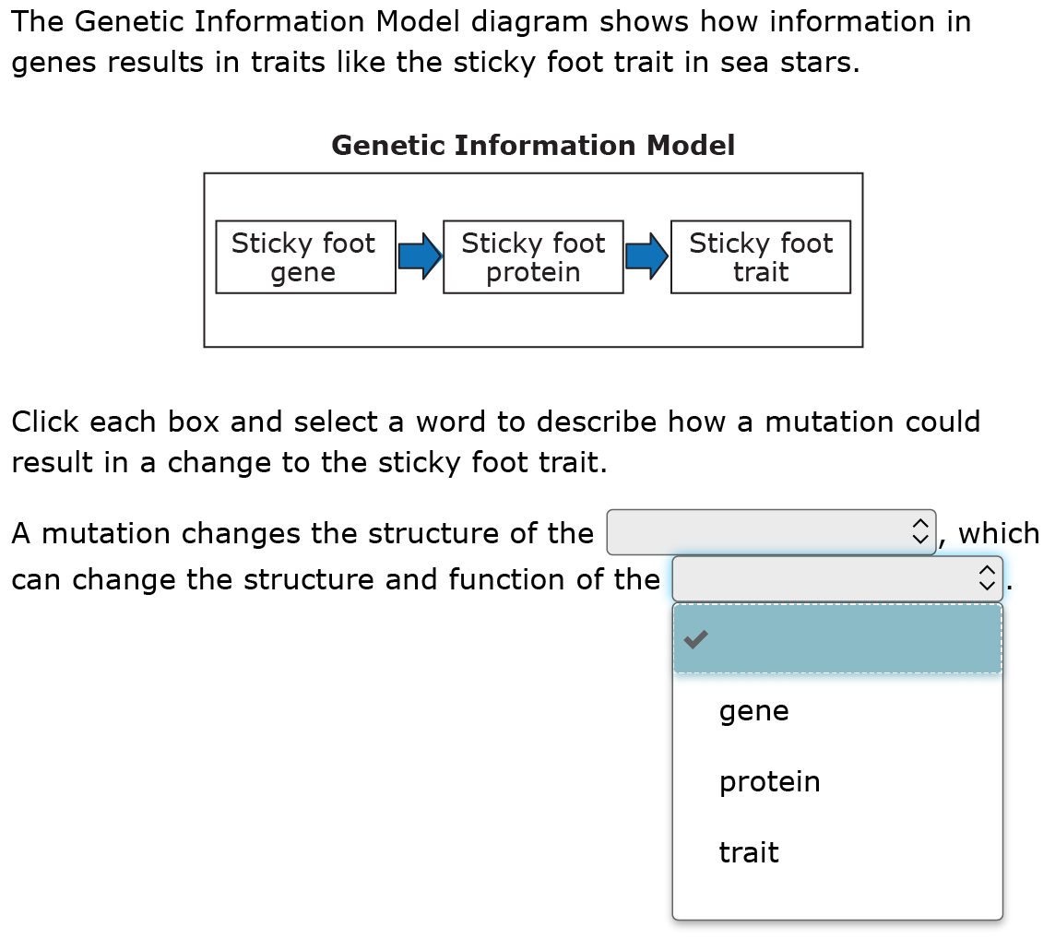
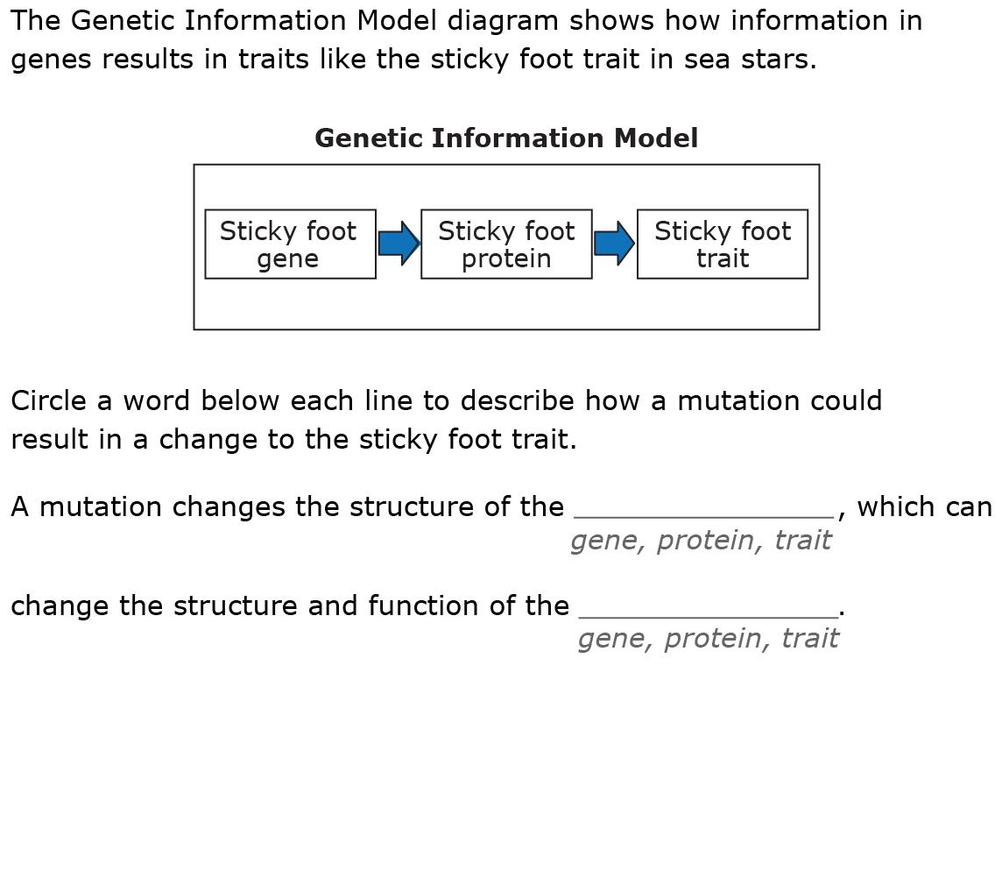
Item Types: Edit Task Inline Choice
Online Example
Paper Example
Grade 8 Training Test Item 7
Notes:
[5 minutes to allow for discussion]
This slide shows how an online edit task inline choice item can be done in a paper format.
The options available for each drop-down box in the online version should all be visible beneath each blank in the paper version. In the paper version students can circle a word, number, or phrase below each blank line to complete the sentence(s).
Discussion: The SEP for this item is Developing and Using Models. The CCC is Structure and Function. In small groups, have participants discuss:
How does the use of this item type support the assessment of the SEP?
How does the use of this item type support the assessment of the CCC?
In discussing alignment, participants may find it useful to examine the item specification for the PE, MS-LS3-1. In particular, the bullets for the SEP in the Details and Clarifications which state:
Develop and/or use a model is expanded to include:
using a given complete or partial model to make predictions and/or to describe phenomena
using a model to show relationships among variables
revising a given complete or partial model
describing the limitations of a complete or partial model
using a model to represent current understanding of a system
using a model to aid in the development of questions and/or descriptions

Slide 48
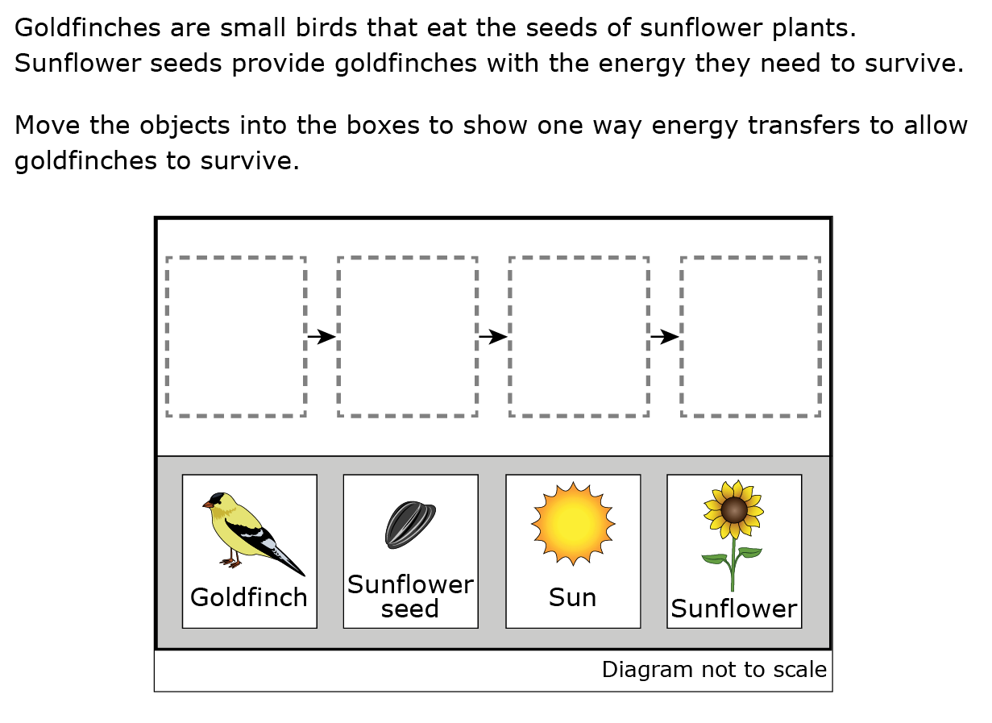
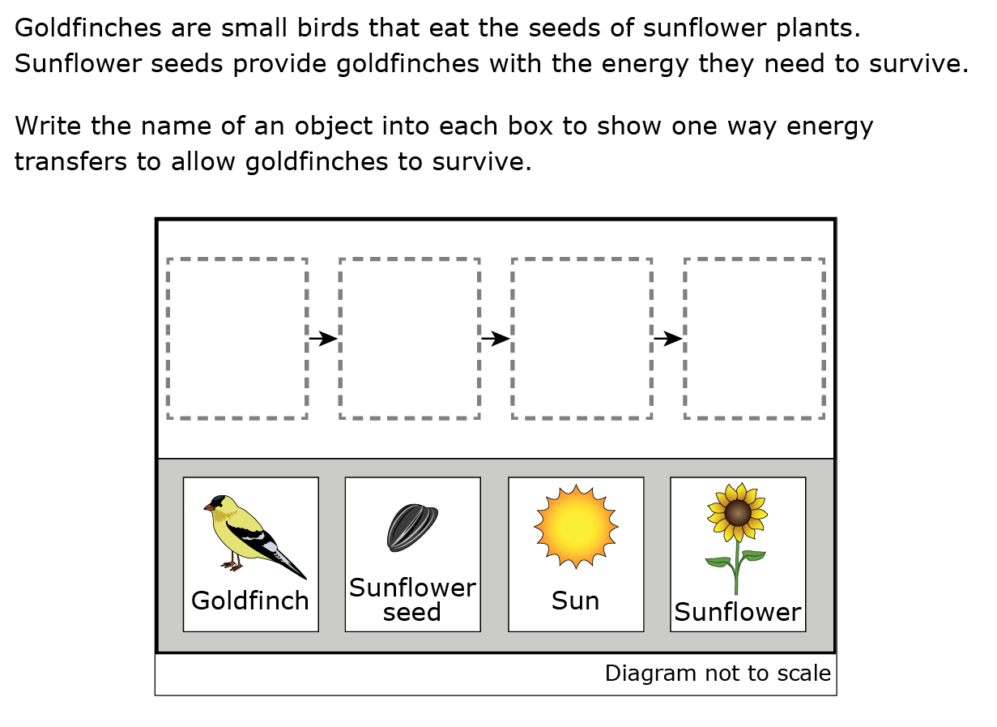
Item Types: Drag and Drop Grid
Online Example
Paper Example
Grade 5 Training Test Item 4, Part A
Notes:
[5 minutes to allow for discussion]
This item is an example of a type of grid interaction called a drag-and-drop item. This is an example of one way the item could be used for a paper format. Another idea would be to cut out the objects and move the paper pieces into the model.
Discussion: Note that this item is also aligned to 5-PS3-1. The SEP for this item is Developing and Using Models. The CCC is Energy and Matter. In small groups, have participants discuss:
How does the use of this item type support the assessment of the SEP?
How does the use of this item type support the assessment of the CCC?
This item has a part B multiple select item that further strengthens the alignment to the CCC.
Part B
Select two statements that are supported by the answer to part A.
A Goldfinches use energy from the sun to make sunflower seeds.
B Energy transfers to goldfinches when goldfinches eat sunflower seeds.
C Sunflower plants use energy from the sun to produce sunflower seeds.
D Energy from sunflower plants transfers to the sun to make sunflower seeds.
E Energy from the sun transfers to sunflower plants when goldfinches eat sunflower seeds.

Slide 49
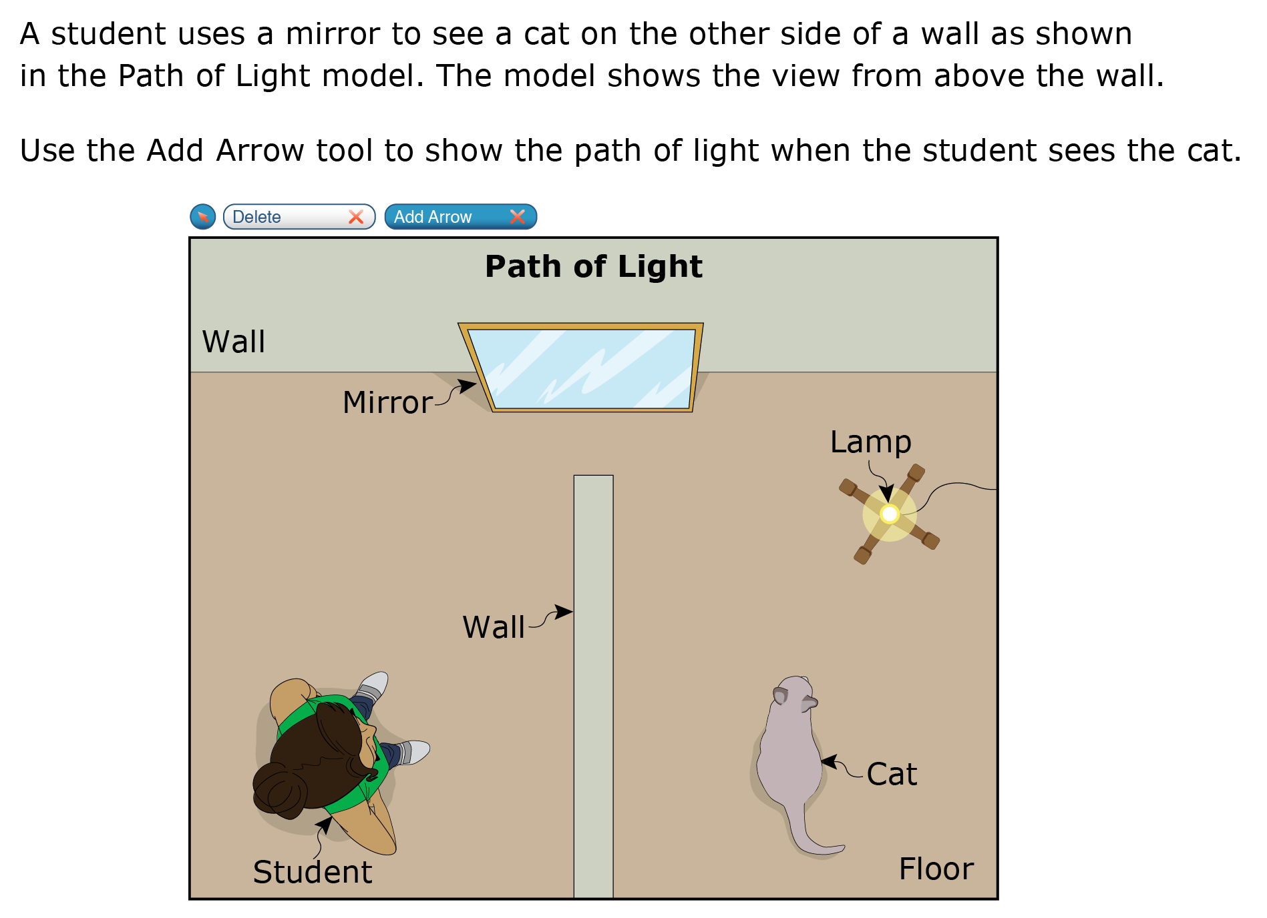
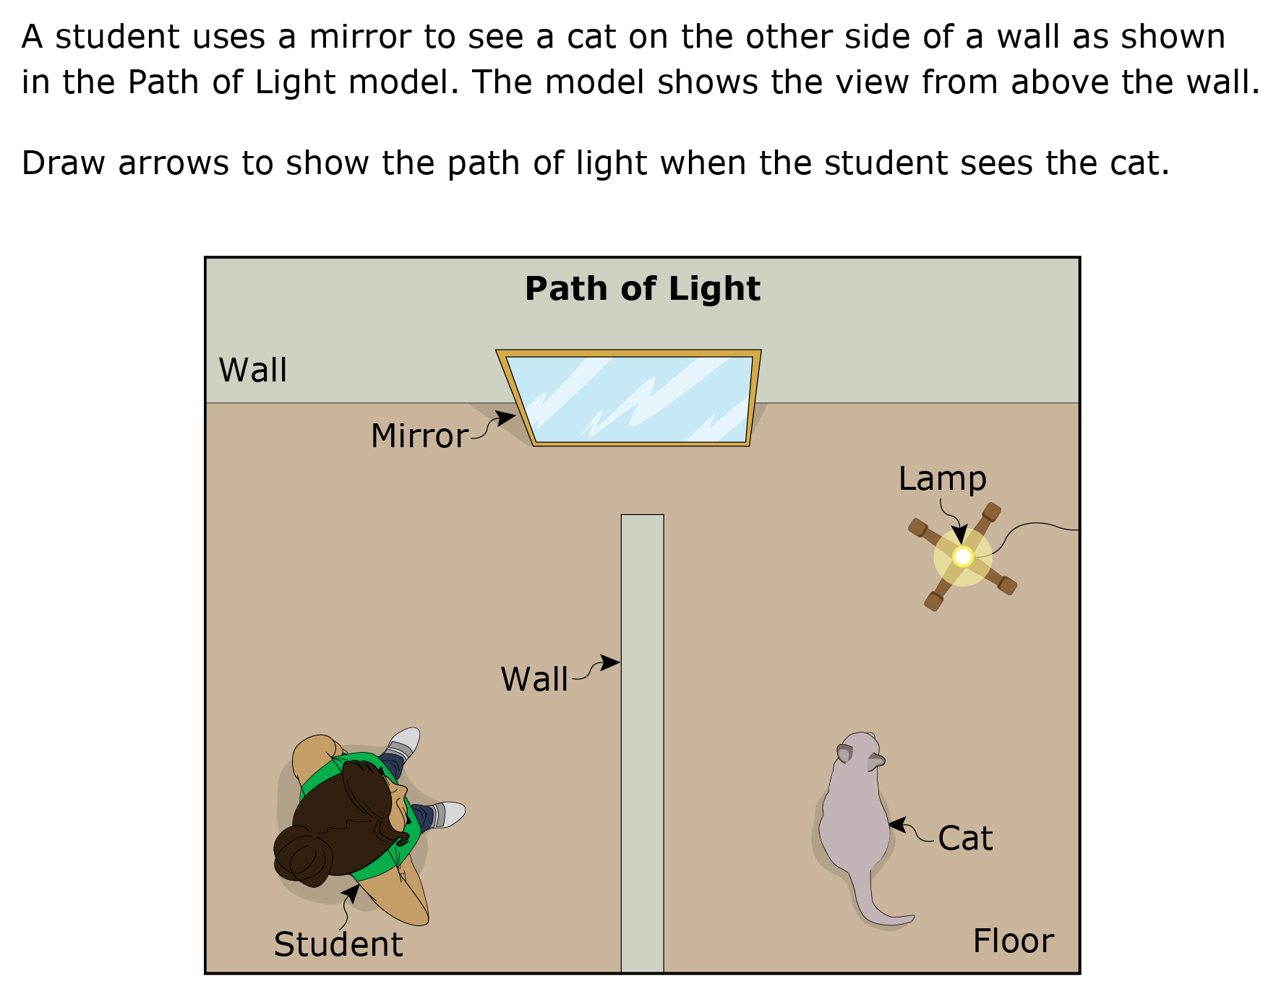
Item Type: Draw Arrows Grid
Online Example
Paper Example
Grade 5 Training Test Item 2, Part A
Notes:
[5 minutes to allow for discussion]
This item is a type of grid interaction that requires students that interact with the item online to use an Add Arrow tool to show the path of light. For a paper format, students can draw the arrows on the image with a pencil or pen.
In the classroom, this item type could be used to make a model, add to a model, make a graph, etc.
Discussion: Note that the PE for this item is 4-PS4-2. The SEP for this item is Developing and Using Models. The CCC is Cause and Effect. In small groups, have participants discuss:
How does the use of this item type support the assessment of the SEP?
How does the use of this item type support the assessment of the CCC?
This item has a part B multiple select item that further strengthens the alignment to both of these dimensions.
Part B
Select two changes that could prevent the student from seeing the cat.
A removing the wall
B removing all light from the room
C adding a second lamp behind the student
D switching the current mirror with a larger mirror
E hanging the mirror on the wall between the student and the cat

Slide 50
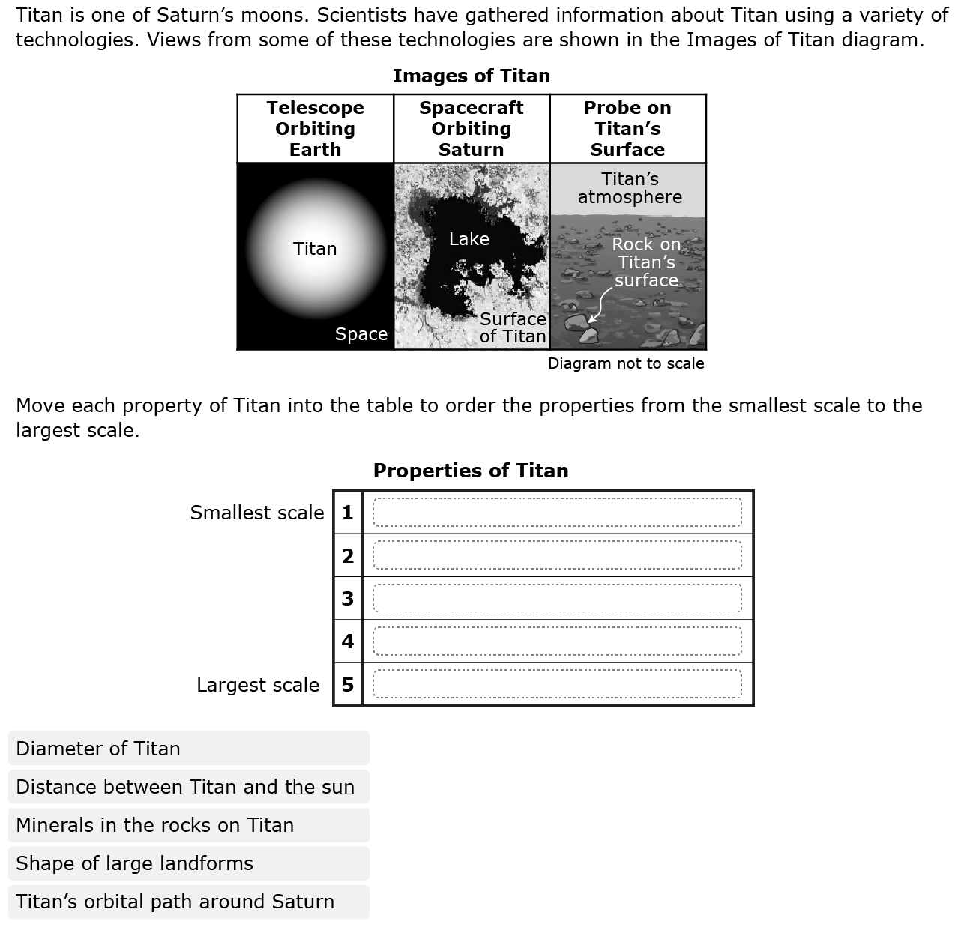

Item Types: Hot Text
Online Example
Paper Example
Grade 8 Training Test Item 1, Part A
Notes:
[5 minutes to allow for discussion]
This item part is an example of a hot text item where students move and drop statements into a table in the online format to describe a particular order. For the paper format, students can write the properties into the table.
Discussion: The item part is aligned to MS-ESS1-3. The SEP for this item is Analyzing and Interpreting Data. The CCC for this item is Scale, Proportion, and Quantity. In small groups, have participants discuss:
How well does the use of this item type support the assessment of the SEP?
How well does the use of this item type support the assessment of the CCC?
What type of data is presented to students in the introductory information?
This item also has a part B that is shown as an example of a table match item on the next slide.

Slide 51
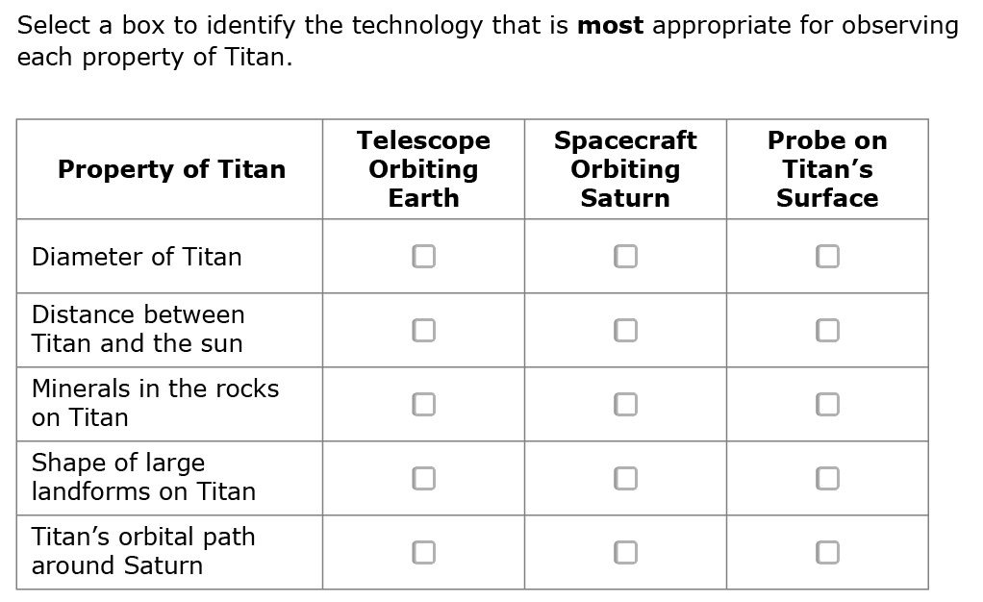
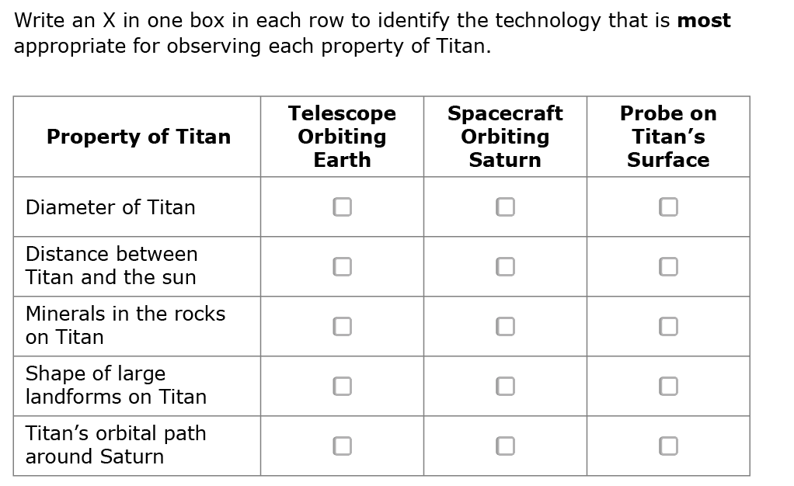
Item Types: Table Match
Online Example
Paper Example
Grade 8 Training Test Item 1, Part A
Notes:
[5 minutes to allow for discussion]
This item part is part B of the item on the previous slide. It is an example of a table match item. In the online format, students click cells to select them. For a paper-pencil format, students can write an X or make a check mark in the box.
Discussion: This item part is aligned to MS-ESS1-3. The SEP for this item is Analyzing and Interpreting Data. In small groups, have participants discuss:
How well does the use of this item type support the assessment of the SEP?
How well does the use of this item type support the assessment of the CCC?

Slide 52
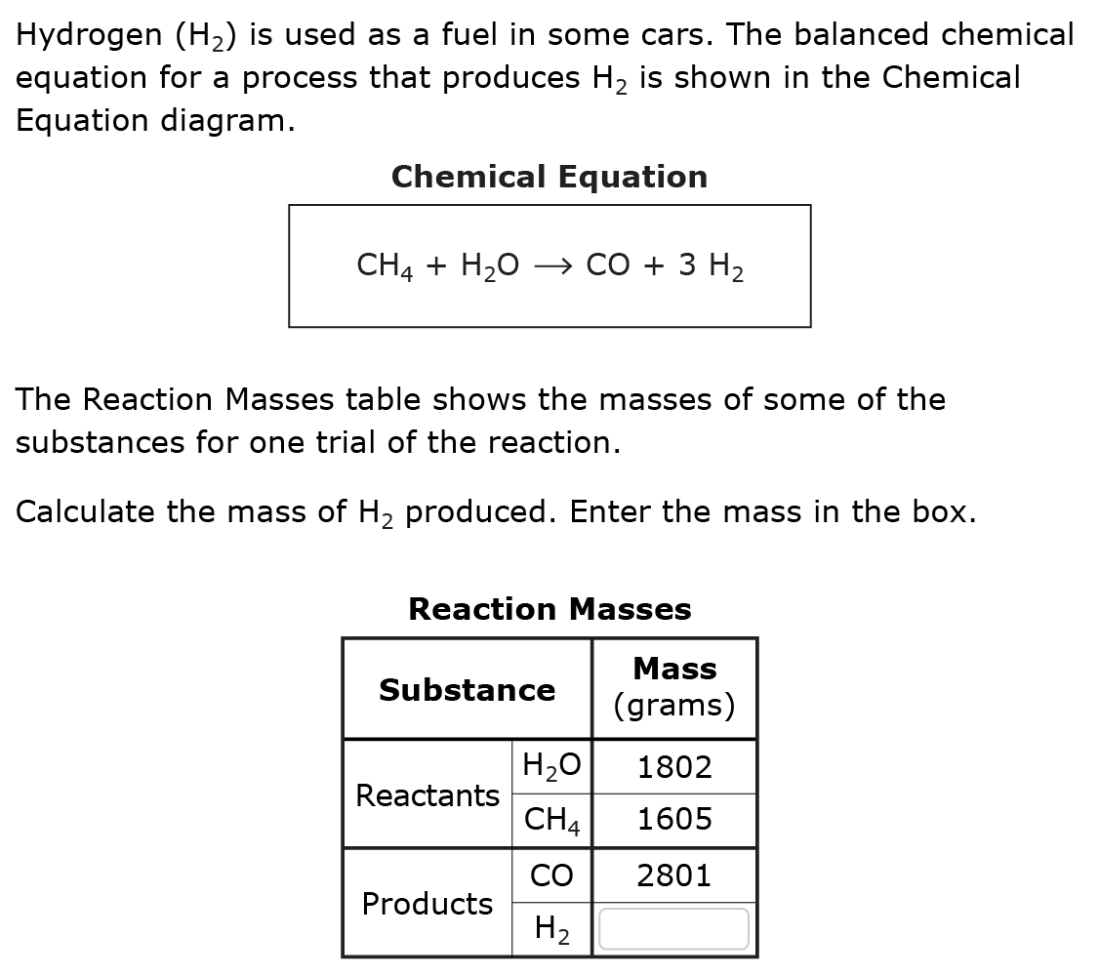
Item Type: Table Input
Online and Paper Example
Grade 11 Training Test Item 1, Part A
Notes:
[5 minutes to allow for discussion]
This item part is an example of a table input item where students enter numerical values into a table. Like multiple choice and multiple select items, table input items can be presented the same way online and on paper, so there is only one example here.
Discussion: This item part is aligned to HS-PS1-7. The SEP for this item is Mathematics and Computational Thinking. The CCC for this item is Energy and Matter. In small groups, have participants discuss:
How well does the use of this item type support the assessment of the SEP?
How well does the use of this item type support the assessment of the CCC?
This item has a part B multiple choice item that further strengthens alignment to the SEP.
Part B
Which statement supports the answer to part A?
A The mass of H₂ is one-half the mass of CH₄.
B The mass of H₂ is two-thirds the mass of H₂O.
C The total mass of the products is twice the total mass of the reactants.
D The total mass of the reactants is equal to the total mass of the products.

Slide 53
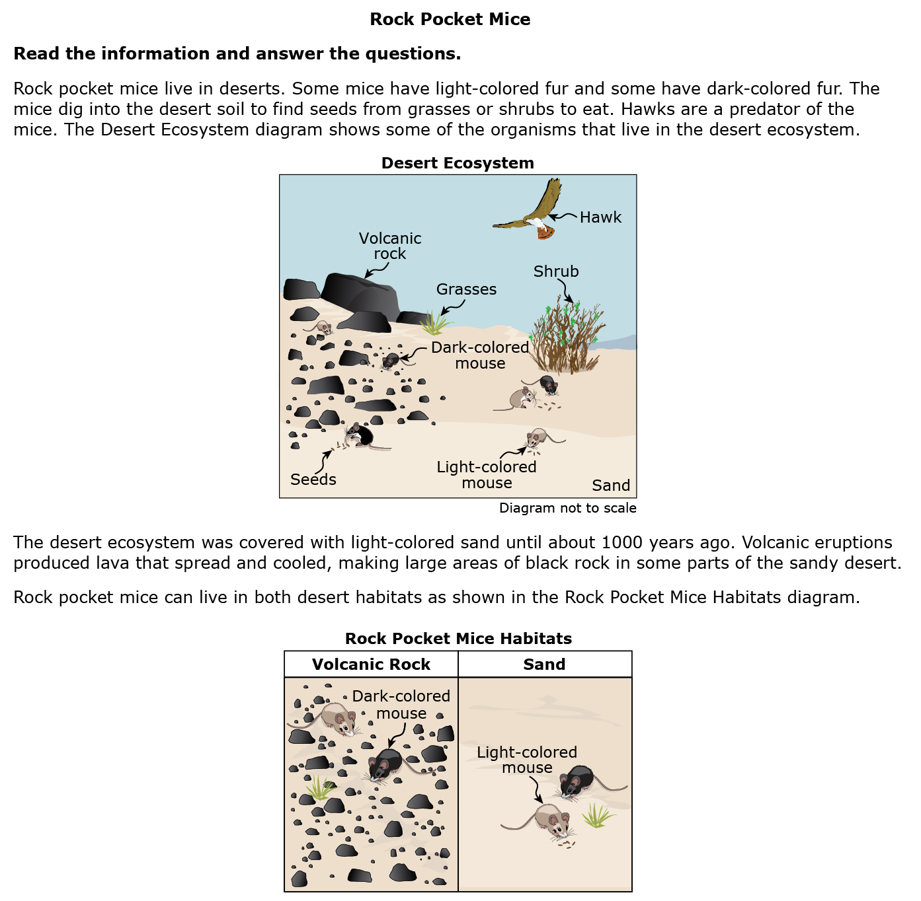
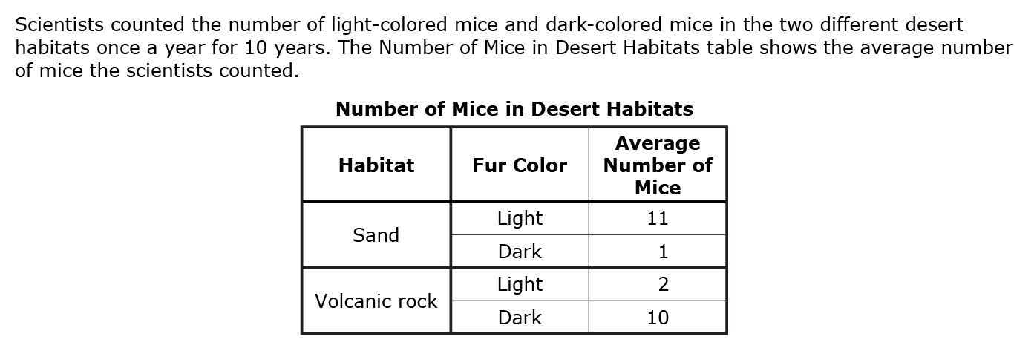
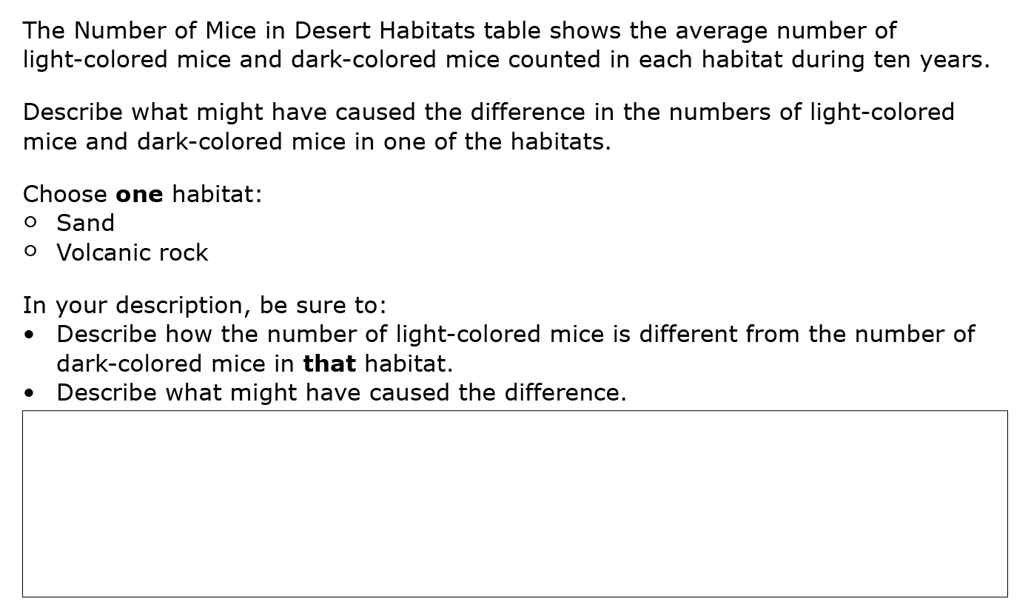
Item Type: Short Answer
Grade 5 Training Test Item 9
Notes:
[5 minutes to allow for discussion]
Here is an example of a short answer item where students compose an answer in their own words. Like multiple choice, multiple select items, and table input items, short answer items can be presented the same way online and on paper, so there is only one example here.
Discussion: This item part is aligned to 3-LS4-2. The SEP for this item is Constructing Explanations and Designing Solutions. The CCC for this item is Cause and Effect. In small groups, have participants discuss:
How well does the use of this item type support the assessment of the SEP?
How well does the use of this item type support the assessment of the CCC?
What type of data is presented to students in the introductory information?

Slide 54
Discussion: Item Types
  Discuss in your small groups:
  What types of items are your students familiar with?
  How do the various item types lend themselves to assessing the S E P? DCI? CCC?
  What technologies are available for developing online versions of classroom assessment items?
  Which item type(s) would be most appropriate for your item idea?
Notes:
[10 minutes to allow for discussion]
Discussion: Allow time for small group discussion, then share out to the larger group.

Slide 55
Writing Time
Using the PE and item specification for guidance, draft an item based on your context, data, and item type.
Peer review to give and receive feedback
Revise
Notes:
[20-30 minutes to allow for writing and peer review]
Provide 20-30 minutes for small groups to draft the item based on their item idea using the context, data, and item type that the team has decided upon.
In person, groups could use chart paper to make a poster of their draft item, then do a gallery walk with sticky note feedback.
In person or for a virtual meeting, groups could trade items and peer review.
For a virtual meeting, provide a google doc or other online interactive platform to allow groups to see work.
Suggestions for peer review considerations might include:
Authors provide information on what they like about their item, concerns, and/or any aspects they would like feedback to focus on.
Reviewers provide desired feedback plus any notes on what's strong about the item, what’s confusing or unclear, the appropriateness of item type, whether the item is engaging/culturally relevant/unbiased, alignment to the dimensions, and/or grade-level appropriateness of the item. They may also want to consider other ways the item could be presented to meet different students’ needs.

Slide 56
Item Writing Part B:
Using a New S E P to Write Items Aligned to Instruction
Notes:
[15 seconds]
Transition to using other/additional SEPs to write items aligned to the standards and classroom instruction. While Part B focuses on adding SEPs, additional DCIs and CCCs can also be incorporated into a lesson, unit, and/or assessment.

Slide 57
S E P’s in the Classroom (1)
Each PE includes a single S E P. For example, the S E P for
MS-PS1-2 is Analyzing and Interpreting Data.
  MS-PS1-2: Analyze and interpret data on the properties of substances before and after the substances interact to determine if a chemical reaction has occurred.
Instruction aligned to this PE might start with a phenomenon:
  A clear solution of limewater becomes white and cloudy when using a straw to blow air into it.
Instruction designed to help students achieve the goal described by the PE will likely include other S E P’s in addition to Analyzing and Interpreting.
Notes:
[10 minutes to allow for discussion]
Discussion: Have participants brainstorm several SEPs that might be included in instruction centered on the phenomenon on the slide.
Note: Replace the example PE and phenomenon on this slide with one from a different grade level and/or content area as needed to better meet the needs and expertise of the group.

Slide 58
S E P’s in the Classroom (2)
Consider ways that these S E P’s might be incorporated into instruction during the unit.
  Asking Questions and Defining Problems
  Developing and Using Models
  Planning and Carrying Out Investigations
Notes:
[10 minutes to allow for discussion]
Discussion: In the full group, prompt participants to consider how they would incorporate these SEPs into instruction that will enable students to make sense of the phenomenon:
Asking Questions and Defining Problems (e.g., Start the lesson with the demonstration of blowing into the limewater with a straw; have students brainstorm questions to add to a driving question board or to use as a starting point for planning their own investigation.)
Developing and Using Models (e.g., Students develop a model of the reaction and use their model to explain what’s happening at the particle level in the reaction.)
Planning and Carrying Out Investigations (e.g., Students plan their own investigation to test their question identifying relevant variables, the data to be collected, and the methods/tools they will use.)
Note: Replace the SEPs and examples on this slide if changes were made to slide 57.

Slide 59
S E P’s in the Classroom (3)
Classroom instruction provides opportunities for students to use many S E P’s in the process of making sense of a phenomenon.
Although an item specification is written to the S E P, D C I, and CCC for a specific PE, the details and clarifications can be used to develop other combinations of S E P’s, DCI’s, and CCC’s.
Notes:
[30 seconds]
The following slides will explain how to use the templated SEP bullets to develop an item aligned to the DCI and CCC of a PE but with a different SEP.

Slide 60
A Closer Look at the S E P’s in the Item Specifications
Consider the Details and Clarifications for the example PE, MS-PS1-2:
  MS-PS1-2: Analyze and interpret data on the properties of substances before and after the substances interact to determine if a chemical reaction has occurred.
The first bullet in the Details and Clarifications reflects the language used in the PE to describe the S E P.
  Analyze and/or interpret data is expanded to include . . .
Within a grade band, the sub-bullets for a given S E P are always the same.
Notes:
[10 minutes]
The first bullet for each SEP is derived from the SEP language in the associated PE in the grade band.
The sub-bullets are the same for every PE with that SEP at the grade band. Remember that the sub-bullets were derived, in part, from the progressions in Appendix F—Science and Engineering Practices in the NGSS and in part from experience developing the WCAS.
Discussion: Have participants refer to the module document, “WCAS Item Specifications SEP Bullets”, and examine the sub-bullets for 2-3 SEPs.
How does the language in the first bullets for an SEP vary within a grade? Across grade bands?
How does the language in the sub-bullets vary across grade bands?
[Pause to allow for individual think time to review the handout and note any realizations, surprises, or wonderings. Encourage small group conversation, and then sharing with the large group.]

Slide 61
Writing Time
Select a new S E P for the PE and item specification you used in Item Writing Part A.
Use the S E P bullet and sub-bullets to draft a new item aligned to the different S E P.
Notes:
[20-30 minutes to allow for writing and peer review]
Provide 20-30 minutes for small groups to draft their new item. Using their previous item idea will minimize the time needed for this task as they will have already discussed context and data.
Challenge participants to use a different item type than used in their previous item.
In person, groups could use chart paper to make a poster of their new item, then do a gallery walk with sticky note feedback.
In person or for a virtual meeting, groups could trade items and peer review.
For a virtual meeting, provide a google doc or other online interactive platform to allow groups to see work.
Suggestions for peer review considerations might include:
Authors provide information on what they like about their item, concerns, and/or any aspects they would like feedback to focus on.
Reviewers provide desired feedback plus any notes on what's strong about the item, what’s confusing or unclear, the appropriateness of item type, whether the item is engaging/culturally relevant/unbiased, alignment to the dimensions, and/or grade-level appropriateness of the item. They may also want to consider other ways the item could be presented to meet different students’ needs.

Slide 62
Closing Thoughts and Reflections
Notes:
[15 seconds]
Transition to closing thoughts and reflections to bring the learning module to an end.

Slide 63
Reflections
What did you learn that you will use in your classroom?
What do you want to think more about?
What questions do you still have?
What do you need to move forward?
How can you leverage partnerships to continue this work?
Notes:
[15 minutes]
Provide participants time to reflect individually and then share out with the large group.

Slide 64
Thank You
For more information, please email the OSPI Science Team: science@k12.wa.us
Notes:
[1 minute]
Facilitator: Please add your contact information to this slide.

