Slide 1
We’ll get started soon!
Photo by Aaron Burden on Unsplash

Slide 2
Supporting Seniors’ Financial Aid Decisions: Student Loan Advocacy & Resources
Wednesday Webinar - December 2, 2020
Kim Reykdal, OSPI | Stephanie Sampedro, WSAC | Yokiko Hayashi-Saguil, WSAC
11/30/2020 | 2

Slide 3
Land Acknowledgement
School District and Nearest Federally Recognized Tribes*
*Ideally, districts should consult with tribal members to draft land acknowledgement
Text your zip code to (907) 312-5085 to find out the original Native stewards of the land you occupy
11/30/2020 | 3
Notes:
I would like to acknowledge that I’m coming to you today from the traditional lands of the Squaxin Island and Nisqually Tribes in Tumwater, WA. We acknowledge both Tribes commitment to the resurgence of their traditional ways and their respect and protection of all people, not only those who are living, but also those who have gone before and who are yet to be born.
We pay our respect to the elders both past and present and to the valued resource the Tribe has defined as their children. They are the Tribes future.
We ask that the participants of this meeting also honor the Tribal lands on which each of you are located today.
A resource you might consider for your own locale is this School District & Nearest Federally Recognized Tribes document. Or, you can use the number in the bottom arrow to find out which tribe(s) originally inhabited the land on which you now reside.
Best practice is for districts to engage in tribal consultation with the tribes nearest their district to determine their historical lands and craft a mutually agreeable acknowledgement. Each tribe are the experts of their history.

Slide 4
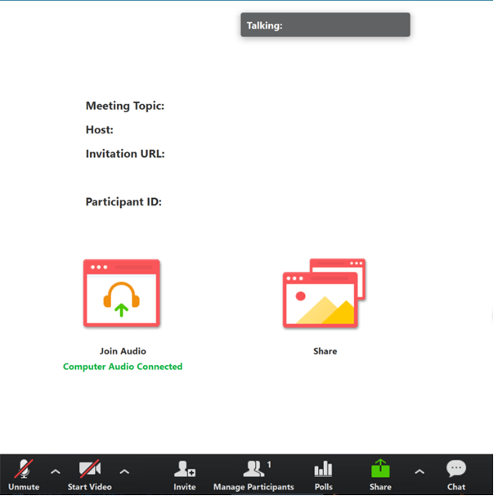
Tips for Participating
Share comments and ideas in the Chat panel (send to “All”)
Questions typed in the Chat will be answered as we go if time allows, or at the end
Please stay muted unless the presenter invites open dialog
Keep your video on if possible ~ visual cues help! ☺
Notes:
Share Slides

Slide 5
Webinar Logistics
This webinar recording will be posted on OSPI’s YouTube channel; slides will be on OSPI’s CCR website
Both the recording and the slides will also be posted on WSAC’s 12th Year Campaign website
1.5 Clock Hours will be available for attending today’s webinar
11/30/2020 | 5

Slide 6
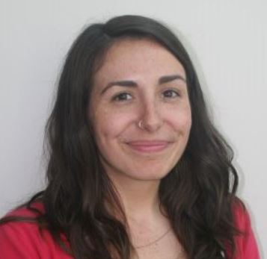
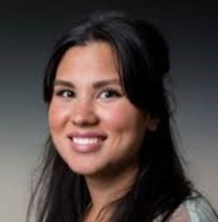
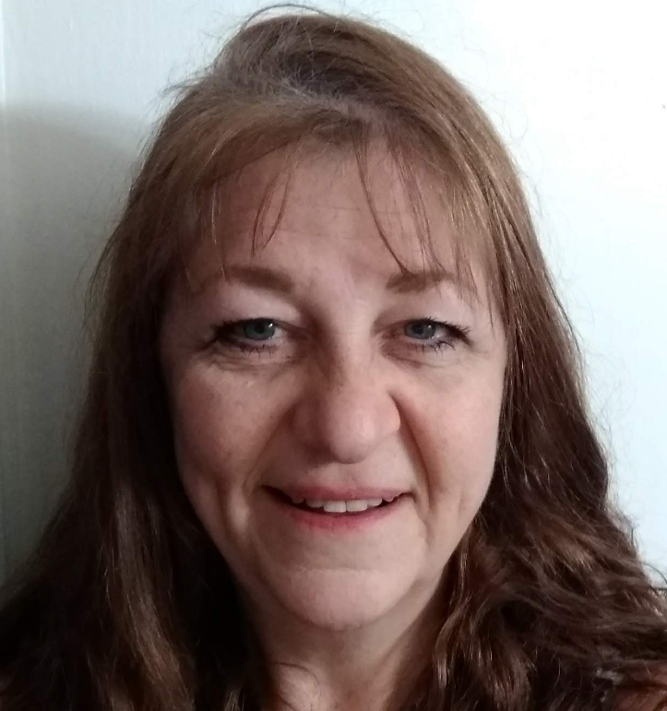
Webinar Host, Tech Support and Presenters
Kim Reykdal
Program Supervisor Lead, Secondary School Counseling
OSPI
kim.reykdal@k12.wa.us
Stephanie Sampedro
Student Loan Advocate
WSAC
StephanieS@wsac.wa.gov
Yokiko Hayashi-Saguil
Program Associate, College Access and Support
WSAC
YokikoH@wsac.wa.gov
Ronnie Larson
Webinar & Clock Hour Rockstar
Administrative Assistant
OSPI
ronnie.larson@k12.wa.us

Slide 7
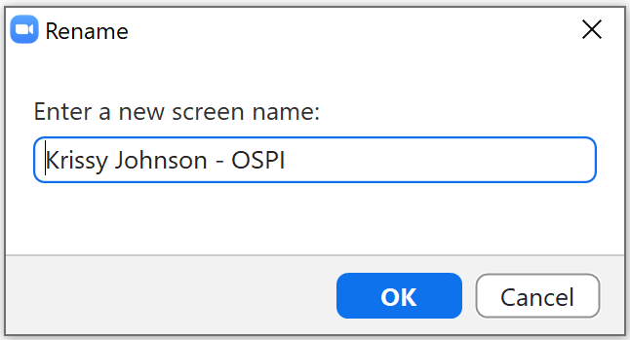
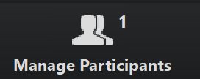
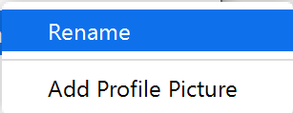
Rename Yourself by Role
1. Click on Participants in the Zoom menu.
3. Add [1,2,3,4,5 or 6] before your first and last name, district/org
2. Find your name in the participants list.
Click More then Rename or Just Rename.
1 – Krissy Johnson – Tacoma SD
School Counselor
Career Counselor/Specialist
College Access Support Staff/CBO
College Financial Aid Officer
Teacher
Other – please type name & role in Chat
Example:
1 - Krissy Johnson – Tacoma SD
11/30/2020 | 7

Slide 8
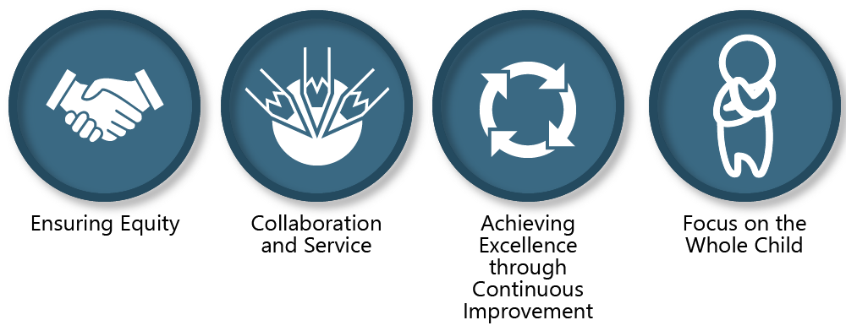
All students prepared for post-secondary pathways, careers and civic engagement
OSPIs MISSION is to “transform K-12 education to a system that is centered on closing opportunity gaps and is characterized by high expectations for all students and educators. We achieve this by developing equity-based policies and supports that empower educators, families and communities.”

Slide 9
WSAC’s mission
Policy and research
Savings and financial aid programs
Access and support programs
Consumer protection
We advance educational opportunities and attainment in Washington State.
Notes:
Under Student loan bill of rights for WA
Student loan servicers must be licensed with DFI
Schools must notify borrowers about Student Loan Advocate
Develop student borrower education course
Borrowers may request information or resources or make a complaint to Advocate
Advocate makes recommendations to legislature regarding student debt in Washington

Slide 10
11/30/2020 | 10

Slide 11
“…requires education leaders to examine the ways current policies and practices result in disparate outcomes for our students …”
“…actively dismantle systemic barriers, replacing them with policies and practices that ensure all students have access to the instruction and support they need …”
11/30/2020 | 11
Notes:
HB 1599 is absolutely built off of these values, and built to deliver on our promise that all students are prepared for life after high school.
Graduation rates class of 2018:
81% all, but 60% for our native kids, 75% for our black/African American students

Slide 12
An abridged version of a statement adopted by PSESD 121
Just as we have already honored the people and lands Native to America, we also want to acknowledge the pain and trauma resulting from 400 years of systemic racism within the United States against people of the African diaspora.
We stand with our communities of color during these unprecedented times of civil unrest, especially those who identify as and/or are categorized as Black and/or African American.
We will continue to center our work in leading with racial equity.
We want to offer a moment of silence, and afterwards, honor the space for people from communities of color to respond to this acknowledgement first. Then, we invite allies and others to communicate their comments after. Please use the chat box.
We invite accountability and partnership.

Slide 13
Rename Yourself by Role
1. Click on Participants in the Zoom menu.
3. Add [1,2,3,4,5 or 6] before your first and last name, district/org
2. Find your name in the participants list.
Click More then Rename or Just Rename.
1 – Krissy Johnson – Tacoma SD
School Counselor
Career Counselor/Specialist
College Access Support Staff/CBO
College Financial Aid Officer
Teacher
Other – please type name & role in Chat
Example:
1 - Krissy Johnson – Tacoma SD
11/30/2020 | 13

Slide 14
2020-21 OSPI-WSAC Webinar Series
January 27th, 1-2:30pm
Supporting Students’ Transitions: Aligning HSBP’s and IEP Transition Plans
March 31st, 1-2:30pm
Supporting Students’ K-12 Career & College Readiness Journey
This Photo by Unknown Author is licensed under CC BY-NC-ND
11/30/2020 | 14

Slide 15
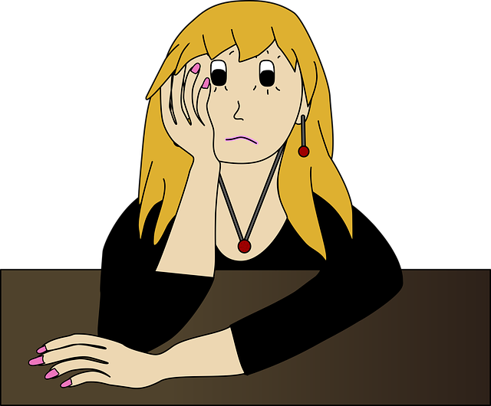
In general, which picture most resembles students’ reaction to making financial aid decisions?
Which picture most resembles YOUR reaction to helping students make a financial aid decision?
This Photo by Unknown Author is licensed under CC BY-SA-NC

Slide 16
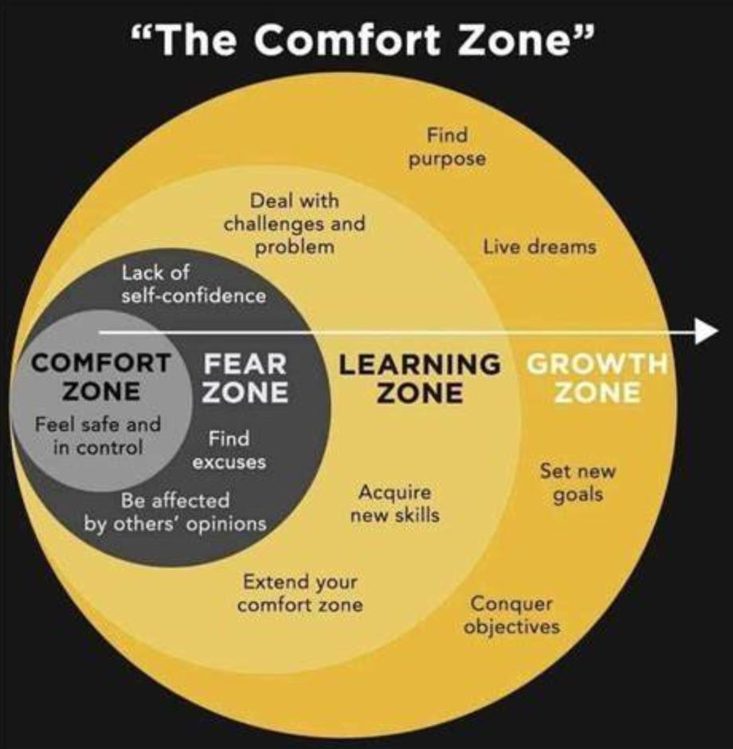
Objectives
Updates on processes and best practices for helping seniors understand future implications of financial aid decisions, including student loan debt
Learn where to get resources & support!
11/30/2020 | 16

Slide 17
Keeping Equity at the Center
How can you use the Student Loan Advocate & Resources to improve college accessibility gaps?
How can current financial aid supports at your school be updated to ensure students furthest from opportunity are at the center of your college prep services?

Slide 18
WA Student Loan Advocacy & Resources
Stephanie Sampedro | Washington Student Achievement Council
Notes:
NOTE: To replace a picture, just select and delete it. Then use the Insert Picture icon to replace it with one of your own!

Slide 19
Where did this begin?
Notes:
I’m going to start with the national landscape of the problem, then talk about how it looks in WA, and what WA is doing. Then I’ll talk about what I’ve already done, and what the future looks like.

Slide 20
Why is a student loan Advocate needed?
Student loan borrowers are struggling
Since 2007, federal student loan debt has tripled, from about $500 billion to an estimated $1.6 trillion
43 percent of student loans are considered in “distress”
Protect borrowers
2019 OIG report stated ED failed to adequately supervise the loan servicers and rarely penalized companies out of compliance
ED has rolled back protections for borrowers defrauded by their schools
Washington Student Achievement Council
Notes:
Distress = meaning they’re delinquent, at risk of default or students aren’t paying enough on their loans

Slide 21
Total Federal and Nonfederal Loans in 2017 Dollars since 97-98 trends.collegeboard.org
Notes:
While overall debt has gone down since its height in 10-11, the usage of Unsub, Parent PLUS, Grad PLUS, & private loans has been on the increase.

Slide 22
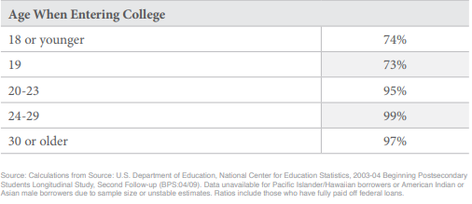
Student loan debt Disparities
Demos, June 2019
Notes:
We know that African American students borrow at a higher rate, carry a higher average debt, and default on their loans 5 times the rate of white graduates. We also know that women carry 2/3 of the total debt nationwide.
Borrowers of color, older students & women are unable to make a dent in their loan balances
12 years after entering college:
white men have paid off 44% of their student loan balance on average
White women have only paid off 28% of their balance
Black men see their balances grow by 11%
Black women see their balances grow by 13%
Adult students who enter college at age 24 or older have repaid 1%-3% of their balance
I think it’s important to say that while it may seem like the average student borrower has a manageable amount of debt (a used car amount), this does not guarantee that they will be able to repay it. There are a variety of other factors that can make it incredibly difficult for borrowers to repay their debt without experiencing financial distress. Additionally, if they are not earning enough, are a borrower of color, never graduated, or live in a place with a high cost of living (like Seattle), this will impact their ability to repay their debt.

Slide 23
Student debt is widening the racial wealth gap
Stalling Dreams - IASP
Notes:
“Twenty years after starting college, the median debt of White borrowers has been reduced by 94% -- with almost half holding no student debt – whereas Black borrowers at the median still owe 95% of their cumulative borrowing total” – Institute on Assets and Social Policy

Slide 24
Student Debt in Washington
760,000+ student loan borrowers
$27.4 billion outstanding student debt
98,214 borrowers in delinquency
$2.4 billion in delinquency
36% increase in senior citizens w/debt
$35,740 average student debt
Notes:
National average of outstanding debt is about $30 billion
National average of debt per borrower is $38,390
Based on 2019 numbers from ED & 2016 CFPB numbers

Slide 25
Washington Student Loan Bill of Rights
Senate Bill 6029
Establishes Student Loan Advocate at WSAC
Student loan servicers must be licensed with DFI
Schools must notify borrowers about the Advocate
Allows DFI & AGO to enforce state consumer protection laws
Third party modification companies must abide by state laws
Notes:
Under Student loan bill of rights for WA
Student loan servicers must be licensed with DFI
Schools must notify borrowers about Student Loan Advocate
Third party modification companies must abide by state law but are not required to obtain a license
Develop student borrower education course
Borrowers may request information or resources or make a complaint to Advocate
Advocate makes recommendations to legislature regarding student debt in Washington

Slide 26
Where are we now?

Slide 27
Advocate role
Complaints
Compile and analyze data on borrower complaints –
Ex. Forgiveness/discharge
Work with loan servicers to resolve complaints
Education
Rights and responsibilities
Promote Advocate as resource to help borrowers, schools, servicers & lenders
Provide info on borrower concerns to public, agencies, legislators, others
Recommend policy for resolving borrower issues and concerns
Analyze and monitor laws, rules, regulations and policies relating to student loans at all levels
Take any reasonable action to assist borrowers
Work with AG & DFI
Advocacy
Notes:
Assess number of borrowers who applied for, received or await a forgiveness/discharge
take any reasonable action to assist borrowers - (Ex. helping apply for discharge)
Any other actions necessary to fulfill the duties of the Advocate outlined in RCW 31.04

Slide 28
Complaint process
Complaint to Advocate
State
AG
DFI
Federal
FSA Ombudsman
CFPB
FTC
Servicer Ombudsman
WA Legal Aid
Notes:
Request assistance if you are having an issue with your student loan servicer
WSAC: loanadvocate@wsac.wa.gov
Complaint portal
Attorney General’s office
Department of Financial Institutions
Consumer Financial Protection Bureau: consumerfinance.gov
FSA Ombudsman: feedback.studentaid.ed.gov
Federal Trade Commission: ftccomplaintassistant.gov/#crnt&panel1-1
Servicer Ombudsman: Contact appropriate servicer

Slide 29
WA Borrower complaint info 2020
Notes:
About 700 total cases from December 2018 – Present (Zendesk & Pre-Zendesk)
346 total cases in 2020
At least 150 of these complaints have been from borrowers who reside outside of WA
Solved/Closed (258) – either solved the issue, referred them to another state entity, out of state, issue unrelated to student loans, no response from borrower
Pending (57) – waiting for a response from the borrower
On Hold (28) – waiting for more info from a third party
Open (3) - ongoing

Slide 30
Borrower issues 2020
Notes:
Discharge & Forgiveness – includes PSLF, TLF, Disability discharge, Borrower Defense to Repayment, Closed School Discharge
Third Party Debt Relief - Borrower pays a company for loan “forgiveness” or to get a lower monthly payment.
Borrower is overwhelmed by repayment process and uninformed
Companies often cause harm and charge high fees

Slide 31
Education
Facilitated loan repayment workshops at seven campuses across the state from Bellingham to Walla Walla to Spokane.
Some survey results:
94% learned how to identify a student loan scam
93% now understand their rights as a borrower
93% have a better understanding of how repayment works
91% know where to make a complaint about their student loans

Slide 32
Workshop feedback
Knowing that I have rights as a borrower
Resource discovery & awareness
The breakdown of payment plans
I was really quite scared about loans and this presentation helped alleviate those fears a little
I appreciate knowing that I can call if I have questions or concerns
One-on-one appointment
Borrowers need more
Have a “Stephanie” in Spokane
Borrower Rights
Repayment options
I became more aware of financial details and scams
I knew almost none of this
Fear & uncertainty
Understanding where to go to view your loans and choose a payment plan
Individualized support
More time
Organize more of these workshops
Clear steps on repayment
Learning about IDR plans & forgiveness

Slide 33
advocacy
2020 legislative report
FSA Ombudsman caucus
National Consumer Law Center
Represent borrower interests to servicer
Multi-state advocacy letters

Slide 34
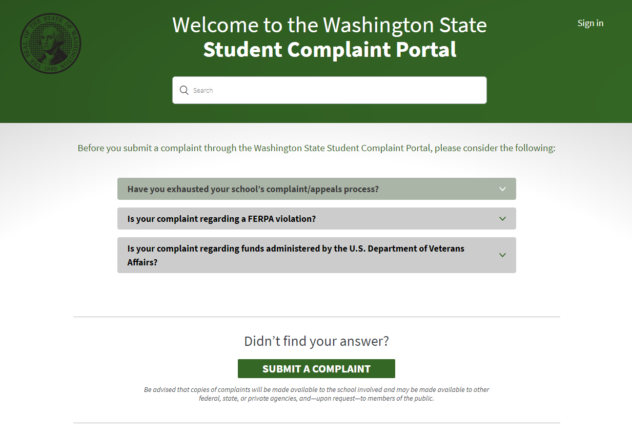
Complaint portal
www.studentcomplaints.wa.gov
Notes:
Single website for students & borrowers to make complaints about their school or loans. Managed by 4 different state agencies.
Studentcomplaints.wa.gov

Slide 35
New developments

Slide 36
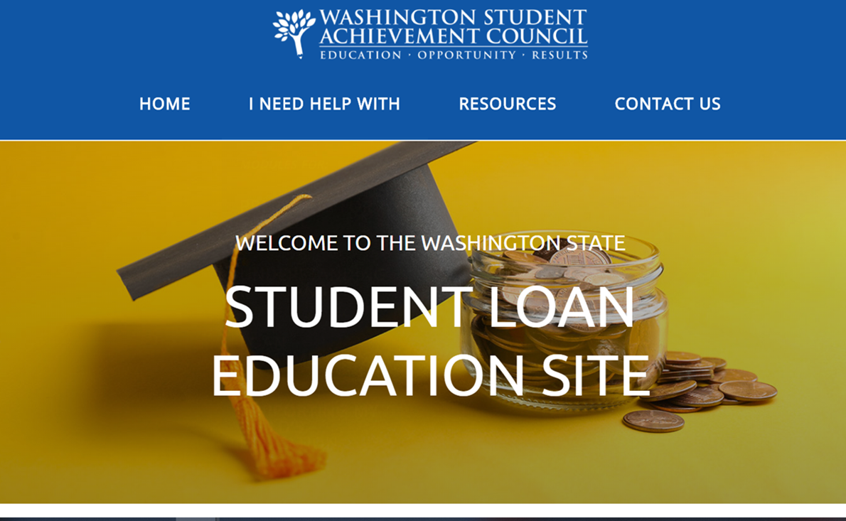
A new resource for wa students
www.studentloaned.wa.gov
Notes:
15 modules
Each module contains a video summarizing the info in the module, links to pertaining resources, and a quiz to test the user’s comprehension.
4 tracks:
Preparing for school
Understanding my loans
Loan Repayment
Supporting my child’s education
Coordinated promotion around this tool in early October to coincide with FAFSA/WASFA awareness (w/ Student Financial Assistance)

Slide 37
Track 1: Preparing for school
Applying for Financial Aid
College Savings Plan
Understanding College Costs
Understanding Aid Options & Comparing Award Letters
How Much Should I Borrow?
Options & Benefits for Service Members & Veterans
Finding Loan Information
How Does Student Debt Affect Other Financial Decisions?
Scams & Deceptive Practices
Federal Consumer Info & Warnings
Notes:
Finding loan info
Key loan terms
Federal loans vs. private loans
Repayment plans
Documentation required
Monthly payment obligations
Federal regs intended to protect student loan borrowers
Forgiveness refund and discharge
Documentation required
Eligibility requirements
State repayment programs
Identify student loan scams
Asking for money or FSA ID
FTC and CFPC have resources on this
How to make a complaint
Step-by-step instructions for our complaint portal
Other state agencies
Federal agencies
Private companies/servicers
Student debt and other financial decisions
Getting married
Buying a home
General credit implications
Service members and veterans
Deferments
Interest rate reductions
Tuition recovery
WA bill that instituted a tuition recovery trust fund
Process for making a complaint/claim against the school
Federal consumer info and warnings
SL specific and general (FDCPA)
We will are unsure if we will try to produce this in-house or go through an RFP process.

Slide 38
Track 2: Understanding my loans
Options & Benefits for Service Members & Veterans
Finding Loan Info
Repayment Plans
Scams & Deceptive Practices
How to Make a Complaint About Your Student Loans
State-Based Tuition Recovery
Federal Consumer Info & Warnings

Slide 39
Track 3: Loan Repayment
Finding Loan Info
Loan Forgiveness, Cancellation & Discharge
Consolidation, Default, & Rehabilitation
How Does Student Debt Affect Other Financial Decisions?
How to Make a Complaint About Your Student Loans
Repayment Plans
Scams & Deceptive Practices
State-Based Tuition Recovery
Federal Consumer Info & Warnings

Slide 40
Track 4: Supporting my child’s education
Applying for Financial Aid
College Savings Plans
Understanding College Costs
Understanding Aid Options & Comparing Award Letters
How Much Should I Borrow?
Finding Loan Information
Repayment Plans
Scams & Deceptive Practices

Slide 41
Anatomy of a module
Outcomes with anchored link
Animated video goes over key themes for the module
Notes:
User can take a quick look at the outcomes to see if this module is of interest to them/answers their questions.
Video for diversity of learning styles
Video transcript for accessibility
Hyperlinks tell you which tracks this module belongs to

Slide 42
Anatomy of a module (cont.)
Key Terms
Content
Notes:
Key Terms help the user learn financial aid jargon by defining complex terms that will be used in the module.
Content goes into detail and walks the user through each topic, breaking it down into several sections.

Slide 43
Anatomy of a module (cont.)
Some modules contain tools embedded
May include images, PDFs and other media that is relevant to current topic
Notes:
This is an image of a calculator that can help users estimate the total amount they should borrow based on their Total Cost of Attendance & estimated aid

Slide 44
Anatomy of a module (cont.)
Comprehension quiz
Resources referenced in the module
Notes:
Each module ends with a comprehension quiz. Based on the user's ability to answer the questions correctly, it will either congratulate the user on having a good understanding of the module’s content or tell them that they may want to revisit the module to better understand the content.
Resources are collected at the end and link to outside sites that are relevant to the module’s content. These resources are all compiled on the larger Resources Page (& separated by module topic)

Slide 45
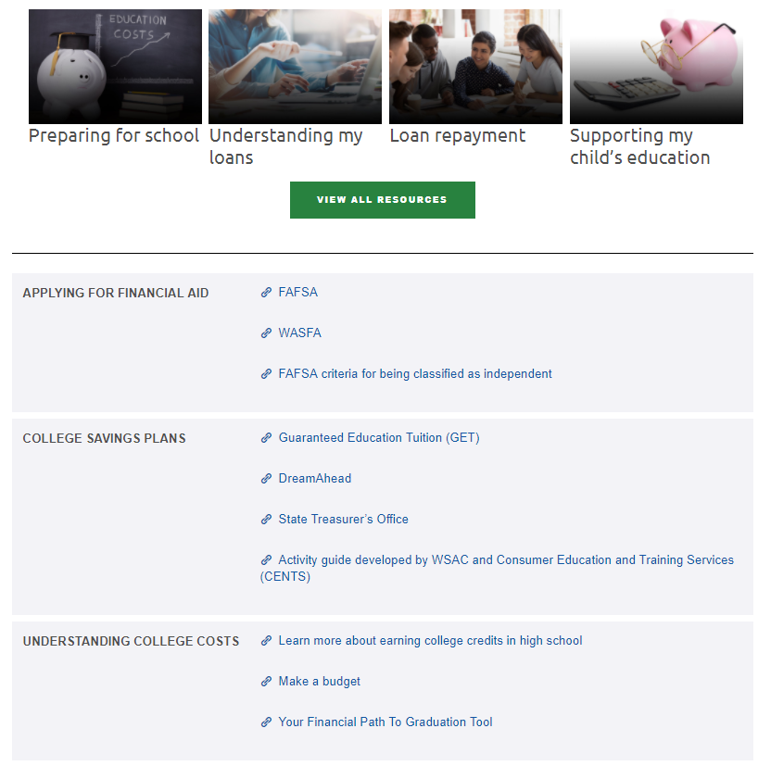
Additional highlights
Resources Page
Uses Google Translate service
Can translate into 22 languages
Including: Spanish, Russian, Vietnamese, Somali, Arabic, Ukrainian, Filipino, Korean & Punjabi
Contact link routes to WSAC site
Notes:
Resources are all compiled on the larger Resources Page (& separated by module topic)
Translates into 9/10 most spoken languages in WA
Student Loan Advocacy pages lists link to Student Loan Complaint Portal as well as loanadvocate@wsac.wa.gov email

Slide 46
collaboration
We’re hoping that this education site can be used by all:
Increase enrollment in postsecondary education
Educate students before they borrow
Help borrowers understand their loans in repayment
Use alongside FAFSA/WASFA completion
Use in the classroom or while counseling students
Please reach out if you have feedback
We want to make it as user-friendly and relevant as possible
Notes:
This is a new site. Your feedback can help us significantly

Slide 47
Targeted partnerships
Reducing debt burden
National service
AFT
Veterans
Women’s orgs
State employees
BIPOC orgs
Notes:
Through targeted partnerships loan advocates can reach organizations that support communities that are particularly hit hard by student debt or for which there exists a student loan benefit.
For example:
Serve WA – loan forgiveness options for national service as well as can count towards PSLF
Teachers Union – Teacher Loan Forgiveness/PSLF
Vets – TPD, PSLF
American Association of University Women – PSLF, and women carry 2/3 of student debt nationwide
State employees - PSLF
Also looking at– various communities of color, people with disabilities.

Slide 48
Questions?
Stephanie Sampedro
loanadvocate@wsac.wa.gov
833-881-0397
www.wsac.wa.gov/loan-advocacy

