Slide 1
ASCA 4th Edition Overview
OSPI-WSAC Wednesday Webinar Series
February 5, 2020

Slide 2
Happy National School Counseling Week!

Slide 3
Today’s Objectives
The Why of the ASCA National Model
ASCA Model overview
Support and Resources

Slide 4
2006 – School Counselor in Law
A School Counselor is a professional educator who holds a valid school counselor certification as defined by the professional educator standards board.
The purpose and role of the school counselor is to:
WA State RCW 28A.410.043
How the Legislature has defined the role and purpose of the School Counselor
Plan, Organize and Deliver a Comprehensive School Guidance and Counseling Program that
Personalizes education and supports
Promotes and enhances the academic, personal, social and career development of all students
Based on the national standards for school counseling programs of the American School Counseling Assoc.

Slide 5
ASCA Reframes the Wondering….
How are students different as a result of what School Counselors do?
What do School Counselors do?

Slide 6
ASCA National Model 4th Edition
What does it mean for WA state?

Slide 7
Feedback
Public Comment
Trainings
RAMP

Slide 8
Feedback

Slide 9
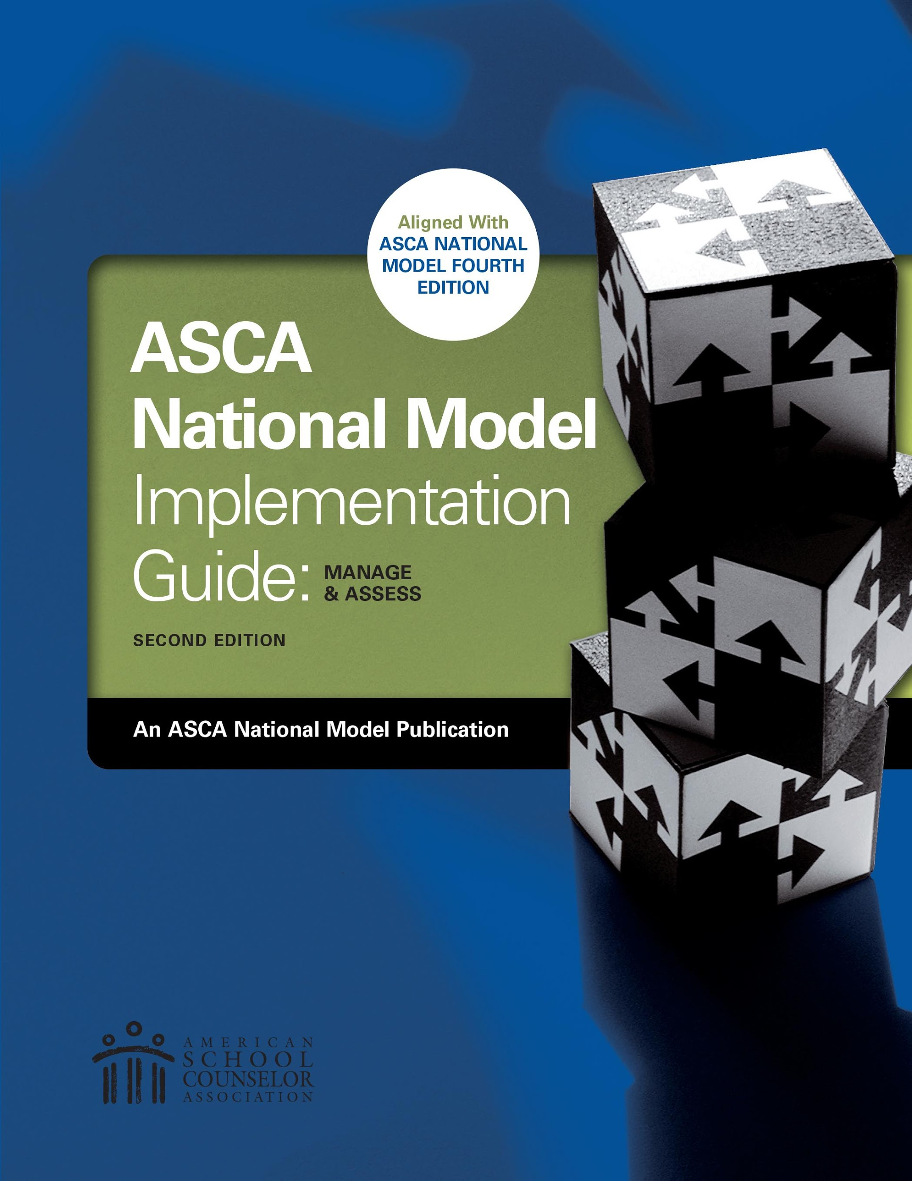

Slide 10
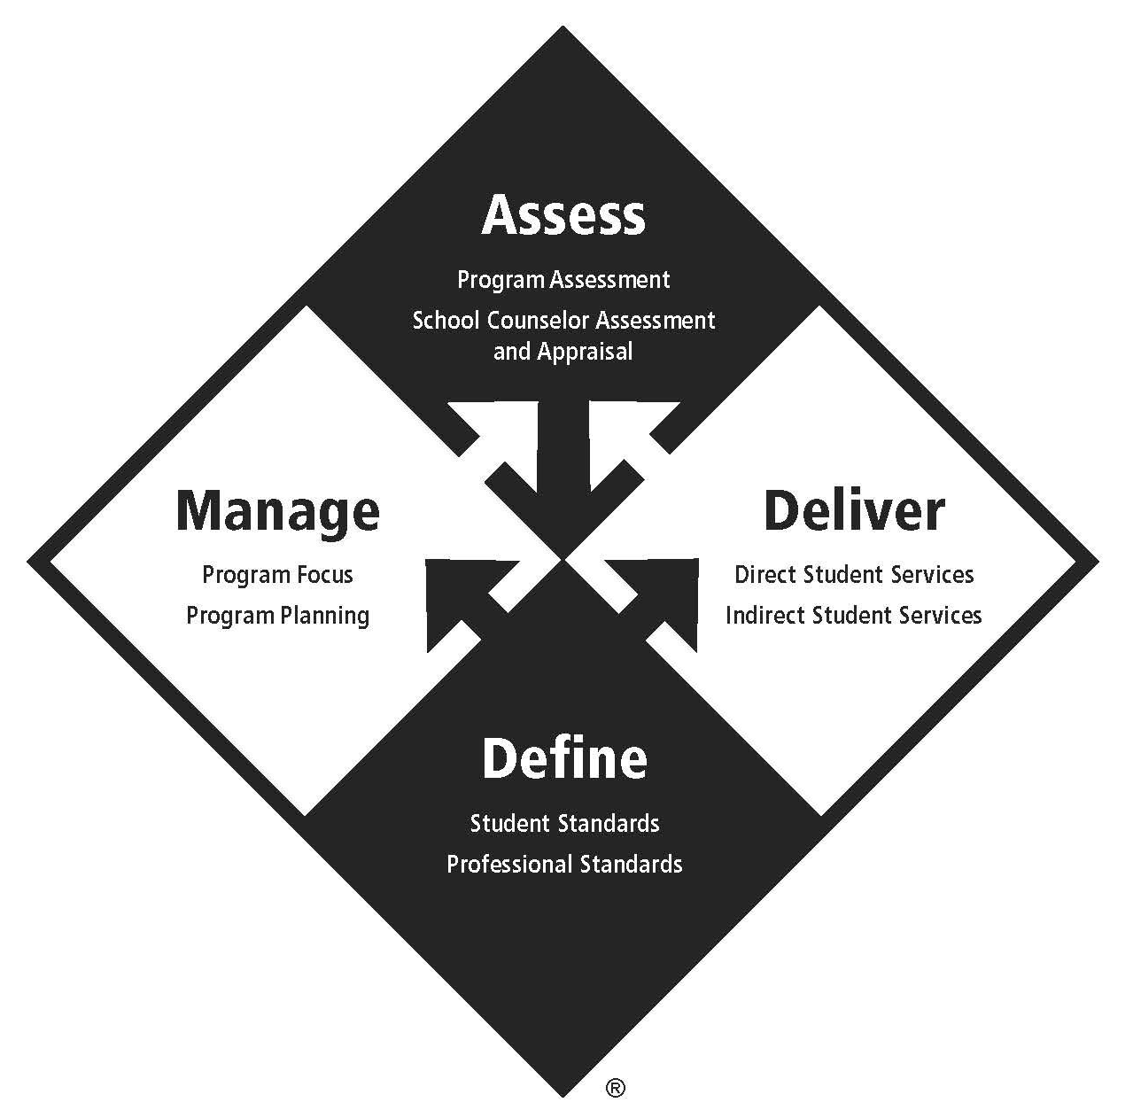
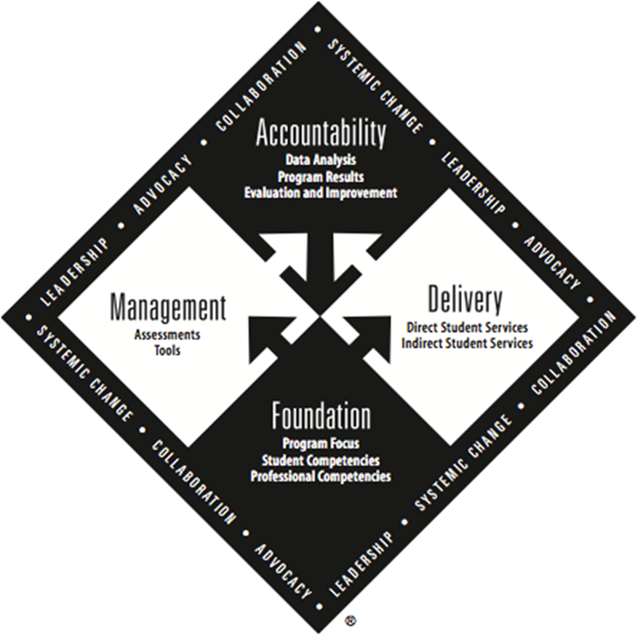
Notes:
Okay! Let’s talk about the 4th Edition ASCA National Model!
There is a lot to take in about the changes in the newest Model edition, but this webinar will show you where to look for the most change.
REMEMBER! This does not change the way we deliver our programs, which is 80% of our practice of School Counseling. “The ASCA National Model is intended to help school counselors improve not impair their programs (pp.xi)”
The ASCA Model 4Ed. Introduction says, “[The] fourth edition does not introduce or eliminate any substantive content, but because the educational environment has changed substantially, language from the previous edition was clarified to reflect the current state of education…In addition, some sections have been moved to make the ASCA National Model easier to read, understand, and implement. (pp.x)”
The Model still has the same overarching themes: Leadership, Advocacy, Collaboration, and Systemic Change
ASCA 4Ed. says “The four themes of leadership, advocacy, collaboration, and systemic change no longer appear around the edge of the ASCA National Model diamond but instead are woven throughout the ASCA National Model to show they are integral components of a comprehensive school counseling program. Implementing the ASCA National Model requires leadership, advocacy, and collaboration with a focus on systemic change in outcomes. (pp.116)”
The Executive Summary now (4th Ed) includes Appropriate and Inappropriate Activities for School Counselors. This was a nice addition, I think!

Slide 11
3rd | 4th
Foundation | Define
Management | Manage
Delivery | Deliver
Accountability | Assess
Notes:
Now that we have looked at the new and improved ASCA National Model diamond, let’s dive into title changes.
The four component titles were updated from Foundation to Define, from Management to Manage, from Delivery to Deliver, and from Accountability to Assess.
ASCA 4Ed. says “...using verbs instead of nouns was more active and descriptive of what school counselors do. (pp.x)”
Now, let’s look at the changes in each component.

Slide 12
3rd | 4th
Foundation | Define
Competencies Program Focus | Competencies
Management | Manage
Assessments Tools | Program Focus Program Planning
Notes:
The Define component is simplified down to include only Competencies which describe what we expect of our students and what we expect of ourselves!
Previously, the Foundation component included Program Focus, however the 4th Edition has restructured to fit this piece in the Manage component.

Slide 13
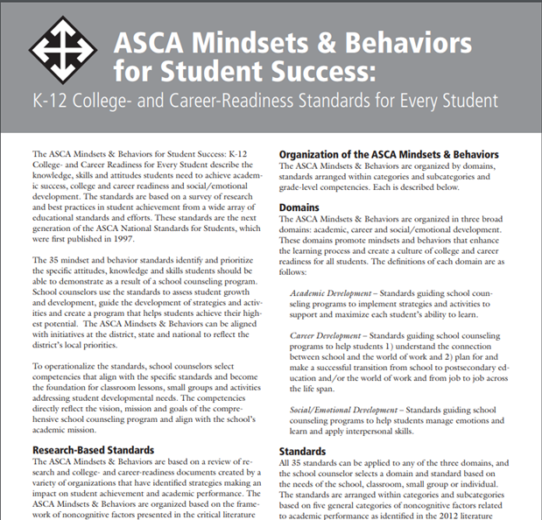
DEFINE Student Standards Professional Standards
Notes:
Included in the Define component are Student Standards and Professional Standards. These have not changed for us.
The Student Standards refers to the ASCA Mindsets and Behaviors for Student Success.
The Professional Standards refer to ASCA School Counselor Professional Standards and Competencies and the The ASCA Ethical Standards for School Counselors.

Slide 14
3rd | 4th
Foundation | Define
Competencies Program Focus | Competencies
Management | Manage
Assessments Tools | Program Focus Program Planning
Notes:
The Manage component has some changes within it to pay attention to. I like to think of the Manage component as our Program maintenance. Both our Program Focus and Program Planning make up this component.
Previously the Foundation component included Program Focus, however the 4th Edition has restructured this to fit under the Manage component.
Previously Program Planning was labeled as “Tools” but still serves the same purposes.
In the previous Management component, there are Assessments included, however they are also repeated in the 3Ed Accountability component. So, in the updated edition these pieces are only done once in the Assess component. Simplified!

Slide 15
MANAGE Program Focus
Vision
Mission
Beliefs
Notes:
Program Focus has one small change. In the 4Ed Annual Student Outcome Goals are included in the next Manage component, Program Planning. Previously, they were included in Program Focus.

Slide 16
MANAGE Program Planning
3rd | 4th
Management Tools | Manage Program Planning
Annual Agreement Advisory Council Use of Data School Data Profile Program Results Data Action Plans Lesson Plans Calendars | Data Annual Student Outcome Goals School Data Summary Program Results Data Action Plans Lesson Plans Calendars Advisory Council Annual Administrative Conference
Notes:
Here, we have a title change, from Tools, to Program Planning. Where there are also order and implementation changes, as well as updated templates.
Annual Student Outcome Goals are now included in this Program Planning, rather than previously in Program Focus and titled Program Goals.
The order of the smaller components differs slightly in the new edition for easier flow and implementation. It has stayed in mostly the same order except the Advisory Council and Annual Administrative Conference are now done last rather than first. It makes sense to gather information and produce these documents prior to meeting with our Administrators, then when we do meet with them, we do have a full program plan to show.

Slide 17
MANAGE Data
3rd | 4th
Process | Participation Who participated in what activities?
Perception | Mindsets & Behaviors What did they learn?
Outcome | Outcome How did the learning affect achievement, attendance or discipline?
Notes:
Data. There has been change in what we label certain data as. Previously called Process Data, is now called Participation Data. Previously called Perception Data, is now called simply the Mindsets and Behaviors. Outcome Data is still Outcome Data

Slide 18
MANAGE Program Planning
3rd | 4th
Program Goals | Annual Student Outcome Goals Achievement Attendance Discipline
Notes:
As I mentioned before, Program Goals are now called Annual Student Outcome Goals and live under Program Planning in the Manage component.

Slide 19
MANAGE Outcomes
Data 3rd
Achievement
Attendance
Behavior
Data 4th
Achievement
Attendance
Discipline
Notes:
Outcome Data is still split into three categories. The only change here is that Behavior Data is now called Discipline Data.

Slide 20
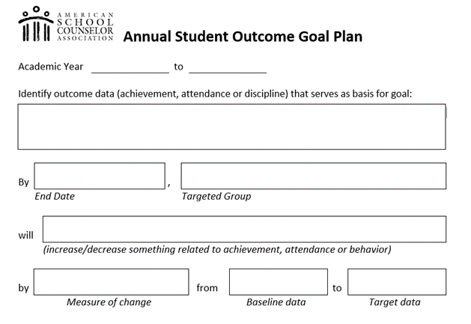
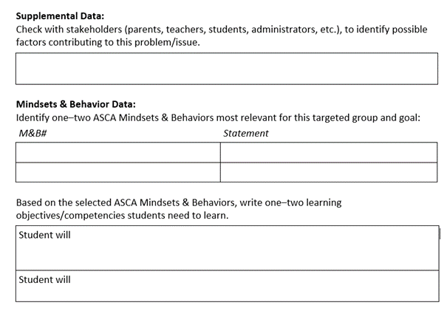
Notes:
Annual Student Outcome Goal Plan. This was previously called Program Goals and had a similar template. There are additions to the updated template: There is a space to identify the outcome data used as a basis for the goal, and the template now has a Supplemental Data section.

Slide 21
MANAGE Data
Supplemental data
Needs assessments
Opinion surveys
Program/Activity Evaluation
Notes:
This newly added Supplemental Data section in the Annual Student Outcome Goal Plan can include the following: needs assessments, opinion surveys, or program and activity evaluations.

Slide 22
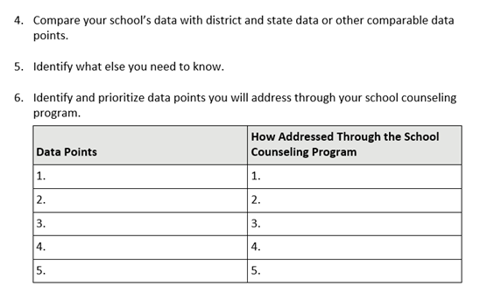
MANAGE Program Planning
Notes:
This piece within Program Planning has changed. Previously it was called the School Data Profile, and it has now changed to the School Data Summary; this includes changes to the implementation procedures. Previously the School Data Profile was a chart template to enter data values. The updated School Data Summary gives a numbered succession of questions and prompts to reflect mindfully about School Data rather than a data entry template.

Slide 23
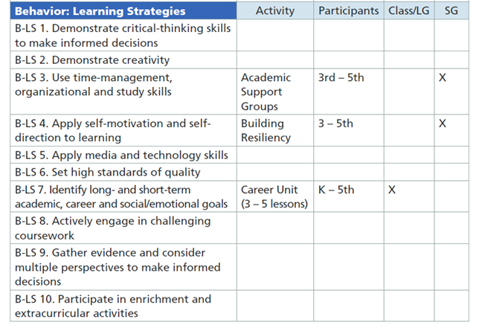
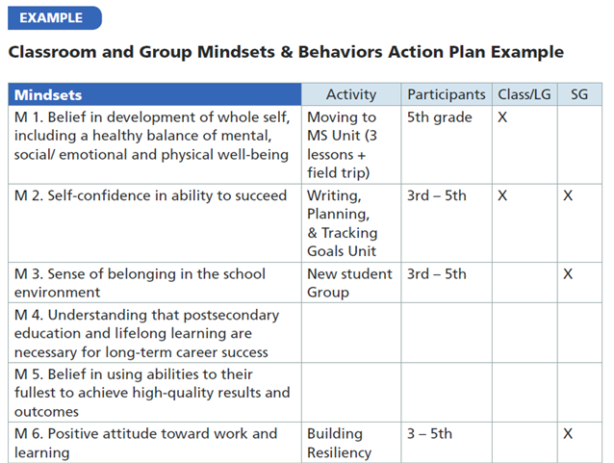
MANAGE Action Plans
Notes:
Now onto Action Plans.
Classroom and Small Group Action Plans have been simplified! They are now combined together and have been put in a template of the Mindsets and Behaviors within a chart format. Previously, these two Action Plans were in column templates.

Slide 24
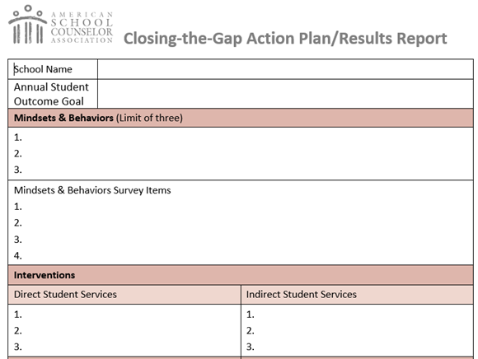
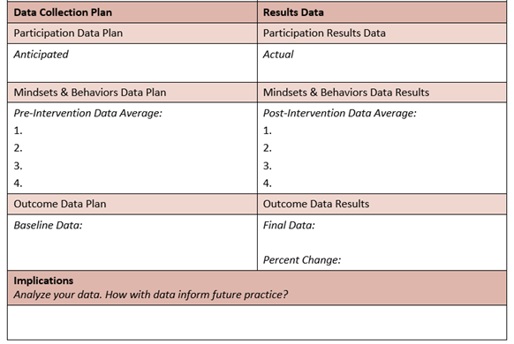
Notes:
The Closing the Gap Action Plan is now in a vertical type template rather than a horizontal chart template. This allows for more information to be included in the Action Plan and the Results Data. Another change for this Action Plan is that Results Data is completed on the same template as the Action Plan.

Slide 25
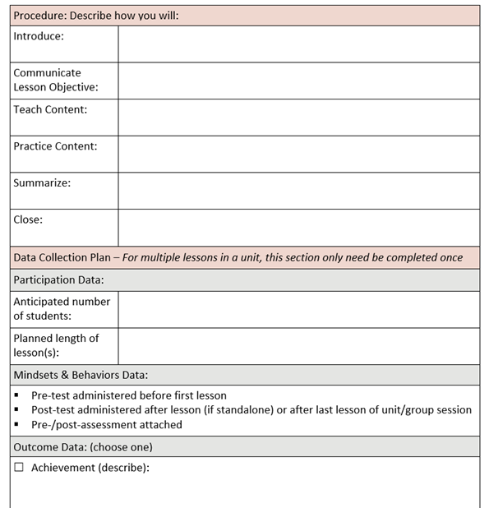
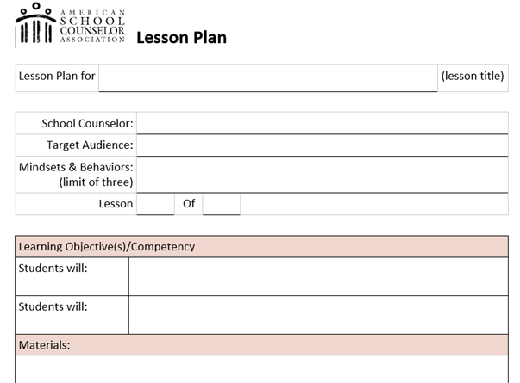
Notes:
Moving right through to the Lesson Plan template. The Lesson Plan template has some changes, and the order of the components has shifted as well.
There is the addition of an “Evidence Base” section, which gives the option to choose from Best Practice, Action Research, Research-Informed, or Evidence-Based. In this image, it is cut off, but it comes after Materials. Also, the Procedure section has been updated to offer more opportunity for details.
Previously, The Data Collection Plan was called the Plan for Evaluation, and now includes the updated data labels: Participation Data, Mindsets and Behaviors Data, and the original Outcome Data.

Slide 26
Notes:
Calendars. The Annual Calendar changes are mostly title changes, School Counseling Core Curriculum to Instruction; Individual Planning to Appraisal and Advisement; and Responsive Services to Counseling.
In the previous Model Edition, within the Annual Agreement was “Individual Duties”. This section was taken out of the new Annual Administrative Conference template with the intention to add these duties to our annual calendar, as they can be things that are planned that you participate in throughout the year.

Slide 27
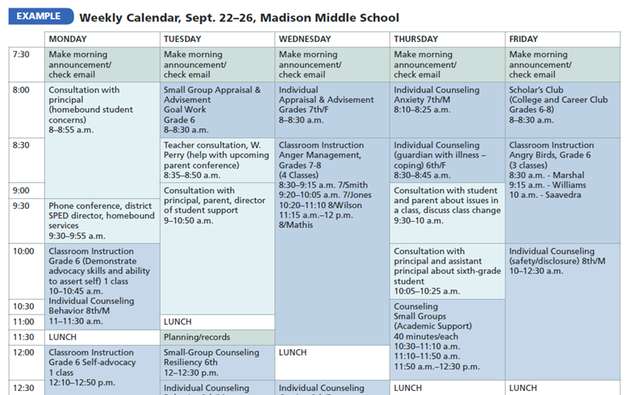
Notes:
The weekly calendar template has stayed the same other than the same title changes as the Annual Calendar: School Counseling Core Curriculum to Instruction; Individual Planning to Appraisal and Advisement; and Responsive Services to Counseling.

Slide 28
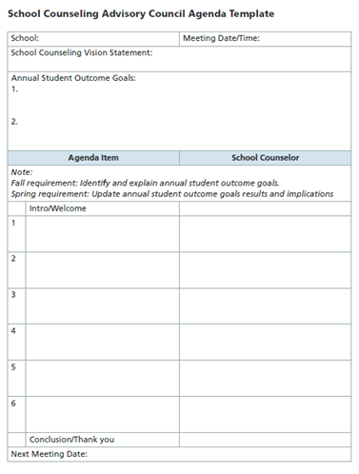
Notes:
For the Advisory Council, there are now templates provided for both the agenda and for meeting minutes. Having these provided is helpful and so simple!

Slide 29
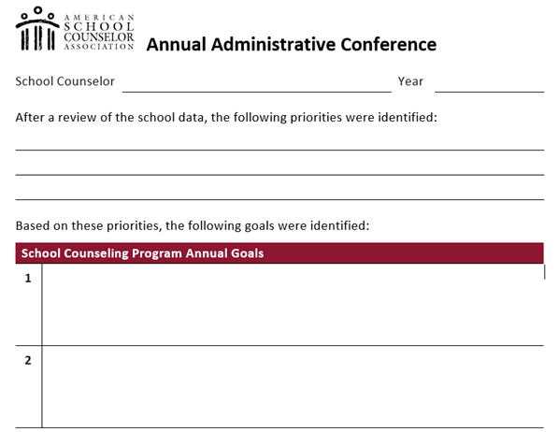
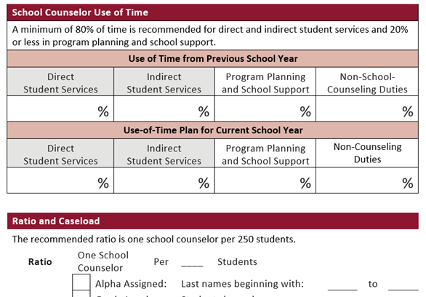

Slide 30
80% of time should be spent on Directly and Indirectly serving students.
Notes:
Direct: Different titles, same practices Indirect: Different order

Slide 31
DELIVER Direct Student Services
3rd | 4th
SC Core Curriculum Instruction Group | Instruction
Individual Student Planning Appraisal Advisement | Appraisal and Advisement
Responsive Services Counseling Crisis Response | Counseling
Notes:
Different titles, same practices

Slide 32
DELIVER Direct Student Services
Direct Student Service | Setting
Instruction | Classroom Small group Individual
Appraisal and Advisement | Classroom Small group Individual
Counseling | Small group Individual
Notes:
Appraisal and Advisement used to be called Individual Student Planning in the 3Ed

Slide 33
DELIVER Indirect Student Services
Consultation
Collaboration
Referrals
Notes:
Different order: Same names, Same practices
Referrals moved from 1st to last, with the intention of using all of our available resources before we refer.

Slide 34
3rd Accountability | 4th Assess
Data Analysis | Program Assessment
Program Results | School Counselor Assessment and Appraisal
Evaluation and Improvement | Reporting Results
Notes:
Simpler!
3Ed Data Analysis - Done in 4Ed Manage: Program Planning, School Data Summary and Use of Time within the Annual Administrative Conference.
3Ed - Assessments done twice, once in Management and again in Accountability. 4Ed simplifies this to once per year.
The content of following templates are very similar and components are similar within [3Ed Program Results and Evaluation and Improvement] and [4Ed Program Assessment and School Counselor Assessment and Appraisal]
In 4Ed, The following 4 templates are separated into Program and School Counselor Assessments, rather than before having Results separated from the Program and School Counselor Assessments/Evaluations
4Ed Reporting Results - How and in what methods do we Report the Results of our Program Annually?

Slide 35
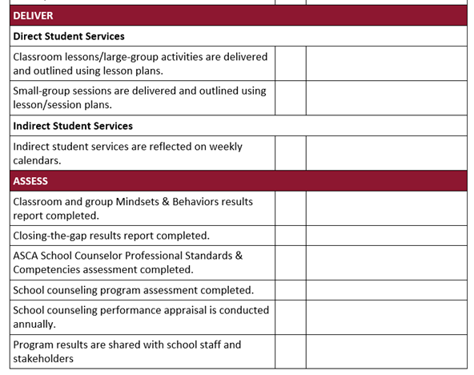

Slide 36
ASSESS Results Reports

Slide 37
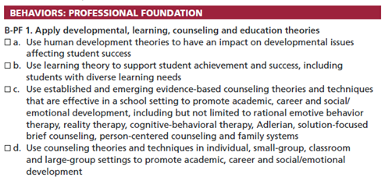
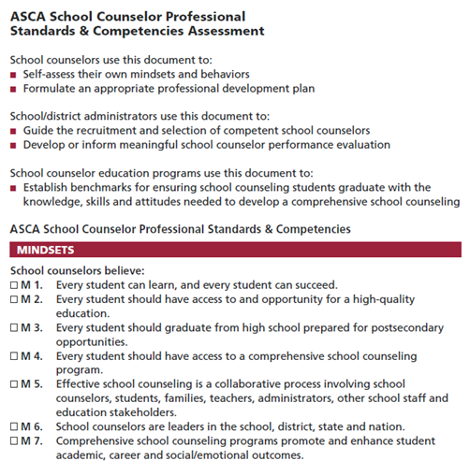
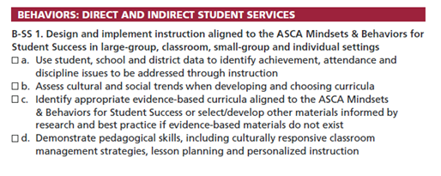

Slide 38
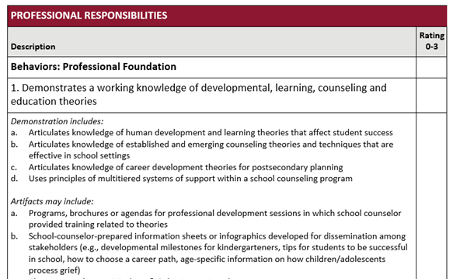
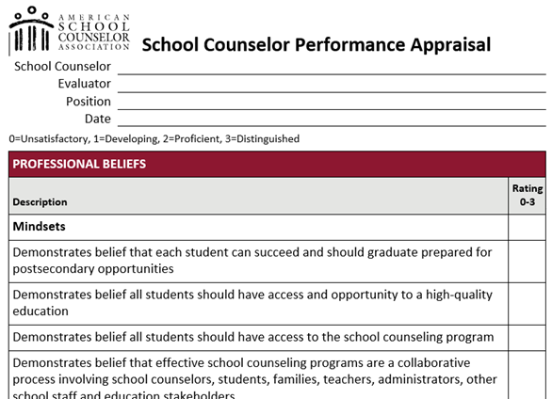

Slide 39
Integrating ASCA 4th Ed. with WA State
Our essential practice is still the same and how we Deliver our programs has not changed.
Our methods, template, and actions have been simplified
WA K12 SEL Standards and Benchmarks
Career Guidance Washington
High School and Beyond Plan

Slide 40
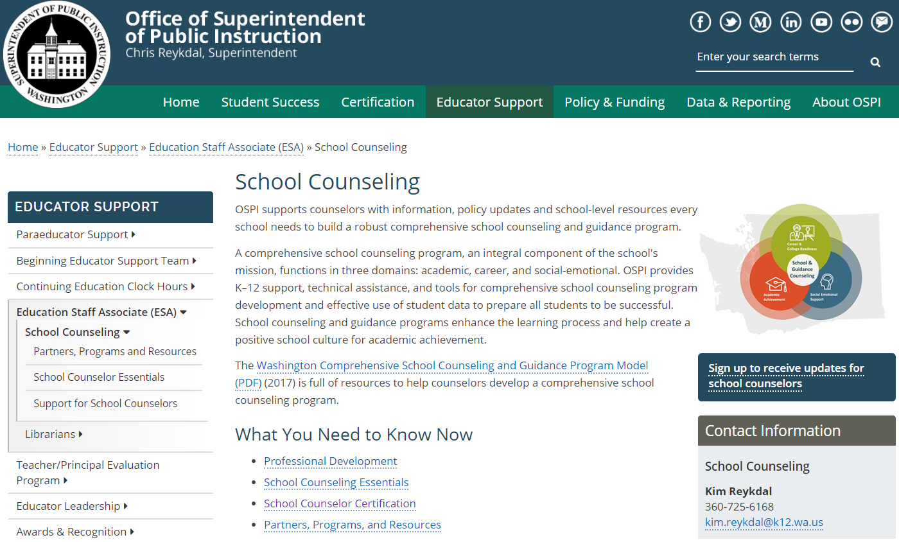
WA State Resources

Slide 41
Creating lesson plans aligned to the new ASCA Lesson Plan template that align to
The High School and Beyond Plan and/or
Closing-the-Gap Action Plans/Results Reports that align to the College Bound Scholarship program

Slide 42
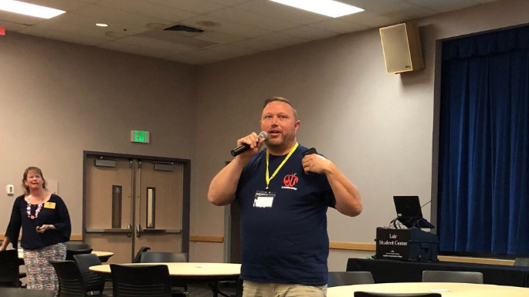
Training available through:
Washington School Counselor Association (WSCA)
OSPI
Rural Counselor Network
NEW! Regional School Counseling Networks (ESDs: 101, 112, 114)

Slide 43
WA K-12 SEL Standards | ASCA Mindset Standards | ASCA Behavior Standards
Self-Awareness | Self confidence in the ability to succeed | Self-Management Skills
Self-Management | Development of whole self; Positive attitude toward work and learning | Self-Management Skills
Self-Efficacy | Belief in using abilities to their fullest to achieve high-quality results and outcomes | Learning Strategies
Social Awareness |  | Social Skills
Social Management |  | Social Skills
Social Engagement | Sense of belonging in the school environment | Social Skills
Additional Standards | Understand post-secondary education and life-long learning are necessary for long term success
Emphasizing the ASCA Mindsets and Behaviors AND Washington’s K-12 Social Emotional Learning Standards and Benchmarks
Crosswalking standards

Slide 44
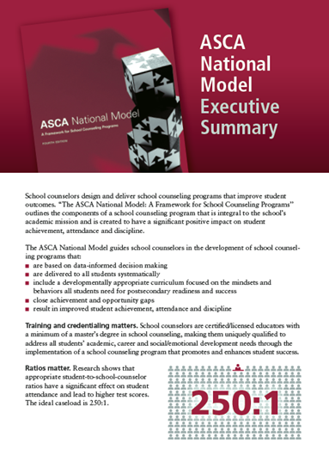
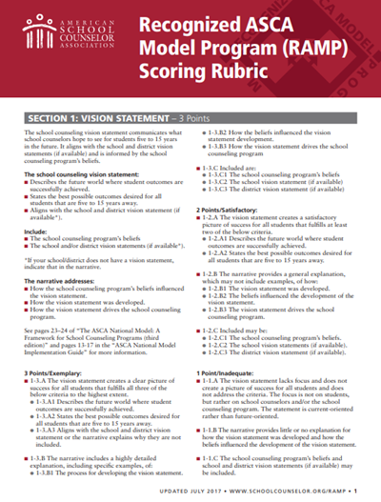
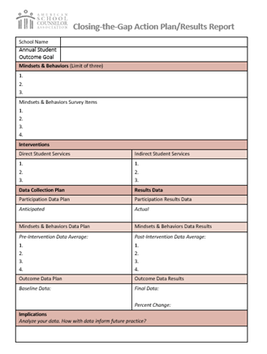
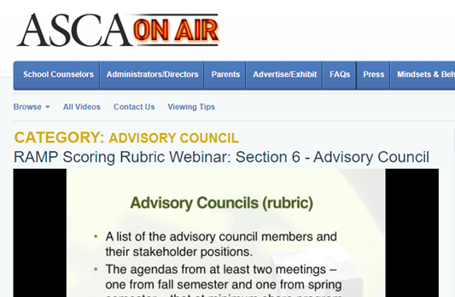
Free Resources

Slide 45
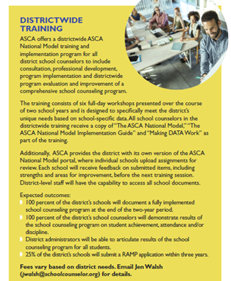
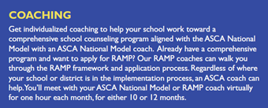
Resources

Slide 46
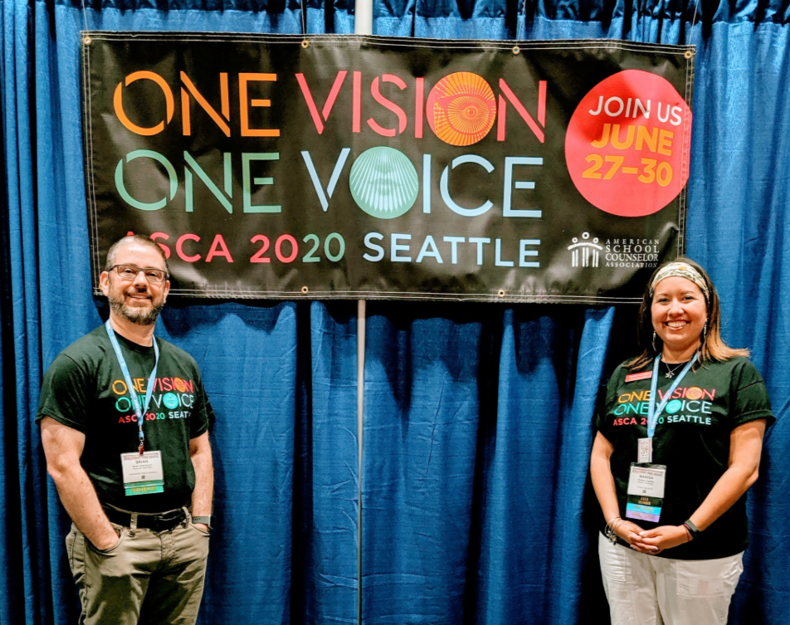
Will we be seeing you at the WSCA State Conference on February 26-28th, 2020 in Sea-Tac?
What about the ASCA National Conference on June 27-30th, 2020 in Seattle?

Slide 47
What questions can we help you answer?
Type in the Q & A box….

Slide 48
Creative Commons Copyright Statement
Except where otherwise noted, this work by the Office of Superintendent of Public Instruction is licensed under a Creative Commons 4.0 International License.
Many of our images come from Canva.com and TheNounProject.com.

Slide 49
WSCA is #morethanaconference
WE ADVOCATE FOR YOU!
Senate Bill 6480 80/20 Ratio

