Slide 1
April GATE Equity Webinar Collaborating for Student Success: Alignment of High School and Beyond Planning and IEP’s
Exploring topics related to equity in graduation success
The webinar will begin soon.
While you wait, please share in the chat panel:
Use 6 words to describe your connection to the HSBP.
Notes:
Thank you for joining us for the February GATE Equity Webinar!
This webinar will be recorded and will be posted in the next couple of weeks.
The PowerPoint is posted on OSPI on the GATE Equity Webinar page if you want to follow along.
I’m Kefi Andersen, OSPI Graduation Equity Program Supervisor.
Today’s topic is Language Learners 101: Supporting Best Practices
We chose this topic because Washington has one of the highest Language Learner populations in the United States and many of our Language Learner students aren’t making to graduation. We are committed to providing access to education for all students. So today we are providing you with some of the Best Practices for language learners.

Slide 2
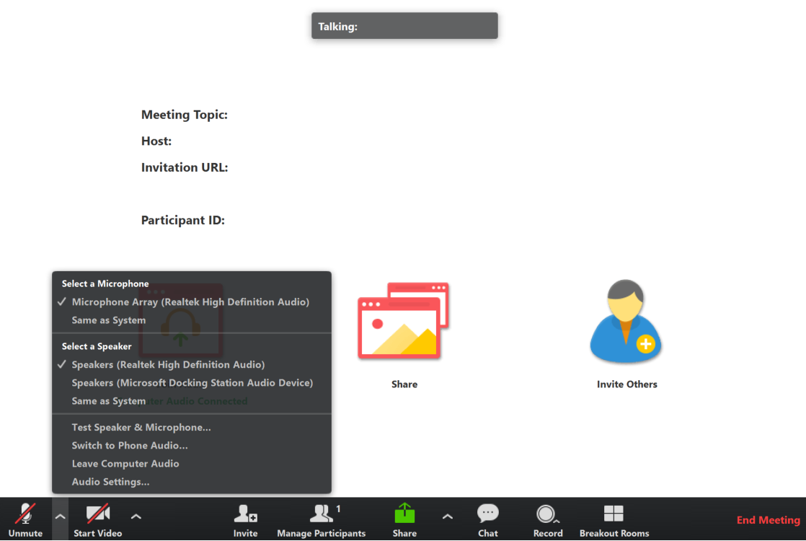
Connect to Audio
Welcome to the GATE Equity Webinar!
We’ll be starting in a few minutes.
You can join by computer audio or call in.
Dial +1 669 900 6833 or
+1 646 558 8656
Webinar ID: 122-657-497
Test Audio
3/26/2020 | 2
Notes:
We’re going to get started in a few minutes. You can test your audio in the bottom left hand corner of the menu.

Slide 3
Sound Check
Welcome to the GATE Equity Webinar!
We’ll be starting in a few minutes.
We’re going to get started in a few minutes.
Can you hear us?
Please let us know in the chat!
Test Audio
3/26/2020 | 3
Notes:
We’re going to get started in a few minutes. You can test your audio in the bottom left hand corner of the menu.

Slide 4
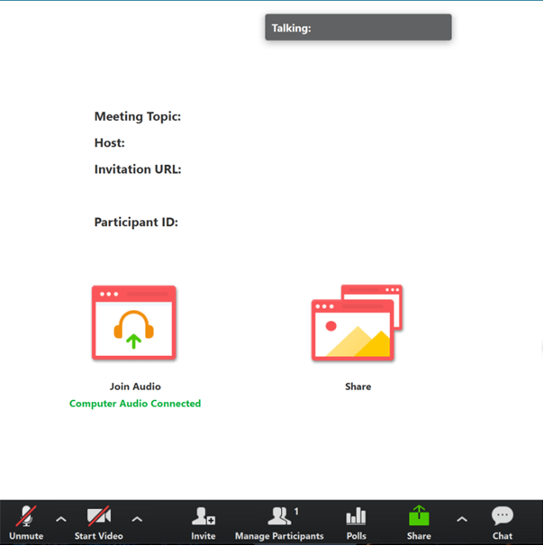
Tips for Participating
Share comments and ideas in the Chat panel (send to “All”)
Ask presenters questions in the Q&A panel
Slides are available on the GATE Equity Webinar page in the Archive now.
Recording will be available at the end of the month.
3/26/2020 | 4
Notes:
Thank you for sharing comments and ideas in the chat.
If you’d like our presenters to answer a question, please use the Q&A instead.
Our slides are available on the GATE Equity Webinar page now if you would like a copy.
We do record our webinars and they’re also on our page in the archive section. The recording from today should be available by the end of the month.

Slide 5
Webinar Etiquette
Focus on the topic, stay present
Assume positive intent
Growth mindset
3/26/2020 | 5
Notes:
As we go through the webinar, please keep this webinar etiquette in mind.
We encourage a growth mindset, where you are open to thinking about new ideas and willing to push yourself to grow.
As with any professional development you’ll get out of it what you put into it. So thank you for staying present, focused, and positive!

Slide 6
April GATE Equity Webinar Collaborating for Student Success: Alignment of High School and Beyond Planning and IEP’s
Exploring topics related to equity in graduation success
The webinar will begin soon.
While you wait, please share in the chat panel:
Use 6 words to describe your connection to HSBP.
Notes:
Thank you for joining us for the February GATE Equity Webinar!
This webinar will be recorded and will be posted in the next couple of weeks.
The PowerPoint is posted on OSPI on the GATE Equity Webinar page if you want to follow along.
I’m Kefi Andersen, OSPI Graduation Equity Program Supervisor.
Today’s topic is Language Learners 101: Supporting Best Practices
We chose this topic because Washington has one of the highest Language Learner populations in the United States and many of our Language Learner students aren’t making to graduation. We are committed to providing access to education for all students. So today we are providing you with some of the Best Practices for language learners.

Slide 7
Do You Need Clock Hours?
We are offering 3 free Clock Hours for attending both of today’s webinars.
Register for clock hours.
Complete the pre-reading assignment.
Attend both the morning and afternoon live GATE Equity Webinars.
Complete the PDEnroller Evaluation.
Clock Hours will be released when attendance is verified, usually within a week.
Questions? Contact Ronnie.Larson@k12.wa.us
Clock Hour Instructions and Registration Here!
3/26/2020 | 7
Notes:
We’d love to see our listeners get clock hours for joining us, so if you are planning to watch both webinars live today you can use this link in the chat to get into PDEnroller and collect your hours.
This month’s pre-reading assignment was______________. If you’ve done that, and registered with PDEnroller, all you have left to do is complete the PDEnroller evaluation, print, sign, and send back to Ronnie Larson.
We assigned this because___________
We should have a confirmation to you by early next week.
We hope you can take advantage of this free offering!

Slide 9
Notes:
OSPI has developed an Equity Statement that we think helps frame our webinars. We believe each student family and community possesses strengths and cultural knowledge that benefit their peers, educators and schools.
In our leadership role, we examine the ways current policies and practices result in disparate outcomes for our students and work to intentionally consider historical contexts, ways to partner in decision making, and ways to dismantle systemic barriers so that the students in our schools can access instruction and support in our schools.

Slide 10
Office of System & School Improvement
We believe we are more likely to see school improvement across multiple measures if we:
Study
Focus on schools identified for supports
Support
Connect programming to specific needs
Serve
Build the health of systems
Elevate Provide professional learning on data inquiry and supportive resources and tools
3/26/2020 | 10
Notes:
This webinar is brought to you through the Office of System and School Improvement.

Slide 11
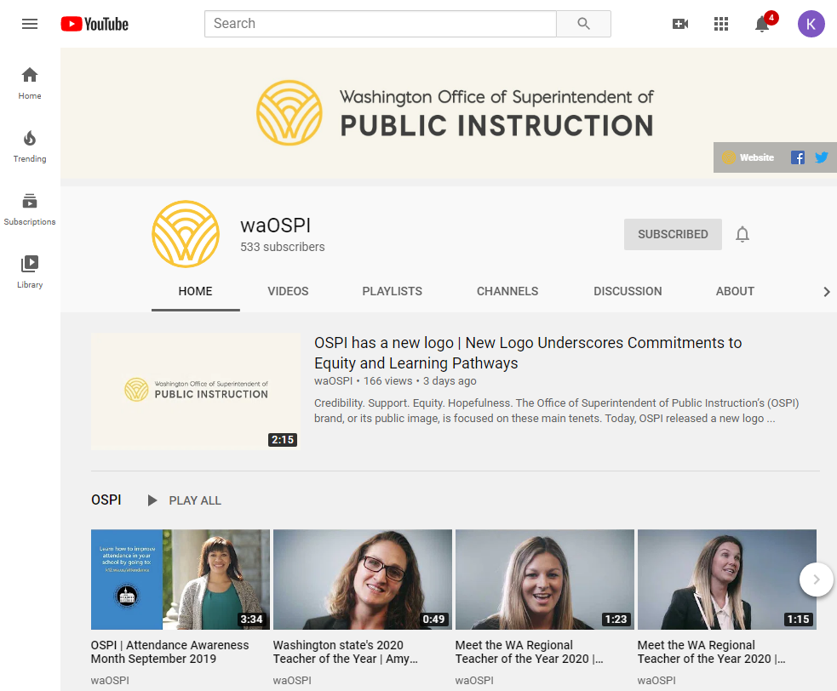
OSPI YouTube Channel
Did you know you can subscribe to the OSPI YouTube Channel?
Watch our past webinars!
Youtube.com/waOSPI
3/26/2020 | 11
Notes:
Did you know our webinars are all posted on our YouTube channel? If you want great ideas from Washington schools you should definitely subscribe!

Slide 12
Objectives
Understand systems level approach for designing Language Learner services
Learn from an Educational Service District how they are implementing these supports
Get resources to get started!
3/26/2020 | 12

Slide 13
Who Are We?
Bonnie Zimmerman
Tiered Supports Program Specialist
OSPI
Alexandra Toney
Special Education
Program Supervisor
OSPI
Kris Hirschmann
Director of Transition Services
Center for Change and Transition
Seattle University
Abby Smith
Program Manager Special Services
PSESD
3/26/2020 | 13
Notes:
I’m joined today by Veronica Gallardo, OSPI’s Director of Migrant and Bilingual Services.
And she’s brought with her ESD 105’s …
Thanks for all the work you’ve done to share your experiences with our audience!

Slide 14
Next Month
May 13, 2020
Dual Credit 101:
Model Program Recommendations
10 a.m. – 11 a.m.
Dual Credit 201:
A Strategy Worth Sharing in Depth
3 p.m. – 4 p.m.
3/26/2020 | 14
Notes:
Next month we’re going to be talking about how to support Students with Disabilities.
These links will be in the chat if you want to register now. Please share this link with friends who may be interested!

Slide 15
MTSS PLC Webinar Series
April 10
May 8
Rhonda Nese
Providing alternatives to exclusion
Devon Minch
Engaging Families in MTSS
3/26/2020 | 15
Notes:
We have a sister webinar series, the MTSS PLC Webinar Series. They have a great line up of presenters and topics! This webinar would be useful for any school that wants to think more deeply about MTSS implementation. It was created to support early MTSS adopters in Washington and provides a great place to network and learn from other schools as well as nationally recognized experts in MTSS, we are linking to their bios, If you grab the slides. I know I’ll be there to soak up some knowledge, and hope you check it out too! 11-noon, usually second Friday of the month

Slide 16
Questions & Polling 1
Who’s here?
Administrator
Counselor
Teacher
Parent
ESD
District
Continuous Improvement Partner or Coach
Grad Specialist
Community Based Organization
Paraprofessional
Other
Has your school been identified for Comprehensive or Targeted Supports by OSPI?
Yes
No
Not Sure
How familiar are you with our topic?
Very
Somewhat
It’s new!
3/26/2020 | 16
Notes:
We like to get to know our audience so that we can tailor our content to your needs.

Slide 17
????

Slide 18
Statewide Trends from Washington Report Card & the Healthy Youth Survey
Engagement Qs from HYS
Engagement Qs from HYS
Graduation Rate %
Engagement Qs from HYS
%
Graduated in 4 years Class of 2019
*OSPI Report Card & Healthy Youth Survey data
3/26/2020 | 18

Slide 19
Systems Level Supports
text
text
3/26/2020 | 19
Notes:
Rules? Trends? Etc.

Slide 20
Big Ideas
3/26/2020 | 20

Slide 21
High Leverage Supports Examples
Universal
Targeted
Personalized
3/26/2020 | 21

Slide 22
Implications for Rural Districts
3/26/2020 | 22

Slide 23
What Advice Would You Give To Schools Starting This Work?
Text
Text
Text
3/26/2020 | 23

Slide 24
Questions & Polling 2
What systems level supports are you currently implementing?
List…
3/26/2020 | 24

Slide 25
What does alignment look like in best practice?

Slide 26
Who Am I? Where Am I From?
Me
My School
My Past Experience
3/26/2020 | 26

Slide 27
Why did you start looking at High School & Beyond Planning?
Data
Who was effected
How did staff respond?
3/26/2020 | 27

Slide 28
Root Causes: What did you find?
Results
3/26/2020 | 28

Slide 29
What did you do as a result?
3/26/2020 | 29

Slide 30
What Were Some Themes You Noticed?
3/26/2020 | 30
Notes:
What root causes did you find? How did you address those?
What were some Themes you found for why students were absent?(team, intervention, system)
Root cause – kids with Fs aren’t involved, they’re isolated, mentor helps them with life too. The relationship helps them deal with their traumatic effects
RN/ 3 visitng counselors 1 day a week – seen right there at school
SAGE domestic violence agency comes once a week
Local agency 1 a week for mental health counseling
Drug alcohol counseling
School counselors setup a visiting office for them to use
1st period freshmen rotate classes health, food/nutrition, comp programming (TEALS), intro to technology wood class CTE gives them a well rounded education and gives them a hands on success rate – high engagement in a block (85 minute period)
Absenteeism? Well below the state average in district. 3% lower than the state 2015-2016
Get student services department. No punishment, family community liaisons do home visits, get away from punishment. Spanish speaking. Resource officer goes to pick up kids we think are AWOL
Let out 5 early for lunch – kids with fewest tardies
Ice cream social for them in advisory classes
Attendance takes a team effort

Slide 31
Our Supports Related to HSBP
Universal
Targeted
Personalized
3/26/2020 | 31

Slide 32
Process For Building A System
How did the work spread in your district?
How do you know the work will continue after you leave your building?
3/26/2020 | 32

Slide 33
What Advice Would You Give To People Starting This Work?
Text
Text
3/26/2020 | 33

Slide 34
GATE Evaluation
This presentation will change my practice in the future:
Definitely
Probably
Not Sure
No – not helpful
This presentation was well organized with a variety of participant involvement:
Strongly agree
Agree
Disagree
Strongly Disagree
The presenters were content experts:
Strongly agree
Agree
Disagree
Strongly Disagree
The presentation met the stated learning objectives:
Strongly agree
Agree
Disagree
Strongly Disagree
GATE Feedback Survey
3/26/2020 | 34
Notes:
We would like to get more information from our audience about our webinars, so we’re going to try something new this month and run our evaluation as a poll.
Thank you for letting us know what you think! If something comes to you later, you also always have the option to share your thoughts through our web evaluation, which is linked on our webinar reminders.

Slide 35
Resources

Slide 36
Resources
Funding
Tools & Videos
Websites
3/26/2020 | 36

Slide 37
Contact Us….
Bonnie Zimmerman
Tiered Supports Program Specialist
OSPI
Bonnie.Zimmerman@k12.wa.us
Alexandra Toney
Special Education
Program Supervisor
OSPI
Alexandra.Toney@k12.wa.us
Kris Hirschmann
Director of Transition Services
Center for Change and Transition
Seattle University
hirschmk@seattleu.edu
Abby Smith
Program Manager Special Services
PSESD
asmith@psesd.org
3/26/2020 | 37
Notes:
I’m joined today by Veronica Gallardo, OSPI’s Director of Migrant and Bilingual Services.
And she’s brought with her ESD 105’s …
Thanks for all the work you’ve done to share your experiences with our audience!

Slide 38
Get Personalized Assistance
Do you want personalized support?
We want to help connect you to the right people!
Use the Green Button!
3/26/2020 | 38
Notes:
Another resource we’ve developed is a green button. We want you to be able to contact a real live person to help answer any questions you have. If you want to learn more, connect to a program or get some fresh ideas, we are here for you! Just click on the button and an OSSI staffer will help you get whatever you need.

Slide 40
Creative Commons
Except where otherwise noted, this work by the Office of Superintendent of Public Instruction is licensed under a Creative Commons 4.0 International License.
3/26/2020 | 40

Slide 41
Discussion Questions for the Chat
What are your next leadership moves?
What did you value in the presentation?
What questions do you still have?
What were the big ideas you got from today?
3/26/2020 | 41
Notes:
As we wrap up today, we want to encourage you to take a moment to reflect on the webinar and discuss these questions. You can use the chat, the people around you, or just jot down some thoughts on a sticky note.
What were the big ideas for you?
What are your next leadership moves?
What did you value?
What questions are you still wondering about?
We’ll be here to answer questions for a little while, so take advantage of the opportunity to talk to our presenters with the Q&A. Thank you for joining us for GATE Equity Webinar.
We’ll see you next month as we explore social emotional learning!
<mute>

