Slide 1
LEA Planning for Safety, Emotional or Behavioral Distress, and Threat Assessment
Ross Boylan, Student Engagement & Support
Notes:
Thank the AC

Slide 2
Feedback & Questions
We have a full agenda today, and I want to make sure I get all of your comments and questions on this topic!
Please feel free to log input and questions on the Padlet during the presentation.
Notes:
Open notepad file with padlet link
We will have some time during the morning for questions and discussion, too, but it may be limited so please put your thoughts on the padlet.

Slide 3
Acronyms
RCW – Revised Code of Washington
Washington State law.
LEA – Local Education Agency
LEAs include school districts, charter schools, tribal schools, School for the Deaf, School for the Blind, WA Challenge Academy.
TA – Threat Assessment
EBD – Emotional or Behavioral Distress

Slide 4
Project Background

Slide 5
RCW 28A.300.645
Passed into law as 2SHB 1216 (2019-20)
Requires OSPI to collect data from LEAs to measure their implementation of:
Threat assessment programs (RCW 28A.320.123)
District & school safety planning (RCW 28A.320.125)
Emotional or behavioral distress plans (RCW 28A.320.127)
Notes:
We are trying to determine if districts have three types of safety plans or programs in place

Slide 6
Methodology
Data was collected using an online survey (1 survey for each required plan/program, for a total of 3 surveys)
Surveys were designed to measure:
Whether an LEA had the required plan/program
What components were in the plan/program
Barriers to implementation

Slide 7
Methodology
Survey data was collected between March, 2022, and Feb, 2023:
20% of LEAs were surveyed between March and May of 2022.
The remaining 80% of LEAs were surveyed between Nov, 2022, and Feb, 2023.
100% of Washington’s 321 LEAs responded to all 3 surveys.
Surveys were completed by LEA administrators.
Notes:
This was the first time these surveys have been conducted.

Slide 8
About This Presentation
This presentation does not contain everything that we learned from the surveys.
The analysis in this presentation focuses on areas of particular importance, areas of strength, or areas in need of improvement.
Notes:
It may seem like this presentation is focusing more on areas in need of improvement, but that’s only because these are of particular interest. We appreciate everything that school districts do and know that they're working hard on these plans.

Slide 9
Threat Assessment

Slide 10
Threat Assessment Overview
81% of LEAs (260) reported having a Threat Assessment (TA) program.
On average, TA programs were found to be 72% compliant with the requirements of RCW 28A.320.123.
78% of LEAs with a TA program have established both a TA policy and procedure.
92% of LEAs with a TA program are using SK-Cascade for their threat assessment model.
Notes:
Throughout this section on TA many of the percentages will use a denominator of these 260 LEAs with a TA program. Not required to use SK-Cascade but OSPI recommends districts use the SK-Cascade Model because:
It is created specifically for use in the K-12 environment.
The protocol provides a step-by-step process which includes an equity lens to assist districts in performing assessments to fidelity.
SK-Cascade is considered the leading practice in Washington state and has been in use in for many years. All 9 of the ESDs have adopted this model to provide consistency and better coordination across the state.

Slide 11
Threat Assessment Data
The law requires LEAs to create guidelines for their TA teams to collect, report, and review quantitative data on their activities.
This would include data review to…
Ensure that TA is not being used as part of a disciplinary process.
Look for disproportionate impacts on certain demographic groups.
This is an area of particular weakness for LEAs. Only 53% of LEAs with a TA program said they had these guidelines in place.
Notes:
For example:
students with disabilities
students of color
low-income students
ELL students,
students whose gender identity is non-binary

Slide 12
Focus on Situational Variables
The law states that a TA team must:
Gather and analyze information about the student's behavior to determine a level of concern for the threat that focuses on situational variables, rather than the student's demographic or personal characteristics.
89% of LEAs with a TA program said this requirement was outlined in their TA policy.
However…
Notes:
This is an important equity concern, because focusing the focus on situational variables is intended to reduce bias.

Slide 13
Focus on Situational Variables
We also asked a short answer question:
What tools is your district using to ensure that threat assessments focus on situational variables and not the student’s demographic or personal characteristics?
43% of LEAs with a TA program were unable to provide an answer that indicated to us they are using proper protocols for focusing on situational variables.
Notes:
We scored this against a rubric. The rubric was very lenient.

Slide 14
Non-Exclusionary Intervention Strategies
The law also states that a TA team must:
Depending on the level of concern, Develop and implement intervention strategies to manage the student's behavior in ways that promote a safe, supportive teaching and learning environment, without excluding the student from the school.
86% of LEAs with a TA program said that their TA process explicitly instructed TA staff to use non-exclusionary intervention strategies, when possible.
However…

Slide 15
Non-Exclusionary Intervention Strategies
We also asked a short answer question:
What intervention strategies has your district used in the past – or would consider using in the future – to ensure that a student is not excluded from the classroom?
59% of LEAs with a TA program were unable to name at least 2 interventions they were using (or would consider using) that were student-centered, inclusive, and trauma informed.
Notes:
We scored this against a rubric. The rubric was very lenient (kind of graded on a curve).
Important to remember they could even name strategies they would CONSIDER using.
Would say that 41% of LEAs with a TA program have a good or great grasp of implementing non-exclusionary interventions.

Slide 16
IEPs & Section 504 Plans
We asked districts:
In the case of threatening, or potentially threatening, behavior of a student with disabilities, does your threat assessment process instruct the threat assessment team to work with a student’s individualized education program or Section 504 plan team?
This is required by law.
98% of LEAs with a TA program answered “yes.”
86% reported having special ed staff trained in TA.
Notes:
Overall, LEAs seem to be doing well in this area.

Slide 17
Suspension or Expulsion Based on TA Referral
The law requires that:
…a school-based threat assessment program must prohibit suspension or expulsion based merely on threat assessment referral or performance.
Only 44% of LEAs with a TA program reported that their TA process did prohibit suspension or expulsion based merely on a referral to the TA process or the performance of a TA.
Notes:
Suspending or expelling a student removes them from their learning community and increases the likelihood of a violent attack. Should be avoided, if at all possible.

Slide 18
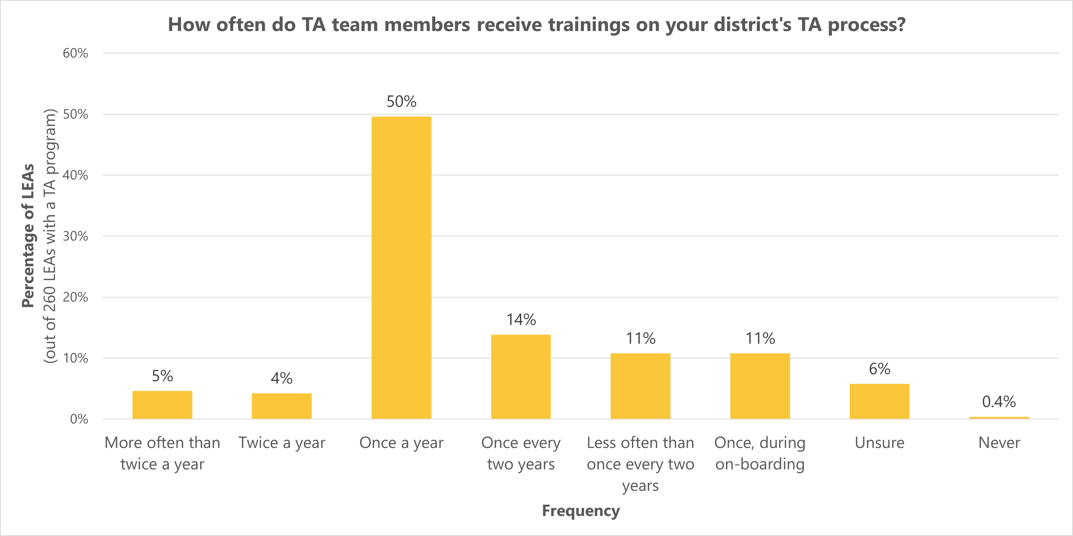
Training
Notes:
Training less than at least once a year is less than ideal, so 59% of LEAs with a TA program are training on their TA model/process as often as they should be (so… not the worst, but not great)

Slide 19
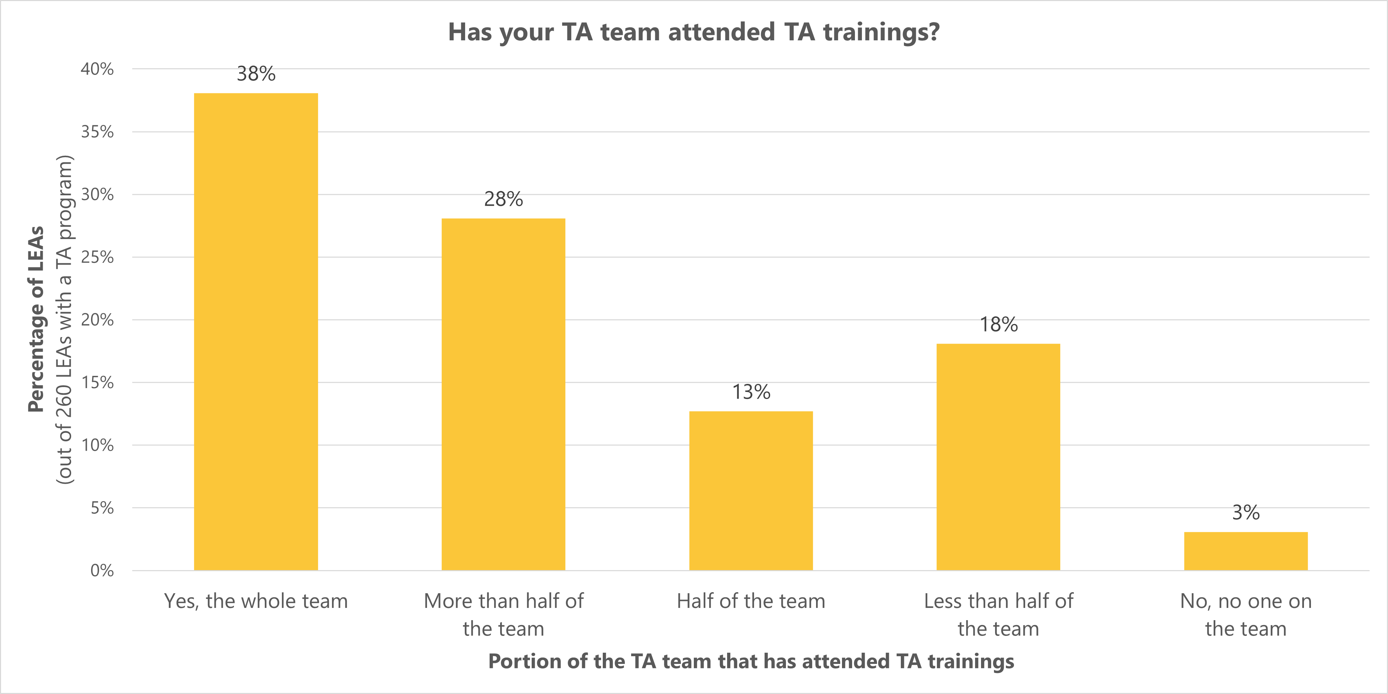
Training
Notes:
we were hoping that LEAs would indicate that their entire TA team had attended trainings. Only 38% of LEAs with a TA program were able to say that this was the case.
the difficulty of training TA team members was the most often mentioned barrier to implementation a threat assessment program, and we’ll talk about barriers next.

Slide 20
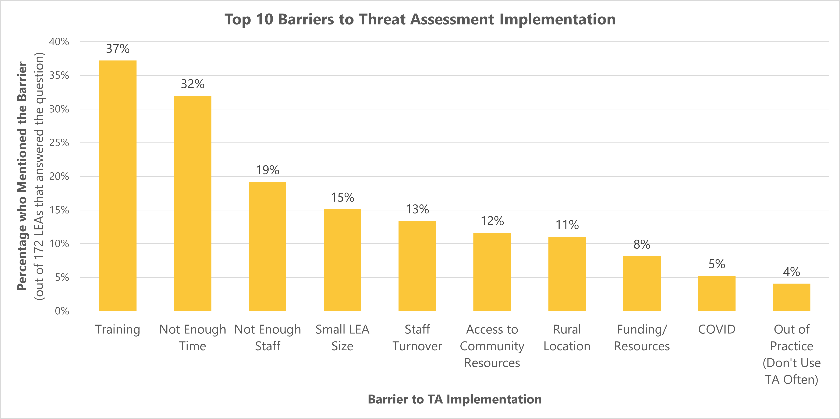
Notes:
At the end of the survey, we asked every respondent:
What barriers has your district encountered in developing a threat assessment program as required by RCW 28A.320.123?
The question was not required.
172 LEAs responded to this question.
Can’t discuss all of these in depth, so I’m just going to mention the top 5 or so…
Training
Training is the most mentioned barrier. Districts that mentioned training as a barrier most often mentioned (1) trouble training staff due to time constraints and (2) the difficulty of training new staff.
Human Resources
Not having enough time and not having enough staff were the 2nd and 3rd most mentioned barriers to implementing a TA program, but these two barriers can easily be considered as part of the same larger issue: an overall lack of human resources. When these two barriers are combined, lack of time or adequate staff becomes the most mentioned barrier. One or both was mentioned by 42% of the 172 LEAs that answered this question.
Another human resources related barrier that LEAs mentioned was staff turnover, which was mentioned by 13% of respondents to this question. In mentioning staff turnover as a barrier, LEAs most often mentioned (1) the difficulty of training new staff and (2) the difficulty of getting a robust TA program in place during changes in leadership.
LEA characteristics that were often mentioned as barriers included:
Being a small LEA (in terms of student population)
Access to community resources
The LEA being in a rural area.
Can go into more depth, if time allows:
Serving a small student population was a barrier for a variety of reasons. Many LEAs with this barrier mentioned that their limited staff are already filling so many roles at the LEA that it’s difficult for them to add TA to their plate (going back to the time and training issues previously mentioned). Some LEAs mentioned that this was a barrier because they had less staff to draw from when assembling a TA team. With such a small team, it can be hard to find coverage for staff to train on TA procedures or take part in a TA. Some small LEAs also mentioned that they didn’t need to do TA very often, because they had so few students, which could cause the additional issue of being out of practice.
Not all LEAs that mentioned lack of community resources were specific about which resources they lacked, but those that were, mentioned law enforcement and community mental health organizations. For a level 2 threat assessment, it is considered a best practice to have a member of a community organization on your TA team. Law enforcement and community mental health professionals are good fits for this role, so not having access to these resources makes level 2 threat assessments more difficult. Additionally, a lack of mental health providers could limit the types of non-exclusionary intervention strategies that could be used as the result of a TA.
The location of an LEA in a rural area was barrier for LEAs partially because being rural often meant also having smaller student populations and not having as many community resources, but other issues mentioned by rural districts were:
(1) less access to training
(2) the difficulty of convening a district team when their school buildings were spread out over a large geographic area

Slide 21
District & School Safety Planning

Slide 22
Safety Planning Overview
78% of LEAs (249) reported having a Comprehensive District Safety Plan.
On average, district safety planning was found to be 71% compliant with the requirements of RCW 28A.320.125.
Notes:
Throughout this section on safety planning SOME of the percentages will use a denominator of these 249 LEAs with a district safety plan. I’ll make it clear which ones do.

Slide 23
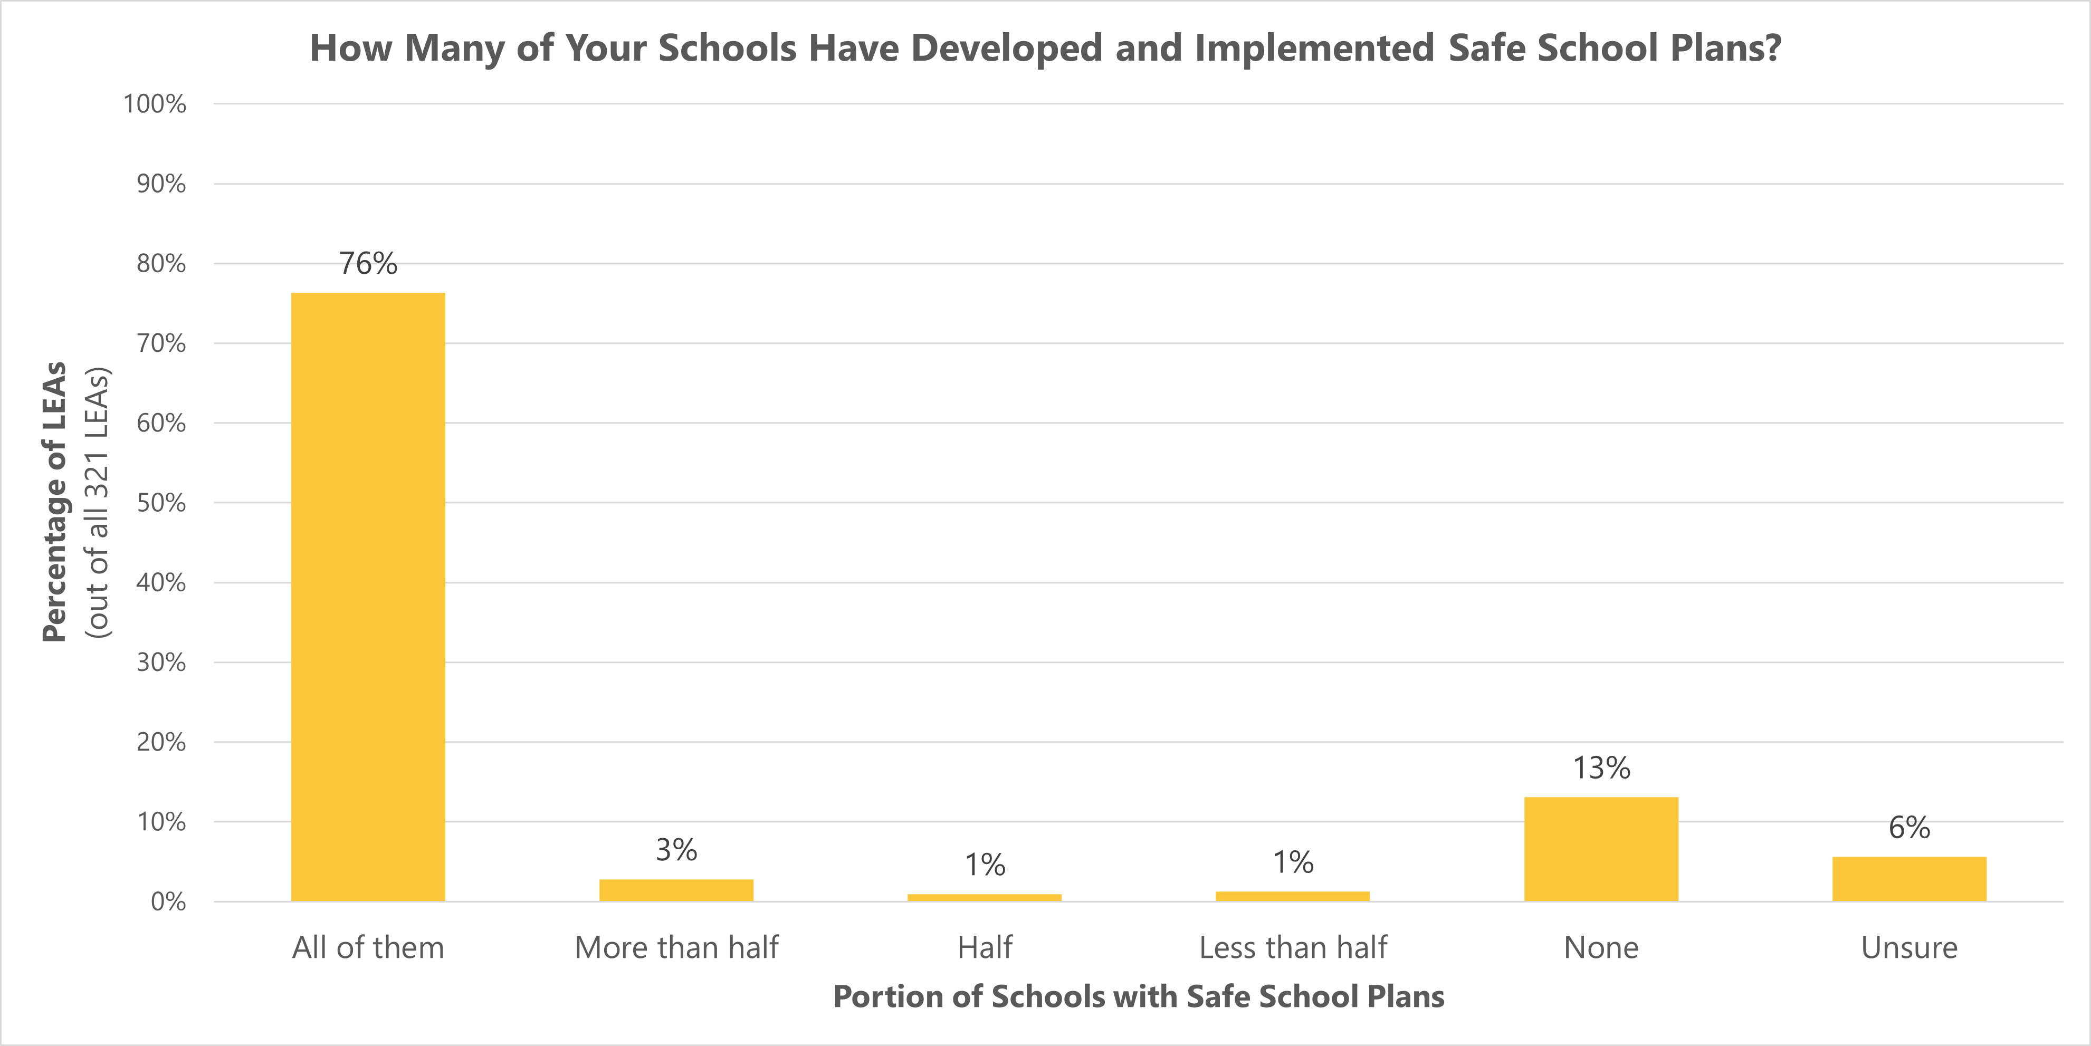
Safety Planning Overview
Notes:
Having safe school plans in place is an extremely important part of planning for the physical safety of all your students, so although 76% of LEAs say that all their school have these plans, it is still concerning that 13% say that none of their schools have them.
Want this to be 100% so that families are assured that school buildings are ready when something happens.

Slide 24
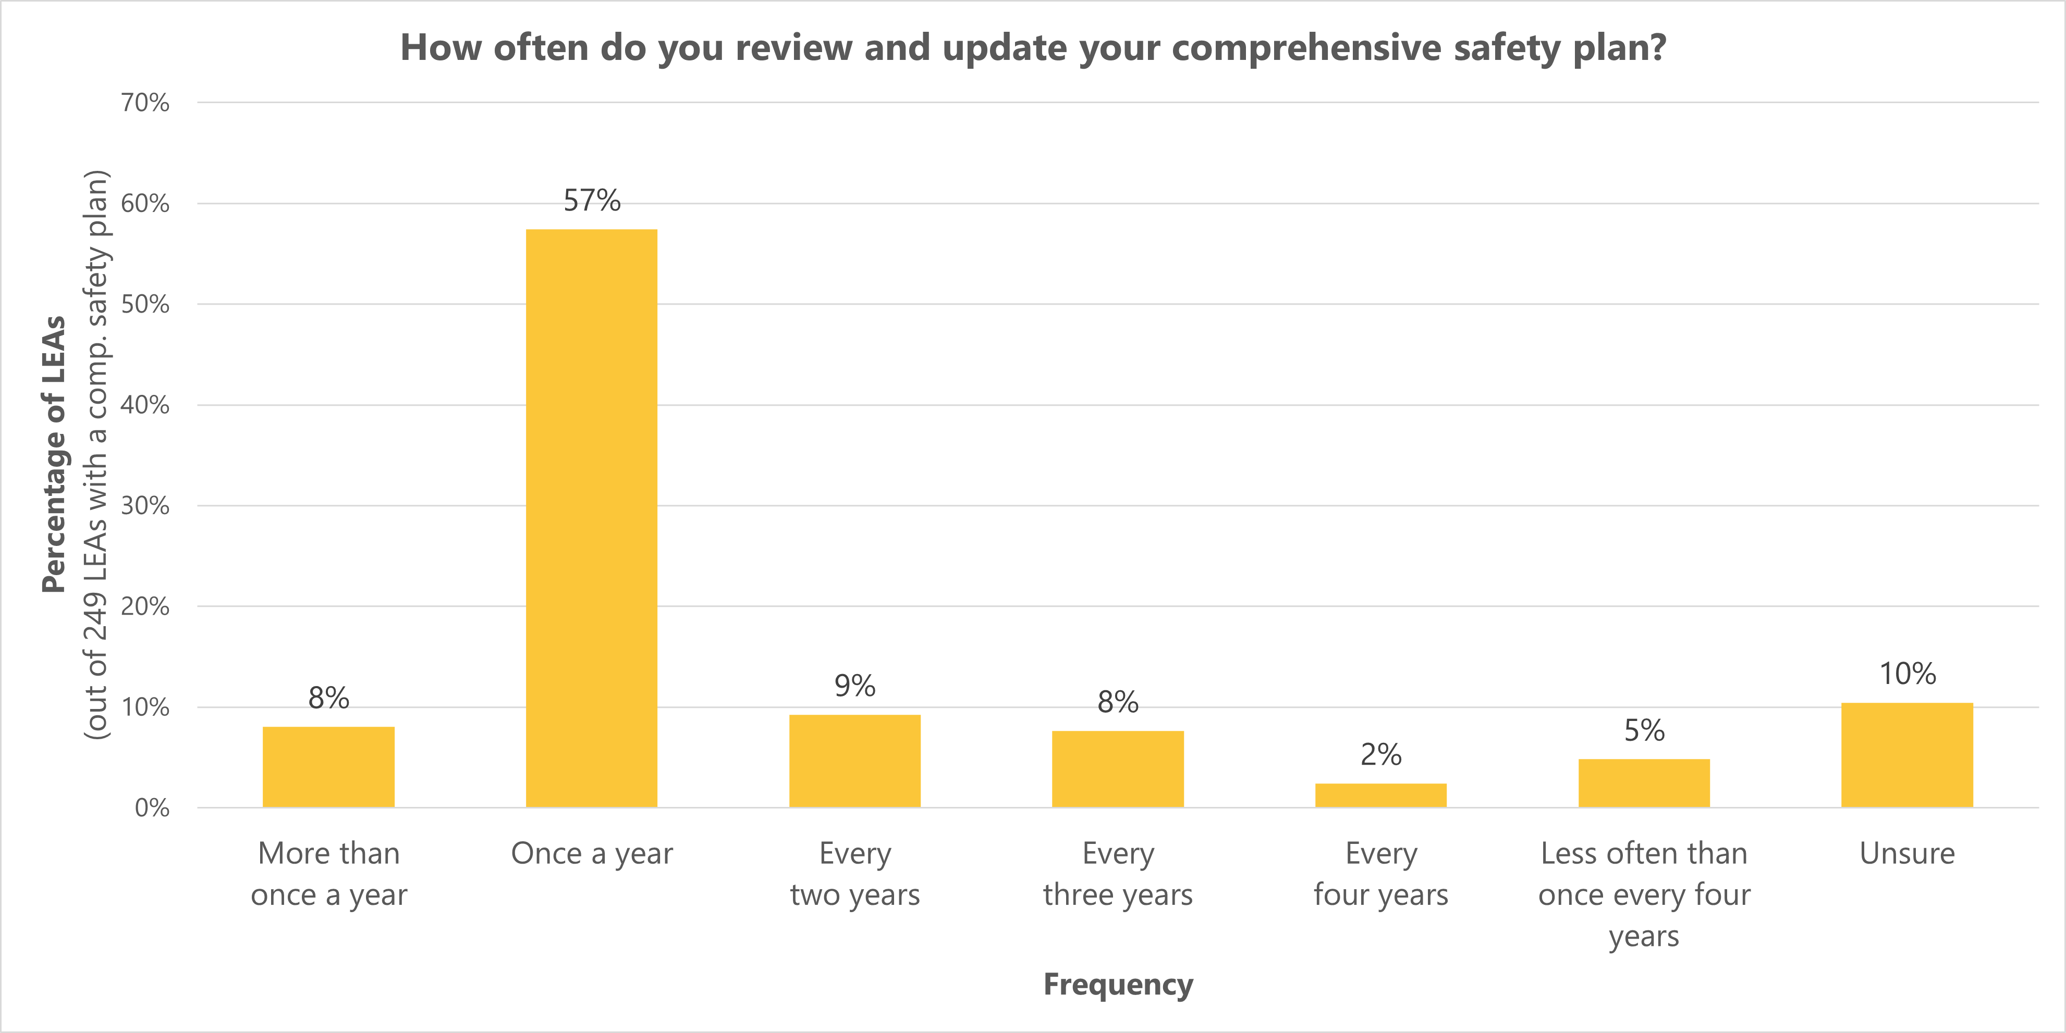
Safety Planning Overview
Notes:
The law states that comprehensive safety plans should be updated annually, to the extent funds are available. Possible reasons for plan updates could include the following:
Changes to threats and hazards.
Changes in LEA or school policy, personnel, organizational structures, processes, facilities, or equipment.
Changes in the surrounding community (such as public facilities, infrastructure, or reunification sites).
Changes to emergency responder agencies (such as personnel, protocols, or jurisdictions)
Lessons learned from exercises or drills.
Lessons learned from actual emergencies.
65% (163) of LEAs with Comprehensive Safety Plans reported updating their plans at least once a year. It is concerning that 35% of LEAs may have outdated safety plans, but updating your safety plan every year can be difficult and time consuming.
The difficulty of keeping plans up to date was mentioned by several respondents as a barrier to implementing RCW 28A.320.125.
12:11

Slide 25
Safety Exercises
RCW 28A.320.125 states that LEAs are encouraged to work with local emergency management agencies and other emergency responders to conduct…
one tabletop exercise
one functional exercise
two full-scale exercises
…within a four-year period.
Notes:
Tabletop exercise: A discussion-based exercise used to familiarize people with current procedures, plans, policies, and agreements.
Functional exercise: Practices what people are supposed to do in the event of an emergency (like a drill) but they involve other partners in a more realistic situation.
Full-scale exercise: Conducted in real time, creating a stressful, time-constrained environment that closely mirrors real events.

Slide 26
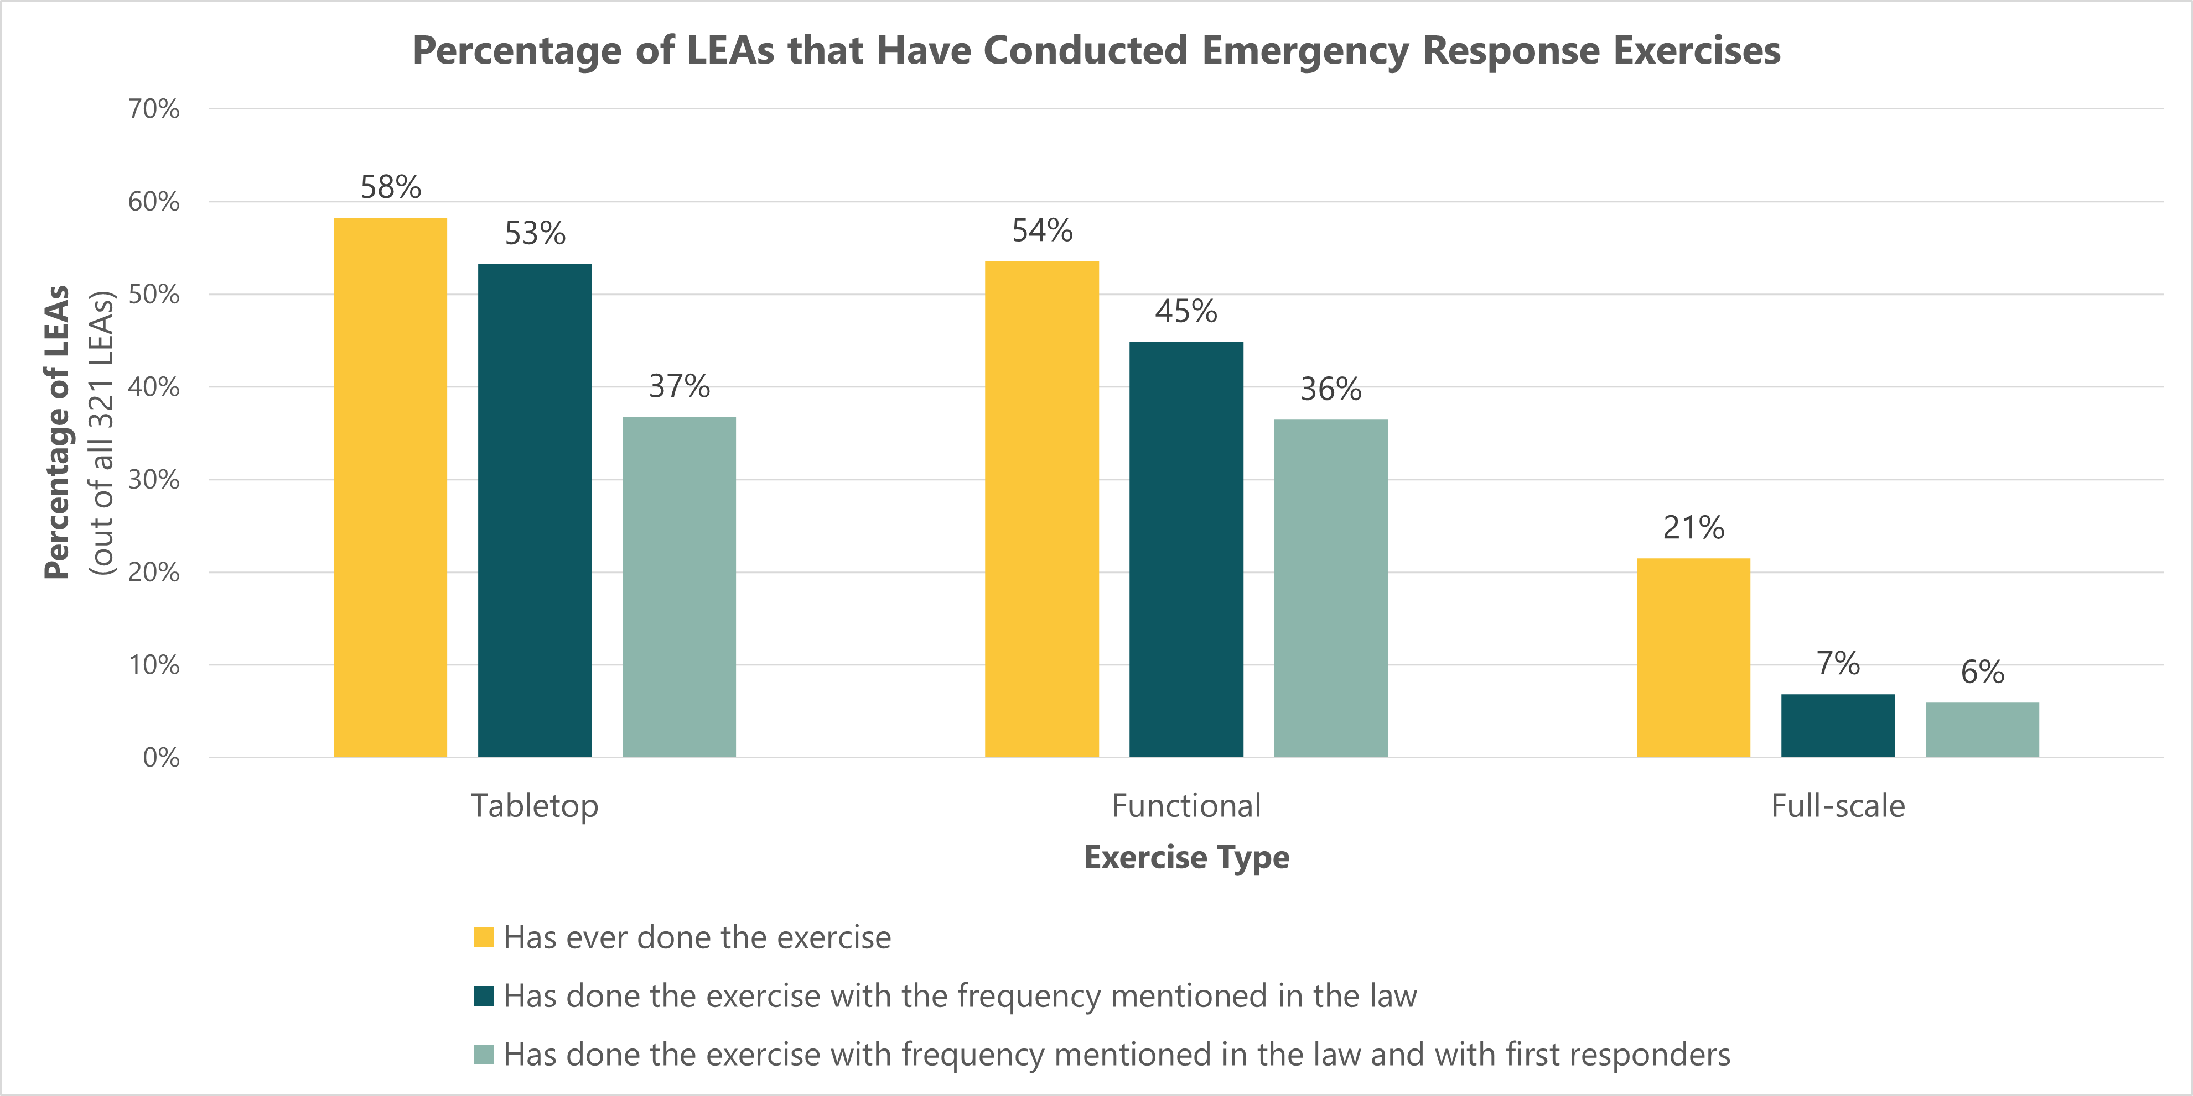
Safety Exercises
Notes:
These are the respondents who said “yes” as opposed to “no” or “unsure.”
As the graph shows, compliance with the recommendations outlined in the law decreases as more conditions are added to the exercise.
For instance, though 58% of LEAs are sure they have done a tabletop exercise… [read rest from graph]
Compliance with the recommendations also decreases as the complexity of the exercise type increases, with the most LEAs being able to confirm that they have conducted tabletop exercises (the least involved) and the least number of LEAs being able to confirm conducting full-scale exercises (the most involved).
It should also be noted that the law recommends conducting two full-scale exercises in a four-year period, making this recommendation more difficult to comply with.

Slide 27
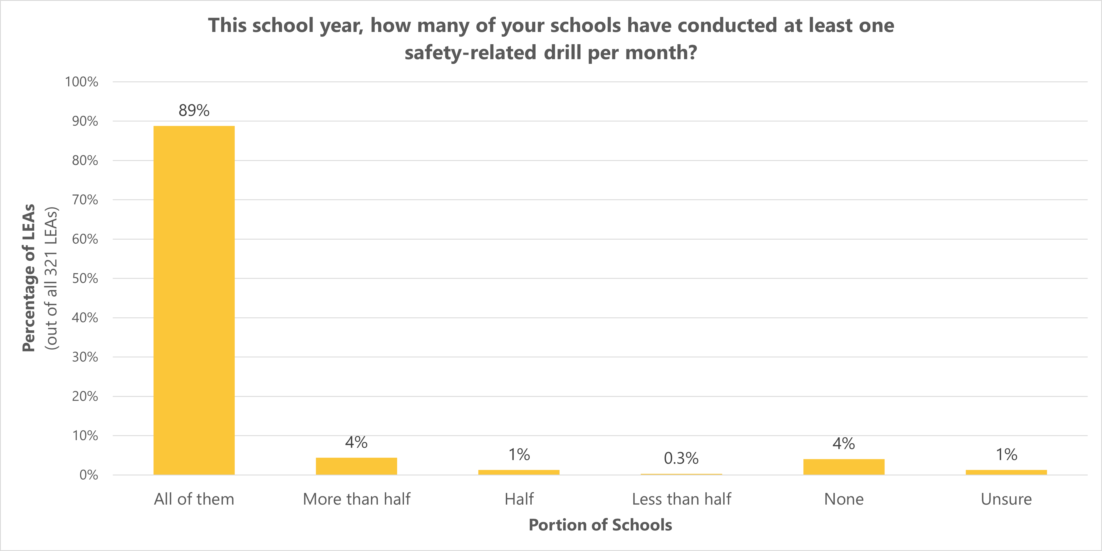
School Safety Drills
Notes:
RCW says: “Schools shall conduct at least one safety-related drill per month,”
89% (285) of LEAs answered that all their schools had conducted at least one safety-related drill per month, making them fully compliant with the law.
This is a pretty basic requirement, so we’d like to see a number even higher than 89%. But it looks like most LEAs are doing exactly what they’re supposed to with school drills.

Slide 28
School Safety Drills
Tsunami Drills
39 schools in 15 LEAs are in tsunami hazard zones.
87% (13) of these LEAs were aware that they were in a hazard zone.
40% (6) LEAs in tsunami hazard zones are both aware that they are in a hazard zone and reported holding one pedestrian evacuation drill in the last 12 months.
Notes:
The law requires that LEAs in mapped lahars or tsunami hazard zones hold pedestrian evacuation drills.
[Used WA DNR data to determine which schools/district are in hazard zones]

Slide 29
School Safety Drills
Lahar Drills
83 schools in 25 LEAs are in lahar hazard zones.
64% (16) of these LEAs were aware that they were in a hazard zone.
24% (6) LEAs in lahar hazard zones had held 1 pedestrian evacuation drill at all the schools in hazard zones in the last 12 months.
Notes:
Lahars are mudflows or debris flows emanating from a volcano and typically flowing along river valleys.
[SLIDE]
Additionally, 9 of the 16 LEAs (56%) that indicated knowing they had schools in a lahar hazard zone, indicated that none of these schools had held a pedestrian evacuation drill in the last year.
So over half of the LEAs that know they have a lahar hazard, are not holding the drills for it.
This suggests that there may be barriers other than awareness to implementing this requirement.
We likely need to increase awareness around the importance of these drills, but additional support, resources, and education around logistics may be needed.
16:18

Slide 30
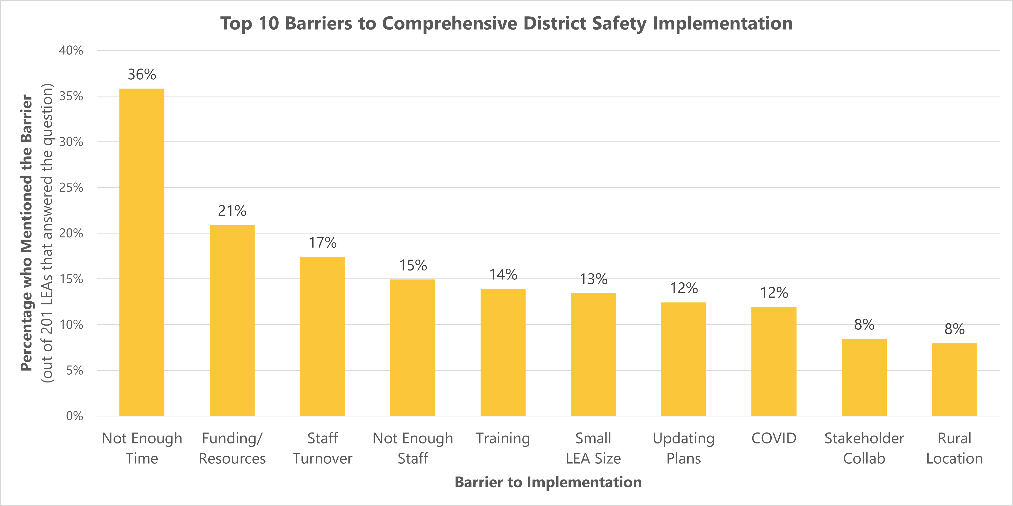
Notes:
Question was optional. 201 LEAs answered.
I’m not going to go through all of these, because there is so much to say about them. So just going to hit the top 5…
Human Resources
Not having enough time and not having enough staff were the 1st and 4th most mentioned barriers to district safety planning. When taken together as an overall lack of human resources, at least one of these two barriers was mentioned by 42% (85) of the 201 LEAs that answered this question, which makes sense. It’s a ton of work:
It’s a big task (school and district plans) requiring expertise that district staff don’t necessarily have
There isn’t a template (the 11th most mentioned barrier)
Everything needs to be kept up to date
Staff and students need to participate in regular training on multiple types of scenarios
Staff turnover was another human resources related barrier and was mentioned the 3rd most often. LEAs said this was a problem because of:
The continuity and knowledge loss through administrative turnover
The difficulty of training new staff on safety procedures.
Funding & Resources
2nd most mentioned barrier - 21% of LEAs (42 LEAs) mentioned lack of funding or resources as a barrier.
One respondent wrote, “Without more state [or] federal funding it is near impossible to implement many of the safety recommendations without asking for a bond or special levy.”
Another respondent stated, “Funding issues continue to be a problem. School safety needs funding in the state of Washington.”
Several LEAs did mention that they specifically needed funding for emergency supplies (which could include a variety of items such as food and water, reflective vests, walkie talkies, first aid supplies, generators, and flashlights, just to name a few)
LEAs also mentioned needing funding to cover the expense of training staff.
Training
Training was the 5th most mentioned barrier by LEAs. Respondents mentioned several obstacles with training, most of which we’ve covered already:
Having limited time to train staff
Staff turnover and the difficulty of keeping up with training new staff
the lack of funding for training.
Some districts also mentioned that they could use help developing training exercises, while others mentioned the difficulty of coordinating with stakeholders for drills or exercises.

Slide 31
Emotional or Behavioral Distress Planning

Slide 32
Emotional or Behavioral Distress Planning Overview
54% of LEAs (172) reported having an emotional or behavioral distress (EBD) plan.
On average, EBD plans were found to be 84% compliant with the requirements of RCW 28A.320.127.
Notes:
Throughout this section on EBD plans many of the percentages will use a denominator of these 172 LEAs with an EBD plan.

Slide 33
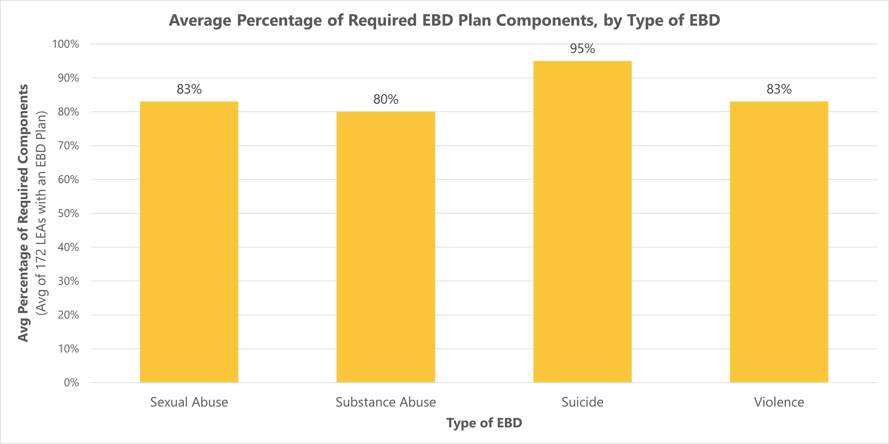
EBD Planning Overview
Notes:
LEAs with EBD plans seemed to have done the most planning around suicide prevention . LEAs reported having, on average, 95% of the suicide prevention components we were looking for in their plans.
There is some work for LEAs to do on the sexual abuse, substance abuse, and violence components of their EBD plans, but overall, they seem to be doing well and have plans that include many of the components required in the law.
This is a theme you will see throughout: That LEAs seem better prepared all around for responding to suicide than other types of EBD. The state has been doing deliberate suicide prevention with districts for over two decades. So when we do prioritize this work it happens and we see results.

Slide 34
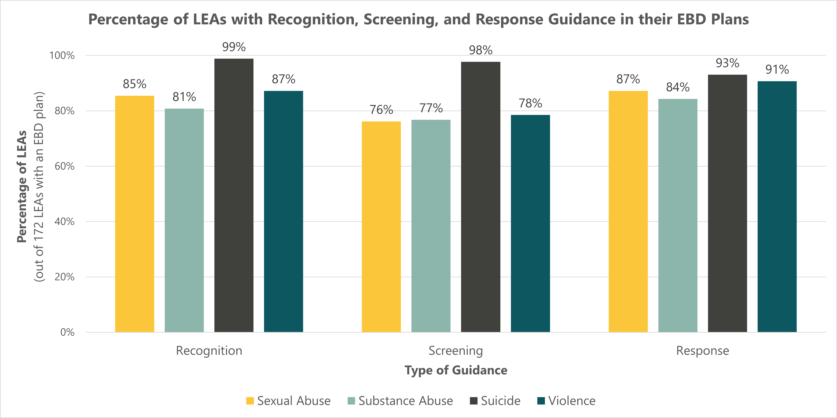
Recognition, Screening, and Response
Notes:
The law requires LEAs to “adopt a plan for recognition, initial screening, and response to emotional or behavioral distress in students, including but not limited to indicators of possible substance abuse, violence, youth suicide, and sexual abuse.”
[SLIDE – This graph shows…]
Recognition, screening, and response to students at risk of suicide is an area of particular strength for LEAs.
The discrepancy between guidance for suicide risk screening and other types of EBD screening is notable. This suggests that LEAs may need more resources, guidance, or technical assistance and training on screening tools for sexual abuse, substance use, and violence.
I also want to note that preliminary discussions in The Children and Youth Behavioral Health Work Group Subcommittee on School-based Behavioral Health and Suicide Prevention lead us to believe that their primary recommendation will be for funding to support the implementation of recognition, screening, and response planning statewide. So hopefully the recommendation from that workgroup will get this a little bit of attention as well.

Slide 35
Partnerships
RCW 28A.320.127 requires that EBD plans address:
The identification and development of partnerships with community organizations and agencies for referral of students to health, mental health, substance abuse, and social support services, including development of at least one memorandum of understanding between the district and such an entity in the community or region.
93% of LEAs with an EBD plan said that their plan identified existing partnerships for referrals.

Slide 36
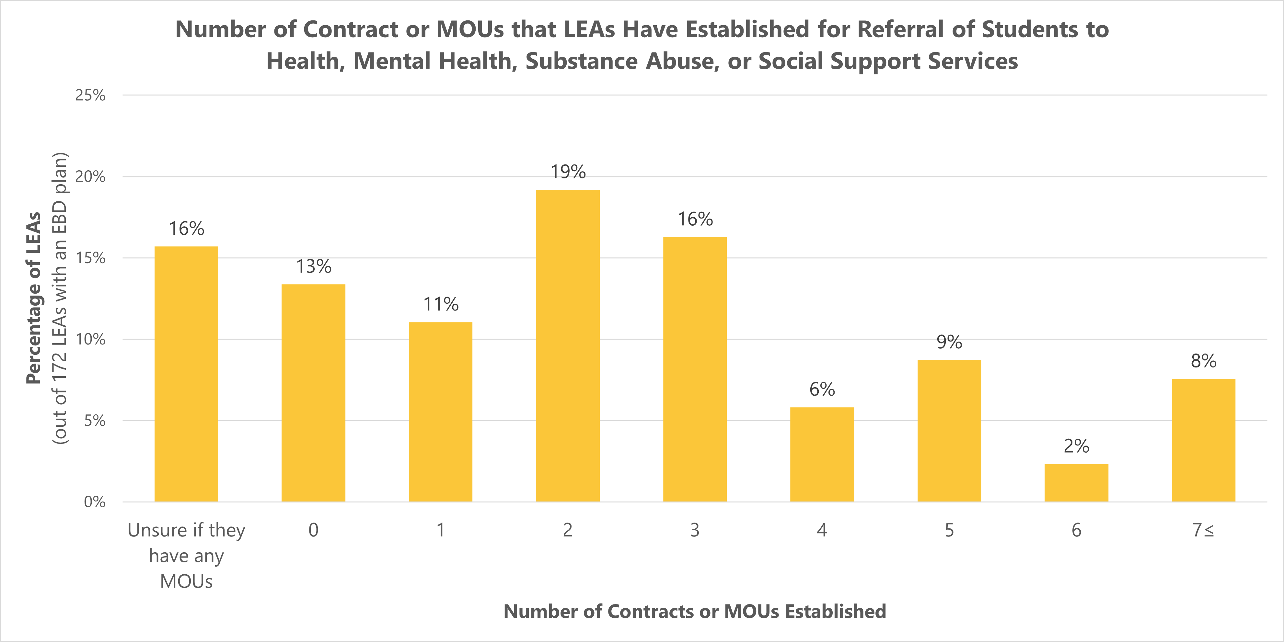
Partnerships
Notes:
The law requires the development of at least one memorandum of understanding between the district and a community organizations or agencies for referral of students to health, mental health, substance abuse, and social support services.
This graph shows….
This data tells us that 71% (122) of LEAs with an EBD plan are in compliance with the legal requirement to have at least one MOU established for the referral of students experiencing EBD (with an additional 16% (27) being unsure whether they do or not).

Slide 37
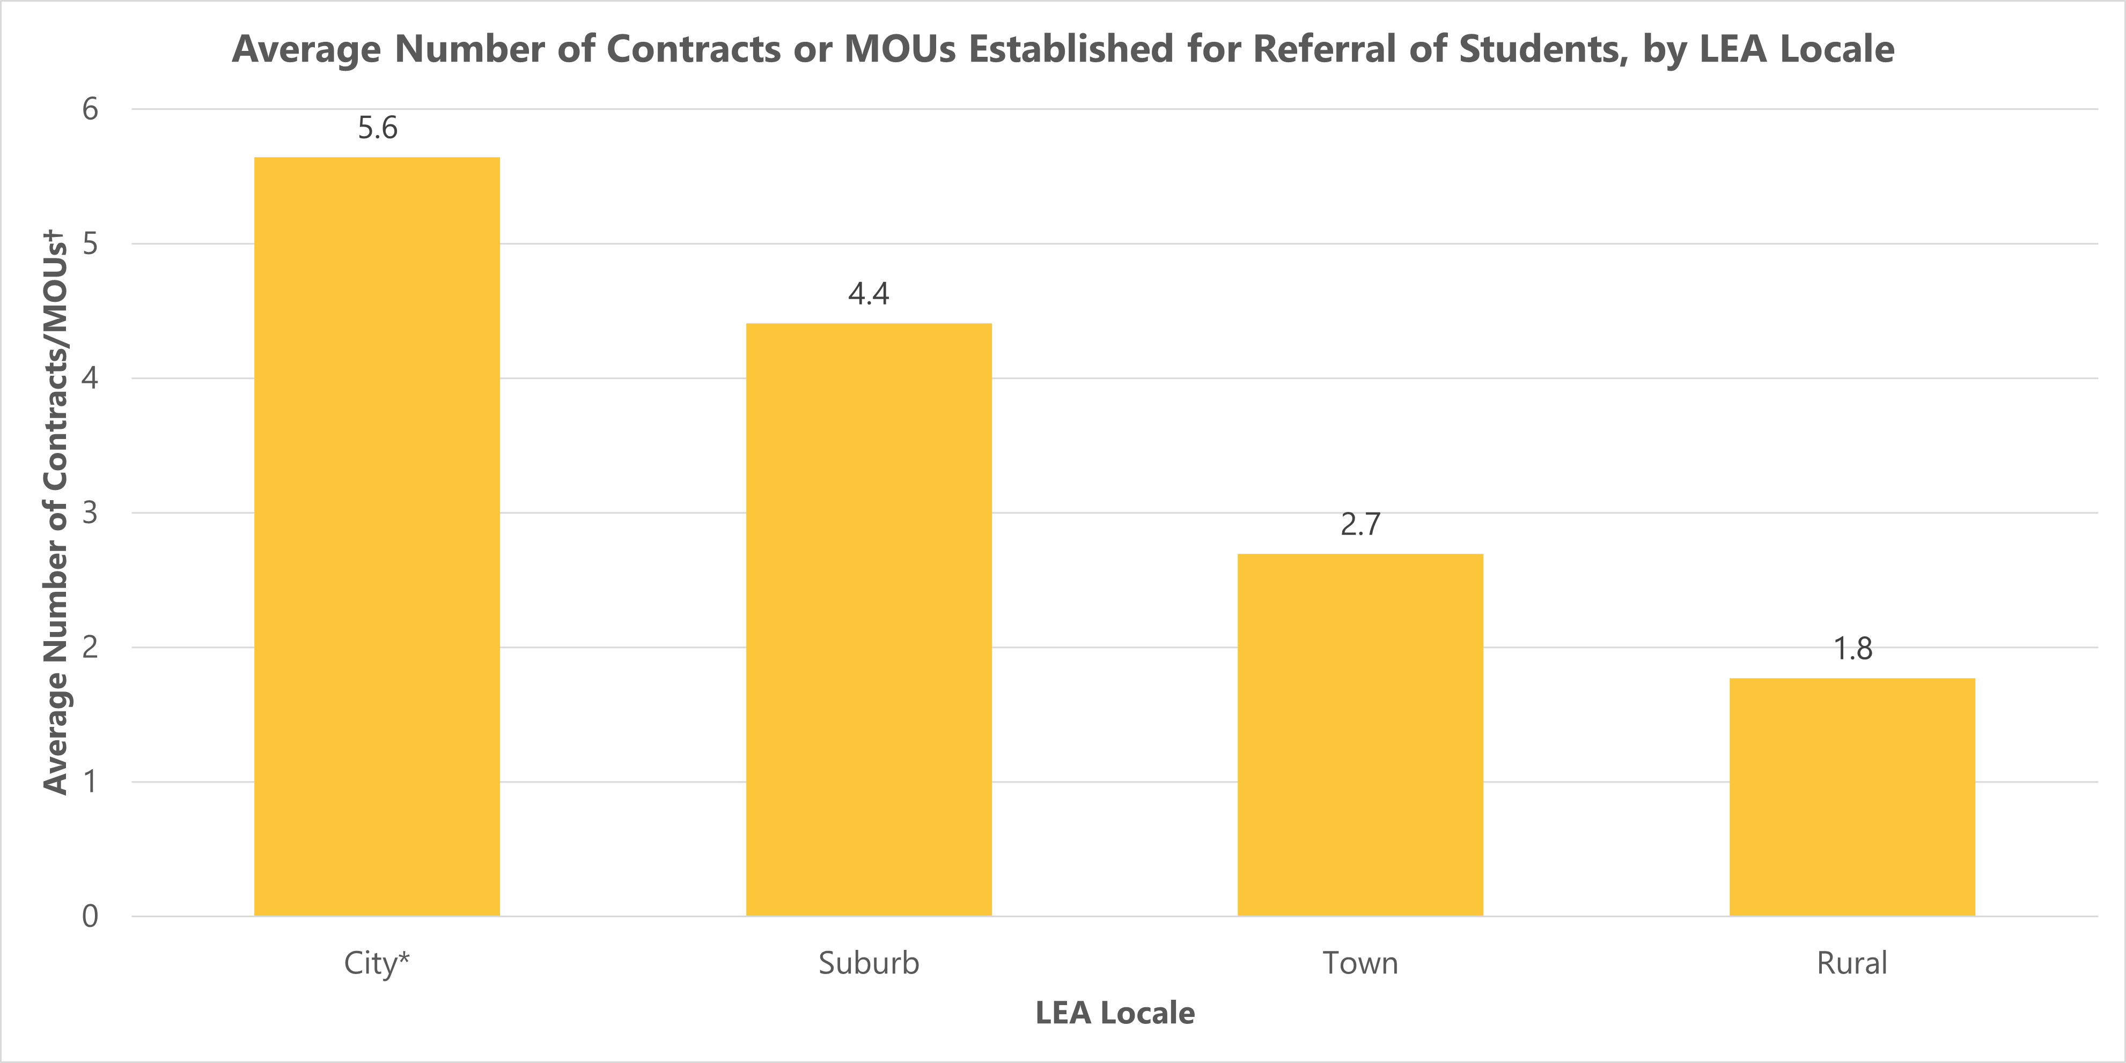
Partnerships
Notes:
One barrier to creating an EBD plan that was mentioned by rural LEAs was lack of access to community resources and behavioral health services. This point is supported when you look at the average number of MOUs/contracts LEAs have established by locale. This graph shows that more rural LEAs (the town and rural locales) have less MOUs/contracts established on average than more urban LEAs (the city and suburb locales).
---------
*Seattle reported having established 100 contracts/MOUs, the most reported by any district (the next highest was 30). The purpose of this average is to give an impression of what is typical for LEAs in this locale type across the state, so Seattle was excluded from this figure as an outlier. With Seattle included, the average number of contracts/MOUs for LEAs in the city locale type would be 9.3.
†Averages include LEAs that answered they had no contract/MOUs included as zeros but exclude LEAs that were unsure if they had any contracts/MOUs.
Locale data taken from the U.S. Department of Education's National Center for Education Statistics' (NCES) Education Demographic and Geographic Estimates (EDGE) Program, 2021. For definitions of locale types, please see the Appendix.

Slide 38
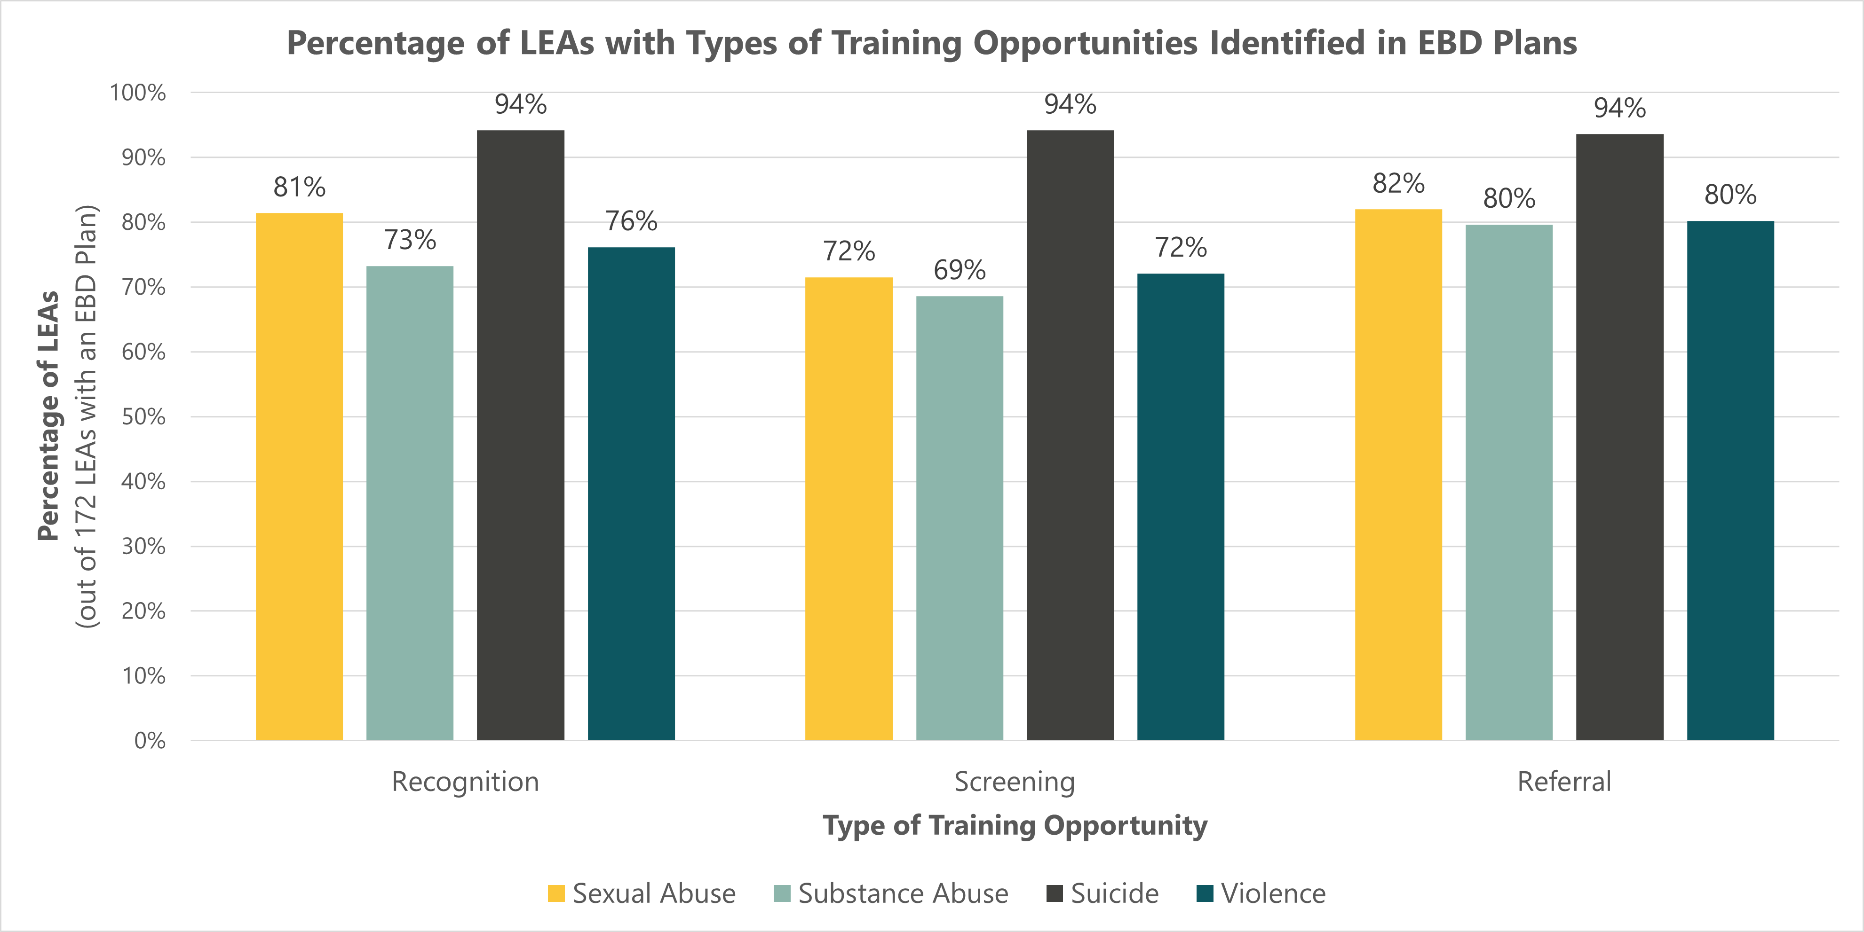
Training
Notes:
The law requires that EBD plans identify training opportunities in recognition, screening, and referral.
Again, LEAs with EBD plans seem to be doing very well in identifying training opportunities for recognition, screening, and referral of students at risk of suicide, with other areas lagging behind.
Training opportunities in screening for types of EBD other than suicide again stands out as an area that needs improvement.
It is also worth noting that training opportunities for substance abuse – in all three areas – (the light green bars) have been identified by the lowest number of LEAs in all three areas.

Slide 39
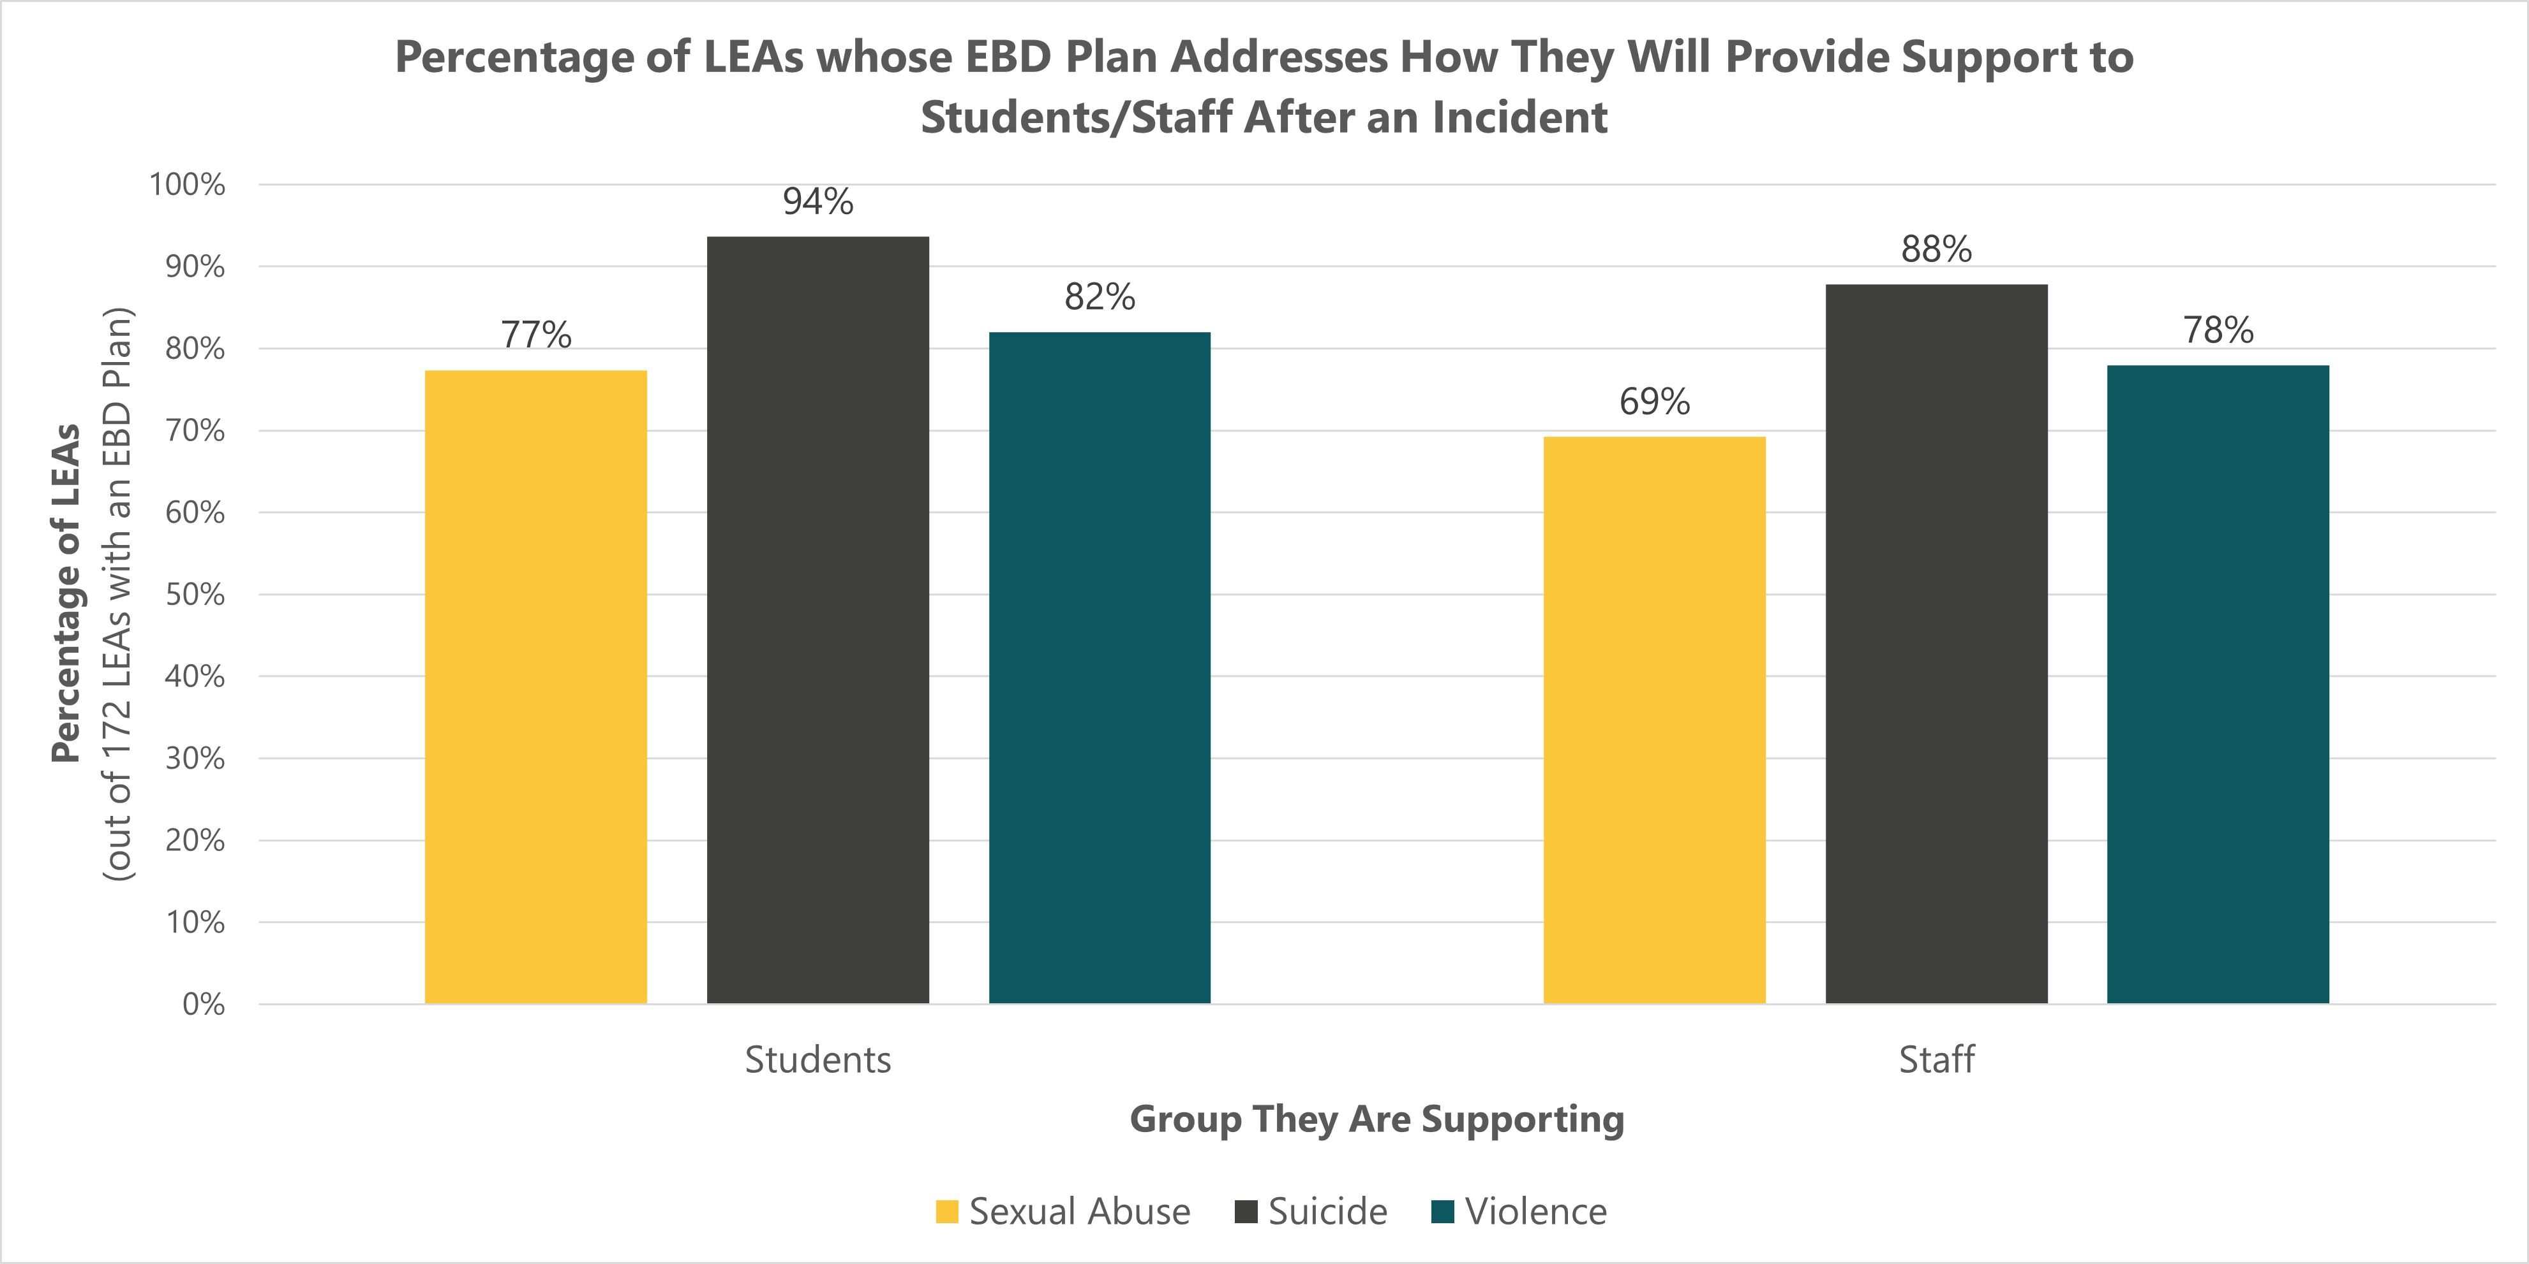
Support After an Incident
Notes:
The law requires that LEA EBD plans address how they “will provide support to students and staff after an incident of violence, youth suicide, or allegations of sexual abuse.”
This graph shows…
Again, LEAs seem to be the most prepared in the context of suicide.
LEAs also seem to be slightly more prepared to support students after an incident than staff. It’s important to remember that staff need to heal just like students do.
Overall, there is some planning work to be done in this area to get LEAs’ plans for support after an incident of sexual abuse or violence up to the same level as their plans for suicide postvention.

Slide 40
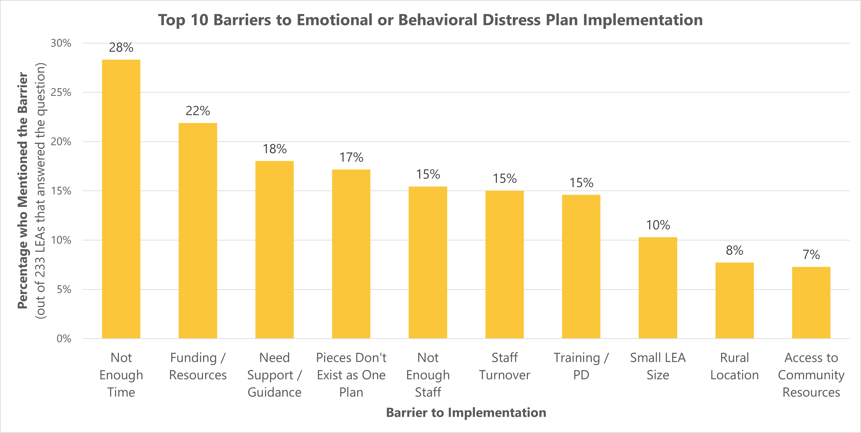
Notes:
This question not required. 233 LEAs answered. So a lot of LEAs opted to answer this question – less districts answered this optional question for the other two plan types (201 for district safety planning and 172 for TA).
Lots to say about these, so again I’m just going to do the top 5…
Human Resources
Not having enough time and not having enough staff were the 1st and 5th most mentioned barriers to implementing an EBD plan, but these two barriers can easily be considered as part of an overall lack of human resources. Combined, lack of time or adequate staff (one or both) was mentioned by 36% (84) of the LEAs that answered this question.
Funding & Resources
Lack of funding and/or resources was the 2nd most mentioned barrier.
Many LEAs mentioned that they needed more funding to ensure proper training and professional development, both to create the plan and train their staff to support the plan once it was created.
Several LEAs also mentioned that they would need funding for an additional staff member to create the plan, since they felt their current staff didn’t have the time or the proper expertise.
Similarly, some LEAs said that they would need money to hire behavioral health staff to support the plan once it was created.
Other LEAs pointed to a lack of behavioral health resources in their community as a barrier to putting this plan in place.
Some respondents used this question on the EBD plan survey to complain about “another unfunded mandate” or the overall volume of government requirements that they were having to implement. This is notable because LEAs could have easily said the same about threat assessment programs or district and school safety plans, but very few respondents made these complaints in the context of the other plan types. This makes it seem like there is something uniquely stressful about implementing this particular requirement.
Maybe LEAs are stressed about planning requirements and best practices for student behavioral health, specifically.
Or maybe LEAs feel poorly equipped to create an EBD plan, relative to district safety planning and threat assessment.
It’s also possible that more LEAs are expressing their frustration with the EBD plan simply because more of them still need to create one.
Whatever the reason, it’s worth noting that LEAs seemed the most frustrated with the EBD planning requirement, compared to threat assessment and district safety planning.
Needing Support & Guidance
LEAs mentioned a few things here, but The most common support requested by respondents was access to a plan template or examples from other school districts. Luckily, OSPI does have an EBD model plan template available on our website. The template is relatively new and was published online in the fall of 2022.
High demand for this template suggests that OSPI and the ESDs might want to continue outreach to school districts to inform them of this valuable EBD planning resource.
Pieces Don’t Exist as One Plan
Many LEAs mentioned the task of uniting existing plans under one plan as a barrier.
Some LEAs said they thought putting these components together into one plan sounded challenging, either because
They thought the resulting EBD plan would be unwieldy
They already had different processes for different types of EBD, or
Different types of EBD were handled by different teams within their LEA.
Others expressed that they felt uniting these components under one plan would be redundant, since they already had policies/procedures in place to separately address many of the requirements.

Slide 41
Next Steps

Slide 42
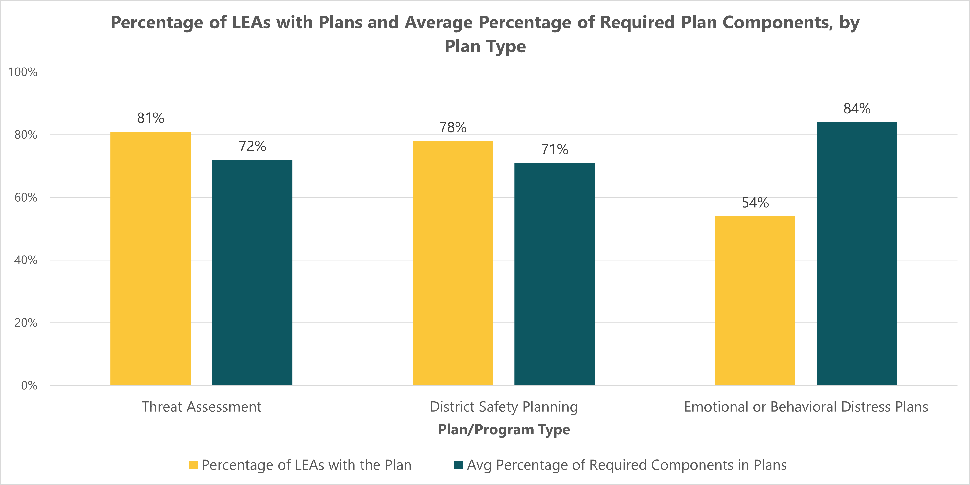
Next Steps
Notes:
Just to summarize some of the top level numbers in one place.
More LEAs have TA programs and comprehensive district safety plans in place.
Less LEAs Have EBD Plans, However, the EBD plans seem to include more of the required components. So there’s more work to do helping districts get the plans in place, less work to do helping districts improve existing plans.

Slide 43
Next Steps
OSPI is reaching out to LEAs to...
Inform them of their survey results (email).
Connect them with resources on the OSPI website.
Connect them with staff at both the ESDs and OSPI that can help them establish compliant plans/programs.
OSPI is required to measure the implementation of these plans/programs again within 5 years.
Notes:
We are reaching out this month (Oct)

Slide 44
Questions?
Ross Boylan
Email: ross.boylan@k12.wa.us
Phone: (360) 480-0253

