Slide 1
Washington Comprehensive Assessment of Science
Test Design & Item Specifications
Grade 8
Science Assessment Development Team
February 5, 2020
Notes:
Hello, and welcome to the Grade 8 Washington Comprehensive Assessment of Science Test Design & Item Specifications training. My name is Dawn Cope, and I am the Science Assessment Lead at OSPI.

Slide 2
Logistics
Webinar Recording, PowerPoint slides and FAQ
https://www.k12.wa.us/student-success/testing/state-testing-overview/washington-comprehensive-assessment-science/wcas-educator-resources
Chat Box
pdEnroller
https://www.pdenroller.org
Notes:
The training is being recorded. The recording will be available on the science assessment website in a few weeks. The final PowerPoint slides, with a script in the notes section, will be posted to the Science Assessment webpage by the end of this week.
All participants have been muted. Please submit questions through the Chat box function in the Zoom Meeting. We will compile questions into an FAQ document that will be posted along with the PowerPoint slides on the science assessment webpage. We will not be using the Hand Raise button today.
Additional details about accessing webinar materials will be given at the end of the presentation.
To receive clock hours, sign in to pdEnroller, create an account, if needed, and register for the webinar. If you have not already registered for the webinar in pdEnroller, you can still do so after today’s presentation. You will need to complete a short evaluation of the webinar to receive the clock hours.

Slide 5
Objectives
This presentation contains a script in the notes section. If you are accessing this information with a screen reader, be sure you are reading the notes section as well as the text contained in the slides.
Share the design and development of the Grade 8 WCAS
Share how Grade 8 WCAS items are aligned to and assess the 2013 Washington State K-12 Science Learning Standards which are the Next Generation Science Standards, or NGSS.
Notes:
The objectives of this presentation are to:
Share how the Grade 8 WCAS is designed and developed.
Share how Grade 8 WCAS items are written to assess the 2013 Washington State K-12 Science Learning Standards which are the Next Generation Science Standards, or NGSS.
The information we are going to share is found in a document called the Grade 8 WCAS Test Design and Item Specifications. The most recent version of the Test Design & Item Specifications document was published in August 2019. This version included item specifications for all 59 PEs.
The OSPI Science Team wants to acknowledge and extend a big THANK YOU to all of the Washington State educators who contributed to the development of the item specifications.
The Test Design and Item Specifications document is always in draft form. We make slight modifications throughout the year as we receive feedback from educators that participate in assessment development work groups like item writing and content review. An updated document is published each fall, accompanied by a modifications log so you can see the changes that were applied.
Please note that the Test Design and Item Specifications document is not intended to guide classroom instruction, but rather, it describes how item clusters (stimuli and items) and standalone items are developed to assess the Washington State K–12 Science Learning Standards (NGSS) on the state summative test.

Slide 6
Contact Information
Dawn Cope—Science Assessment Lead
  dawn.cope@k12.wa.us
Jacob Parikh—Science Assessment Specialist
  jacob.parikh@k12.wa.us
Korey Peterson—Science Assessment Specialist
  korey.peterson@k12.wa.us
Jessica Cole—Program Specialist
  jessica.cole@k12.wa.us
General e-mail account
  science@k12.wa.us
Notes:
I am joined today by Jacob Parikh and Korey Peterson, state Science Assessment specialists.
Korey and Jacob will be presenting the webinar today, and I will be monitoring the chat box. We will pause about mid-way through and near the end of the presentation to address questions as needed.
This slide provides contact information for the science assessment team. Please do not hesitate to contact us with your questions about this training or any other questions you have about the state science assessment.

Slide 7
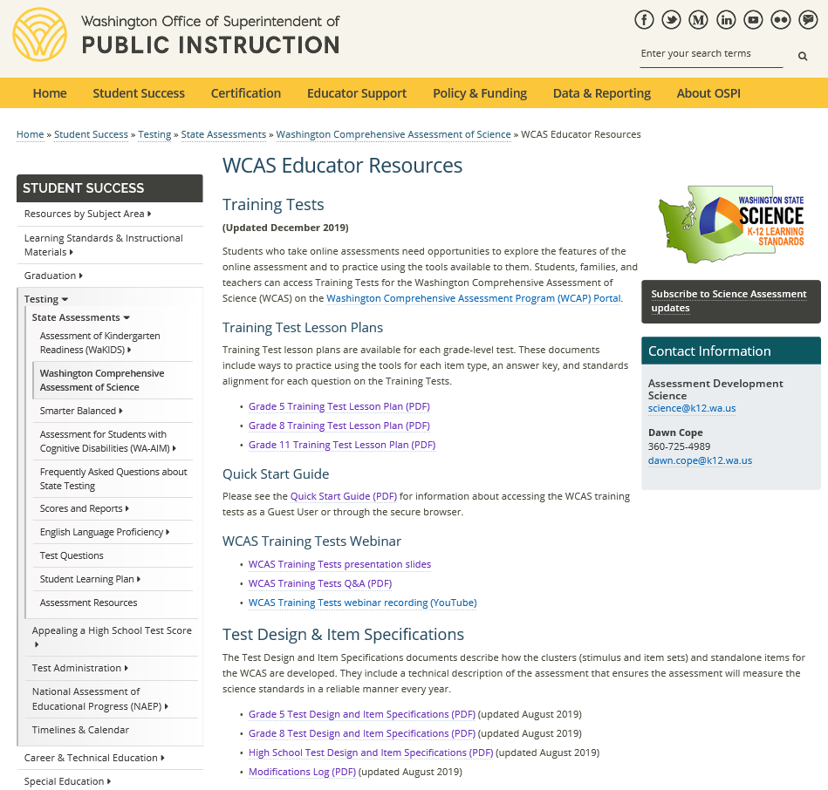
Test Design and Item Specifications-Grade 8
https://www.k12.wa.us/student-success/testing/state-testing-overview/washington-comprehensive-assessment-science/wcas-educator-resources
Notes:
You can find the Grade 8 Test Design and Item Specifications document by going to the WCAS Educator Resources webpage: https://www.k12.wa.us/student-success/testing/state-testing-overview/washington-comprehensive-assessment-science/wcas-educator-resources
There are separate documents for 5th grade, 8th grade, and high school. Many parts of the documents are similar. Key differences occur on the Test Blueprint pages and the Item Specifications sections of the documents.
This training is for the Grade 8 Test Design and Item Specifications document.
[CLICK]
Additional trainings cover the Grade 5 and High School documents.
Those of you who registered for this webinar were sent a PDF of the Grade 8 Test Design and Item Specifications via email yesterday. I am going to pause for one minute so you can access the document in your email or from the Science Assessment Educator Resources page.
We posted a link to the Grade 8 document in the chat.

Slide 8
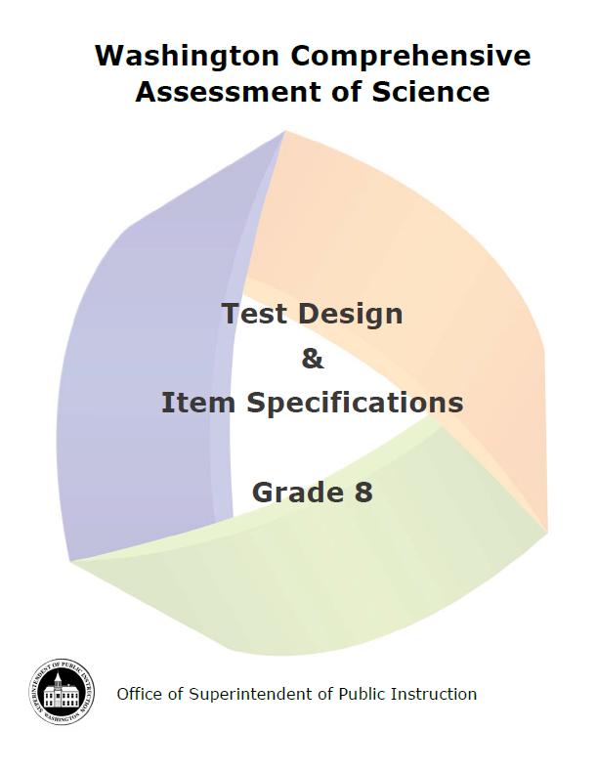
Document Components
Test Design (pages 1-14)
  Development Cycle
  Structure of the Test
  Item Types
  Test Structure
  Standards Overview
  Resources and References
Item Specifications (pages 15-141)
SEP, DCI, and CCC Vocabulary
(pages 142-144)
Notes:
The Test Design section of the document (pages 1-14) is an overview of the test design and development. We will be touching on many components of this section during the presentation. The section has the answers to important and commonly asked questions. We encourage you to become familiar with the information the test design section contains.
The second section of the document contains the item specifications (pages 15 to 141). Item specifications describe how items are written for the WCAS. The section has an item specification for each of the 59 Performance Expectations that could be assessed on a Grade 8 WCAS. For a given year, about 25 to 30% of the Performance Expectations are assessed. This will be explained further when we talk about the test blueprint.
The third section of the document contains a list of vocabulary terms (pages 142-144).
As we move through today’s presentation, relevant page numbers for the Test Design and Item Specifications document will be displayed in purple text boxes.

Slide 9
WCAS Development Process
Educator Involvement
Notes:
Pages 1 and 2 of the Test Design and Item Specifications document give an overview of the WCAS development process.

Slide 10
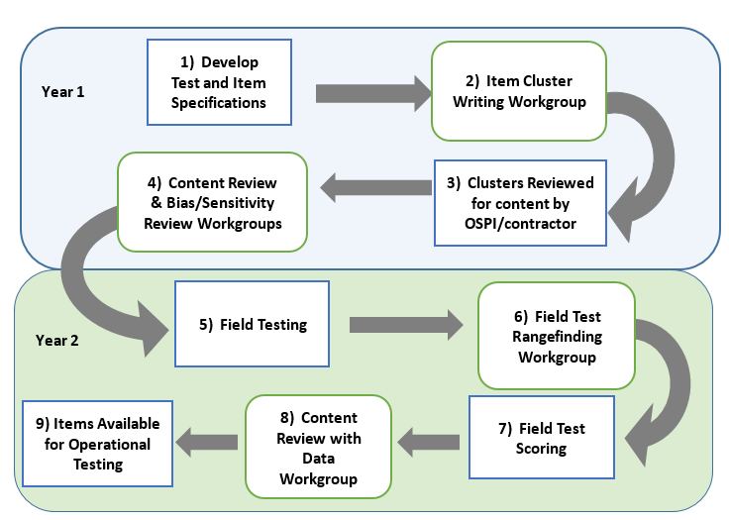
Science
Assessment
Development
Cycle
Pages 1-2
Notes:
Washington educators are heavily involved in this process, which takes place over the course of at least 2 years from when an item is first drafted to when it could possibly be seen by a student and count in their test score.
The Science Assessment Development Cycle graphic is found on page 2.
The first step in the Science Assessment Development Cycle is the development of the Test Design and Item Specifications. The OSPI science team began thinking about Test Design and Item Specifications when the science standards were adopted in 2013 and through each of the development work groups over the past several years. Step 1 occurs during each of the other steps of this process as parts of the Test Design and Item Specifications document is reviewed during each work group.
The second step is the Item Cluster Writing Work Groups. This is where Washington educators work in teams of 2-3 to write stimuli, items, and rubrics for item clusters (a set of stimuli and items), that are designed to measure student understanding of the state standards. The item clusters are then reviewed by the OSPI science team and the development contractors for content, including improvements to the art work (step 3).
In step 4, during Content Review Work Groups, educators review the products of the item cluster writing work group to ensure every stimulus, item, and rubric is scientifically accurate and gathers appropriate evidence about student mastery of the NGSS. At the same time, a separate committee of community members reviews the items and stimuli for any bias and sensitivity issues. Recommendations from the Bias and Sensitivity review are considered by the Content Review work group.
After that the OSPI science team works with the test delivery contractor to put the items and stimuli into the online system for field testing with students (step 5). Students see the Field Test items as part of their operational test, but the items are not counted in a student’s WCAS score.
After student testing is completed, educators meet in Field Test Range Finding Work Groups (step 6) to look at a range of student responses to each short answer field test item and decide how to score the responses. This educator workgroup refines scoring rubrics and produces the materials that will be used to score the short answer field test items. Then, the items are scored by the contractor in step 7. Remember, the field test results do not count toward a student’s WCAS score.
The 8th step in the process is the Content Review with Data Work Group where educators use item performance data (which is a variety of statistics about how students responded to the items), as well as their science content knowledge, to recommend whether each item should advance into the item bank. Educators see data for each item that answers questions like:
How many students answered the item correctly?
Which “wrong” answers were chosen by the most students?
Do students who score high on the test get this item correct?
Did students of a particular gender or ethnicity answer the item differently than the rest of the students?
The OSPI science team use the stimuli and items that have been accepted into the item bank to build the WCAS.
Step 9 takes about 6 months, from the point when the OSPI science team puts a test form together in the fall to when students see the test the following spring.
[PAUSE]
Educators are a critical component of Science Assessment Development, and the OSPI Science team welcomes and encourages your participation.
The OSPI Science Team wants to acknowledge and extend another big THANK YOU to all of the Washington State educators, this time to those who have participated in assessment development work groups and helped the OSPI science team develop every stimulus and item that appears on the WCAS.
10

Slide 11

Join Us!
Science Assessment Professional Development Opportunities
https://www.k12.wa.us/student-success/resources-subject-area/science/science-assessment-professional-development-opportunities
Invitations to apply for work groups are emailed to those signed up for science assessment updates through the science assessment listserv. https://public.govdelivery.com/accounts/WAOSPI/subscriber/new
Notes:
If you are interested in participating in a science assessment development work group, you can find more information on the Science Assessment Professional Development Opportunities webpage. https://www.k12.wa.us/student-success/resources-subject-area/science/science-assessment-professional-development-opportunities
To receive invitations to apply for work groups, as well as receive science assessment updates, be sure to sign up for the science assessment listserv. https://public.govdelivery.com/accounts/WAOSPI/subscriber/new

Slide 12

Washington Standards Overview
NGSS 101
Notes:
Pages 10 through 12 of the Test Design and Item Specifications document describe how the standards are the basic foundation of the design of the WCAS.
The standards that the WCAS tests are the Next Generation Science Standards or NGSS, which were adopted in fall 2013. OSPI re-named the NGSS as the Washington State 2013 K-12 Science Learning Standards.

Slide 13
NGSS Middle School Band
Pages 10-12
Domains
  Physical Sciences (PS)—19 Performance Expectations
  Life Sciences (LS)—21 Performance Expectations
  Earth and Space Sciences (ESS)—15 Performance Expectations
  Engineering Design (ETS)—4 Performance Expectations
  Each Performance Expectation includes a Science and Engineering Practice (SEP), a Disciplinary Core Idea (DCI), and a Crosscutting Concept (CCC)
Notes:
The structure of the standards is important to understand before diving into the structure of the WCAS. An overview of the standards is provided on pages 10-12 of the Test Design and Item Specifications document.
The Middle School Band of standards includes 59 Performance Expectations organized into 4 domains:
Physical Sciences
Life Sciences
Earth and Space Sciences
Engineering Design
Each Performance Expectation provides a statement of what students should be able to do by the end of instruction and includes a Science and Engineering Practice, a Disciplinary Core Idea, and a Crosscutting Concept.

Slide 14
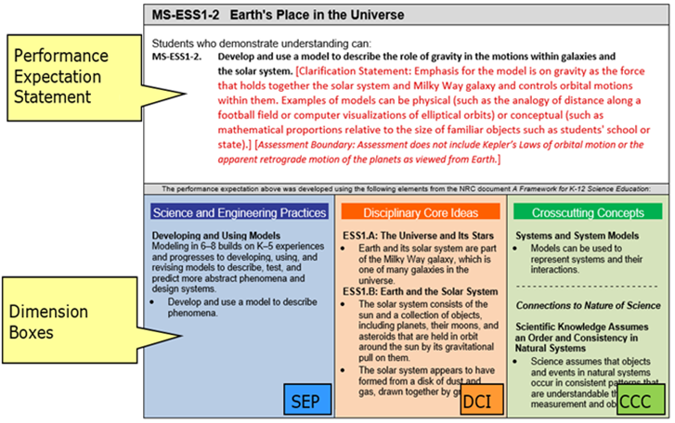
NGSS
Performance
Expectation
Notes:
This slide shows one Performance Expectation, MS-ESS1-2. The “MS” tells us that it is a middle school Performance Expectation, the “ESS1” refers to the overarching concept of “Earth’s Place in the Universe,” and the “-2” tells us that it is the second in a series of middle school Performance Expectations about that overarching concept.
The text of the Performance Expectations starts with the Performance Expectation Statement in black font and may be followed by a clarification statement and/or assessment boundary in red font. The clarification statements supply examples or additional clarification to the performance expectations. The assessment boundaries are meant to specify limits to large-scale assessment. They are not meant to put limits on what can be taught or how it is taught, but to provide guidance to assessment developers.
The Performance Expectation statement incorporates three dimensions, shown below in the Dimension Boxes. These include a science and engineering practice (SEP), one or more disciplinary core ideas (DCI), and a crosscutting concept (CCC). The Performance Expectation statement can provide some insight as to how the student is expected to utilize the SEP, DCI, and CCC together to achieve the performance expectation.
We will talk more about this structure when we get to the Item Specifications section of the presentation.

Slide 15
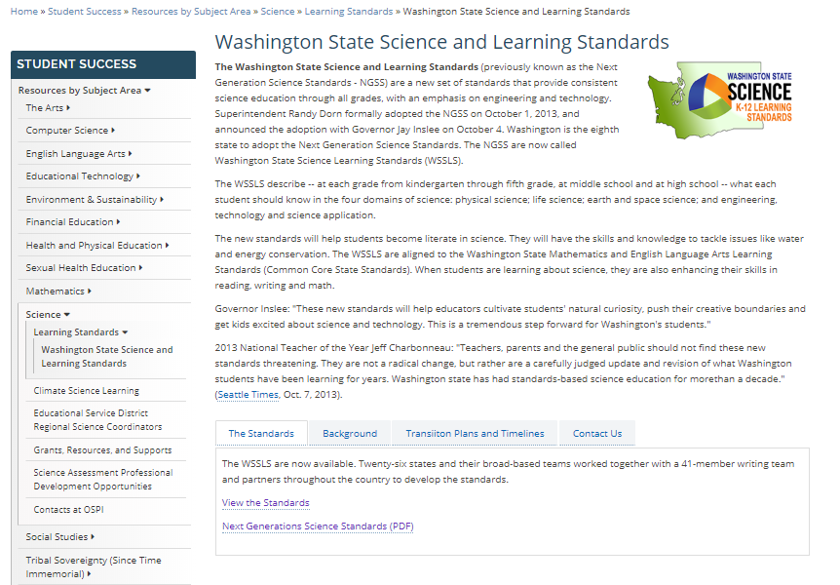
The 2013 Washington State K-12 Science Learning Standards are the Next Generation Science Standards (NGSS)
OSPI Science Standards Webpage
https://www.k12.wa.us/student-success/resources-subject-area/science/science-k%E2%80%9312-learning-standards/washington-state-science-and-learning-standards
Next Generation Science Standards https://www.nextgenscience.org/search-standards
Get to Know the Standards
https://www.nextgenscience.org/get-to-know
Understanding the Standards: https://www.nextgenscience.org/understanding-standards/understanding-standards
Notes:
This slide provides you with a link to the OSPI Science Standards [CLICK] webpage as well as additional NGSS resources.

Slide 16
Test Structure
Notes:
Pages 3-9 of the Test Design and Item Specifications document describe the structure of the WCAS.
The WCAS is composed of item clusters and standalone items that align to the NGSS Performance Expectations. It will take us a few slides to build the full picture of how item clusters and standalone items are carefully put together to compose a test form.

Slide 17
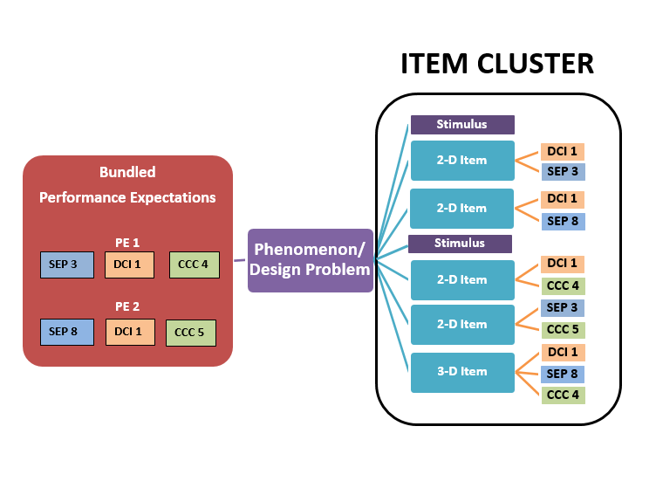
Cluster
Map
Page 3
Notes:
The graphic on this slide models the structure of an item cluster and can be found on page 3 of the Test Design & Item Specifications document.
Let’s start with the phenomenon or design problem that is used to give the cluster coherence.
[CLICK]
The use of phenomena or design problems in item and cluster development provides:
a context in which to demonstrate transfer of knowledge and skills,
a focus for combining knowledge and abilities from multiple dimensions, and
an element of interest and motivation for students.
Next, a Performance Expectation bundle is generally two related Performance Expectations that are used to explain or make sense of a scientific phenomenon or a design problem.
[CLICK]
Performance Expectations may be bundled across domains (for example., Life Science and Earth and Space Science PEs) or may be domain-specific (for example., all Life Science).
Performance Expectations may be bundled that have dimensions in common (for example, all Performance Expectations have the modeling SEP) or bundled to include a range of dimensions (for example, the Performance Expectations have no SEP, DCI, or CCC in common).
Some Performance Expectations may be robust enough to support an entire item cluster on their own, but most bundles will consist of two Performance Expectations. An individual Performance Expectation may be used in more than one bundle, but care will be taken to ensure that no Performance Expectation will be over-represented on a WCAS form.
The item cluster is carefully constructed such that:
[CLICK]
each item is linked to a stimulus or stimuli and to the other items within the item cluster,
each item is aligned to at least two dimensions from the PE bundle,
at least one item is three-dimensional,
all items support the phenomenon or design problem identified, and
the items progress logically and contain internal scaffolding to support the student’s progression to higher levels of complexity.
In addition,
Stimuli are interspersed among the items to add information as needed.
Some items have more than one part (ex: Part A, Part B) in order to achieve 2 or 3-dimensional alignment.

Slide 18
Standalone Items
Use a single item to address two or three dimensions of one PE
Stimulus and question/questions
Notes:
A standalone item is a focused measurement tool that uses a single item to address two or three dimensions of one Performance Expectation. Standalone items allow for increased Performance Expectation coverage on a given administration of the WCAS. A standalone item includes a stimulus and a question. Standalone items can have more than one part (e.g., Part A, Part B).

Slide 19
Grade 8 Blueprint
Pages 8-9
Reporting Area | Percentage of PEs per Science Domain in the Standards | Percent Range for the WCAS per Science Domain | Score Point Range for WCAS per Science Domain
Practices and Crosscutting Concepts in Physical Sciences | 35% | 30-40% | 12-16
Practices and Crosscutting Concepts in Life Sciences | 38% | 33-43% | 13-17
Practices and Crosscutting Concepts in Earth and Space Sciences | 27% | 22-32% | 9-13
40 Total points
6-12 standalone items
5 clusters
Estimated testing time: 120 minutes
ETS PEs are assessed but not reported separately.
Notes:
The Grade 8 blueprint is found on page 9 of the Test Design and Item Specifications document, and shows how clusters and standalone items are put together for a test.
The number of Performance Expectations in three of the domains (physical sciences, life sciences, and Earth and space sciences) in the middle school band of the standards were used to find the percentage of Performance Expectations per domain. See the second column. Approximately 35% of the standards are from the physical sciences domain, 38% of the standards are from the life sciences domain, and 27% of the standards come from the Earth and space sciences domain.
The WCAS will include a similar percentage of items per domain. That is what you see in the third column. The last column takes the 40 total points for the grade 8 WCAS, and breaks them out by those percentages.
A student receives an overall scale score on the WCAS, and a sub-score for each of three reporting areas: practices and crosscutting concepts in physical sciences, practices and crosscutting concepts in life sciences, and practices and crosscutting concepts in Earth and space sciences.
The Engineering Design (ETS) Performance Expectations are always bundled with a Physical Sciences, Life Sciences, or Earth and Space Sciences Performance Expectation for the WCAS, but are not reported in a separate reporting area.

Slide 20
Performance Expectation Coverage
Pages 8-9
Stand Alone items
  6-12 items per operational form
  Each item must assess 2 or 3 dimensions of a single PE
  Increases DCI, SEP, and CCC coverage for the whole test
Item Clusters
  3-6 items per cluster
  5 clusters per operational form
  At least one PE from each domain (PS, LS, ESS, and ETS) represented
  A minimum of 3 different SEPs across the clusters
  A minimum of 3 different CCCs across the clusters
Notes:
As students work their way through the Grade 8 WCAS, they will first encounter 6 to 12 standalone items.
After the standalone items, the test turns to item clusters. There are 3 to 6 items per cluster.
The grade 8 assessment has 5 clusters. There will be at least one cluster on the test that assesses each domain (physical, life, and Earth and space sciences, as well as engineering design). There will be a minimum of 3 different Science and Engineering Practices across the clusters, and a minimum of 3 different Crosscutting Concepts across the clusters.
Approximately 1/4 to 1/3 of the 59 Performance Expectations can be covered on a given year’s WCAS. This means that, with careful planning and test building, all of the grade 8 performance expectations can be assessed over 3-5 administrations.
If it feels like you are starting to put together a 4-D puzzle in your head with all of these requirements….you are on the right track for what test building feels like.

Slide 21
Structure and Administration
Pages 8-9
Structure
  Operational Section
    Counts toward a student’s score
    Fixed form
  Field Test Section
    Embedded in the online administration
    Does not count toward a student’s score
    A cluster or several standalone items
Administration
  Can be administered in multiple sessions like the Smarter Balanced ELA and Math tests
  1 to 3 sessions recommended
Notes:
Remember, there are items field-tested on each years’ WCAS. They are embedded in the online test and do not count toward a student’s score. The field test items are either a cluster of items, or several standalone items. We need students to put forth as much effort into field test items as they do for the operational items to get as accurate information as possible about how the field test items function.
Like the Smarter Balanced tests, the WCAS can be given to students over multiple test sessions. We recommend 3 sessions maximum.

Slide 22
Features & Item Types
Pages 4-7
Features
  Collapsible Stimuli
  Locking items
  Multipart items
  Animation
  Periodic Table https://wa.portal.cambiumast.com/
  Calculator https://www.desmos.com/testing/washington
Item Types
  Multiple Choice
  Multiple Select
  Short Answer
  Drag and Drop
  Hot Text
  Table Match
  Table Input
  Edit Task Inline Choice
  Simulation
Notes:
Pages 4 through 7 of the Test Design and Item Specifications document give details about the features and item types on the WCAS.
Standalone items fill the entire screen.
For an item clusters, stimuli and items are presented side-by-side—with stimuli on the left and items on the right.
For an item cluster that has more than one stimulus, each stimulus is delivered along with the items most closely associated to that stimulus. Once a stimulus is presented, it is available to the student throughout the cluster. To minimize vertical scrolling and the need to move back to previous screens within a cluster, a stimulus is collapsed once the next stimulus is provided. A +/- icon in the heading of a stimulus section allows the stimulus to be hidden from view or expanded to suit a student’s current need.
WCAS clusters include some locking items in which the student cannot change their answer once they have moved on to the next item. A padlock icon next to the item number alerts students that they are answering a locking item. When they start to move on from the item, an “attention” box warns the student that they will not be able to change their answer once they move on. The student can either return to the item or move forward and lock in their answer.
Locking items allow the student to be updated with correct information in subsequent items or stimuli. In addition, locking items help to limit item interaction effects or clueing between items in a cluster.
Students can return and view an item that has been locked. The student will see their answer, but they cannot change their answer.
A periodic table is embedded in the online platform for all items in the WCAS for grade 8 and high school. A printable version of the periodic table can be downloaded for classroom use on the WCAP Portal. https://wa.portal.airast.org/
A scientific calculator is embedded in the online platform for all items in the WCAS for grade 8 and high school. Students should be familiar with the functionality of the calculator prior to using it on the assessment. The calculator is available online and as an app for practice. For more information about the calculator available during testing, visit the Desmos.com State Assessments webpage https://www.desmos.com/testing/washington

Slide 23
WCAS Training Tests
Grades 5, 8, 11
Accessed through the WCAP Portal
https://wa.portal.airast.org/training-tests.stml
Grade 5 Lesson Plan
https://www.k12.wa.us/sites/default/files/public/science/pubdocs/LessonPlans5-FINAL%20DRAFT.pdf
Grade 8 Lesson Plan
https://www.k12.wa.us/sites/default/files/public/science/pubdocs/LessonPlans8-FINAL%20DRAFT.pdf
Grade 11 Lesson Plan
https://www.k12.wa.us/sites/default/files/public/science/pubdocs/LessonPlans11-FINAL%20DRAFT.pdf
Quick Start
https://www.k12.wa.us/sites/default/files/public/science/pubdocs/OnlineTrainingTestQuickStart-FINAL_DRAFT.pdf
Notes:
The WCAS is delivered online using the same platform as the Smarter Balanced tests and may look familiar to students. However, students who take online assessments need opportunities to explore the features of the online assessment and to practice using the tools available to them.
The WCAS training tests were expanded in December 2019. The training tests are available through the WCAP Portal. https://wa.portal.airast.org/training-tests.stml
The Grade 5 and Grade 8 training tests each have two new standalone items.
The Grade 11 training test has three new standalone items and one new item cluster.
All standalone items and item clusters on the training tests were developed by Washington educators and successfully field tested with Washington students. The standalone items and item clusters were carefully chosen for the training tests to represent a variety of online question types and features. All students can access all three training tests, if desired.
Training Test Lesson Plans for each grade-level training test are available on the WCAS Educator Resources webpage.
https://www.k12.wa.us/student-success/testing/state-testing-overview/washington-comprehensive-assessment-science/wcas-educator-resources
The documents include descriptions of ways to practice using the tools for each item type, an answer key, and information about the standards alignment for each question.
Grade 5 lesson Plan
https://www.k12.wa.us/sites/default/files/public/science/pubdocs/LessonPlans5-FINAL%20DRAFT.pdf
Grade 8 Lesson Plan
https://www.k12.wa.us/sites/default/files/public/science/pubdocs/LessonPlans8-FINAL%20DRAFT.pdf
Grade 11 Lesson Plan
https://www.k12.wa.us/sites/default/files/public/science/pubdocs/LessonPlans11-FINAL%20DRAFT.pdf
A separate Quick Start Guide includes information about accessing the training tests as a guest user or through the secure browser.
Quick Start Guide
https://www.k12.wa.us/sites/default/files/public/science/pubdocs/OnlineTrainingTestQuickStart-FINAL_DRAFT.pdf

Slide 24

Q&A
Notes:
We are going to stop here for a few minutes and answer some questions that have come in.

Slide 25
Item Specifications
Notes:
Now we are going to move into the Item Specifications part of the presentation.
The science assessment team at OSPI worked with Washington State educators and assessment research and development partners to produce item specifications that will support multi-dimensional item development.
The following two slides represent an item specification. We are going to use Performance Expectation MS-LS3-2 as the example. It can be found on pages 86 and 87 of the Grade 8 Test Design and Item Specifications document.

Slide 26
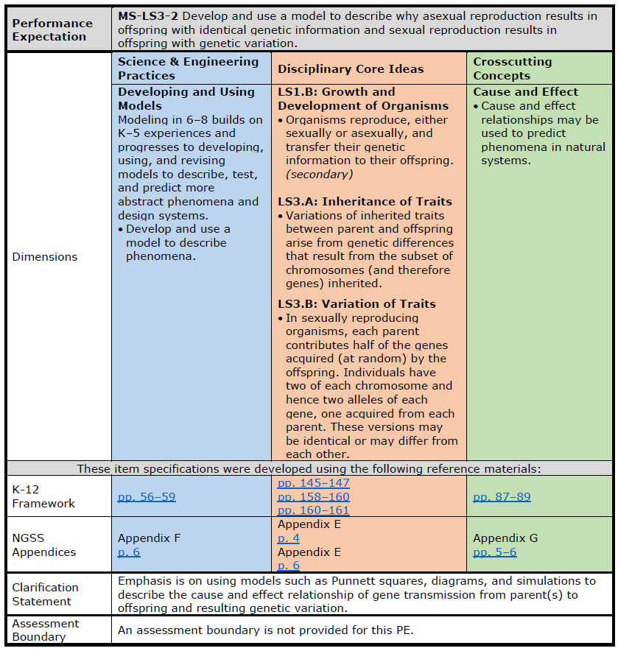
MS-LS3-2
Pages 86-87
Front Page
Notes:
The Item Specification is two pages.
Most of the front page is language copied from the NGSS.
For example, the Performance Expectation statement [CLICK]
And the dimensions information
the Science and Engineering Practice in blue [CLICK],
the Disciplinary Core Idea in orange [CLICK], and
the Cross-Cutting Concepts in green [CLICK]
Come directly from the Performance Expectation.
While the performance expectations can stand alone, a more coherent and complete view of what students should be able to do comes when the performance expectations are viewed in tandem with the contents of the dimensions boxes.
Let’s read these four pieces together to see how this works.
MS-LS3-2: Develop and use a model to describe why asexual reproduction results in offspring with identical genetic information and sexual reproduction results in offspring with genetic variation.
Science & Engineering Practices: Developing and Using Models
Modeling in 6–8 builds on K–5 experiences and progresses to developing, using, and revising models to describe, test, and predict more abstract phenomena and design systems.
Develop and use a model to describe phenomena.
Disciplinary Core Ideas:
LS1.B: Growth and Development of Organisms
Organisms reproduce, either sexually or asexually, and transfer their genetic information to their offspring.
LS3.A: Inheritance of Traits
Variations of inherited traits between parent and offspring arise from genetic differences that result from the subset of chromosomes (and therefore genes) inherited.
LS3.B: Variation of Traits
In sexually reproducing organisms, each parent contributes half of the genes acquired (at random) by the offspring. Individuals have two of each chromosome and hence two alleles of each gene, one acquired from each parent. These versions may be identical or may differ from each other.
Crosscutting Concepts: Cause and Effect
Cause and effect relationships may be used to predict phenomena in natural systems.
Next, you’ll find links to the exact pages in the K-12 Framework for Science Education [CLICK] and the NGSS Appendices [CLICK] where more information about each dimension can be found.
The K-12 Framework for Science Education is the foundational document for the NGSS. It is grounded in the most current research on science and science learning and identifies the science all K–12 students should know upon completion of high school. https://www.nap.edu/catalog/13165/a-framework-for-k-12-science-education-practices-crosscutting-concepts
The NGSS Appendices provide background and detail about the standards. https://www.nextgenscience.org/resources/ngss-appendices
We won’t explore these links today, but this feature of the item specifications provides a quick way to access this helpful information.
Finally, the front page lists the clarification statement [CLICK] and assessment boundary [CLICK] which also include language directly from the Performance Expectation.
For this Performance Expectation, these statements tell us that the “Emphasis is on using models such as Punnett squares, diagrams, and simulations to describe the cause and effect relationship of gene transmission from parent(s) to offspring and resulting genetic variation.” and that “An assessment boundary is not provided for this PE.”

Slide 27
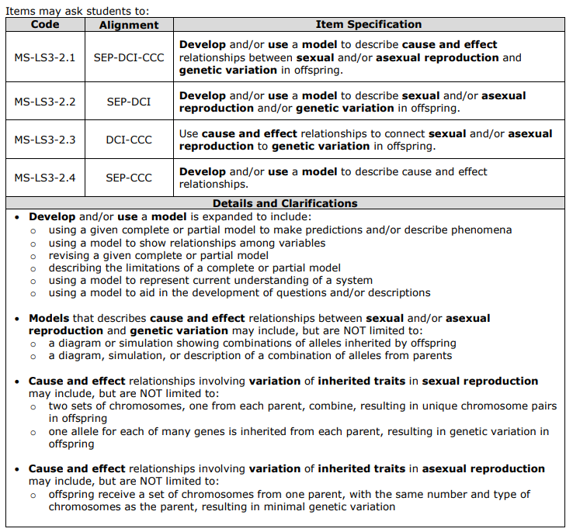
MS-LS3-2
Pages 86-87
Back
Page
Notes:
The back page is specific to the WCAS and always starts with a table of four Item Specifications [CLICK].
The first item specification has a code with a “.1” added onto the end of the Performance Expectation number. The code for the first item specification here is MS-LS3-2.1. The first item specification describes how a three dimensional item is written to assess the SEP, DCI, and CCC of the Performance Expectation.
The second item specification listed--has a code with a “.2” added onto the end of the Performance Expectation number. The second item specification describes how a two dimensional item is written to assess the SEP and DCI of the Performance Expectation.
The third item specification listed--has a code with a “.3” . The third item specification describes how a two dimensional item is written to assess the DCI and CCC of the Performance Expectation.
The fourth item specification listed--has a code with a “.4” . The fourth item specification describes how a two dimensional item is written to assess the SEP and CCC of the Performance Expectation.
When you read each of the four specifications, you’ll notice key words bolded.
The “Details and Clarifications” section [CLICK] includes information that helps unpack those key words.
It is important to note that the details and clarifications section provides EXAMPLES only, NOT exhaustive lists.
If I want to write a three dimensional item, I would use item specification MS-LS3-2.1 as a guide, and then use the details and clarifications section to help put the pieces together. The other three item specifications would guide the development of two-dimensional items.
I can see from the first set of bullets in the details and clarifications section that there are several ways to assess the SEP “Developing and Using Models ”. For example, I could write an item in which students are:
using a given complete or partial model to make predictions and/or describe phenomena; or
using a model to show relationships among variables; or
revising a given complete or partial model; or
describing the limitations of a complete or partial model; or
using a model to represent current understanding of a system; or
using a model to aid in the development of questions and/or descriptions
I am not limited to “Developing and using a model to describe phenomena.” like the blue box on the first page indicated.
The second set of bullets gives some examples of how models can be used to describe cause and effect relationships between sexual and/or asexual reproduction and genetic variation, like:
a diagram or simulation showing combinations of alleles inherited by offspring
a diagram, simulation, or description of a combination of alleles from parents
The third set of bullets gives some examples of cause and effect relationships involving variation of inherited traits in sexual reproduction, like:
two sets of chromosomes, one from each parent, combine, resulting in unique chromosome pairs in offspring
one allele for each of many genes is inherited from each parent, resulting in genetic variation in offspring
And the fourth set of bullets gives an example of a cause and effect relationship involving variation of inherited traits in asexual reproduction, like:
offspring receive a set of chromosomes from one parent, with the same number and type of chromosomes as the parent, resulting in minimal genetic variation

Slide 28
Item Specifications Activity
Notes:
Now we are going to use the Sea Star Reproduction cluster found in the Grade 8 WCAS Training Test to connect the item specification we just looked at to item development for the WCAS.
Please note that for of this next part of the presentation, even though the cluster is available online in the Grade 8 WCAS training test, we are not going to look at the cluster in the online platform. Instead, the science team has come up with a way to show alignment between the items and the performance expectation bundle using static images.

Slide 29
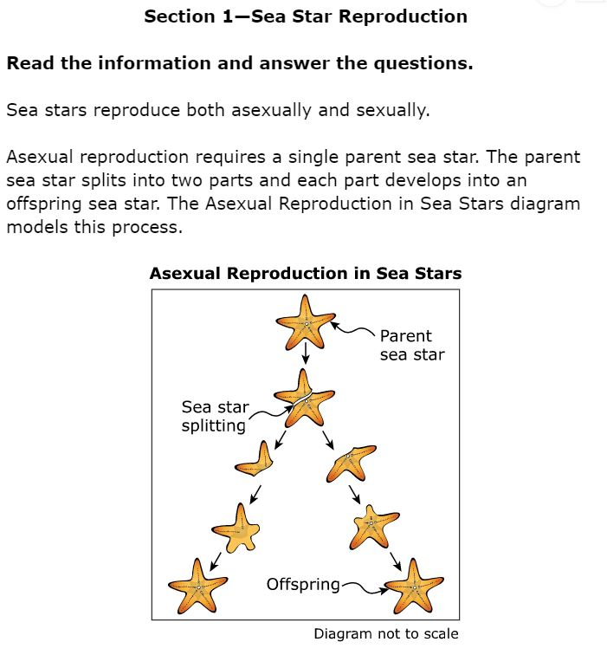
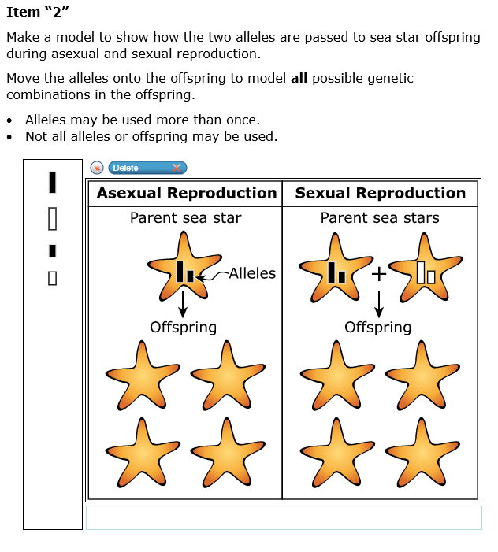
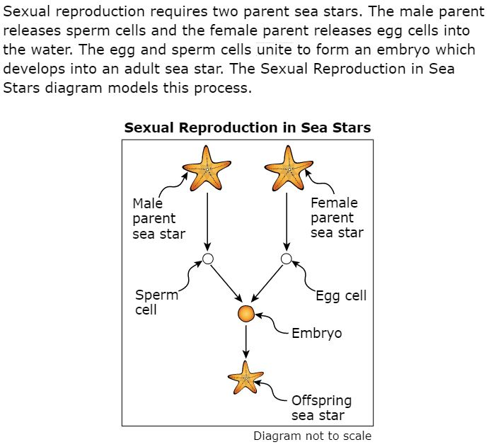
Item 1
Notes:
This is the first stimulus section for Sea Star Reproduction.
It reads:
“Sea Star Reproduction. Section 1. Read the information and answer the questions. Sea stars reproduce both asexually and sexually. Asexual reproduction requires a single parent sea star. The parent sea star splits into two parts and each part develops into an offspring sea star. The Asexual Reproduction in Sea Stars diagram models this process.”
Sexual reproduction requires two parent sea stars. The male parent releases sperm cells and the female parent releases egg cells into the water. The egg and sperm cells unite to form an embryo which develops into an adult sea star. The Sexual Reproduction in Sea Stars diagram models this process.
The first item in the Sea Star Reproduction cluster reads:
“Make a model to show how the two alleles are passed to sea star offspring during asexual and sexual reproduction.
Move the alleles onto the offspring to model all possible genetic combinations in the offspring. Alleles may be used more than once. Not all alleles or offspring may be used.”

Slide 30
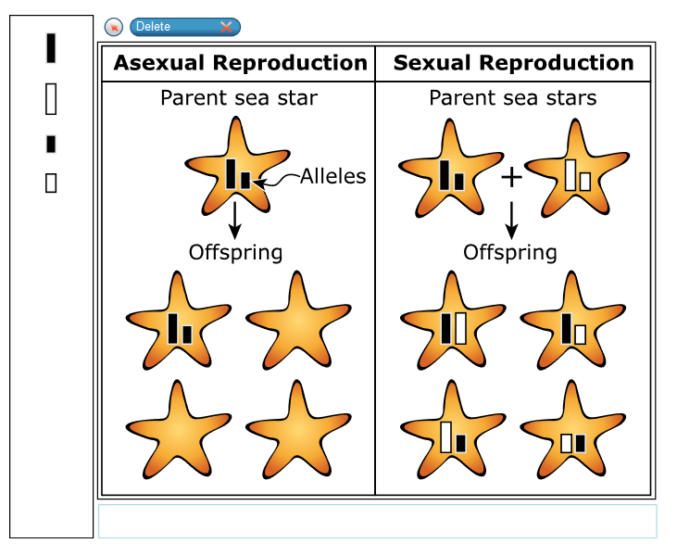
Item 1
Notes:
Here is an example of one correct answer for item 1. There are more possible correct answers. [PAUSE]
This item was developed to align to MS-LS3-2, the Performance Expectation we just looked at. The next question is—Which item specification does the item align to: MS-LS3-2.1, .2, .3, or.4?

Slide 31
Item 1
Notes:
Here is the set of item specifications and details and clarifications again for MS-LS3-2.
Thinking about what students are asked to demonstrate in item 1, which specification does this item most closely align to?
If they are being asked to “Develop and/or use a model to describe cause and effect relationships between sexual and/or asexual reproduction and genetic variation in offspring.” then this is a three-dimensional item aligned to MS-LS3-2.1.
If they are being asked to “Develop and/or use a model to describe sexual and/or asexual reproduction and/or genetic variation in offspring.” then this is a two-dimensional item aligned to MS-LS3-2.2.
If they are being asked to “Use cause and effect relationships to connect sexual and/or asexual reproduction to genetic variation in offspring.” then this is a two-dimensional item aligned to MS-LS3-2.3.
If they are being asked to “Develop and/or use a model to describe cause and effect relationships.” then this is a two-dimensional item aligned to MS-LS3-2.4.
Take a few moments to decide which item specification you think this item is aligned to. [PAUSE]
If you chose MS-LS3-2.2. , then you agree with the educator work groups that developed and reviewed this item.
Students complete a model (SEP) to show genetic variation in offspring for both asexual and sexual reproduction. The CCC of “Cause and effect” is not assessed in this item.
This is a locking item. Once students answer the question and move on, they can return to the item and the stimulus, but they cannot change their answer. You’ll see the reason for this in stimulus section 2 and the next item which reads…

Slide 32
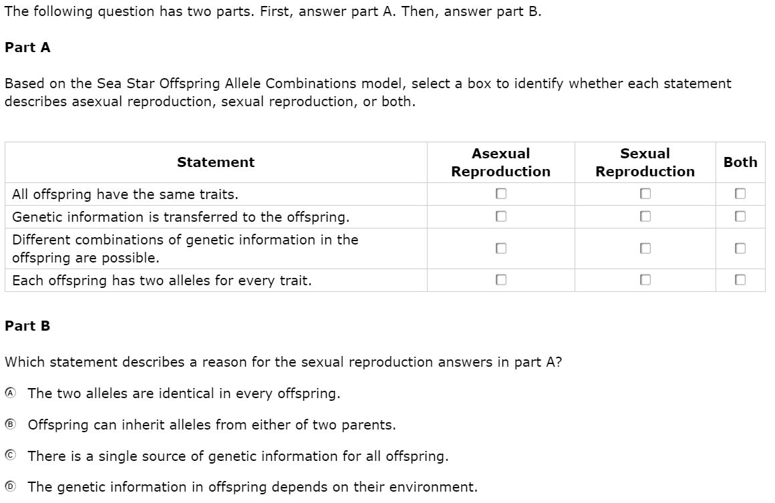
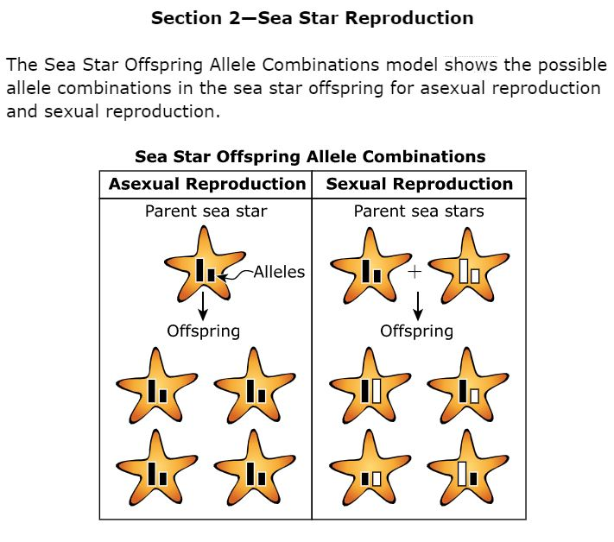
Item 2
Notes:
“The Sea Star Offspring Allele Combinations model shows the possible allele combinations in the sea star offspring for asexual reproduction and sexual reproduction.”
Now, regardless of the student’s response in item 1, they are able to use this new model to help them answer the rest of the items in the cluster.
Item 2 reads:
“The following question has two parts. First, answer part A. Then, answer part B. Part A.
Based on the Sea Star Offspring Allele Combinations model, select a box to identify whether each statement describes asexual reproduction, sexual reproduction, or both.”
The statements read “All offspring have the same traits. Genetic information is transferred to the offspring. Different combinations of genetic information in the offspring are possible. Each offspring has two alleles for every trait.”
Part B.
Which statement describes a reason for the sexual reproduction answers in part A?
A The two alleles are identical in every offspring.
B Offspring can inherit alleles from either of two parents.
C There is a single source of genetic information for all offspring.
D The genetic information in offspring depends on their environment. “

Slide 33
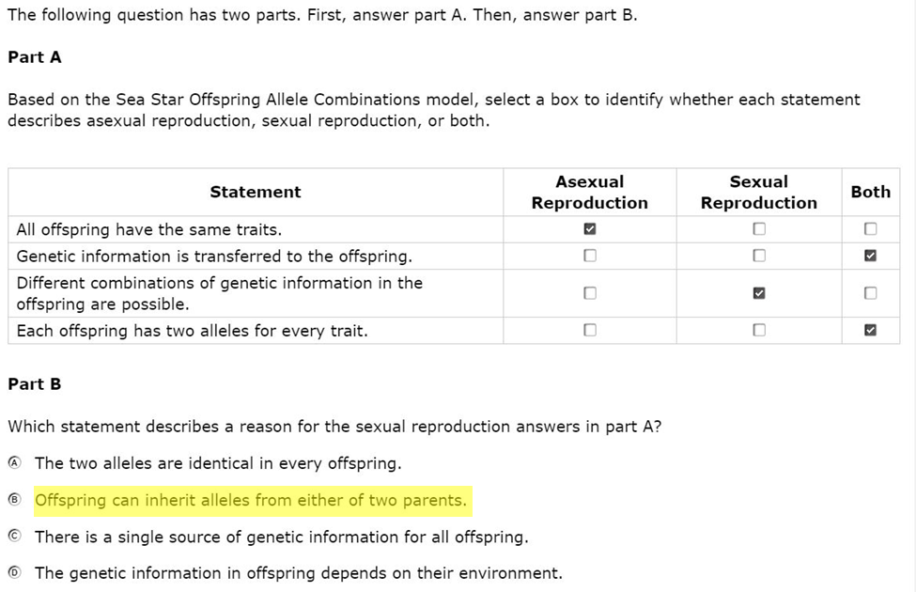
Item 2
Notes:
Here are the correct answers.
This item was also developed to align to MS-LS3-2. [PAUSE]
When we have a multipart item such as this, we consider both part A and part B together when making alignment judgements.

Slide 34
Item 2
Notes:
Here is the set of item specifications and details and clarifications again for MS-LS3-2.
Again, thinking about what students are asked to demonstrate in this 2-part item, which specification do the parts together most closely align to?
Take a few moments to decide which item specification you think this item is aligned to. [PAUSE]
If you chose MS-LS3-2.1. , then you agree with the educator work groups that developed and reviewed this item.
Students use the model given in the stimulus (SEP) to describe characteristics of asexual and sexual reproduction (DCI) in part A, and then are asked about the cause and effect relationship (CCC) in part B.

Slide 35
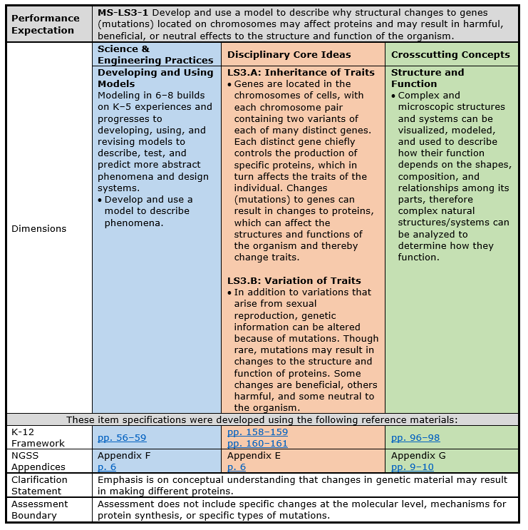
MS-LS3-1
Pages 84-85
Front Page
Notes:
The last three items in the Sea Star Reproduction Cluster are aligned to MS-LS3-1. Let’s take a look at the item specification for that Performance Expectation. As we read through this one, please note how the format is the same as that for MS-LS3-2. All item specifications are formatted the same way.
First, the performance expectation statement: Develop and use a model to describe why structural changes to genes (mutations) located on chromosomes may affect proteins and may result in harmful, beneficial, or neutral effects to the structure and function of the organism.
Then, the Science & Engineering Practices: Developing and Using Models
The blue box contains same modeling information as MS-LS3-2, so we won’t read through it again.
The Disciplinary Core Ideas:
LS3.A: Inheritance of Traits
Genes are located in the chromosomes of cells, with each chromosome pair containing two variants of each of many distinct genes. Each distinct gene chiefly controls the production of specific proteins, which in turn affects the traits of the individual. Changes (mutations) to genes can result in changes to proteins, which can affect the structures and functions of the organism and thereby change traits.
LS3.B: Variation of Traits
In addition to variations that arise from sexual reproduction, genetic information can be altered because of mutations. Though rare, mutations may result in changes to the structure and function of proteins. Some changes are beneficial, others harmful, and some neutral to the organism.
LS3.A and LS3.B are the same DCI categories we had for MS-LS3-2, however the bulleted statement are different between the two PEs.
and the Crosscutting Concept: Structure and Function
Complex and microscopic structures and systems can be visualized, modeled, and used to describe how their function depends on the shapes, composition, and relationships among its parts, therefore complex natural structures/systems can be analyzed to determine how they function.
Next, are the links to the exact pages in the K-12 Framework for Science Education and the NGSS Appendices where more information about each dimension can be found.
For this Performance Expectation, the clarification statement tell us that the “Emphasis is on conceptual understanding that changes in genetic material may result in making different proteins.”, and the Assessment Boundary specifies that “Assessment does not include specific changes at the molecular level, mechanisms for protein synthesis, or specific types of mutations.”
Remember, all of the information on this page (with the exception of the links) is taken directly from the NGSS.

Slide 36
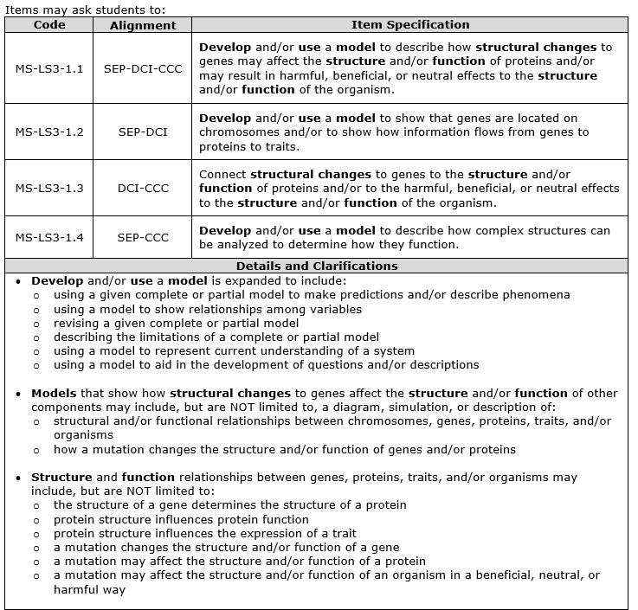
MS-LS3-1
Pages 84-85
Back Page
Notes:
On the back of the page, we start with the table of item specifications [CLICK], just like with MS-LS3-2.
MS-LS3-1.1 describes how a three-dimensional item is written to assess the SEP, DCI, and CCC.
.2 describes how a two-dimensional item is written to assess the SEP and DCI.
.3 describes how a two-dimensional item is written to assess the DCI and CCC.
.4 describes how a two-dimensional item is written to assess the SEP and CCC.
And below the item specification we have the details and clarifications [CLICK].
Since the SEP for this Performance expectation is Modeling, the first set of bullets is identical to the first set of bullets on the back page of MS-LS3-2. This set tells all the different ways we might assess the modeling SEP. We won’t read though these again.
The second set of bullets gives some examples of how a diagram, simulation, or some other type of model can be used to show how structural changes to genes affect the structure and/or function of other components, like:
structural and/or functional relationships between chromosomes, genes, proteins, traits, and/or organisms
how a mutation changes the structure and/or function of genes and/or proteins
The third set of bullets gives some examples of structure and function relationships between genes, proteins, traits, and/or organisms, like:
the structure of a gene determines the structure of a protein
protein structure influences protein function
protein structure influences the expression of a trait
a mutation changes the structure and/or function of a gene
a mutation may affect the structure and/or function of a protein
a mutation may affect the structure and/or function of an organism in a beneficial, neutral, or harmful way
Remember, the details and clarifications section provides EXAMPLES only, NOT exhaustive lists.

Slide 37
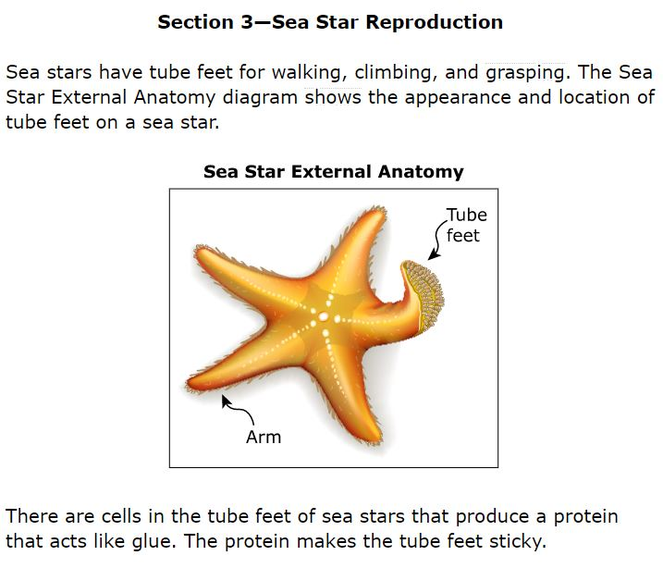
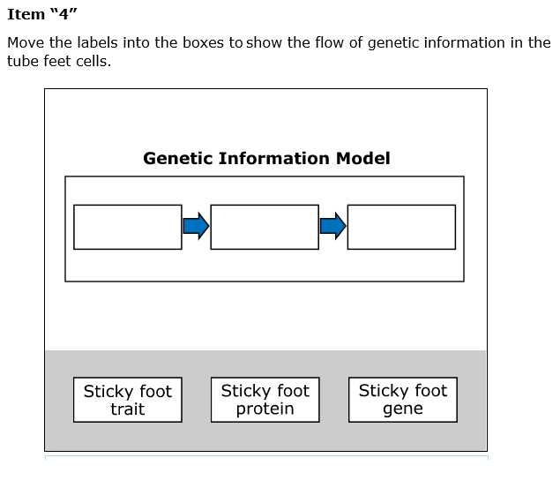
Item 3
Notes:
Now lets take a look at the section 3 stimulus in the Sea Star Reproduction cluster. It reads “Sea stars have tube feet for walking, climbing, and grasping. The Sea Star External Anatomy diagram shows the appearance and location of tube feet on a sea star.”
“There are cells in the tube feet of sea stars that produce a protein that acts like glue. The protein makes the tube feet sticky.”
Item 3 is another drag and drop, or grid item.
It reads: “Move the labels into the boxes to show the flow of genetic information in the tube feet cells.”
The labels that students use are : “Sticky foot trait”, “Sticky foot protein, and Sticky foot gene”.

Slide 38
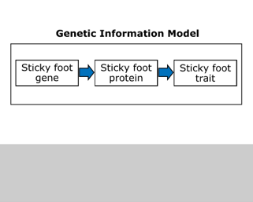
Item 3
Notes:
Here is the correct answer for Item 3. [PAUSE]
This item was developed to align to MS-LS3-1.

Slide 39
Item 3
Notes:
Here is the set of item specifications and details and clarifications again.
Thinking about what students are asked to demonstrate in this item, which specification does this item most closely align to?
If they are being asked to “Develop and/or use a model to describe how structural changes to genes may affect the structure and/or function of proteins and/or may result in harmful, beneficial, or neutral effects to the structure and/or function of the organism.” then this item is three dimensional and aligned to MS-LS3-1.1.
If they are being asked to “Develop and/or use a model to show that genes are located on chromosomes and/or to show how information flows from genes to proteins to traits.” then the item is two dimensional and aligned to MS-LS3-1.2.
If they are being asked to: “Connect structural changes to genes to the structure and/or function of proteins and/or to the harmful, beneficial, or neutral effects to the structure and/or function of the organism.” then the item is two dimensional and aligned to MS-LS3-1.3.
If they are being asked to: “Develop and/or use a model to describe how complex structures can be analyzed to determine how they function.” then the item is two dimensional and aligned to MS-LS3-1.4.
Take a few moments to decide which item specification you think this item is aligned to. [PAUSE]
If you chose MS-LS3-1.2. , then you agree with the educator work groups that developed and reviewed this item.
This item asks students to develop a model to show how information flows from genes to proteins to traits. Because students are not asked to describe structure and function relationships, the item is not aligned to the CCC.
This is a locking item. Students cannot change their answer to this item once they move on.

Slide 40
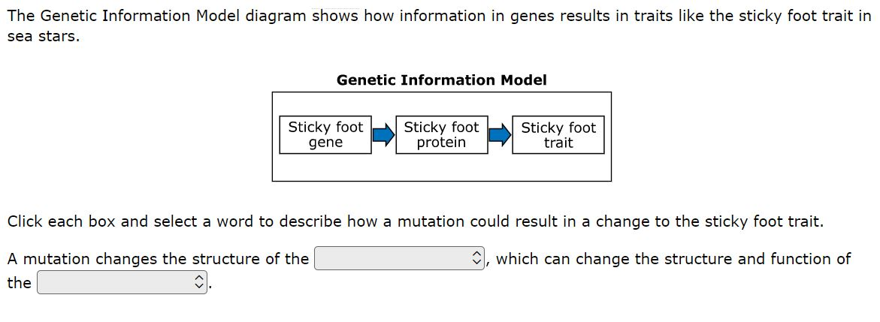
Item 4
Notes:
The fourth item uses the same Section 3 stimulus, and provides an update to Item 3.
The item reads: “The Genetic Information Model diagram shows how information in genes results in traits like the sticky foot trait in sea stars.”
“Click each box and select a word to describe how a mutation could result in a change to the sticky foot trait. A mutation changes the structure of the (gene, protein, or trait), which can change the structure and function of the (gene, protein, or trait).

Slide 41
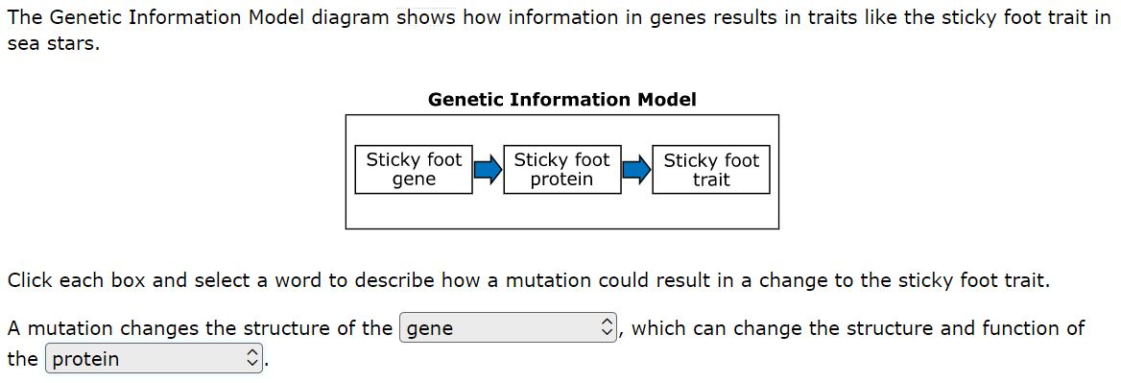
Item 4
Notes:
Here is the correct answer for Item 4. [PAUSE]
This item was also developed to align to MS-LS3-1.

Slide 42
Item 4
Notes:
Here is the set of item specifications and details and clarifications again.
Thinking about what students are asked to demonstrate in item 4, take a few moments to decide which item specification you think this item is aligned to. [PAUSE]
If you chose MS-LS3-1.1. , then you agree with the educator work groups that developed and reviewed this item.
This item asks students to use model that shows the flow of information from genes to proteins to traits to make a claim about the effect of a mutation on the structure and function relationship between genes and proteins. (SEP, DCI, and CCC alignment).

Slide 43
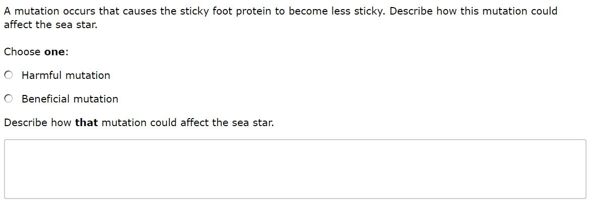
Item 5
Notes:
The final item in the Sea Star Reproduction cluster uses the same Section 3 stimulus.
The item reads:
“A mutation occurs that causes the sticky foot protein to become less sticky. Describe how this mutation could affect the sea star.
Choose one: Harmful mutation. Beneficial mutation.
Describe how that mutation could affect the sea star.”

Slide 44
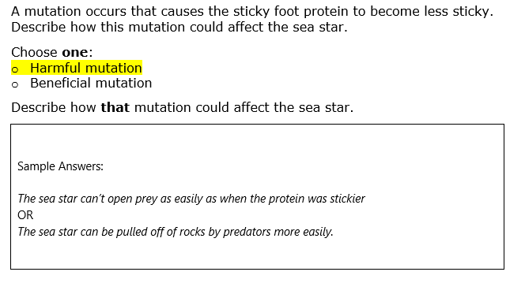
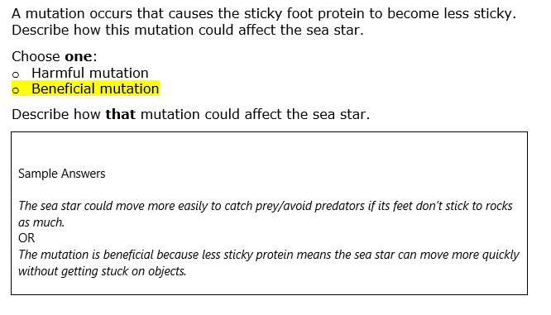
Item 5
Notes:
Here are a few sample answers for Item 5. There are other creditable answers. [PAUSE]
This item was also developed to align to MS-LS3-1.

Slide 45
Item 5
Notes:
Here is the set of item specifications and details and clarifications again for MS-LS3-1.
Thinking about what students are asked to demonstrate in Item 5, which specification does this item most closely align to? Take few moments to decide.
If you chose MS-LS3-1.3. , then you agree with the educator work groups that developed and reviewed this item.
This item asks students to describe how a change to the function of a protein can affect the function of the organism.
Because students are not asked to demonstrate an aspect of the modeling practice, the item is not aligned to the SEP.
This brings us to the end of our alignment activity. Alignment judgements are made and revisited during each step of the science assessment development process, and Washington educators are a key part of these discussions. Although making some alignment judgements is more clean cut than making others, we are confident in the process, documentation, and decisions that are used for aligning the WCAS items to the NGSS.
The alignment activity can be repeated using the three standalone items from the Grade 8 Training test. Performance Expectation and answer key information for all of the training test items is found on page 7 of the Grade 8 Training Test Lesson Plan mentioned on slide 23.

Slide 46
Vocabulary Terms
Notes:
You’ll find a list of expected SEP, DCI, and CCC vocabulary terms on the last three pages of the Test Design and item Specifications document.

Slide 47
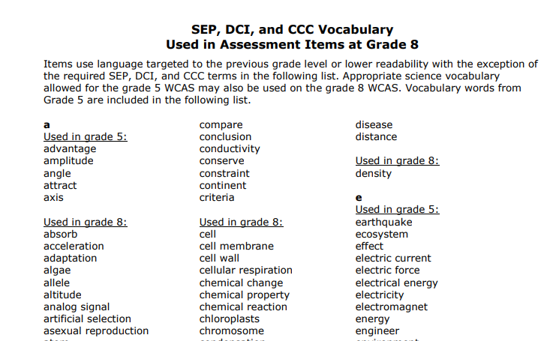
Expected
SEP, DCI, and CCC
Vocabulary
Pages 142-144
Notes:
WCAS stimuli and items use language targeted to the previous grade level or lower readability with the exception of the required SEP, DCI, and CCC terms that are included in the vocabulary list. Students are expected to know the meaning of these words when they take the WCAS, even though the words may be above grade level.
Notice that the list includes the science words required for grade 5. Grade 8 students are expected to know these words also.
OSPI cannot endorse any particular resource or curriculum, therefore we can’t point to a particular source for definitions.

Slide 48
Q&A
Notes:
We are going to stop here and answer a more few questions that have come in.

Slide 49
Reminders & Wrap up
Notes:
Please remember that the Test Design and Items Specifications documents are intended to guide the writing of test items for the state summative assessment.
Classroom instruction should align to the Washington State K–12 Science Learning Standards (NGSS). The Test Design and Items Specifications documents can also serve as another resource, much like the NGSS Appendices, to help clarify understanding of the standards.
The Test Design and Items Specifications documents will be updated through the steps of the assessment development cycle, and a modifications log will be published that shows where changes were made.

Slide 50
Where to find the materials
WCAS Educator Resources Webpage
https://www.k12.wa.us/student-success/testing/state-testing-overview/washington-comprehensive-assessment-science/wcas-educator-resources
  Presentation slides with script 1 week out
  FAQ document with answers to Chat questions 1 week out
  Webinar recording 2 weeks out
pdEnroller
https://www.pdenroller.org/
Notes:
We will post this PowerPoint presentation, including notes with our script, on the WCAS Educator Resources Webpage by a week from today. We’ll put it in the section about the “Test Design and Item Specifications.”
An FAQ with your questions as well as a recording of the webinar will be posted next to the presentation by the end of the following week.
Remember that if you would like to receive clock hours, you need to sign in, register, and complete an evaluation of the webinar through pdEnroller.

Slide 51
Thank You!
Notes:
We will keep the webinar open for a few more minutes to capture any remaining questions you may want to enter into the chat box.
Thank you for joining us this afternoon.

