Slide 1

Supporting Seniors’ Financial Aid Awareness:
Financial Aid Advising Days
Wednesday Webinar - September 23, 2020
Kim Reykdal, OSPI | Christina Winstead, WSAC | Yokiko Hayashi-Saguil, WSAC
9/23/2020 | 1

Slide 2




Webinar Logistics
This webinar is being recorded and will be posted on OSPI’s YouTube channel
Both the recording and the slides will also be posted ASAP on WSAC’s website and the slides will be on OSPI’s CCR website
2 Clock Hours will be available (remember to explore www.wsac.wa.gov/12th-year-campaign for at least 30 minutes)

Slide 3

Land Acknowledgement
School District & Nearest Federally Recognized Tribes*
*Ideally, districts should consult with tribal members to draft land acknowledgement
Washington Tribes Map
9/23/2020 | 3
Notes:
I would like to acknowledge that I’m coming to you today from the traditional lands of the Squaxin Island Tribe. We acknowledge the Tribes commitment to the resurgence of their traditional ways and their respect and protection of all people, not only those who are living, but also those who have gone before and who are yet to be born.
We pay our respect to the elders both past and present and to the valued resource the Tribe has defined as their children. They are the Tribes future.
We ask that the participants of this meeting also honor the Tribal lands on which each of you are located today.
A resource you might consider for your own locale, is this School District & Nearest Federally Recognized Tribes document or the Washington Tribes map.
When you see the “within tribe boundaries” this is based on their current land not historical.
Best practice is for districts to engage in tribal consultation with the tribes nearest their district to determine their historical lands. Each tribe are the experts of their history.
We thank you for your participation.
https://www.nctsn.org/what-is-child-trauma/trauma-types/disasters/wildfire-resources

Slide 4
Cultural
We acknowledge the pain and trauma resulting from 400 years of racism in the United States. We stand in partnership with our communities of color, especially those who identify as Indigenous and African American or Black.
We will continue to center our work in leading with racial equity to end the injustices experiences by our students and families of color.
We offer a moment of silence and honor the space for people from communities of color to respond to this acknowledgement first.
Please use the chat box.
We invite accountability and partnership.
An abridged version of a statement adopted by PSESD 121
Notes:
We also would like to take a moment to ground ourselves in history, both the past and our current state of civic and social unrest in recognition of injustices experienced by our students and families of color.
We stand with our communities of color, especially those who identify as and/or are categorized as African American. We will continue to center our work in leading with racial equity. The time is ripe for transformational change and we believe attendance is critical for access to education.
Throughout our webinar today and moving forward in this work, we invite accountability and partnership.
We want to offer a moment of silence and honor the space for people from communities of color to respond to this acknowledgement. Please use the chat box.
DO NOT TALK FOR AT LEAST 40-60 SECONDS TO HONOR THE MOMENT OF SILENCE. (Adopted by PSESD 121.)

Slide 5
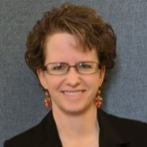

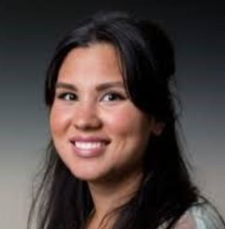
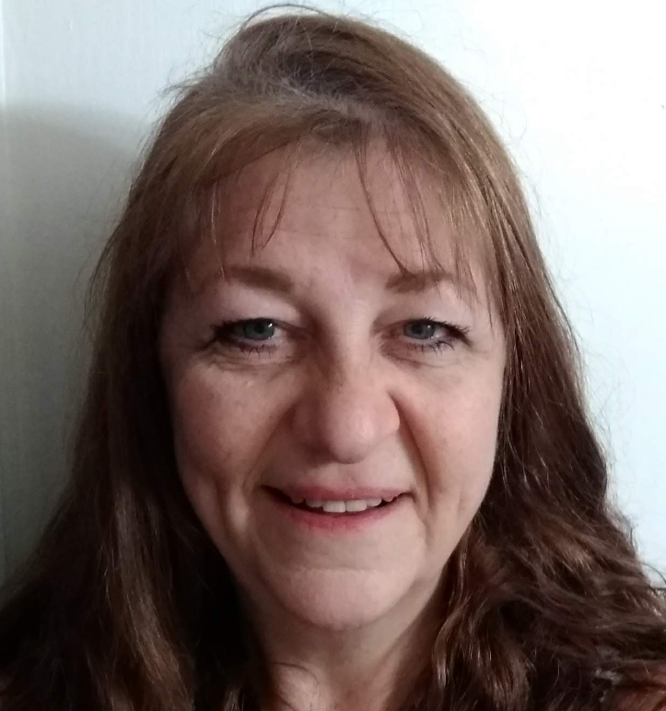

Webinar Host, Tech Support and Presenters
Kim Reykdal
Program Supervisor Lead, Secondary School Counseling
OSPI
kim.reykdal@k12.wa.us
Christina Winstead
Assistant Director for Outreach
WSAC
ChristinaW@wsac.wa.gov
Yokiko Hayashi-Saguil
Program Associate, College Access and Support
WSAC
YokikoH@wsac.wa.gov
Ronnie Larson
Webinar & Clock Hour Rockstar
Administrative Assistant
OSPI
ronnie.larson@k12.wa.us

Slide 6
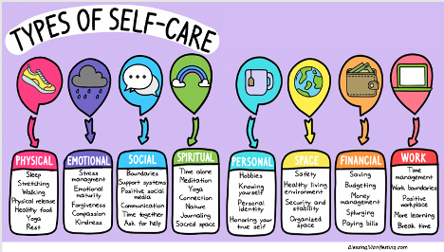

Take care of your seniors and take care of YOU too!
This Photo by Unknown Author is licensed under CC BY
This Photo by Unknown Author is licensed under CC BY-SA-NC

Slide 7

You can’t fill others’ cups if yours is empty

Slide 8
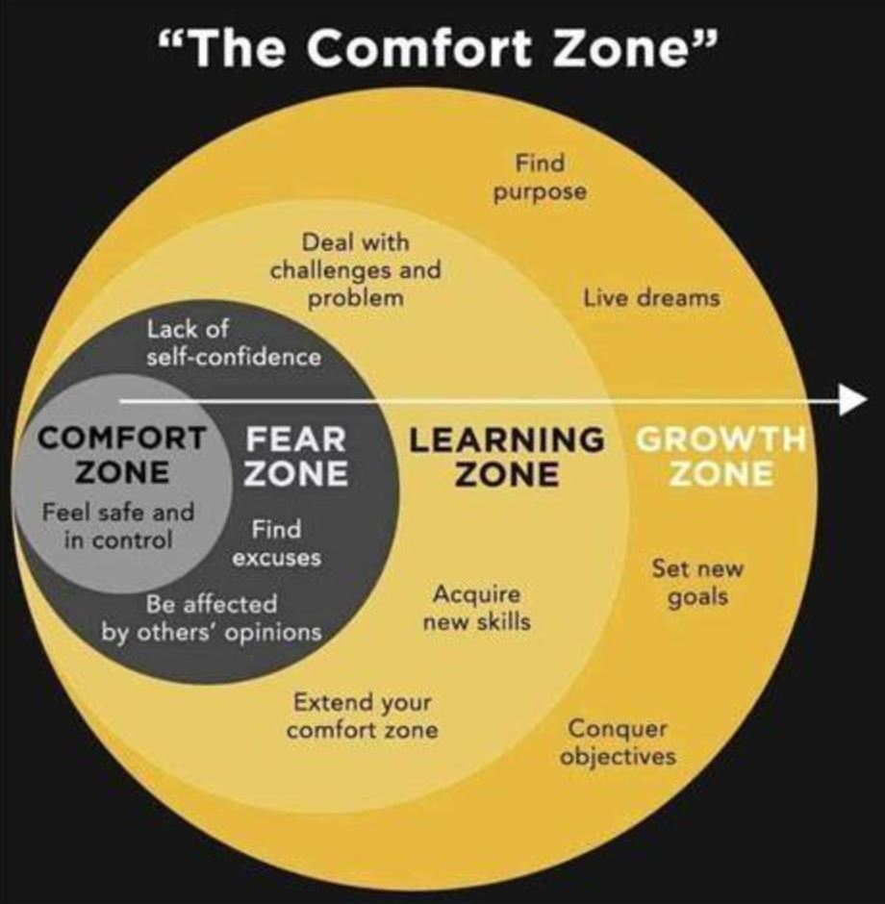
Objectives
Understand related recent & NEW! 2020 legislative requirements
Updates on processes and best practices for helping seniors complete financial aid applications
Get resources & support!
9/23/2020 | 8

Slide 9

Keeping Equity at the Center
How can you use the HSBP and Financial Aid Advising Day to improve college accessibility gaps?
How can previous practices be updated to put equity at the center of all your CCR services and supports?
Notes:
Remember the Class of 2020 has the waiver.
Use your data: which of these pathways would your students have qualified last year? How many of your students haven’t yet met the requirements of at least one pathway? Will they need the waiver?
What about your junior class? What additional access does your district need to secure for 2021?
Remember what it will take to make sure students with IEPs have equitable access to the pathways.
Think ahead: what story does your district want the data to tell? When OSPI has to report on disaggregated data about which of our students are accessing which of the pathways, how do you want that to look?
How can you leverage this move district goals around equity, access to CTE, equivalencies, enhanced community relationships?

Slide 10

High School & Beyond Plan (HSBP) and Financial Aid Updates
This Photo by Unknown Author is licensed under CC BY
Notes:
Yokiko

Slide 11
HSBP Updates [HB1599 & SB6141]
Requirements Since 2016
Added by HB1599 (2019)
Info about federal & state financial aid (7 specifics)
Students with IEPs get same HSBP planning, with similar staff, as classmates
10th Grade HSBP Update: SBA scores* must inform 11th grade course choices
Starts by 8th grade
Career Interest Inventory
Career Goal(s)
Educational Goals
Dual Credit
College Bound Scholarship
CTE Equivalency Courses
Support classes (if needed)
Academic Course Plan
Résumé/Activity Log
Acad. Accel. by 2021-22
SB6141 (2020)
Financial Aid Advising Day
by 12/1 annually
WSAC Rocks! ☺
* School Closures negated the ability to use SBA scores to inform junior year courses for the Class of 2022

Slide 12
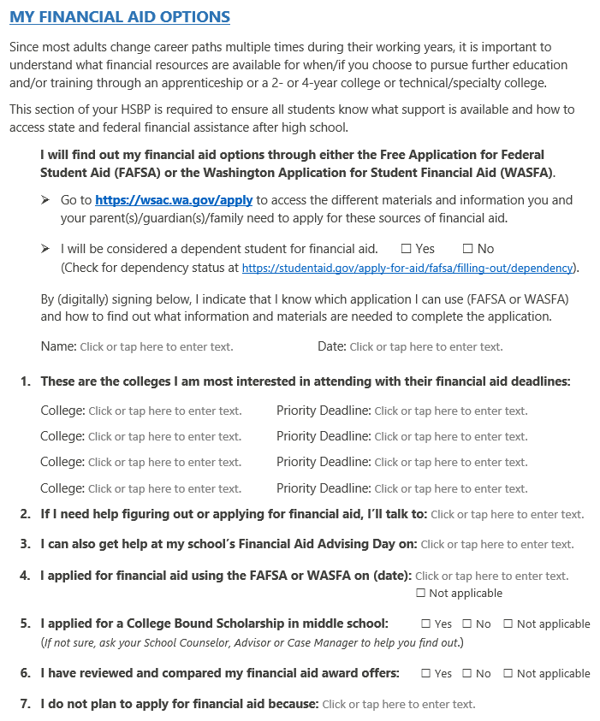
HSBP Template Update
Class of 2021
HSBP Template
Attestation
FAAD info.
9/23/2020 | 12

Slide 13
Equity in Connecting Students with IEP’s
HSBP
IEP Transition Plan
Starts in 7th or 8th grade
Student generated/student facing
Reviewed and updated yearly
State graduation requirement
Usually School Counselor or Advisor facilitated
Guides course choices and school/community activities
Must be in the IEP year that the student turns 16
IEP team generated
Reviewed and updated yearly
Federal requirement (IDEA)
Case Manager/team facilitated
Measurable outcomes
Guides all activities of the IEP
Guidelines for Aligning HSBPs and IEP Transition Plans
High School and Beyond Plan IEP Transition Checklists for Educators

Slide 14
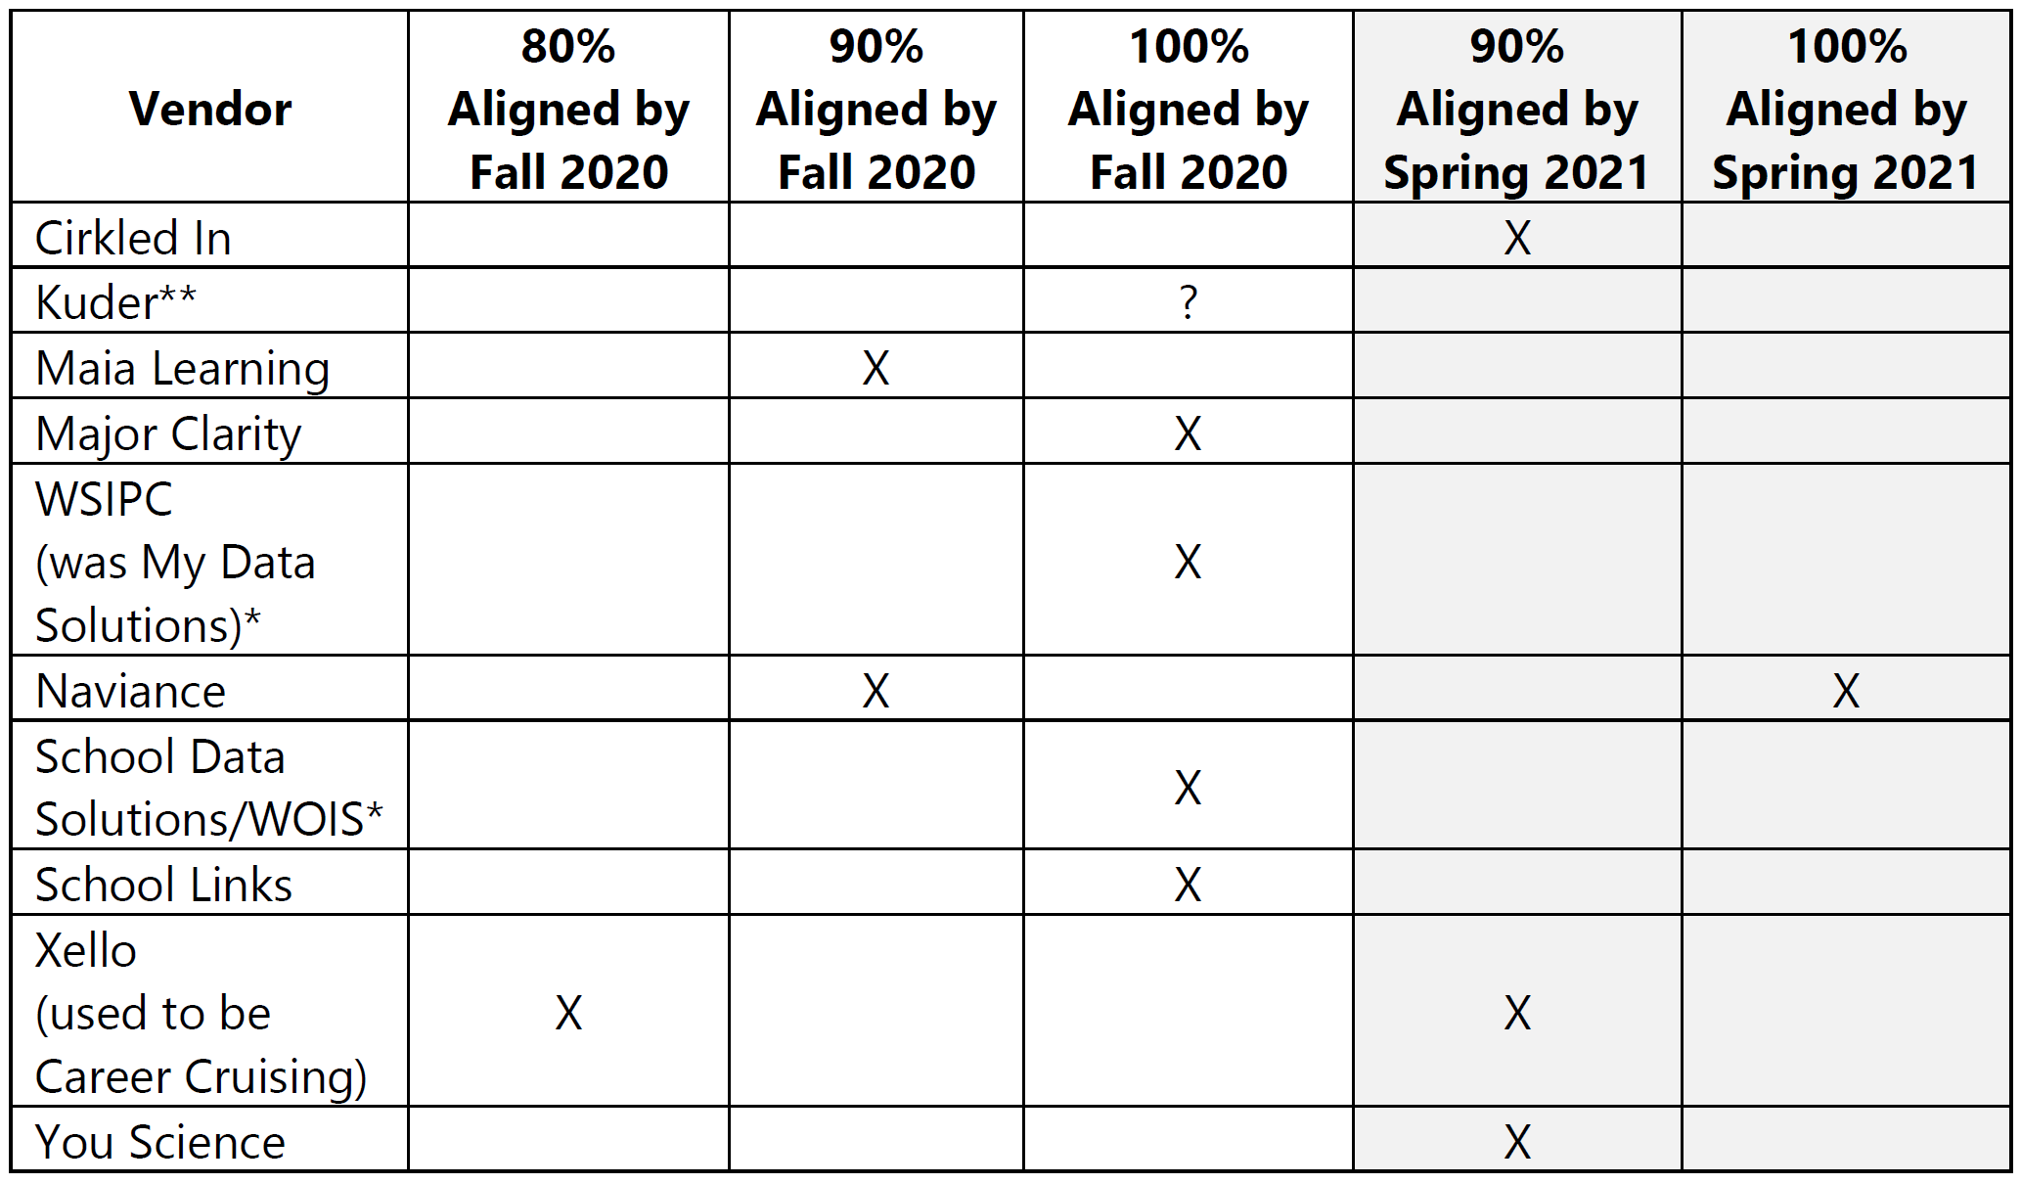
Online Vendors List Update
By 2020-21, all schools are required to provide every student with access to an online HSBP platform
OSPI was tasked with creating a list that matched criteria established by legislators, but SCHOOLS DO NOT HAVE TO USE VENDORS ON THIS LIST
See OSPI’s Bulletin 041-20 for more details and information

Slide 15


HSBP Data to Support College Decisions
Hello ___________,
You are receiving ___________ scholarship information because going to college is a goal in your High School & Beyond Plan. Please contact me ________ if you have questions or need help.
Hello _________,
You are receiving an invite to this virtual college tour because you’ve saved WSU in your High School and Beyond Plan….. (Go Cougs! ☺)
9/23/2020 | 15

Slide 16

Virtual CCR Counseling Resources
Parent Engagement Drives Rising Achievement
10 Ways to Build Excitement for College App Events (article)
GEAR UP Resources for Educators
Supporting Students in Building their College List (webinar)
Support Seniors Virtually Through the College Admission Process
PNACAC Virtual College Fairs
(Reg. opens 9/15)
ASCA’s Virtual Counseling Toolkits
School Counseling and MTSS (webinar series)
ASCA’s Race and Equity Resources

Slide 17

Financial Aid Basics and Updates
Notes:
Yokiko

Slide 18
Why Financial Aid?
Nationally, seniors who complete a financial aid application are 84 percent more likely to enroll in postsecondary education.
The rate is even higher for students from lower‐income families.

Slide 19
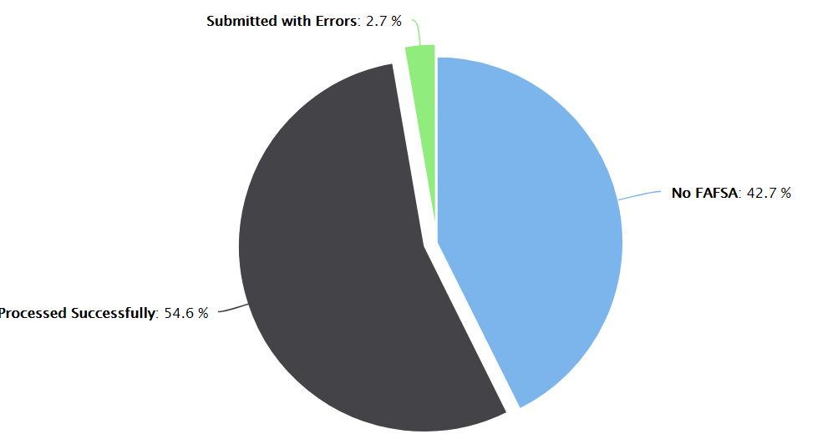

Nearly Half of WA Seniors Didn’t Complete a FAFSA
WA Public HS Seniors FAFSA Completion 2019-20
Submitted with Errors 2%
No FAFSA 46%
Processed Successfully 52%
www.wsac.wa.gov/fafsa-completion
Notes:
Yokiko
As of the end of August
As we’ve spoken about … FAFSA is an important part of accessing all of the programs we’ve just spoken about. Some students may complete a WASFA.

Slide 20
Key Concept Overview
FAFSA/WASFA: Rule of One
State vs. Federal Programs and Updates
The Umbrella
Notes:
Yokiko

Slide 21

Financial Aid As An Umbrella
Grants
Scholarships
Loans
Work Study
Income-based, federal, state and institutional.
Merit and income-based, from public, private, and nonprofit sources.
Income-based, federal and private.
Income-based, federal, state and institutional.
Notes:
Yokiko
Key takeaway: Financial aid is not solely one “thing”.
Four main types of financial aid
Grants
Scholarships
Loans
Work study
Within each of those there may be federal, state, institutional and private options.

Slide 22

Umbrella Term - Undocumented Students
Non-citizens who meet Washington residency requirements (HB1079).
Non-citizens with Deferred Action for Childhood Arrivals (DACA), a federal status(expired or not).
Non-citizens who do not meet state residency requirements.
Notes:
Yokiko
Key Message – there are financial resources, including state aid, for undocumented students.
HB 1079 was a 2003 state law that outlined residency for in-state tuition purposes (additional info: three years in the state prior to HS grad/GED, HS grad/GED from WA, etc)
DACA is a federal status – not a requirement for state financial aid programs but it can be a way students can meet a residency requirement – expired or valid
Undocumented students who do not meet any type of WA residency requirement (i.e. perhaps new to the state). These students do not qualify for state financial aid.

Slide 23
FAFSA/WASFA: Rule of One
FAFSA
Free Application for Federal Student Aid
FAFSA.gov
WASFA
Washington Application for State Financial Aid
ReadySetGrad.org/WASFA
OR
Notes:
Yokiko
Only complete one application.
Fill out the FAFSA if you are eligible for federal aid (i.e. US citizen/permanent resident) and this will also be used to determine state aid eligibility
If you are ineligible for federal aid due to immigration status or you did not register for selective service but you are eligible for a state financial aid program (i.e. are an undocumented student – MORE TO COME ON THIS IN A FEW MIN), complete the WASFA. Some colleges may also use WASFA in place of a FAFSA when calculating institutional/college aid.
Additional info:
WASFA for college aid: If a student doesn’t meet residency eligibility for WCG, or doesn’t have a CBS app…not really eligible for state aid, a college (typically 4 year privates) may need an EFC for school scholarships.

Slide 24

Takeaway: FAFSA and WASFA in October
Fill out 2021-22 FAFSA or WASFA
Using 2019 Taxes
OR WASFA
Notes:
Yokiko
Notes:
2021-22 FAFSA and WASFA available October 1, 2020 (coincides with admissions applications)
Families use 2019 taxes
Apply as early as possible to maximize financial aid opportunities. Some programs are not fully funded which means some eligible students may not receive funding.

Slide 25

Federal Financial Aid Programs
Pell Grant
Federal Work-Study
Unsubsidized/Subsidized Student Loans
Parent Loans
Notes:
Yokiko
Key takeaway:
As we talked about…FA is an umbrella term. Two main sources of financial aid are federal (US Dept of Ed) and Washington State (for residents/for WA schools).
These are some examples of Federal programs.

Slide 26


Washington State Financial Aid & theWashboard.org
Washington College Grant
College Bound Scholarship
State Work-Study
Passport to Careers
Opportunity Grant
Notes:
Yokiko
Key takeaway:
The Washington Student Achievement Council administers the majority of the state’s student financial aid programs, which are known collectively as Opportunity Pathways. These programs help tens of thousands of students annually earn college credits, certificates, and degrees.
Last program is administered by the SBCTC but is considered state aid.
TWB – WA scholarship search engine. Last year over $11.9 million dollars in scholarships were listed on TWB.

Slide 27
2021-2022 FAFSA Changes
Parents that have multiple students who need to file an application may be eligible to transfer their FAFSA information into a new application from the original student’s confirmation page.
The Schedule 1 question and associated help text that appear in the Parent Financials and Student Financials sections of the FAFSA form have been revised. Can now be transferred in DRT.
Federal Student Aid is releasing a new version of the myStudentAid mobile app.
Notification Center – View and manage notifications regarding your student aid.
Dashboard – Access various types of popular tasks and a personalized page to help you determine what actions to take.
2021-22 FAFSA

Slide 28
Common FAFSA Mistakes
Legal information: Name, Social Security Number
Correct FAFSA Year
Correct Year Tax information
Using the correct parent information for dependent students
Parent using 000-00-0000 if the don’t have an SSN
Not finishing the financial aid process

Slide 29
Verification
There are many reasons students are selected for verification
Random/standard practice
Clarify information
Important for students to pay attention to requests
Different schools have different ways of communicating (e.g. email, portal)
Send in requested items as soon as possible
Resources: ASK QUESTIONS!
Don’t be afraid – admissions and financial aid staff want to help!
Notes:
This is a common occurrence and doesn’t necessarily mean a student did something wrong. It is important to provide the information requested and to ask questions!

Slide 30
Special Circumstances
Families financial circumstances may have changed since 2019.
Students will need to contact the financial aid department of the colleges they apply to notify them of an income change.
SwiftStudent is a free tool that helps students understand appeals and provides templates for writing a financial aid appeal letter.
This tool does not share user data with third parties.

Slide 31












Types of Appeal Templates via SwiftStudent
Ask the financial aid office to exclude parental information when they calculate my financial aid
Ask for financial aid to cover my child care costs
Ask for financial aid to cover expenses associated with my disability
Ask for more financial aid if my financial situation changes after I fill out the FAFSA
Ask for financial aid to cover my dependent care costs
Ask for my financial aid to be reinstated if I miss Satisfactory Academic Progress (SAP) requirements
Ask for more financial aid if FAFSA does not capture a financial difficulty I am currently facing
Ask for financial aid to help with a car repair
Ask for additional help if I have a financial emergency
Ask for financial aid to cover a computer or other supplies that I need for school
Ask for financial aid to help with food or housing
Ask for an extension if I miss a financial aid deadline

Slide 32

CSS Profile
The CSS Profile is an online application that collects information used by nearly 400 colleges and scholarship programs to award non-federal aid.
The fee for the initial application is $25. Additional reports are $16. Fee waivers are available
For more information go to cssprofile.collegeboard.org
Notes:
The CSS Profile is an online application that collects information used by nearly 400 colleges and scholarship programs to award non-federal aid. Some students might by required to complete the profile to be con
https://profile.collegeboard.org/profile/ppi/participatingInstitutions.aspx

Slide 33

Financial Aid Advising Day

Slide 34
What is ESSB 6141?
Requires school districts with high schools or serving high school seniors to administer financial aid advising day with information sharing requirements contained in the High School and Beyond Plan (HSBP).
Requires that the HSBP include information about the Washington College Grant and other scholarship opportunities.

Slide 35
ESSB 6141
Financial Aid Calculator
Allows students to estimate Pell and WCG eligibility for all 4-year public institutions
Alignment of Financial Aid Award letters
2-year & 4-year, public & private colleges, & WSAC will collaborate to determine clear and consistent definitions for financial aid award letters.
Colleges will adopt uniform terminologies and templates so students can easily compare them
Financial Aid Advising day
Starting in 2020-2021 all districts with a high school must provide a financial aid advising day between Sept. 1 – Dec.1
Estimate aid based on student & family circumstances
On WSAC website

Slide 36
What you need to know
Schools or districts will need provide financial aid information and host a financial aid advising day before Dec. 1st.
There are resources and information available – You don’t have to reinvent the wheel.
There is alignment between the HSBP, the 12th Year Campaign, and other resources you can use during your event.
Virtual statewide financial aid events will be available.

Slide 37
ESSB 6141 District Examples
Examples of District Information Requirements
Eligibility for Washington College Grant
Information on financial aid applications and CSS Profile
New financial aid calculator
www.wsac.wa.gov/12th-year-campaign
Notes:
A financial aid advising day is an opportunity to provide every senior and their family with key resources and knowledge for completing the financial aid application process. Per ESSB 6141, districts with a high school must provide both a financial aid advising day and notification of financial aid opportunities at the beginning of each school year to parents and guardians of any student entering the twelfth grade. The notification must include information regarding:
The eligibility requirements of the Washington College Grant
Information on resources, such as the CSS profile and new financial aid calculator
Any community-based resources available to assist parents and guardians in understanding the requirements of and how to complete the free application for federal student aid (FAFSA) and the Washington application for state financial aid (WASFA)
The district’s process for opting out of the financial aid advising day
The full requirements of the financial aid advising day can be found in ESSB 6141
WSAC’s new 12th Year Campaign site is a one-stop shop for support for this initiative

Slide 38
ESSB 6141 Notification Requirements
Notification Requirements
School time, encouraged to support filing events with families outside of the school day
District process for opting out

Slide 39
ESSB 6141 Resources and Assistance is available
Assistance
Many already doing similar work! Partner with other schools in your district.
12th Year Campaign resources and statewide hosted financial aid completion events

Slide 40
Financial Aid Advising Day Event Options
Host your own event
Host a districtwide event
Co-host an event with WSAC

Slide 41
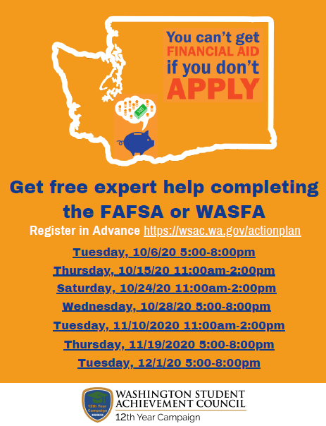
12th Year Campaign Statewide Financial Aid Events
Open to all students
Attendees must register in advance
Hosted on Zoom
12th Year Sites are invited to co-host an event with us.

Slide 42
Co-Hosting Statewide Financial Aid Events
Register as a 12th Year Site
Select Your Event Date
Designate a site lead and which staff will be assisting with your event
Order Your Materials
Training and Action Planning
Choose from the available dates which one you would like to co-host and register online
We have digital and physical resources available for distribution to your students
FAFSA/WASFA line by line
Action planning sessions are available
Connect with your Volunteers
Connect with your volunteers and have them register online to support your event.

Slide 43
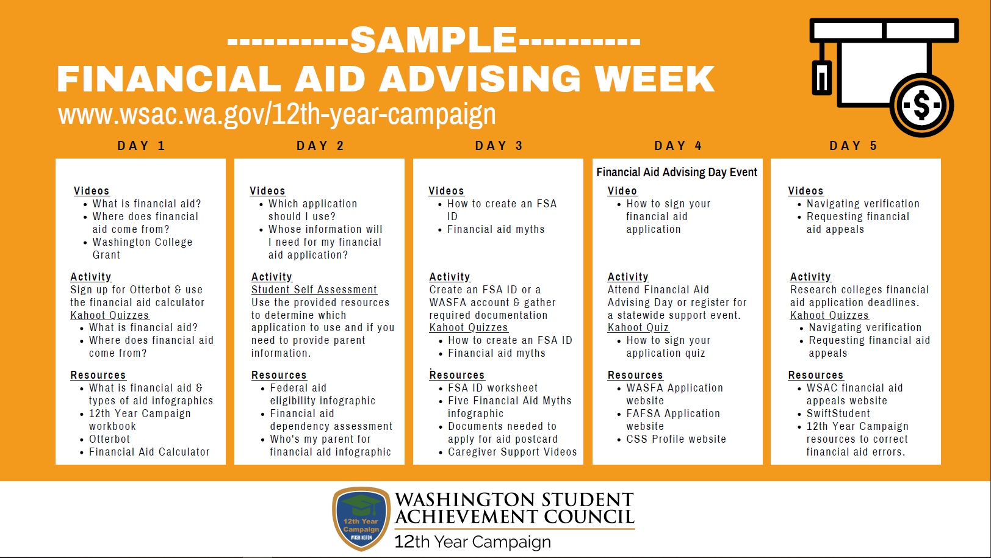
Financial Aid Advising Week: Sample Schedule

Slide 44

Resources & Best Practices

Slide 45
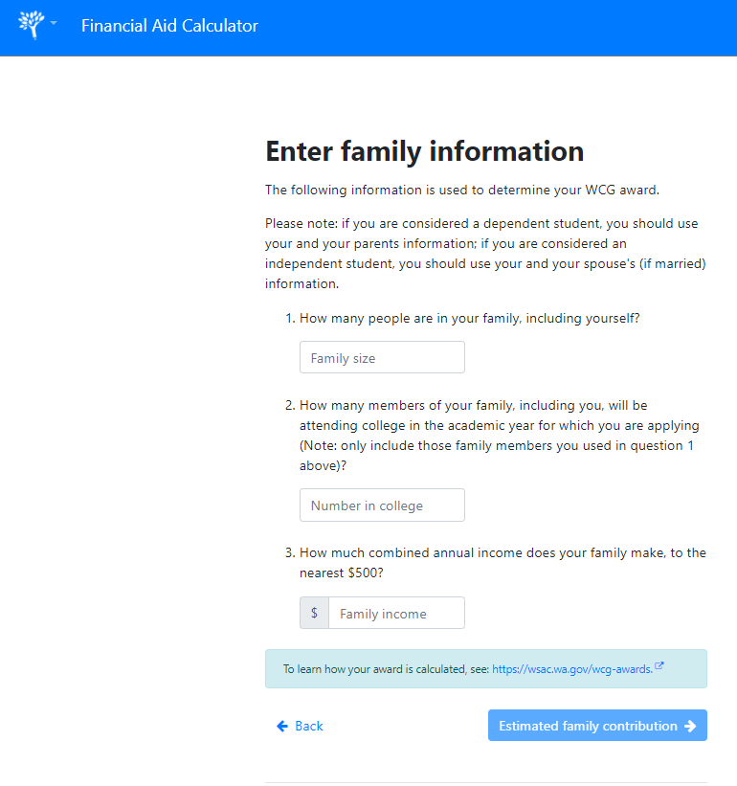
Resource: State Financial Aid Calculator
This tool calculates potential awards from the Washington College Grant and Pell Grant programs.
There may be more aid available to you from other state and federal programs, private scholarships, or directly from the college you attend.
The only way to know for sure how much financial aid you can receive is to complete a FAFSA or WASFA financial aid application
portal.wsac.wa.gov/a/aid-calculator
Notes:
New Resource - This tool calculates potential awards from the Washington College Grant and Pell Grant programs. Note: The FAFSA4Caster will be discontinued beginning 9/24/20

Slide 46

Resource: 12th Year Campaign
Free Materials and Training
3 models of participation to fit your needs
FAFSA Completion Portal
Student-level FAFSA status data
www.wsac.wa.gov/12th-year-campaign
Notes:
Takeaway: 12th Year Campaign is a resource for a ALL of the information we’ve just spoken about and can help you with the requirement that financial aid information be disseminated via the HSBP (1599) and financial aid advising day. Free materials, that ship within 14 days and trainings are online (YouTube). Multiple ways to participate in 12th YR – varying levels of support depending on what you need. New site has links to activities, resources and whatever else you’ll need!
.
FAFSA portal: district needs to have a data sharing agreement in place…districts sign; Non Disclosure Agreements for users to get a portal account.
Additional info: if someone wants their district’s data sharing agreement, email FAFSA@wsac.wa.gov to ask.
Material questions: Contact Christina Winstead, christinaw@wsac.wa.gov

Slide 47

Resource: Otterbot Texting Service - Help with Financial Aid
Students can access Otterbot via text message 24 hours a day, seven days a week by texting "Hi Otter" to
360-928-7281.
www.wsac.wa.gov/otterbot

Slide 48

Resource: College Knowledge
Develop in collaboration with OSPI, PSCCN, Road Map Project, WSAC, and WCAN
Digital Resource: https://www.wcan.org/college-knowledge/
Physical copies in Spanish and English can be order from 12th Year Campaign

Slide 49
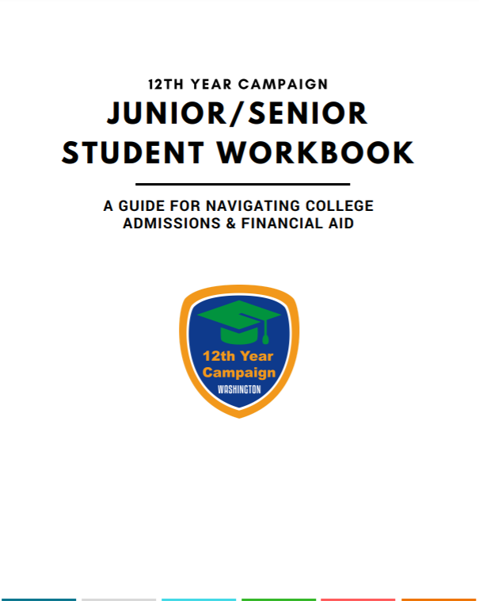
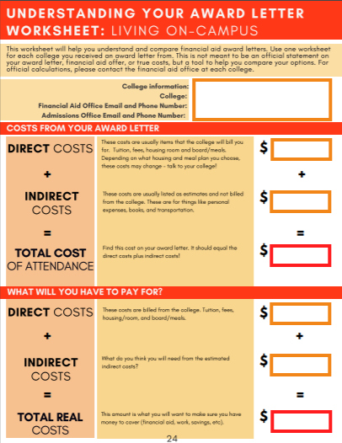
Resource: Junior/Senior Student Workbook
https://readysetgrad.wa.gov/12th-Year-Resources

Slide 50
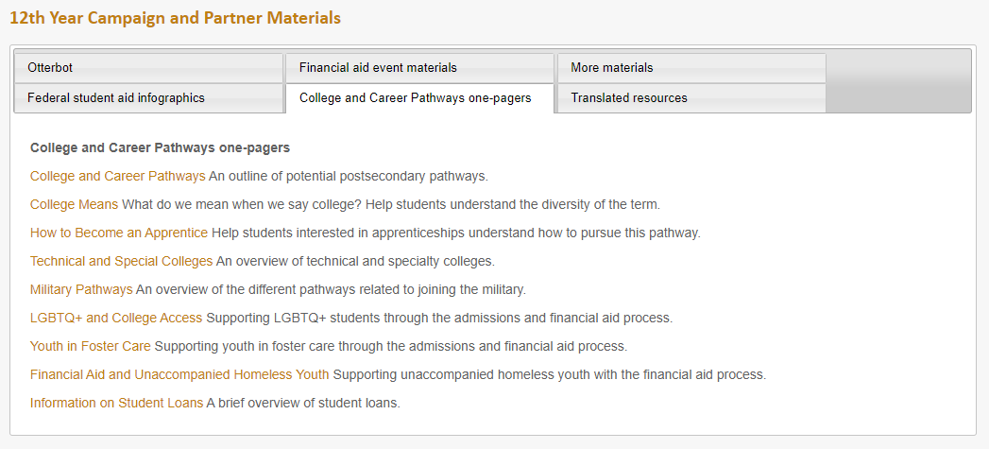
Resource: College and Career Pathways One-Pagers

Slide 51
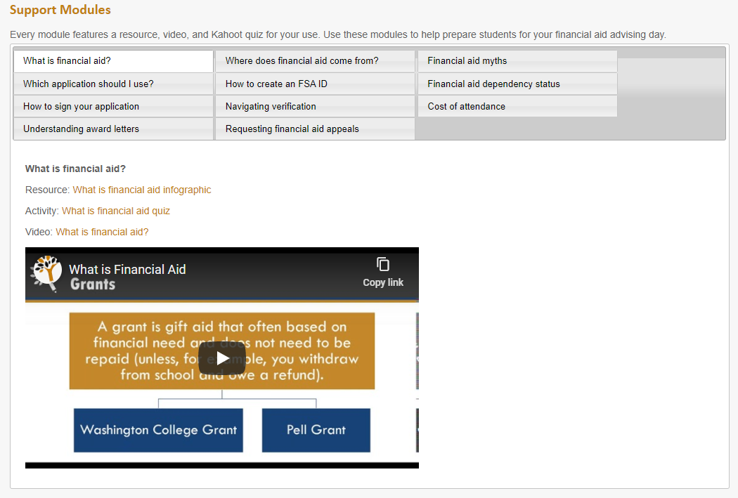
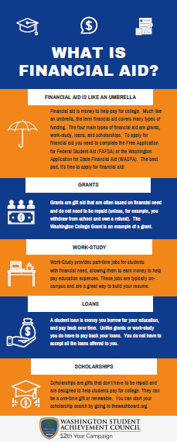
Resource: Student Support Modules
Short Video
Resources
Quiz or Activity

Slide 52
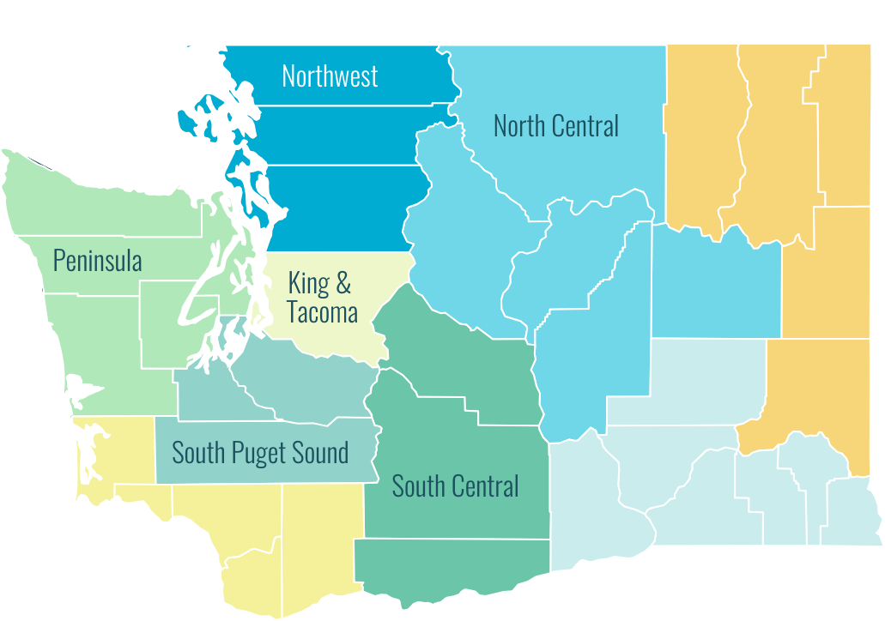
Resource: WCAN Regional Officers
Materials for your students
Student Engagement Initiatives
College Knowledge Book & Handouts
College Map
College Bound Repledge Booklets
College Bound Scholarship Sign Ups
FAFSA/WASFA Completion
College Bound Repledge
https://www.wcan.org

Slide 53
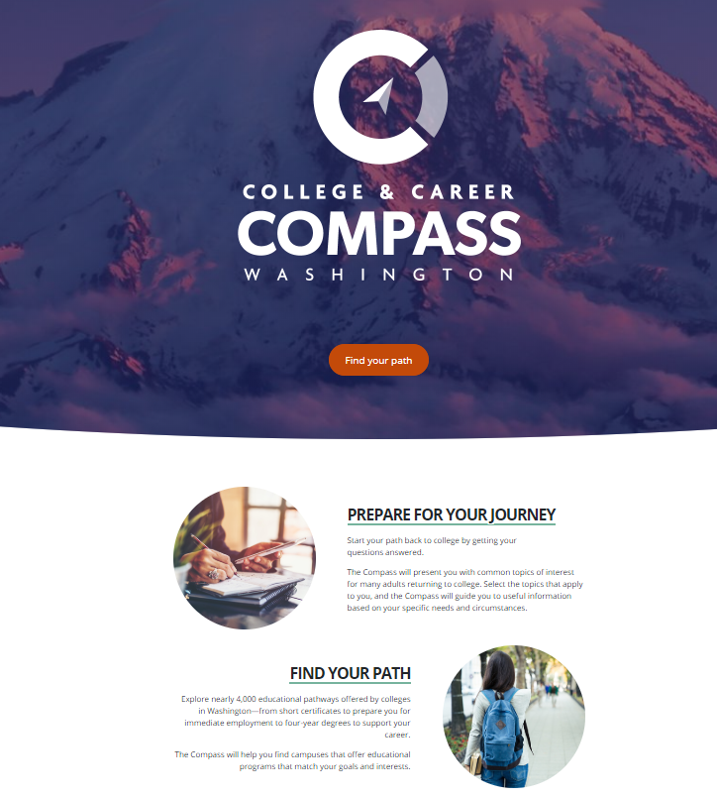
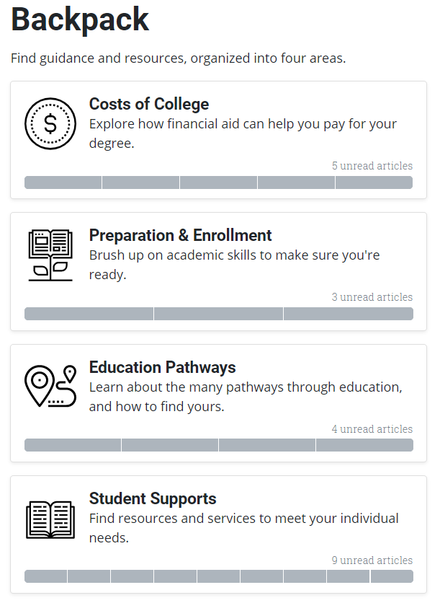
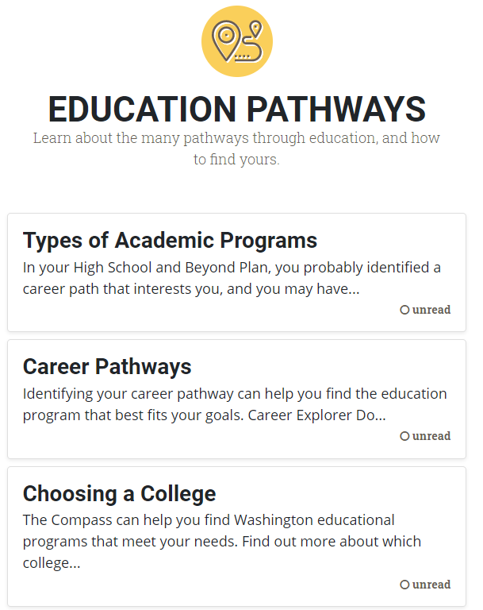
Resource: College & Career Compass
https://compass.wa.gov/

Slide 54
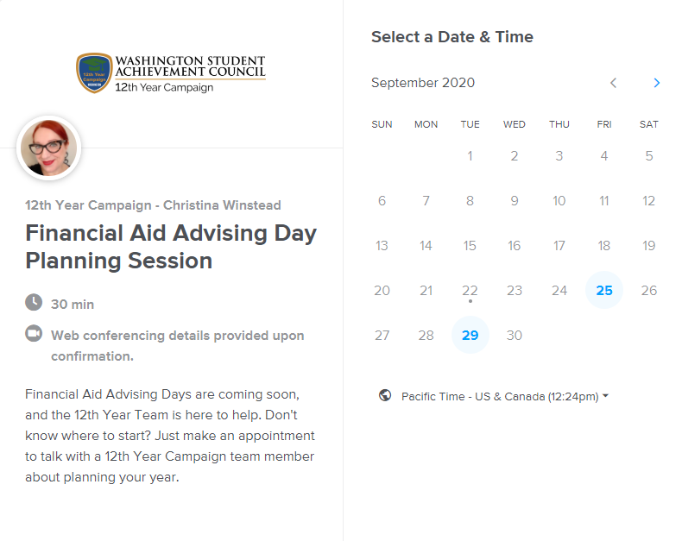
Resource: Financial Aid Advising Day Planning Sessions
https://calendly.com/12thyear/planning

Slide 55
Best Practices
These are Financial Aid events, avoid using “FAFSA” exclusive language. Students in Washington have two options, using “Financial Aid Event” includes both options available.
Don’t assume which application is appropriate for students. That’s for them to determine with their families.
Translated materials are available in many languages.
Partner with other high schools in your district.

Slide 56

Supporting Key Student Groups
Supporting Former Foster Youth and Unaccompanied Homeless Youth
Passport to College Promise Scholarship
Comprehensive supports from high school to higher education
Passport to Apprenticeship Opportunities
Career-related training under state approved pre-apprenticeship and apprenticeship programs
Notes:
This program supported 825 students in 2019-20 with over $2.9 Million in scholarships awarded. An additional $984, 000 was sent to institutions for support services to eligible students.
Expanded to include support for apprentices, administered by ANEW.
Effective July 1, 2020, the age timeframes align with the FAFSA age required in foster care
Monitor our Ready Set Grad website (foster care site) for the most recent updates for this program; also the Program guide is on the wsac.wa.gov/passport/guide and information will be on your key flash drives available today
Students may ask for assistance in obtaining their McKinney Vento confirmation if applicable.
Additional program information can be on www.wsac.wa.gov/passport or www.readysetgrad.wa.gov/passport
Back pocket: Passport grid for technical questions

Slide 57
Supporting Key Student Groups
Supporting Undocumented Students
You don’t have to be a U.S. citizen to get state financial aid or resident tuition in Washington.
Undocumented students should assess themselves for WASFA eligibility.
Not all undocumented students will be eligible for state financial aid.
If a student is not eligible, they can still apply for scholarships. The Beyond Dreaming Scholarship Resource guide has 37 pages of scholarships with no citizenship status required.
Notes:
This program supported 825 students in 2019-20 with over $2.9 Million in scholarships awarded. An additional $984, 000 was sent to institutions for support services to eligible students.
Expanded to include support for apprentices, administered by ANEW.
Effective July 1, 2020, the age timeframes align with the FAFSA age required in foster care
Monitor our Ready Set Grad website (foster care site) for the most recent updates for this program; also the Program guide is on the wsac.wa.gov/passport/guide and information will be on your key flash drives available today
Students may ask for assistance in obtaining their McKinney Vento confirmation if applicable.
Additional program information can be on www.wsac.wa.gov/passport or www.readysetgrad.wa.gov/passport
Back pocket: Passport grid for technical questions

Slide 58
Next Steps
Convene your team
Make a plan
Continue the conversation
Who needs to be at the table for this work? Can you partner with other schools/organizations?
Decide how you will inform your students & their families of their financial aid opportunities. Determine how you will provide a financial aid advising event.
Make a plan to support students throughout the financial aid cycle.

Slide 59

Key to Success: Order Yours Today!
Pre-loaded and updatable with tools and resources.
Visit www.wsac.wa.gov/12th-year-campaign to request your key!
Notes:
Key takeaway:
Literally.
Resources we’ve been talking about are on there. Thumb drive will automatically upload every time you plug it into a computer with internet access. Come visit to get one!

Slide 60

Christina Winstead
Assistant Director, 12th year Campaign
Christinaw@wsac.wa.gov
Yokiko Hayashi-Saguil
Program Associate, College Bound Scholarship
Yokikoh@wsac.wa.gov
Contact Us

