Slide 1
Welcome!
https://cdn1.vectorstock.com/i/1000x1000/92/25/welcome-paper-poster-with-colorful-brush-strokes-vector-21849225.jpg
While we wait for others to join, please introduce yourself by entering the following into chat:
Your Name.
Your School and/or District.
The grade level/band you support.
Notes:
Thank you so much for joining us today. We will be starting in a few more minutes. As people are getting connected, please share in the chat box your name, your school and/or district affiliation, and the grade level/band you support. We are so glad you are here!

Slide 2
Land Acknowledgement
Notes:
Today, those of us representing OSPI respectfully acknowledge that the agency is located on the traditional lands of the Squaxin Island Nation - Descendants of the maritime people who lived and prospered along the shores of the southernmost inlets of the Salish Sea. We ask each of you to show gratitude to the Tribal Nations where you are currently located.
We acknowledge the commitment of all Pacific Northwest Tribes to the resurgence of their traditional ways and their respect and protection of all peoples, not only those who are living, but also those who have gone before and who are yet to be born. We pay our respect to the elders both past and present and to a valued resource the Tribes have defined as their children. They are the Tribes future. They are the future for us all.
We raise our hands to all sovereign Tribes who have stewarded these beautiful lands throughout the generations.

Slide 3
Cultural Acknowledgment
We acknowledge the pain and trauma resulting from these past months and over 400 years of racism in the United States.
We stand with our communities of color, especially those who identify as and/or are categorized as African-American. We are committed to centering our work to dismantle structural racism.

Slide 4
AESD/OSPI LRE Case Studies Series – 1 of 3
September 16, 2020
Tania May
Director
tania.may@k12.wa.us
Alexandra Toney
Program Supervisor
alexandra.toney@k12.wa.us
Dr. Rebecca Lynn
Program Supervisor
rebecca.lynn@k12.wa.us
Notes:
Introductions

Slide 5
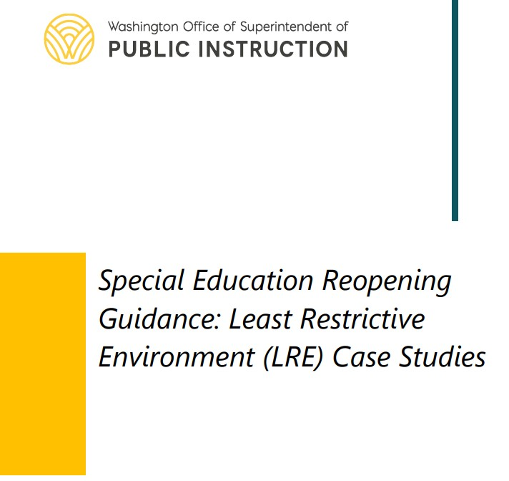
LRE Case Studies Resource
IEP Guidelines
LRE Requirements
Settings across Reopening Models
Accommodations & Modifications
Parent Engagement & Support
LRE Case Studies
Elementary
Behavior
Secondary Transition
Early Childhood
https://www.k12.wa.us/sites/default/files/public/specialed/pubdocs/LRE-Case-Study.pdf
Notes:
Today is the first of 3 webinars in a weekly series. The series will focus on an overview and deeper dive into the case studies from our LRE Case Studies resource. The resource is linked on this slide. We’ll also be sharing strategies and resources and addressing questions throughout, as time allows. Please feel free to add your questions to the Q&A at any time.

Slide 6
LRE Case Studies Webinar Series
Today:
Overview, Elementary,
& Behavior
Sept 23, 3pm:
Secondary Transition
Sept 30, 3pm:
Early Childhood
9/23 Registration Link
9/30 Registration Link
Notes:
Today’s webinar will focus on the elementary and behavior case studies. Next week, we’ll discuss the secondary transition case study with our partners from the Center for Change in Transition Services. The third webinar in the series will focus on early childhood with our ECSE Coordinator, Ryan Guzman.
Darcy sent out the PowerPoint slides this afternoon, including the speaker notes, and these slides also will be posted along with the webinar recordings.

Slide 7
Series Learning Objectives:
Know when an IEP/amendment is necessary (and when it may not be!)
Review strategies for providing instruction and monitoring progress across reopening models
Collaborate to support inclusive access across reopening models, including staff and family supports
Notes:
The objectives for the webinar series include…

Slide 8
Today’s Discussion:
http://clipart-library.com/data_images/141710.jpg
Documenting SDI & LRE
LRE Case Studies
Elementary
Behavior
Instructional Strategies & Progress Monitoring
Q&A – throughout today’s session
Notes:
Today, we’ll start with some framing and considerations for documenting SDI and LRE across reopening models. We’ll have a brief discussion of the elementary case study and a deeper discussion of the behavior case study. We’ll close out today’s webinar with strategies and resources to support instructional strategies and progress monitoring. Rather than a closing Q&A, we can pause for questions as we go. So, let’s get started!

Slide 9
Systems-Level Support for All Students
Universal Screening for all students, including access to distance learning.
Professional Development plans to support all educators with student and family engagement.
Family Engagement and support that is flexible and individualized.
Asynchronous learning options to meet individual student and family needs.
Notes:
Before any consideration of special education programming, it’s important to remember that students with IEPs are general education students first. Our reopening models are new for all educators, students, and families; many of the technical questions we are receiving in our special education office are directly connected to instructional planning for all students at a systems level. While that isn’t our focus for today, it is important for case managers and IEP team members to have knowledge of the universal screenings in place for all students, including with respect to distance or remote learning; professional development opportunities to support all educators across reopening models; flexible family engagement and support; and robust asynchronous learning opportunities. We have included guiding questions and a resource link in the notes page for this slide to support these discussions.
What universal screening is in place to analyze readiness for virtual instruction for all students and families? Here’s an example: https://micourses.org/resources/pdf/toolkit/Interactive_OnlineLearningReadinessRubric.pdf.
What is the ongoing professional development plan to support general educators with student engagement for all students, including students with disabilities?
What family engagement and support are being offered? Many families are feeling overwhelmed. What flexibility in engagement is being offered, including various modalities and times?
How can the universal screening data help educators (and IEP teams, as applicable) develop a parent coaching plan that works better for each family’s situation?
How are asynchronous learning options being developed for all students and families? Not every family may have capability to join scheduled zooms (this is in no way limited to special education).
Are zoom lessons (or portions of content) being recorded, so families can watch with their students at easier times (evenings, weekends)?
What paper-based and/or project-based activities are being offered as back-ups?

Slide 10
Specially Designed Instruction
(c) Specially designed instruction means adapting, as appropriate to the needs of an eligible student, the content, methodology, or delivery of instruction:
(i) To address the unique needs of the student that result from the student's disability; and
(ii) To ensure access of the student to the general curriculum, so that the student can meet the educational standards within the jurisdiction of the public agency that apply to all students.
WAC 392-172A-01175 Special education
Notes:
A quick reminder of the definition of SDI.

Slide 11
Documenting Specially Designed Instruction (SDI)
Documentation | Purpose | Timeline | Action
Annual IEP | District Offer of FAPE | Annual: Must be in place at start of school year | Should reflect current levels of performance and support needs across reopening models
IEP Amendment | District Offer of FAPE | As needed: Can be held without a meeting with parent agreement | Could be used to document temporary changes in services and/or services across reopening models
Continuous Learning Plan (CLP) | District Offer of FAPE | Rare: Only for unplanned, short-term facility closures | If used, update to reflect Continuous Learning 2.0
Notes:
The annual IEP and IEP amendments (if/when needed) should document the district offer of FAPE. IEPs should be implemented as written, based on the needs identified in the current evaluation. Our guidance is to use the IEP and IEP amendment processes to document updates/changes, as necessary. The continuous learning plan (CLP) might be an option in rare cases of short, unplanned, emergency closures that are systemwide.

Slide 12
Identifying Settings Across Reopening Models
SDI can be provided in a general education setting or a special education setting, through synchronous or asynchronous delivery.
In situations where all students in a school or district are participating in a remote learning model, the student's home is the setting from which all students are accessing their instruction. Therefore, generally, the student's home is considered the general education setting.
IMPORTANT: When calculating LRE, the setting in which the student receives services is based on the level of access to the student’s peer group.
Setting does not depend upon the content of the instruction nor the person delivering it.
Just because it is SDI or a related service and is designed by a special education teacher doesn't automatically mean it is a special education setting.
See additional guidance from the IDEA Data Center, an OSEP-funded technical assistance center.
Notes:
Considerations for identifying settings across reopening models are based on guidance from the IDEA Data Center; the original resource is linked on this slide. We’re going to walk through several key points here…

Slide 13
Identifying Settings Across Reopening Models
 | General Education | Special Education
Synchronous | Synchronous online instruction with peers with and without disabilities. | Synchronous online instruction with only peers with disabilities.
Asynchronous | Asynchronous learning activities (prerecorded video, online software available to students with and without disabilities, work packets, etc.). | Asynchronous learning activities (prerecorded video, online software available to students with and without disabilities, work packets, etc.) intended for follow-up discussion only with other students with disabilities.
See additional guidance from the IDEA Data Center, an OSEP-funded technical assistance center.
Notes:
Synchronous means occurring at the same time, and asynchronous means not occurring at the same time. Remember that the definitions of SDI and LRE are not impacted by whether learning is synchronous or asynchronous, nor whether services are provided in person or through distance learning.
This table shows a few examples for how we can think about setting/location across reopening models. Whether instruction is synchronous or asynchronous, the key factor is whether the participating peer group includes only (or primarily) students with disabilities.

Slide 14
Round Up: LRE, SDI, and IEPs (oh my)
IEPs must include the frequency, location, and duration of services.
Location refers to whether the setting is special education or general education (not whether instruction is provided online, in person, or live).
In many cases, the IEP can be implemented as written during remote or hybrid instruction.
IEPs and IEP amendments should document updated present levels, additional need for services, and changes to frequency, location, and duration.
In some cases, an amendment may not be necessary.
Notes:
So, to summarize…
As always, local decisions about when and if and how to document changes should be discussed with your district leadership!
I think now is a good time to pause for questions about identifying and documenting settings across reopening models.

Slide 15
Elementary Case Study: Susan
Notes:
Now, on to our elementary case study. We reviewed this particular case study in an August webinar with WASA. I’m going to walk us through the case briefly today, to demonstrate how we framed the case studies within the LRE Case Studies document. As it’s a relatively simple case study, my plan is to move through this first case quickly, so Alex has as much time as possible to walk you through the more complex behavior case study. Susan’s case study is found on pages 3-4 of the LRE Case Studies document.

Slide 16
Case Study¹: Susan, 3rd grade
Susan will be entering a third-grade class with 26 students at the start of the 2020-21 school year. Per her annual IEP dated 2/20/2020, she receives:
Present Levels update: Susan’s community has experienced an outbreak of COVID-19 and is considering multiple reopening models for the start of 2020-21. Her IEP will be amended to plan for FAPE across all reopening models. During spring 2020, once Susan and her family adjusted to online learning, they reported that Susan enjoyed the format and felt motivated by project-based learning. Susan’s family maintained contact with the case manager throughout the spring and requested some support around use of Zoom and Google Classroom.
Service Area | Frequency |  | Location (setting) | Duration
Math | 150 mpw |  | General Ed | to 2/19/2021
ELA | 250 mpw |  | Special Ed | to 2/19/2021
Speech | 30 mpw |  | Special Ed | to 2/19/2021
Total instructional minutes per week: 1,665 |  | Weekly minutes in a special ed setting: 280 |  | LRE Calculation: 83%
¹Adapted from the NASDSE Brief: LRE in the Wake of COVID-19
Notes:
Our case study for Susan is adapted from an LRE brief developed by the National Association of State Directors of Special Education (NASDSE).
Susan is starting third grade this year, and her district is starting with distance learning and planning ahead for hybrid instruction based on student needs. Her annual IEP, developed before COVID hit, includes…
After an adjustment period, Susan and her family felt relatively good about distance learning and project-based activities in spring 2020.

Slide 17
School Reopening Models
Distance Learning:
Students will participate in a distance learning model for educational services through December 2020 for all students. Instruction will be accessed from the home, with synchronous and asynchronous options, online and with paper-based and project-based activities.
Susan will participate in a distance learning model with her general education third-grade class.
Hybrid Learning:
Students will follow an alternating schedule of 3 days per week in person with physical distancing procedures. The remaining days will be distance learning.
Students groups of no more than 10, with minimal transitions.
Implemented for selected students starting in November 2020, if permitted by health guidelines.
Susan will attend in person 3 days per week and continue with virtual learning 2 days per week.
Notes:
Susan will start with a distance learning format and transition to in-person services 3 days per week starting in November, if permitted by health guidelines. She’ll continue with distance learning 2 days per week.

Slide 18
IEP Team Planning for Susan’s Distance Learning
Math SDI will include asynchronous online curriculum and small-group virtual instruction with the special education teacher and classmates with and without disabilities.
ELA SDI will include asynchronous online curriculum and small-group virtual instruction with the special education teacher and classmates with disabilities.
Speech SDI will be provided in small-group virtual sessions with the SLP and two other students with IEPs.
Accommodations: visual math supports for asynchronous and independent math assignments.
Parent support: District parent training site with videos for Google Classroom and Zoom.
Progress monitoring: IEP goal progress, provider notes, student grades and work samples, and progress on the adapted online curriculum.
Notes:
Each of the LRE case studies includes considerations and decisions made by the IEP team regarding student services. The case studies include examples across reopening models that include service areas and modality; accommodations and/or modifications; parent coaching/support; and progress monitoring considerations.
Note that red text is included to call out specific information, such as a change in setting/location across reopening models.

Slide 19
Amending Susan’s IEP
From Susan’s amended IEP, dated 8/6/2020:
Service Area | Frequency |  | Location (setting)
Math | 150 mpw |  | General Ed
ELA | 150 mpw |  | Special Ed
ELA | 100 mpw |  | General Ed
Speech | 30 mpw |  | Special Ed
Total instructional minutes per week: 1,665 |  | Weekly minutes in special ed setting: 180 |  | LRE: 89%
NOTE:
The total minutes per week of SDI remains the same as the annual IEP.
The location of a portion of the ELA services has changed from special ed to general ed. The ELA services provided through adapted online curriculum is considered a general education setting, per IDEA Data Center (IDC) LRE guidance.
The LRE calculation changed from 83% to 89%.
Notes:
For Susan’s case, the total instructional minutes per week are staying the same, as are her weekly minutes of SDI. Because a portion of her ELA services are changing from a special education setting to a general education setting (asynchronous learning on a software program used by both students with and without disabilities), her IEP amendment has a single change on the service matrix, with a small change to her LRE calculation.

Slide 20
IEP Team Planning for Susan’s Hybrid Learning
Math SDI will include asynchronous online curriculum and in-person instruction with the special education teacher and classmates with and without disabilities.
ELA SDI will include asynchronous online curriculum and in-person instruction with the special education teacher and classmates with disabilities.
Speech, Accommodations, Parent support, and Progress monitoring continue as planned during distance learning.
NOTE: No IEP amendment needed; 8/6/2020 amendment remains in effect.
Notes:
As Susan transitions to hybrid learning starting in November, some of her math and ELA services will be provided in person three days per week. Again, the total instructional and SDI minutes per week remain the same; because she will still access the online software during her distance learning, her fall IEP amendment remains in effect.
We can review a few questions now. I know I went through that example quickly; just remember that my goal for this first run was mostly to show you how we formatted each case study. Alex is now going to go deeper into the next case study, with a focus on behavior.

Slide 21
Behavior Case Study
Notes:
So for the second case study we have Kaleb, If you are following along to make notes in the LRE Case Study document this if found on pages 5-7. This one is more complex than Susan’s example so we are going to spend some more time unpacking it.

Slide 22
Behavior Case Study: Kaleb, 6th grade
Kaleb will be entering a sixth-grade class with 29 students at the start of the 2020-21 school year. Per his annual IEP dated 1/27/2020:
Present Levels Update:
Behavior was a barrier to access instruction and services in Spring of 2020.
Kaleb had difficulties managing his schedule, login requirements and due dates and would become easily frustrated or would “check out”. Kaleb would engage in task avoidance and tantrum behaviors when presented with multiple task demands or unanticipated changes.
Parents would like strategies to support learning in the home environment and to manage Kaleb’s behaviors.
Service Area | Frequency |  | Location (setting) | Duration
Math | 150 mpw |  | General Ed | through 1/27/2021
Social Emotional | 225 mpw |  | Special Ed | through 1/27/2021
Speech | 30 mpw |  | Special Ed | through 1/27/2021
Total instructional minutes per week: 1,665 |  | Weekly minutes in a special ed setting: 255 |  |  | LRE Calculation: 85%
Notes:
This student is a 6th grader who receives the following services under the eligibility category of emotional behavioral disabilities. In his original IEP dated 1/27/2020 He is getting Math SDI in the general education environment and Social Emotional and Speech services in the special education environment
In Spring of 2020 (so instruction provided remotely last year) Behavior was a barrier for Kaleb to access much of the instructional content offered to him. His parents and teacher reported that he had difficulties managing his schedule, log in requirements and due dates and would often check out or engage in task avoidance and tantrums when presented with multiple demands or unanticipated changes.
Keep Spring of 2020 on your mind as we transition to the next slide to talk about the IEP discussion and instructional plan for online learning in the 2020-2021 school year.
(2 minutes)

Slide 23
IEP Team Planning for Kaleb’s Distance Learning
Changes in response to progress data collected in spring of 2020:
Social Emotional SDI will include:
2x per week of online instruction with all students with IEPs on how to utilize a student specific schedule template
Daily check-in from a paraeducator to support schedule use.
1x per week of small group, virtual instruction utilizing a Social Emotional Learning (SEL) curriculum
1x per week virtual social group
Parent Support includes 90 minutes total of parent training (supplementary aid and service) to support the student with a student specific schedule.
Accommodations: shortened assignments, frequent breaks, extended time, embedded behavior expectation prompts and priming for difficult tasks, frequent checks for understanding, use of reinforcement system
Notes:
So Kaleb’s IEP team meet and discussed what the plan for his SDI was for this coming school year. The text on this slide detail some changes that have been made from the original plan to provide services, these changes are in response to data collected in Spring of 2020 and focus on improving Kalebs engagement and behavior.
PAUSE
So lets first talk about the areas that didn’t change. (for simplicity these areas are not on the slide but can be seen in the service matrix on the next slide)
In Math the student will continue to get 90 minutes per week on SDI online in the general education classroom and 60 minutes of small group instruction. No changes here
He will also continue to get small group speech therapy services. No changes
So lets talk about Social Emotional, you can here that some changes have been made to support this student use a student specific schedule template, with some behavior expectations.
This shift includes small group...special education instruction to populate and use a schedule with other students with IEPS. (so this is the special education setting)
The student then has a ten-minute check in each day with the paraeducator to support the student with schedule use, this occurs during a break out room in the ZOOM platform and is functionally similar to a check-in check out procedure students often use with behavior contracts. (this has been coded as the general education setting, because it occurs in the general education zoom setting) (PAUSE)
The student will continue to get SEL instruction in the special education setting for 30 mpw
And will get 30 mpw of a virtual social group. This group includes 3 students with IEP’s and 3 general education students (so this will be marked as the general education setting)
I also wanted to call out that parent training minutes have been added into the IEP as a supplementary aids and service in this example because the intent of the parent training is to support the student in accessing general education instruction. (The transition example in the LRE CASE STUDY PDF also provided an example of how parent training could be added as a related service because the function is about benefiting from special education instruction.)
PAUSES
The IEP team also discussed what Kaleb’s current accommodations are and added some more to support his learning across the reopening models. Some of these accommodations include shortened assignments, frequent breaks, behavior expectations and use of a reinforcement system. You can see the full list of accommodations for this student on the PDF and I wanted to call out that the IEP discussed what was needed and adding some more supports to address student need
So we just went over to some of the changes to this students instructional plan for the upcoming school year. Lets go to the next slide to show how the IEP will be amended.
(3 minutes)

Slide 24
Amending Kaleb’s IEP
From Kaleb’s amended IEP, dated 8/6/2020:
Service Area | Frequency |  | Location (setting)
Math | 150 mpw |  | General Ed
Social Emotional | 80 mpw |  | General Ed
Social Emotional | 90 mpw |  | Special Ed
Speech | 30 mpw |  | Special Ed
Total instructional minutes per week: 1,665 |  | Weekly minutes in special ed setting: 120
SAS | Frequency | Location (setting)
Parent Training | 90 minutes total | N/A
NOTE:
The total minutes per week of SDI remains the same as the annual IEP.
The total minutes per week of specially designed instruction in the area of social emotional have been amended to differentiate between two locations.
The LRE calculation changed from 85% to 93%.
Notes:
So even though the student will be getting the same total number of SDI minutes, and amended IEP was required to document two changes:
The 80 mpw of Social Emotional SDI that have been moved to the general education setting (this includes the 50 mpw of check-in for schedule use and 30 mpw of social group)
The next change that the team needs to document is the Parent training that has been added as a supplementary aids and service because this is part of the districts offer of FAPE
These changes provide Kaleb with the services he needs to make progress across the reopening models and also shifts his LRE calculation from 85% to 93% in the general education setting.
PAUSE
Next slide
(1 minute)

Slide 25
IEP Team Planning for Kaleb’s Hybrid Learning
Math SDI will include:
30 minutes, 3x per week through adapted online curriculum, with asynchronous support.
30 minutes, 2x per week, in the general education classroom.
Social Emotional SDI will include:
30 minutes 2x per week of small group in-person instruction with all students with IEPs, on how to utilize a student-specific schedule template.
10 minutes 5x per week of paraeducator support in the general education classroom to support successful schedule use. During three days of remote instruction these occur in a virtual “break out room”, and as a “check in-check out procedure” for the two days of in-person instruction.
30 minutes 1x week of small group virtual instruction to support social skills and emotional regulation.
30 minutes 1x week of paraeducator lead virtual social groups for small groups with three special education students and three general education students.
Speech and Parent Support will continue as previously planned.
NOTE: No IEP amendment needed; 8/6/2020 amendment remains in effect.
Notes:
Lets talk about the shift to hybrid
Just like Susan’s school, this school will be following an alternating schedule with two to three days per week in person with social distancing and the remaining days using a virtual platform. Starting in November, Kaleb will attend the school in person two days per week and continue with virtual learning three days per week.
This slide details the anticipated instructional plan for the hybrid model. I won't spend too much time here as the instructional plan remains very similar to the previous instructional plan we just went over. The underlining in the slide shows which SDI will occur in person during hybrid model. You can see that the student will get a portion of his math SDI in person, in person support to utilize his schedule and the daily paraeducator check in will occur each day. Meaning three check ins will occur online and two in person.
Notice that even though the student is getting some of his SDI in person that the SDI minutes and location are the same for all services so no IEP amendment is needed.
Next Slide

Slide 26
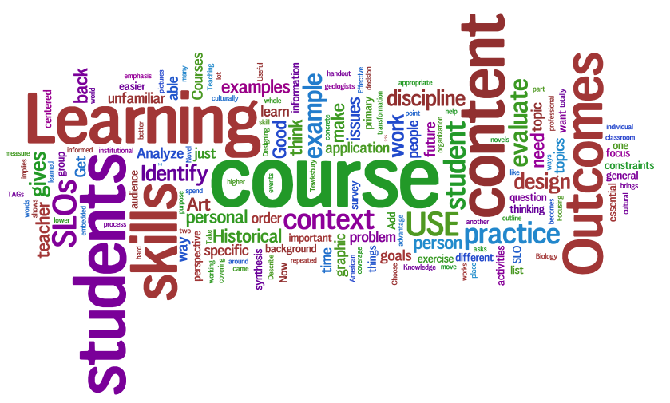
Instructional Strategies
https://p1cdn4static.sharpschool.com/UserFiles/Servers/Server_232884/Image/wordleforteaching.png

Slide 27
Evidence-Based Instruction Across Settings
Clear Learning Objective, displayed visually, in writing, and verbally
Review prior knowledge, stage of learning, and prerequisite skills through pre-assessment, parent input, and technology tools.
Model skill or concept through pre-recorded video, paper examples, physical materials, or in-person using online video, or a white board.
Provide multiple opportunities to practice skill or concept using scaffolds, graphic organizers, and video guidance.
Provide ongoing feedback and check for understanding.
Independent practice and demonstration of skill or concept both offline on own time, and online using pre-made materials, technology software, or video.
Notes:
Evidence-based instruction for students with disabilities are also effective practices for remote learning. High leverage practices include designing instruction toward a specific learning goal, making that goal explicit, review of prior knowledge, modeling, practice with scaffolds, feedback, and independent practice. Universal Design for Learning strategies also encourage teachers to connect learning objectives to student background knowledge, and to use multiple means for helping students recognize the goal, engage in the learning, and demonstrate what they know. All of this is possible with remote learning, and the tools are built into the technology. Teachers can pre-record and share a video stating the objective, modeling the skill or knowledge, and provide directions that can be viewed repeatedly by students and parents. Students can use technology to share what they know or relate to regarding the objective in writing, through speech to text, live, or in a recording. Technology has tools built in such as white boards and graphic organizers. Low tech tools can be combined with higher technology as well, using packets mailed to the family, or instruction printed as pictures.
Parents are essential partners for helping with SDI when available with appropriate with coaching. When physical materials are needed, collaborate with parents to create or receive the materials will be essential. General education teachers are also essential partners for sharing curriculum planning, extending invitations to participate in general education remote classes, and planning adaptations

Slide 28
Strategies/Ideas for Behavior Supports
Consider system strategies for students who need additional support to engage in remote learning:
Develop a student schedule template with embedded links that can be customized with student specific pacing, prompts and reinforcement.
Create parent training videos.
Create peer modeling videos and/or social stories.
Consider establishing intensive, small-group brief instruction for students to learn essential skills to independently navigate remote learning.
Provide parent coaching to support successful transition to the home environment.
Notes:
Systems can utilize behavior and special education teacher expertise to develop behavior support that can be intensified for remote learning as needed.
A schedule template for remote learning could provide structure for many students or be used as extra support for individual students. Schedule templates can be individualized with clickable links, student specific prompts, token systems, and reinforcements such as scheduled fun activities or media access. Once created, paraeducators can support the customization of schedules for individual students.
Another idea is to create training videos for parents to include topics such as how to set up a learning environment, encourage appropriate behavior, provide choices, support students in utilizing a schedule. These can also be developed and archived to use as needed for parent coaching. I am linking a series of 3 parent coaching videos that Lee from our special education office developed, feel free to link to these or to create your own https://www.youtube.com/watch?v=8-mU6rdyAeQ
Peer modeling videos can also be created to support students in understanding clear expectations for online learning. These can include how to ask for help, create an at home learning space, or sign in on time to a virtual class.
For students who need the most intensive behavioral supports (this would be a small number of students), systems could consider bringing in small groups of students to school for a brief period of in-person intervention (i.e., a week or two) to access intensive instruction on independently utilizing a schedule and completing tasks for tokens and exchanging these for reinforcers. Brief, intensive, in-person instruction could be paired with brief parent coaching to support a successful transition back to the home environment.
These are just a few examples of how has a system we can think creatively to address the behavioral needs of our students.

Slide 29
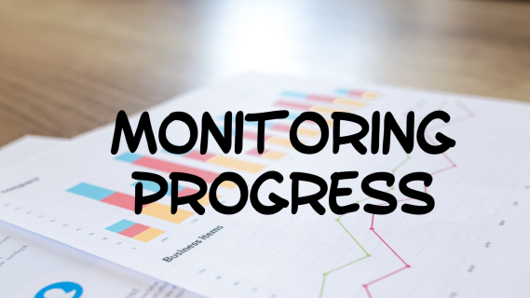
Monitoring Progress
Notes:
https://visioninpracticeblog.files.wordpress.com/2019/05/img_3747.png

Slide 30
Progress Monitoring
#1 Establish baseline and goals
#2 Select or design monitoring tools
#3 Monitor progress regularly (weekly or biweekly)
#4 Review data with team
#5 Continue or change
Continues across all reopening models
Monitor progress on IEP goals and objectives (frequency / duration)
Evaluate effectiveness of instruction and engagement in remote learning
Determine whether the student is making sufficient progress.
Continue instruction or adapt, change or modify materials, goals or intervention as needed
Notes:
Progress monitoring is used to assess students' academic performance, quantify their rates of improvement or progress toward goals, and determine how they are responding to instruction.
Progress monitoring targets particular goals but is also helpful in documenting student engagement in remote learning. It is a circular process that informs the whole team and the family about the effectiveness of instruction and the need to make changes.

Slide 31
Progress Monitoring Data Collection
Due to COVID and virtual learning models, data and progress summary information can be collected with resources available and customized per student goals.
Collect data: combination quantitative and narrative data to evaluate student progress in delivery model, to document IEP progress, to revise services as needed, and to determine the need for individual Recovery Services.
Data sources: report card information, informal assessment data, formal assessment data, district or site-based assessments, educator-made assessments, as well as distance learning activities, including both digital and print-based sources such as tally sheets, work samples, video, audio, self-report, photos of work.
Review of previous data: observations, paraeducator and parent report, spring 2020 data related to IEP goals and remote participation.
Adapted from: IDEA Best Practices during the Covid-19 Crisis
Notes:
There are many resources for collecting data, documenting with data, and reviewing data, even with remote learning.
Quantitative data collection is the process of counting the number of times a behavior or response is observe, the frequency of a response, or the time engaged in an activity. Qualitative data is a narrative that describes details not easily captured in quantitative methods. A combination is often best for capturing a complete picture of what is happening in order to make changes or continue with what is working.
Data for some goals may only be possible when synchronously working with students online to observe responses.
In some cases, families may be able to support data collection during asynchronous learning using data forms, picture, or video work samples, or live report.
Data is all around, but progress monitoring pays attention to data that corresponds to an IEP goal or a particular question about how the student responds to instruction. At the very least, data should be collected about the amount and types of SDI you are providing. Identify goals for progress monitoring, explore sources of data and create forms for documenting new data, then review frequently to monitor the progress and make instructional changes.

Slide 32
Resources for Monitoring Progress
IDEA Best Practices during the Covid-19 Crisis
NCII FAQ on Collecting Progress Monitoring Data Virtually
OSPI Progress Reporting Tip
TIES Center Resources:
Effective SDI within the Distance Learning Environment
Start Now to Plan for Students Transitioning Back to School

Slide 33
Key Practices to Support Online Learning for Students with Disabilities
Ensure digital equity and orientation to tools and platforms.
Maintain reciprocal communication with students and families related to schedules, routines, and expectations, to promote understanding.
Review and reinforce predictable routines for delivering SDI and engagement in synchronous and asynchronous learning.
Develop flexible distance learning and assessment plans based on individual student strengths and needs.
Establish partnerships with families and provide training as well as ongoing support to ensure access to continuous learning.
Collaborate with general education partners to ensure access to general education instruction and inclusive peer interactions.
Adapted from: NCII Supporting Students with Disabilities at School and at Home
Notes:
This list of key practices can be a checklist for educators when developing a remote learning model, and when reviewing and evaluating that model. Consider equity and orientation to the tools to ensure access to instruction.
Ensure students and parents have the resources and the skills to participate in online learning.
Reciprocal communication with the student and families is the best way to share plans and schedules and to learn what works for them.
Predictable routines are good for everyone to maintain a flow that instruction and activities can fall into on a regular basis (one less thing to worry about)
Learning and assessment plans should be flexible so the content or format can be modified for individual students
Parent training and coaching is essential for continuous learning between school and home.
Finally, collaboration with general education partners (and related service providers) is essential for providing a comprehensive and standards-based curriculum alongside peers. Ongoing collaboration with general education teachers can happen online and can be structured around the participation and needs of individual students. Schedules and resources can be shared, and students with disabilities included in the general education remote learning with support, maybe even as online team teachers J

Slide 34
Remote Learning Resources & Supports
OSPI Open Educational Resources (OER) Commons list
OSPI Special Education list: PD Opportunities
OSPI Special Education list: Online & Offline Resources
CEC & Marilyn Friend: Online Instruction During COVID-19
NCII: Supporting Students with Disabilities at School & Home
ISTE: What Works in K–12 Online Learning
UDL on Campus: Executive Functioning in Online Environments
CAST.org: Remote Learning Resources
Notes:
International Society of Tech in Ed

Slide 35
Questions?
Notes:
We will save today’s chat and the Q&A; for any questions we couldn’t address today, we’ll do our best to incorporate them into the next webinars in the series.

Slide 36
Thank you!
Sept 23, 3pm:
Secondary Transition
9/23 Registration Link
Sept 30, 3pm:
Early Childhood
9/30 Registration Link
Notes:
Thanks again for joining us today! We look forward to continuing these LRE discussions during our upcoming webinars focused on secondary transition and then early learning. The registrations links for each webinar are included on this slide.

Slide 37
Copyright Information
Except where otherwise noted, this work by the Office of Superintendent of Public Instruction is licensed under a Creative Commons Attribution License.
This presentation may contain or reference links to websites operated by third parties. These links are provided for your convenience only and do not constitute or imply any affiliation, endorsement, sponsorship, approval, verification, or monitoring by OSPI of any product, service or content offered on the third party websites. In no event will OSPI be responsible for the information or content in linked third party websites or for your use or inability to use such websites. Please confirm the license status of any third-party resources and understand their terms of use before reusing them.

