Slide 1
Enrollment Reporting for the 2020-21 School Year
August 2020 ESD Training
Becky McLean
Program Supervisor, Enrollment Reporting & Categorical Funding
becky.mclean@k12.wa.us 360-725-6306

Slide 2
Agenda
Changes for the 2020-21 School Year
Claiming Enrollment as Schools Reopen for the 2020–21 School Year
Special Education Birth to Age 2 Enrollment
Two Categories for Special Education Kindergarten to Age 21
Open Doors Headcount Reporting
Basics of Enrollment Reporting

Slide 3
State Board of Education Change to Definition of Instructional Hours
The State Board of Education has revised WAC 180-16-200 to define instructional hours:
  “For the 2020-21 school year, “instructional hours” as defined in RCW 28A.150.205 are not limited to in-person educational services. Local education agencies may count as instructional hours…those that are planned by and under the direction of school district staff that are delivered through learning modalities which may include, but are not limited to, distance learning, hybrid classrooms, rotating schedules, or other methods that allow for the delivery of basic education series during the COVID-19 epidemic.”

Slide 4
Difference Between Continuous Learning and ALE
What is the difference between Continuous Learning and ALE?
A bulletin should be available soon that will address this topic in more detail.
Here is a SIMPLIFIED description of the differences.
Continuous Learning | ALE
Daily attendance | Document two-way weekly contact
Bell schedule available to public | Written student learning plan & Monthly progress evaluation
Maximizing K–3 funding is dependent on K-3 class size compliance | No link between staff ratios and funding
Funded via prototypical school model | Funded via nonvocational running start rate and subject to all ALE FTE documentation requirements per chapter 392-550 WAC
20 consecutive school days exclusion applies

Slide 5
Difference Between Continuous Learning and ALE
Things to Consider:
Schools who previously operated ALE schools/programs may choose to adopt the prototypical school funding formula but would need to meet all the requirements of continuous remote learning.
Thoroughly review the ALE school/program, taking into consideration:
  The history and purpose of the ALE school/program.
  The needs and interest of students/families served.
  Degree to which the ALE school/program can efficiently convert.
  Implications for the future.
  OSPI strongly urges maintaining some or all of the ALE requirements to ensure a seamless transition back to ALE when necessary.
  Districts who previously did not provide ALE courses do not need to create an ALE program as an immediate response to this crisis.
  Choose a funding model with full understanding of all requirements.
  Commit to a funding model for the 2020-21 school year. If regular in-person classroom resumes:
    Continue serving those students who wish to remain with continuous learning, through the continuous learning model.
    Continue serving students previously reported as ALE through the continuous learning model.

Slide 6
General Enrollment Reporting Rules for the 2020-21 School Year
  FTE will remain to be based on 1,665 weekly minutes.
  Count day will remain to be the 4th school day of September and the 1st school day for the remaining months.
  To claim a student for state funding, they must meet the definition of a resident student pursuant to WAC 392-137-115 (physically living the majority of time in the district) or attending a nonresident district through a choice transfer or interdistrict agreement.
  An eligible student is one who has not met any of the enrollment exclusion found in WAC 392-121-108 to include attending 20 school days prior to the count day.
    Attendance guidance for 2020-21 is addressed in Bulletin # 064-20 and its Attachment.
    Student presences is determined by engaging in planned asynchronous and synchronous activities.
    If a student does not engage or demonstrate participation in any way, the student is marked absent.
    At minimum, daily attendance will be required.
    Daily attendance can occur outside of the school day.
    An FAQ on attendance will be available shortly.

Slide 7
Claiming Hybrid and Continuous Learning Enrollment
  For both the hybrid and continuous learning model, a student’s FTE will be based on each school’s bell schedules adopted for the 2020–21 school year and available to the public.
  Both synchronous and asynchronous learning can be claimed.
  Asynchronous learning can be proportionately applied to the periods of that day.
  To claim a 1.0 FTE the bell schedule must have at minimum 1,665 weekly minutes, however:
    1,665 weekly minutes translates to 1,000 annual hours of instruction:
    1,000 annul hours divided by 180 school day = 5.55 daily hours.
    5.55 daily hours multiplied by 5 school days of the week.
    27 weekly hours and 45 minutes equals 1,665.
  State Board of Education requires districts to provide an average of 1,027 annual hours of instruction, which is 1,713 weekly minutes.
  Remember lunch time cannot be claimed as an FTE. Make sure to indicate specifically when lunch will occur and what time is for recess or independent study.
  For office hours/small group time, make sure to indicate what students are to do during this time if they are not participating in office hours or a small group.

Slide 8
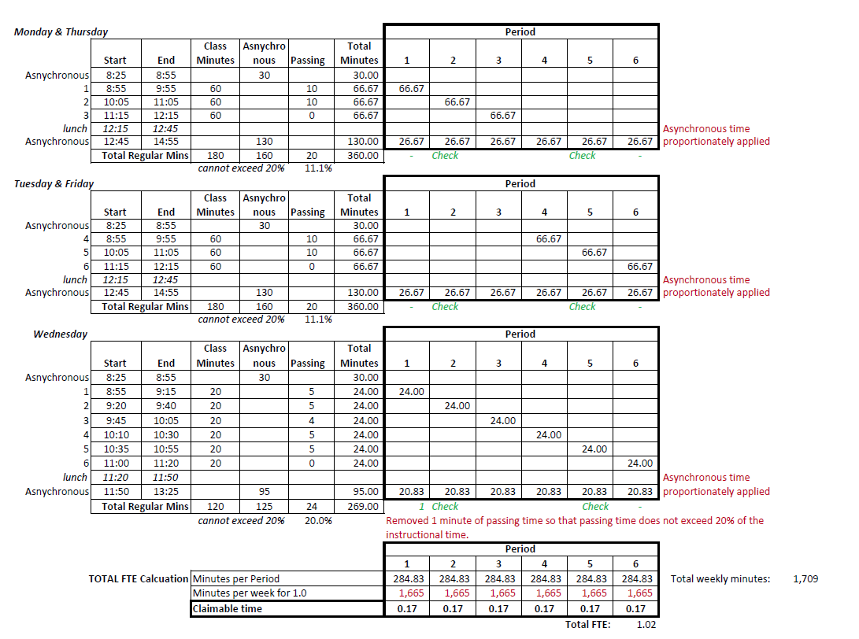
Example #1

Slide 9
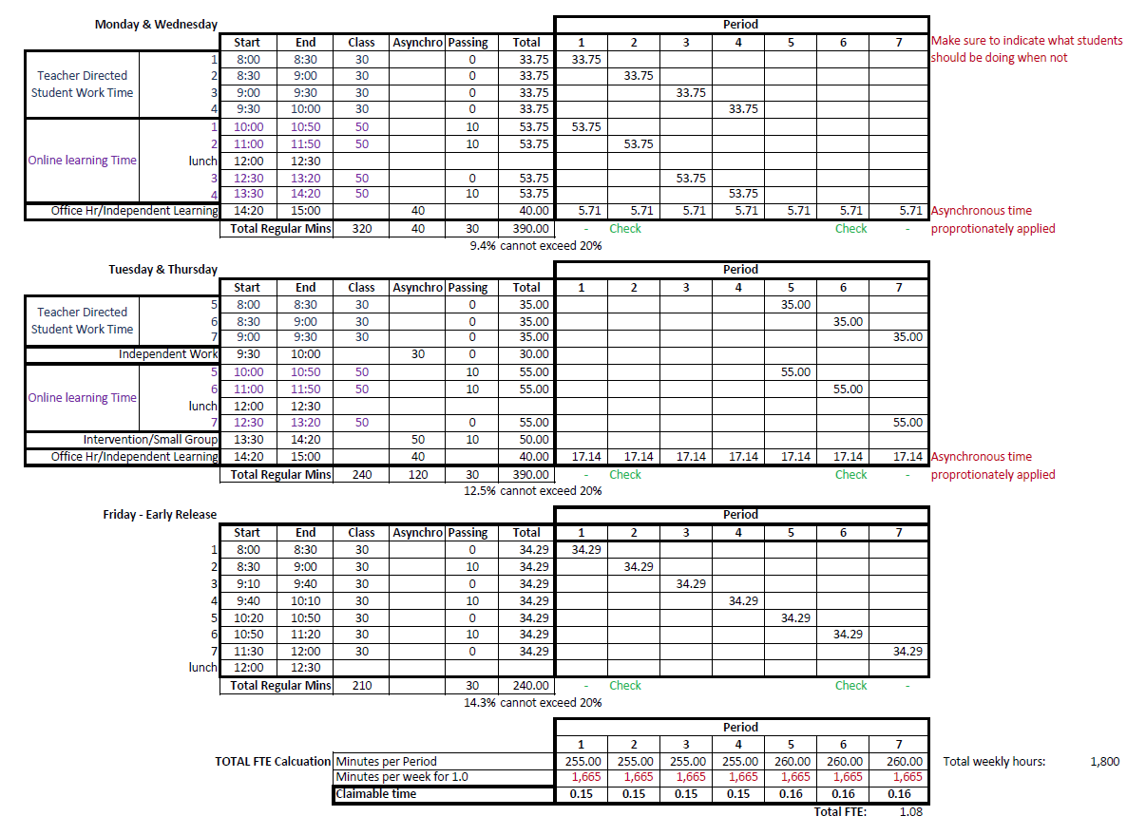
Example #2

Slide 10
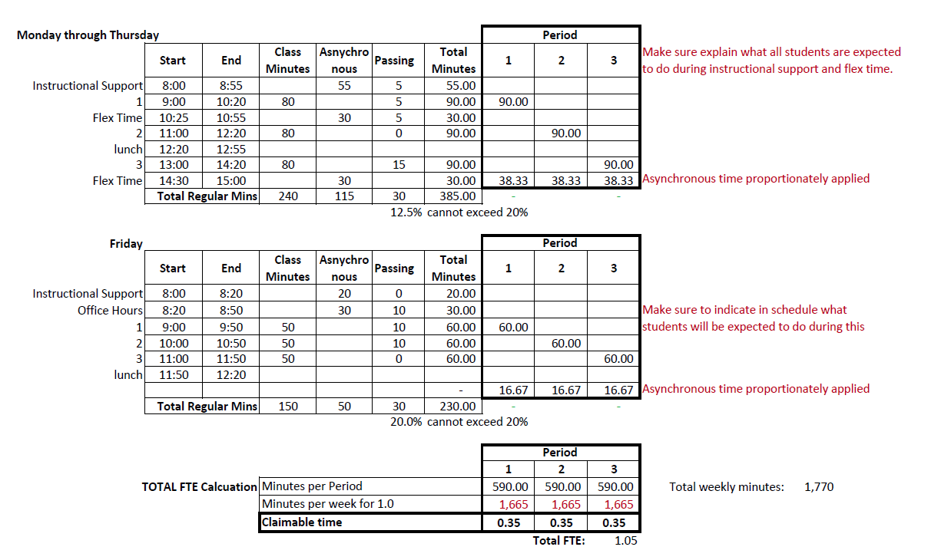
Example #3

Slide 11
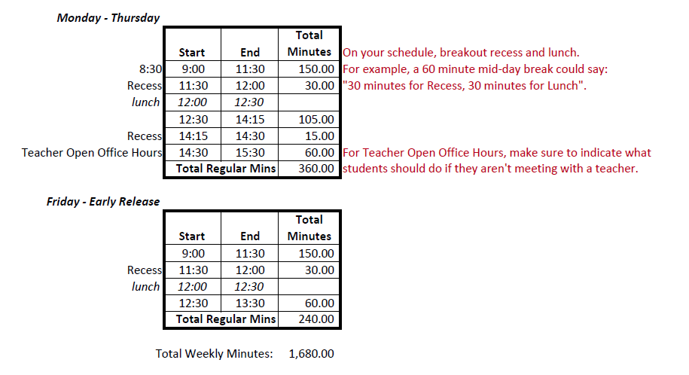
Example #4

Slide 12
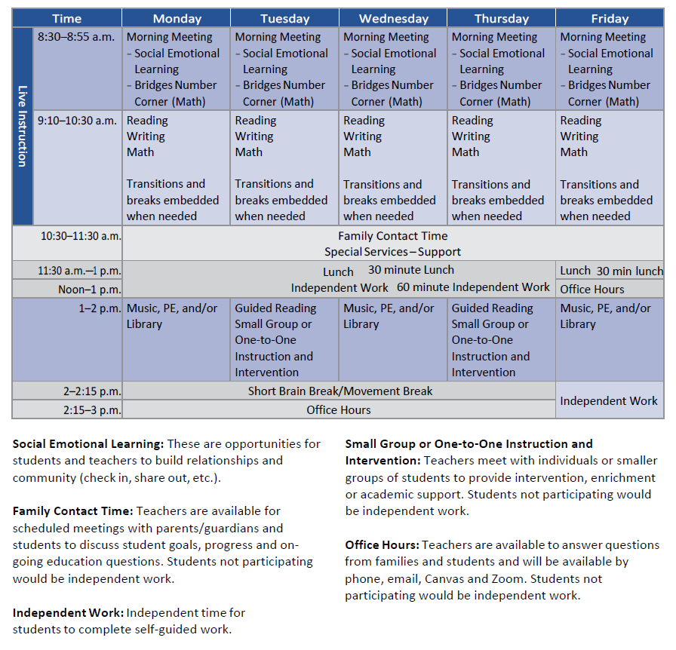
Example #5

Slide 13
Other Changes on Claiming Enrollment as Schools Reopen for the 2020–21 School Year
Claiming Special Education Students on Form P-223H:
As schools reopen for the 2020–21 school year, LEAs can claim a students receiving special education services on the Form P-223H who was previously eligible for special education services but whose IEP and/or evaluation were delayed due to a documented impact of COVID-19 (e.g., staff illness with COVID-19, parent disagreement to participate virtually, or assessment not able to be completed due to safety restrictions) provided that the IEP/evaluation is completed within 30 school days after school resumes.

Slide 14
Other Changes on Claiming Enrollment as Schools Reopen for the 2020–21 School Year continues
  Changes for Running Start:
  Exceeding the 1.20 FTE for the Fall Quarter:
    Students with completed RSEVF for the fall quarter based on the expected high school schedule, and if the high school schedule changed, a student can exceed the 1.20 FTE for the months, October through December.
    Students who exceed the 1.20 FTE for these months may be at risk of exceeding the 1.20 AAFTE and will have their available spring quarter Running Start FTE reduced.
  For colleges that have changed their fall quarter calendar, starting earlier in September and ending before the Thanksgiving break, their October and November monthly count days would be the first school days of those months. Their December count day would be the last school day of the fall quarter.

Slide 15
Other Changes on Claiming Enrollment as Schools Reopen for the 2020–21 School Year continues
  Changes for Open Doors:
  An emergency rule is in effect that allows the following for face to face contact time:
  In-person
  Telephone
  Email
  Instant messaging
  Interactive video communication
  Other means of digital communication
  For more information on the face to face contact emergency rule and what documentation must be retained refer to the Open Doors website.

Slide 16
Special Ed Birth to Age 2 Enrollment
OSPI will no longer be providing special ed funding for students who are birth to age 2.
On the P223H, Birth to Age 2 category has been removed.
Funding will be provided directly to the providers from Department of Children, Youth, and Families (DCYF).
Two Categories for Special Ed K-21
Special Ed funding for K-21 is dependent on the amount of time students spend in a general education setting.
The 2 categories are:
  Tier 1 K-21: For K-21 students who spend 80% or more of their time in a general education setting. Also known as Least Restrictive Environment (LRE) 1.
  Other Tier K-21: For K-21 students who spend less than 80% of their time in a general education setting.

Slide 17
Open Doors Headcount Reporting
When an Open Doors student cannot be claimed for state funding, their headcount should not be reported as an Open Doors HC on the P223.

Slide 18
Basics of Enrollment Reporting

Slide 19
Resources for Enrollment Reporting
  2020-21 Enrollment Handbook should be available before the new school year (moving through the OSPI approval process). It will be available on Enrollment Reporting Instruction website.
  Enrollment Reporting Applications User Guide also available on Enrollment Reporting Instruction website provides instructions on how to navigate:
    NEW Enrollment (P223/P223H) application
    K-3 Class Size application - temporarily suspended for the 2020-21 school year
    SAFS ALE application
ESD enrollment contact
Rules regarding enrollment found in WAC 392-121-106 through -188.
Becky McLean, OSPI
  360-725-6306
  becky.mclean@k12.wa.us

Slide 20
Why is Enrollment Reporting Important?
Monthly enrollment drives school funding.
How enrollment is reported can affect district’s funding.
Mistakes in reporting can result in audit findings.
Data used for forecasting future enrollment and the state’s funding obligations.
High interest area with the public and Legislature.

Slide 21
2019-20 State Summary Average Per Funding Levels as of July 2020
 | Annual Allocation
Basic Education | $9,155 | Per AAFTE
Special Education | $8,700 | Per Average Headcount
Enhanced MS CTE | $1,159 | Per AAFTE
Enhanced HS CTE | $1,164 | Per AAFTE
Enhanced Skill Center | $2,011 | Per AAFTE
TBIP | $1,497 | Per Average Headcount
Exited TBIP | $830 | Per Average Headcount

Slide 22
Enrolled Student
Resident of district or attending pursuant to:
  Choice transfer
  Interdistrict agreement
  Under 21 years of age before September 1st for the new school year.
  Enrolled on or before the monthly count day.
  Participated in a course of study on or before the monthly count day.
  Does not meet any enrollment exclusions.

Slide 23
Count Day
A Snapshot.
Count date is:
  4th school day in September.
  1st school day of October through June. For Open Doors (OD) programs, July and August.
  Running Start is 1st school day of October through June.
  For WAKids, there are two options:
    Count the parent/teacher/student conference days.
    Count the first four days of actual FDK classes.
  For schools or programs that end before June and for seniors that graduate before June, the last school day in May can be the June count day, provided a published school/program calendar reflects the last school day is in May.
  Count date can be determined by an individual school or grade’s start date or calendar.

Slide 24
Enrollment Exclusions
A student shall not be counted as an enrolled student if any of the following are met:
  Consecutively absent for > 20 consecutive school days.
    Allowance exists when an agreement is in place with the parent and the district that states the student will continue his educational progress while absent and the student returns to school before the end of the school year to be counted for two additional count days.
    Dropped out or transferred.
    Met high school graduation requirements before the beginning of the school year (September 1st).
    Paying tuition – F1 Visa.
    Claimed by an institution.
    Resident of either the Washington State School for Blind or Washington School for the Deaf, also known as Center for Childhood Deafness and Hearing Loss. Refer to Bulletin # 006-19.

Slide 25
Course of Study Includes
Basic education instruction
Special education
Alternative Learning Experience (ALE)
Open Doors (OD) programs
Running Start (RS)
Direct-funded technical college
Ancillary service
Work-Based Learning (WBL)
UW transition

Slide 26
Course of Study Does Not Include
Home-based instruction
Private school instruction
Adult education – over 21 years old after September 1st
Out-of-state residents
GED prep instruction when:
  Additional adult education state/federal dollars are generated or
  Instruction does not earn high school credit.
  Extra-curricular activities
  College enrollment not earning dual credit at a high school

Slide 27
Full-Time Equivalent - FTE
FTE is the measurement of student’s enrollment and is used to fund districts.
Claiming FTE is based on:
  Seat-time traditional class: enrolled hours in a classroom.
  Running Start (RS) class: enrolled college credits.
  ALE program: estimated hours of learning in written student learning plan.
  Work-based learning (WBL): actual hours in a WBL program.
  Ancillary Services: actual hours of services.
  Open Doors (OD) program: program’s total planned hours of instruction (below 100 level classes) or enrolled college credits (college level classes).

Slide 28
Factors for FTE Calculations
Seat-time and ALE FTE is calculated as follows:
1.0 FTE is defined as 1,665 weekly minutes (27 weekly hours and 45 minutes).
Running Start (RS) FTE is:
15 college credits equals 1.0 FTE.
# of enrolled credits ÷ 15.
WBL FTE is actual hours of WBL:
  Divided by 200 for cooperative WBL.
  Divided by 100 for instructional WBL.
  Ancillary services and Summer enrollment is claimed as an AAFTE. Divide actual hours by 1,000.

Slide 29
Calculating Seat-Time FTE
For schools where students move between classes (i.e.; middle and high schools), FTE is based on the bell schedules.
Look at a weekly schedule – include any regular late starts or early releases.
  “Regular” means occurring at least once every two weeks.
  If late starts or early releases occur every other week, you would need to calculate FTE based on a two week schedule and using 3,330 (1,665 x 2) minutes.
  Passing time:
    For every 50 minutes of instruction, up to 10 minutes of actual passing time can be claimed – 20% of total instruction.
    Before and after school passing can be claimed if students and busses are expected to arrive before or remain at school during the passing time and passing time is part of a published school schedule.
    Time for meals cannot be claimed as passing time.

Slide 30
Calculating Seat-Time FTE continues
Advisory time can be claimed as unused passing time and applied proportionately to the other daily classes provided:
      Advisory is supervised by a teacher,
      All students at school are expected to attend,
      Attendance is taken, and
      Credit is not awarded for the advisory time.
  Part-time students whose FTE is not based on a per class FTE (i.e., elementary students or Special Ed students in a self contained classroom) will need to have their FTE recalculated using the 1,665 weekly minutes factor. For example:
  A 1st grade student attends one hour or 60 minutes a week. FTE would be 0.04 (60 ÷ 1,665).
  A 4th grade student attends two hours a day/5 days a week for 600 (120 x 5) weekly minutes. FTE would be 0.36 (600 ÷ 1,665).

Slide 31
Super FTE – Exceptions to the 1.0 FTE Limitation
As a general rule, students are limited to 1.0 FTE and 1.0 AAFTE.
Exceptions:
  Running Start (RS) – up to a combined 1.2 FTE.
    Neither High School nor RS enrollment may exceed 1.0 FTE.
  Skill Center (SC) – up to a combined 1.6 FTE.
    Neither High School nor SC enrollment may exceed 1.0 FTE.
  What about a student enrolled in High School, RS, and Skill Center?
    When a student’s enrollment in both High School and SC exceeds 1.0 FTE, the available RS is limited to 0.20 FTE.
    When a student’s enrollment in both High School
    and SC is less than 1.0 FTE, the standard 1.2 FTE
    limitation applies.
 | Student A | Student B
High School FTE | 1.00 FTE | 0.18 FTE
Skill Center FTE | 0.54 FTE | 0.54 FTE
Total HS/SC FTE | 1.54 FTE | 0.72 FTE
Available RS FTE | 0.20 FTE | 0.48 FTE

Slide 32
Headcount
A count of enrolled students.
Amount of instructional or service hours is not a factor.
Each student is 1. No partial numbers.
Used for:
  Special education funding (P223H)
  Transitional Bilingual Instructional Program (TBIP) and Exited TBIP funding
  State Budgeting and Caseload Forecast
  School Construction Assistance Program
  October reporting is critical.

Slide 33
Review of Exited TBIP Reporting
Who is an Exited TBIP student?
One who is enrolled in the district on monthly count day.
Scored Proficient on the past two years Spring ELPA21 test. For 2020–21, either the 2019 or 2020 Spring ELPA21 test.
Does not have to previously been reported as TBIP. Parents could have waived TBIP services.
Purpose of the Exited TBIP count.
Exited TBIP funding provides support dollars for students who were previously eligible for TBIP.
For 2019–20, statewide average was:
  $830 per annual average Exited TBIP headcount
  $1,497 per annual average TBIP headcount
  The Exited TBIP count should stay consistent through a school year with small fluctuations as new qualifying students enroll and others withdraw.
  Make sure to update your Student Info System with the Spring 2020 ELPA21 scores so when pulling the September count, the correct Exited TBIP enrollment is reported.

Slide 34
Types of Districts
Resident District:
The district where the student lives.
For students from a nonhigh district, the high district.
For students that “choice” into a nonresident district.
Serving District:
The district that provides instruction or service.
Home District:
District where the student lives regardless of Choice Transfer.
Used for ALE enrollment reporting on the SAFS ALE application.

Slide 35
Choice Transfer & Interdistrict Agreements
One of following must be in place in order for a district to claim a nonresident student for state funding:
Choice Transfer:
Student released 100% by resident district.
Resident district released financial liability for the student.
Serving (Choice) district is responsible for all services.
Student is reported on P223/P223H as resident of Choice district.
Interdistrict Agreement:
For students that attend another district part-time.
Responsibility for student remains with the resident district.
Serving district reports partial FTE on P223/P223H as a student of their resident district.
Basic education $ flow to the serving district.
Special education $ flow to the resident district.

Slide 36
Choice Transfer & Interdistrict Agreements continues
No choice transfers are required for students attending:
  Charter schools
  Tribal compact schools
  High district coming from a nonhigh district
  Skill Center consortium
Effective dates must be stated – beginning and end dates.
Recommendation that transfers/agreements span for only one school year.
Both districts must sign the transfers/agreements before the enrollment can be counted.
Bulletin No. 035-18 dated April 25, 2018, provides:
Additional guidance on choice transfers and interdistrict agreements.
Information on the Standard Choice Transfer System (SCTS) application.
Required for all students who choice into a nonresident district’s ALE program.
Available to be used for all students’ choice transfers and interdistrict agreements.

Slide 37
Requirements for Claiming a Special Education Student
Enrolled in the school district,
Has a current and in effect IEP in place.
Evaluation is current, and
Receiving special education services as defined under WAC 392-172A-01175 and -01155.
Documentation to Support Enrollment
Refer to Section 10 of 2020–21 Enrollment Handbook for detailed guidance.
Documentation must be retained for ALL CLAIMED ENROLLMENT including enrollment provided under contract with an outside agency or college.

Slide 38
Revising Enrollment
During school year:
  Districts may make revisions directly in EDS.
  Effects to funding will appear on the end of month’s apportionment.
  Enrollment will be used for Levy Authority and LEA calculation.
For 2019-20, after Aug 14 through Nov 23 and for 2020-21, after Aug 17 through Nov 22:
  Districts may revise prior year enrollment in EDS.
  Effects to funding will be a prior year adjustment in the next January apportionment.
  Enrollment will not be used for Levy Authority and LEA calculation.
After Nov 23, 2020 and after Nov 22, 2021: Revisions are submitted by paper.
  Cover letter with:
    Authorizing signature.
    State the status of audit for the specific school year.
    If in the midst of audit, the auditor must be notified of the revision.
  Marked-up 1251 or 1735 report with the changes needed, as well as detailed information on which school’s enrollment needs revising.
After auditor’s exit meeting: Districts cannot revise their enrollment.

Slide 39
Quick Review of EDS Applications
Refer to the User Guide available on Enrollment Instruction page. Needs a bit of updating for 2020–21 which will be done shortly.
    NEW Enrollment (P223 at the school level)
    SAFS ALE Reporting
    K-3 Class Size Reporting – temporarily suspended for the 2020-21 school year
    For Skyward districts, if you “run” your P223 and you don’t see the file in EDS, let ESD or me know. FTP processor may need to be woken up.
    Remember the two new reports available that can be used to reconcile 1220.
    1251RS – Resident District FTE by Serving District
    1735RS – Resident District Special Ed by Serving District
    Also, remember by running Extracts, you can see School Level data.

Slide 40
Questions ?

